Slide 1
CRC Prevention
and the
NordICC Trial
Friday, November 3, 2023
AAPCE Annual Scientific Congress, Orlando, Florida
Andrew W. Swartz, MD
Departments of Emergency Medicine, Family Medicine, and Surgery
Yukon-Kuskokwim Delta Regional Hospital
Bethel, Alaska
Flight Surgeon, 144th Airlift Squadron
Alaska Air National Guard
Joint-Base Elmendorf-Richardson, Anchorage, Alaska

Slide 2
Disclosures
COI’s
Am a member of a profession (and specialty) which profits from illness and it’s treatment
No financial interest in any patents or products
Not trying to get any votes
Not paid for this presentation
Biases
Practice in fear of the legal liability associated with “missing something”
Am a member of a society whose health care system is in financial jeopardy
I thoroughly enjoy determining what is wrong with someone and fixing it

Slide 3
Outline
National Polyp Study
History
Design
Results
Flexible Sigmoidoscopy Trials
Epidemiology principles
Design
Results
NordICC Trial
Design
Results

Slide 4
National Polyp Study
History
Design
Results

Slide 5
1950 – 1970: Evidence Accumulates
National Polyp Study
Numerous autopsy/pathology findings indicated that essentially ALL colorectal cancers evolve within adenomatous polyps:
Extreme rarity of small cancers with no associated adenomatous tissue.
Age distribution of adenomas and cancers
Nearly all colons with cancer contain incidental adenomas
Etc.

Slide 6
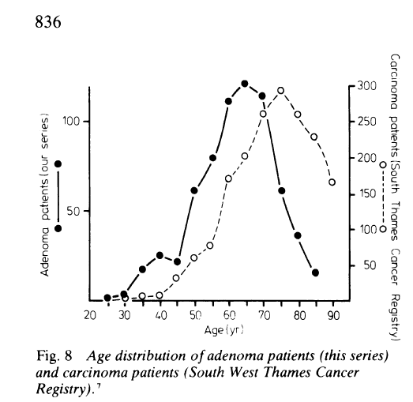
1950 – 1970: Evidence Accumulates
National Polyp Study
Konishi F, Morson BC. Pathology of colorectal adenomas: a colonoscopic survey. J Clin Pathol. 1982;35(8):830-841. doi:10.1136/jcp.35.8.830

Slide 7
National Polyp Study
Areas of minute invasive carcinomas are not uncommon in adenomas. Minute carcinomas not so associated with adenomas are rare. Only 10 (1.5%) in our series of frank carcinomas were under 1.5 cm. The smallest encountered in our series was a 5 mm carcinoma. … if carcinoma commonly arises de novo, it is surprising that more such minute cases of carcinoma are not picked up in the innumerable sigmoidoscopic examinations now performed, or in the thousands of sections of normal colonic mucosa examined under the microscope for evidence of adequacy of excision of colonic carcinomas or for other reasons.
Enterline HT, Evans GW, Mercudo-Lugo R, Miller L, Fitts WT. Malignant potential of adenomas of colon and rectum. JAMA. 1962;179:322-330. doi:10.1001/jama.1962.03050050012003

Slide 8
National Polyp Study
“If some cancers do not arise from adenomatous polyps and villous adenomas, what is the alternative mechanism of histogenesis? Apart from the special problem of cancer in ulcerative colitis, no alternative has yet been described. The concept of cancer 'de novo', whatever this means in morphological terms, remains in the realm of hypothesis.”¹
This remains true today, 49 year later.
1. Morson B. President's address. The polyp-cancer sequence in the large bowel. Proc R Soc Med. 1974 Jun;67(6 Pt 1):451-7. PMID: 4853754; PMCID: PMC1645739.

Slide 9
Theory, Falsifiable Assertion, Experiment
National Polyp Study
DESIGN
Theory: Most/all CRC starts in an adenomatous polyp
Assertion: Removing adenomatous polyps will prevent most/all CRC
Experiment: Follow patients who have had a colonoscopy which clears the colon of adenomas, and compare the CRC rate to a control population

Slide 10
National Polyp Study
Patient Pool
All patients Referred for
initial Colonoscopy Or
Complete Colonoscopy After
Proctoscop or Flex Sig
Excluded
- Previous Hx. of Colon Cancer
- Unrelated Polypectomy
- Inflammatory Bowel Disease
- Family Hx. of Familial Polyposis
1980-1990
9112 - Colonoscopy
Excluded
4763 - No Polyps Found on Colonoscopy
422 - Cancer Found on Colonoscopy
149 - IBD and other findings
3778 – Patients with Polyps
1146 – Ineligible Patients
1214 – Eligible,
Non-Randomized Patients
1418 – Eligible,
Randomized
Patients
776 – Non Adenomatous Polyps
127 – Malignant Polyps
35 – Sessile Polyp > 3 cm
208 – Incomplete Exam
those who did not consent to join the study
those who were excluded from protocol follow-up for medical reasons, distance from the participating center, or inability to give informed consent.
Figure 1. National Polyp Study flow chart
Notes:
Eligible, non-randomized patients:

Slide 11
National Polyp Study
1418 – Eligible,
Randomized
Patients
Arm A
offered colonoscopy and air-contrast barium enema 1 and 3 years after the initial entry polypectomy
Arm B
offered colonoscopy and air-contrast barium enema only 3 years after the initial polypectomy
ALL
offered colonoscopy and air-contrast barium enema at 6 years after the initial polypectomy

Slide 12
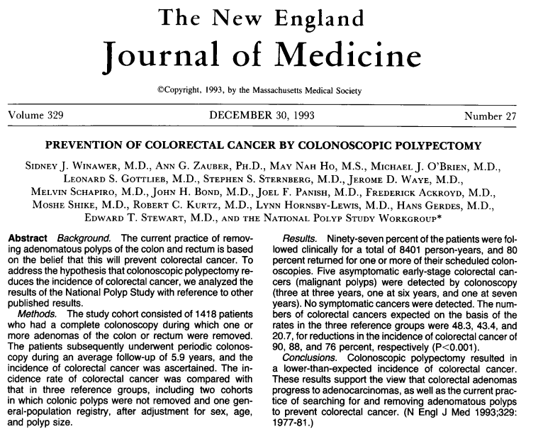
National Polyp Study

Slide 13
National Polyp Study
RESULTS
Patients
97% follow-up for total of 8401 person-years.
80% of patients returned for one or more of their scheduled colonoscopies
Outcomes
Five asymptomatic early-stage cancers detected by colonoscopy
Zero symptomatic cancers were detected

Slide 14
To what should the outcome be compared?
National Polyp Study
Reference group 1 (Mayo Clinic cohort)
Polyps ≥ 1 cm 1965-1970
9y follow-up
Reference group 2 (St Mark’s Hospital, London)
Excision of rectal adenomas 1957-1980
14y follow-up
Reference group 3 (NCI SEER data)
Average risk U.S. population (age-matched)
1983-1987 (i.e. the midpoint of the study period)

Slide 15
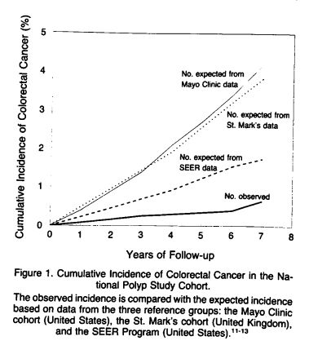
Comparison | CRC Reduction
Mayo | 90% p < 0.001
St Mark’s | 88% p < 0.001
U.S. SEER | 76% p < 0.001

Slide 16
How thorough were colonoscopies in the 1980’s?
video resolution?
withdrawal time?
prep qualities?
etc.
Comparison | CRC Reduction
Mayo | 90% p < 0.001
St Mark’s | 88% p < 0.001
U.S. SEER | 76% p < 0.001

Slide 17
National Polyp Study
History
Design
Results

Slide 18
Flexible Sigmoidoscopy Trials
Epidemiology principles
Randomization + Selection Bias (19 slides)
Cumulative Incidence Plots

Slide 19
Group Comparisons
Entire Study Population
Notes:
This is a large heterogeneous group (2040 individuals) with fairly equal number of reds, yellows, and greens.
In an RCT, it is RANDOMIZED into two identical heterogeneous groups (1020 each).

Slide 20
Group Comparisons
Intervention Control

Slide 21
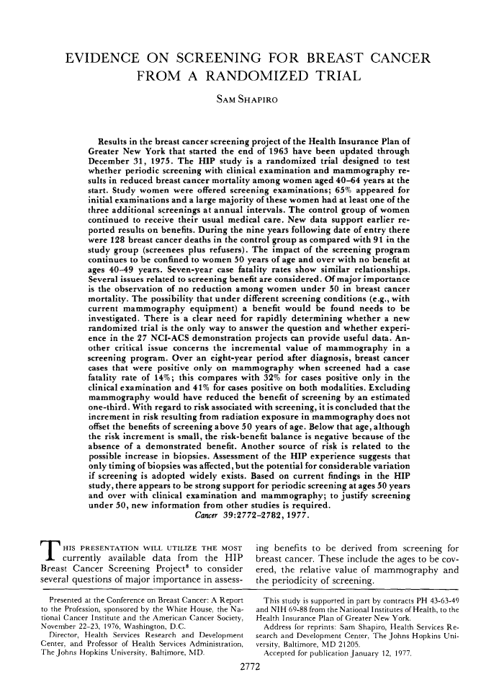
Notes:
The best example can be found in one of the HIP articles. (Note it is published in the same Journal!).

Slide 22
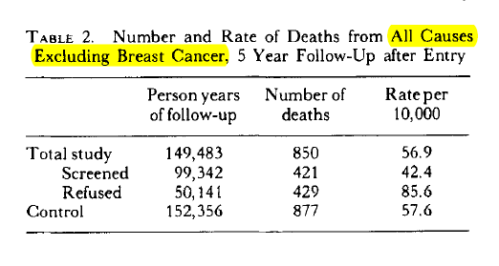
Attendees vs. Non-Attendees
RR = 0.495 [0.43 - 0.57]
p = 0.000000000000000000000000104
= 1.04 x 10⁻²⁵
Shapiro S. Evidence on screening for breast cancer from a randomized trial. Cancer. 1977 Jun;39(6 Suppl):2772-82.
Notes:
At first glance, this make look like powerful evidence for mammograms.
But remember: this is NON-BREAST-CANCER Mortality. Suicides, trauma, heart attacks, sepsis, etc.
There is no rational mechanism for mammograms to cause this effect.
And if we were to believe it, then it logically follows that men should be getting the mammograms also.
http://apfloat.appspot.com/
(0.5^0.5) * 1.77245385091 * (112.357557 ^ ((1/2)-1)) * (2.718281828 ^ (-112.357557/2)) = 0.000000000000000000000000047 ( = 4.7 x 10^-26)
http://keisan.casio.com/calculator
chi2pd(112.36,1) = 1.5029350308499680944682274135205942007041363759762E-26

Slide 23
Group Comparisons
Healthy Lifestyle
Neutral Lifestyle
UN-Healthy Lifestyle
Notes:
This is a large heterogeneous group.
In an RCT, it is RANDOMIZED into two identical heterogeneous groups.

Slide 24
Group Comparisons
Entire Study Population
Notes:
This is a large heterogeneous group (2040 individuals) with fairly equal number of reds, yellows, and greens.
In an RCT, it is RANDOMIZED into two identical heterogeneous groups (1020 each).

Slide 25
Group Comparisons
Entire Study Population
Notes:
This is a large heterogeneous group (2040 individuals) with fairly equal number of reds, yellows, and greens.
In an RCT, it is RANDOMIZED into two identical heterogeneous groups (1020 each).

Slide 26
Group Comparisons
Intention-To-Treat
Intervention Control

Slide 27
Group Comparisons
Intention-To-Treat
Intervention Control

Slide 28
Group Comparisons
Per Protocol
Intervention Control
Notes:
How do I know this? Specifically, how do I know that the attenders had a better prognosis than the non-attenders?

Slide 29
Group Comparisons
Intervention Control
Notes:
The excess events in the non-attenders, compared to the controls, PROVES the presence of selection bias.

Slide 30
Group Comparisons
Intervention Control
Notes:
Here, the deficit of events in the non-attenders PROVES the presence of selection bias. But here, it is in the opposite direction.
Specifically, the deaths which SHOULD be in the non-attendee group MUST be in the attender group.

Slide 31
Group Comparisons
Observational
(cohort)

Slide 32
Group Comparisons
Intervention Control
Notes:
This is a large heterogeneous group.
In an RCT, it is RANDOMIZED into two identical heterogeneous groups.

Slide 33
Group Comparisons
HIP: Deaths from All Causes Excluding Breast Cancer (N = 31,000/31,000)
Comparison
Forest Plot
RR
95% CI
P-value
As Randomized
0.99
[0.90 - 1.09]
0.78
Attendees vs Controls
0.74
[0.66 - 0.83]
2.01 x 10⁻⁷
Non-attendees vs Controls
1.49
[1.33 - 1.67]
1.10 x 10⁻¹¹
Attendees vs Non-attendees
0.50
[0.43 - 0.57]
1.04 x 10⁻²⁵
0.33
0.5
0.75
1
2
3
3
Benefit
Harm

Slide 34
Group Comparisons
Intervention Control
Notes:
This is a large heterogeneous group.
In an RCT, it is RANDOMIZED into two identical heterogeneous groups.

Slide 36
Flexible Sigmoidoscopy Trials
Epidemiology principles
Randomization + Selection Bias
Cumulative Incidence Plots
Designs
Results

Slide 37
General design of the FlexSig Trials
Unscreened persons
randomization
Screening group
Control group
FlexSig + f/u
Results
Results

Slide 38
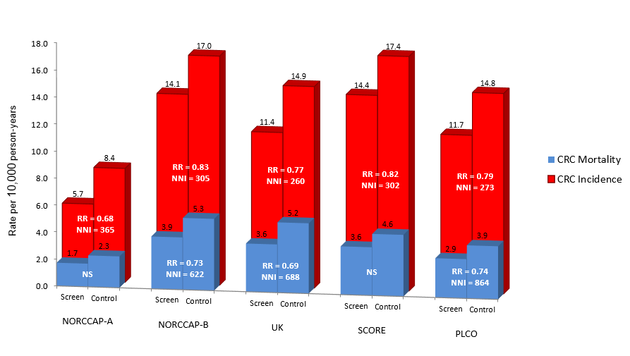
Results of the FlexSig Trials

Slide 39
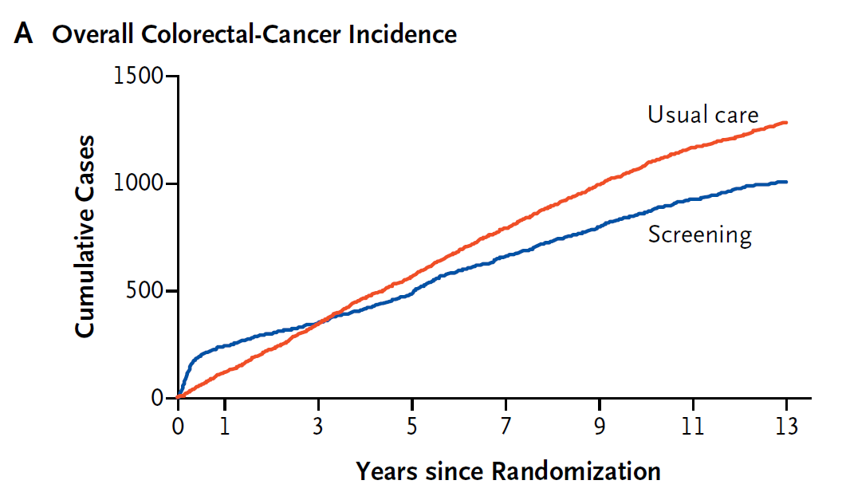
PLCO: CRC incidence (as randomized)

Slide 40
Custom Tool: Relative Risk Ruler

Slide 41
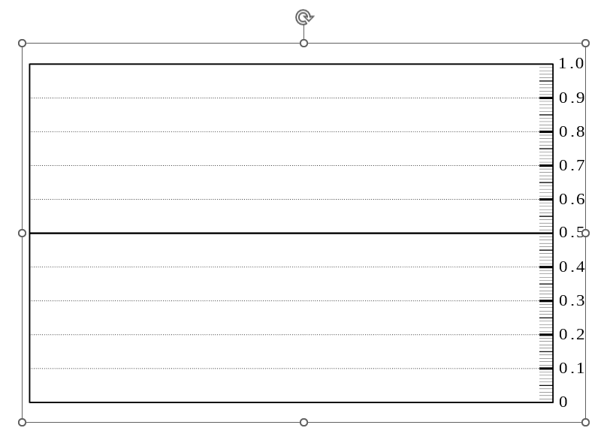
Custom Tool: Relative Risk Ruler

Slide 42
PLCO: CRC incidence (as randomized)

Slide 43
Results of the FlexSig Trials

Slide 44
PLCO: CRC incidence (as randomized)

Slide 45
PLCO: CRC incidence (as randomized)
~40% of mucosa inspected
80% attendance

Slide 46
If
PLCO: CRC incidence (as randomized)
If incident CRC was reduced 30% by inspecting 40% of the mucosa…
… doesn’t that imply about 75% CRC reduction for the inspected mucosa?
~40% of mucosa inspected
80% attendance

Slide 47
FlexSig Results: Takehome
60%-80% reduction in CRC (for the screened mucosa, as randomized).
Obvious implication for the effectiveness of screening colonoscopy.

Slide 48
Flexible Sigmoidoscopy Trials
Epidemiology principles
Randomization + Selection Bias
Design
Results
Cumulative Incidence Plots
Extrapolated results

Slide 49
NordICC Trial

Slide 50
12,574
Bretthauer M, Kaminski MF, Løberg M, et al. Population-Based Colonoscopy Screening for Colorectal Cancer: A Randomized Clinical Trial. JAMA Intern Med. 2016;176(7):894. doi:10.1001/jamainternmed.2016.0960

Slide 51
Poland

Slide 52
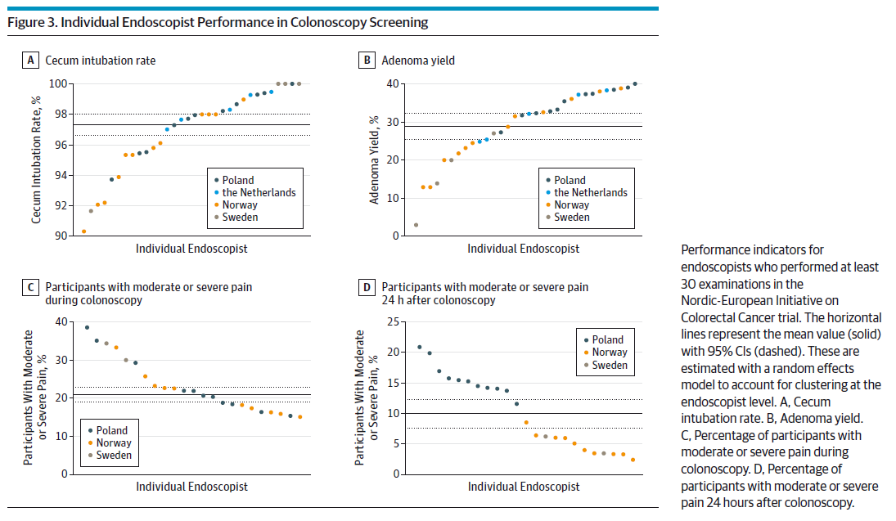
Bretthauer M, Kaminski MF, Løberg M, et al. Population-Based Colonoscopy Screening for Colorectal Cancer: A Randomized Clinical Trial. JAMA Intern Med. 2016;176(7):894. doi:10.1001/jamainternmed.2016.0960

Slide 53
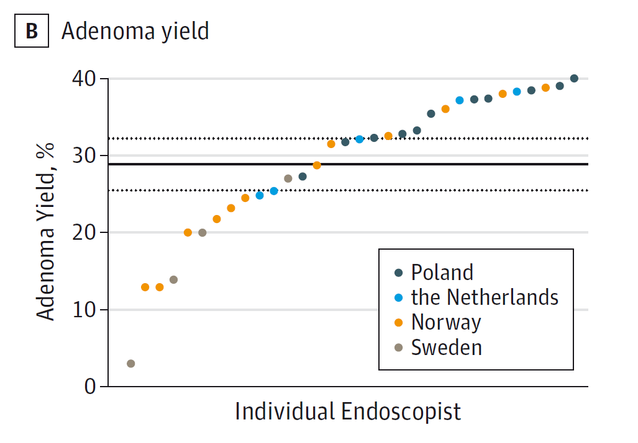
Bretthauer M, Kaminski MF, Løberg M, et al. Population-Based Colonoscopy Screening for Colorectal Cancer: A Randomized Clinical Trial. JAMA Intern Med. 2016;176(7):894. doi:10.1001/jamainternmed.2016.0960

Slide 54
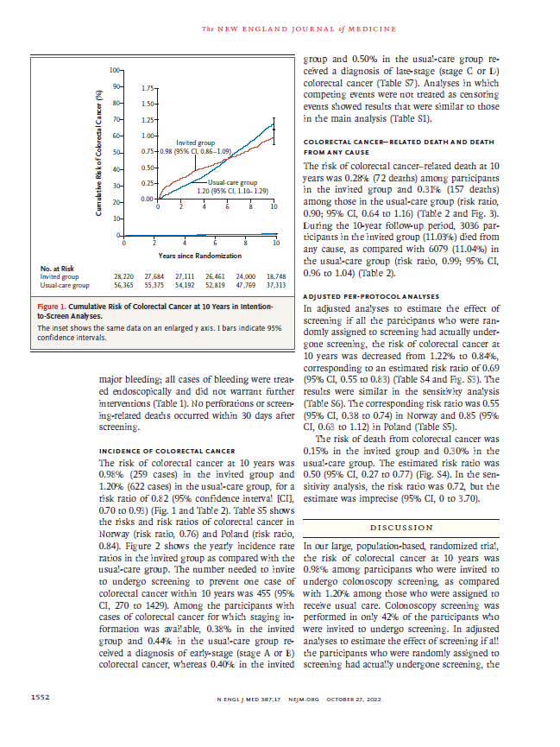

Slide 55
Custom Tool: Relative Risk Ruler

Slide 56
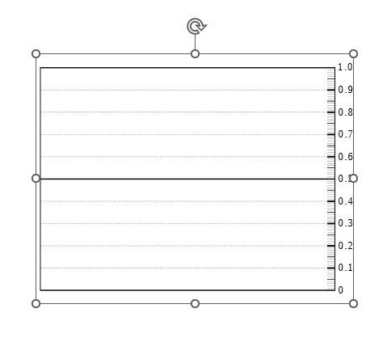
Custom Tool: Relative Risk Ruler

Slide 57
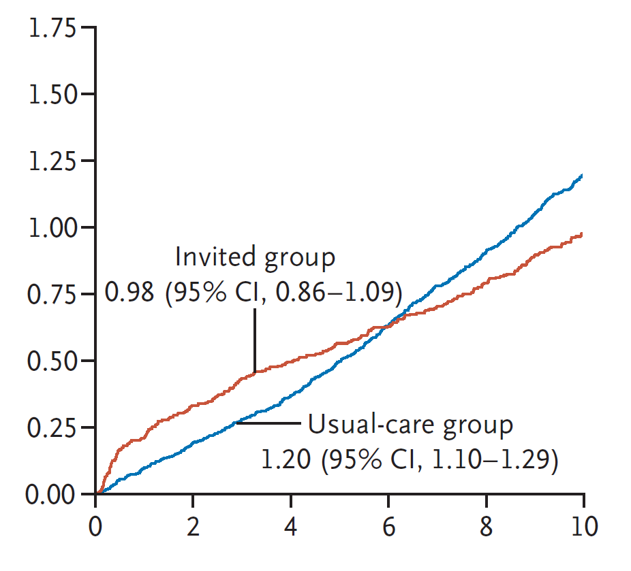
As Randomized
RR = 0.82
RRR = 18%

Slide 58
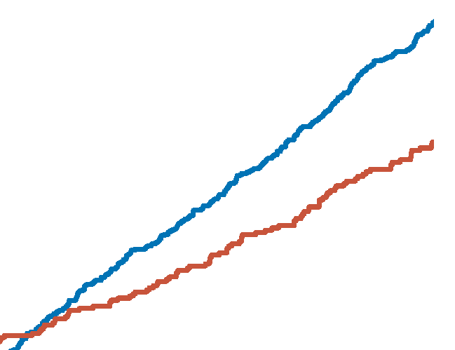
As Randomized, incident cancers
RR = 0.62
RRR = 38%

Slide 59
As Randomized, incident cancers
RR = 0.62
RRR = 38%
In the group randomized to screening, 42% of the mucosa was inspected. This was associated with a 38% decrease in incident CRC.
Might that indicate 90% effectiveness?

Slide 60
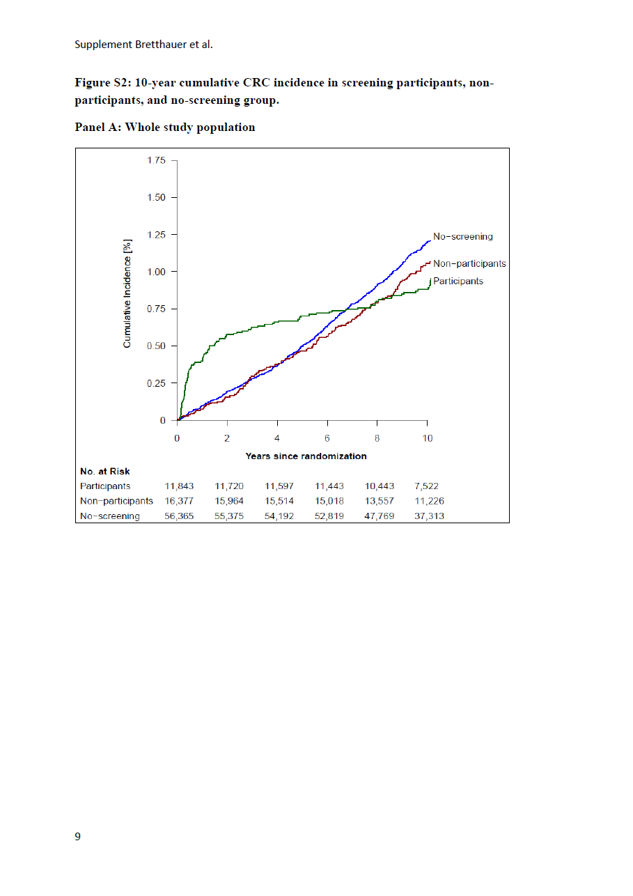

Slide 61
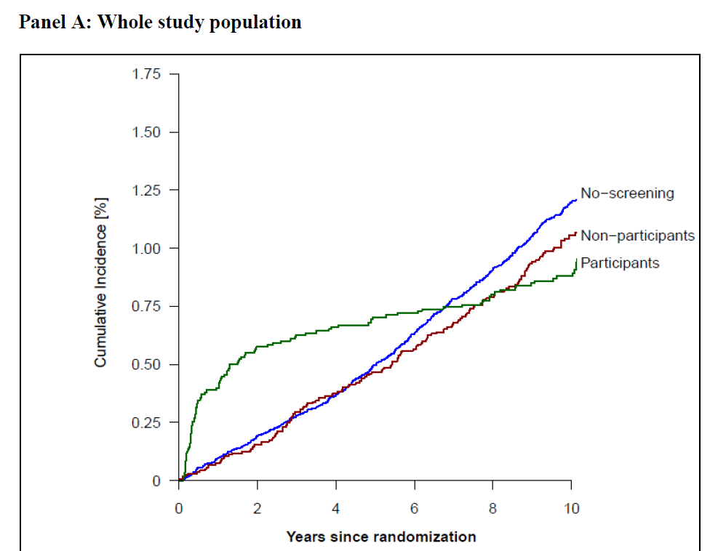

Slide 62
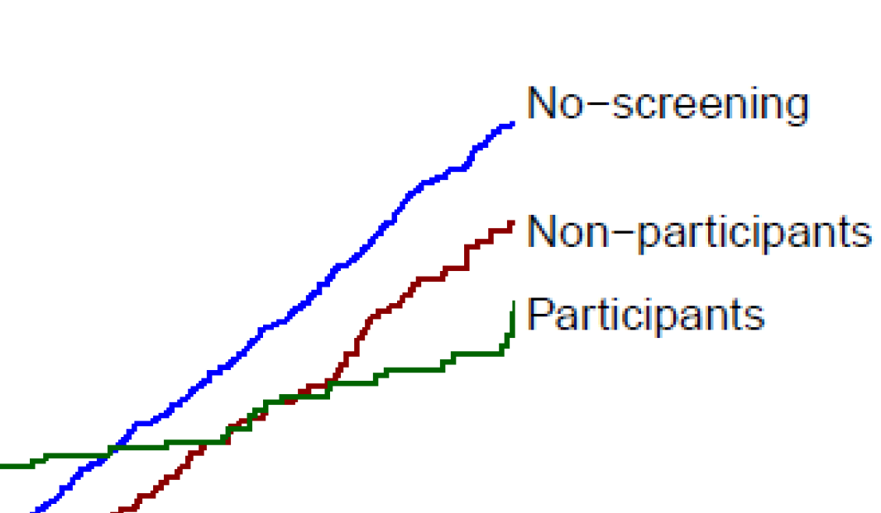
Per protocol, incident cancers
Per protocol analysis is usually an OVER-estimate because the non-participants have worse outcomes than the controls, implying that the participants were destined to have a better outcomes. But here we see the opposite…
RR = 0.46
RRR = 54%

Slide 63
Per protocol, incident cancers
RR = 0.45
RRR = 55%
Under-estimate !
Participants (sham procedure)

Slide 64
Per protocol, incident cancers
RR = 0.35
RRR = 65%
Participants (sham procedure)

Slide 65
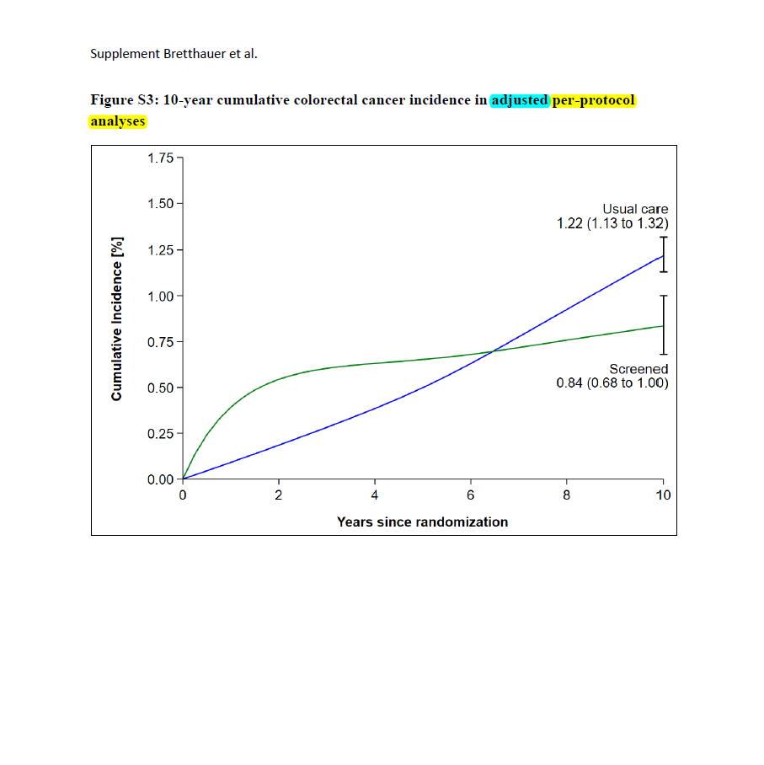
Per protocol

Slide 66
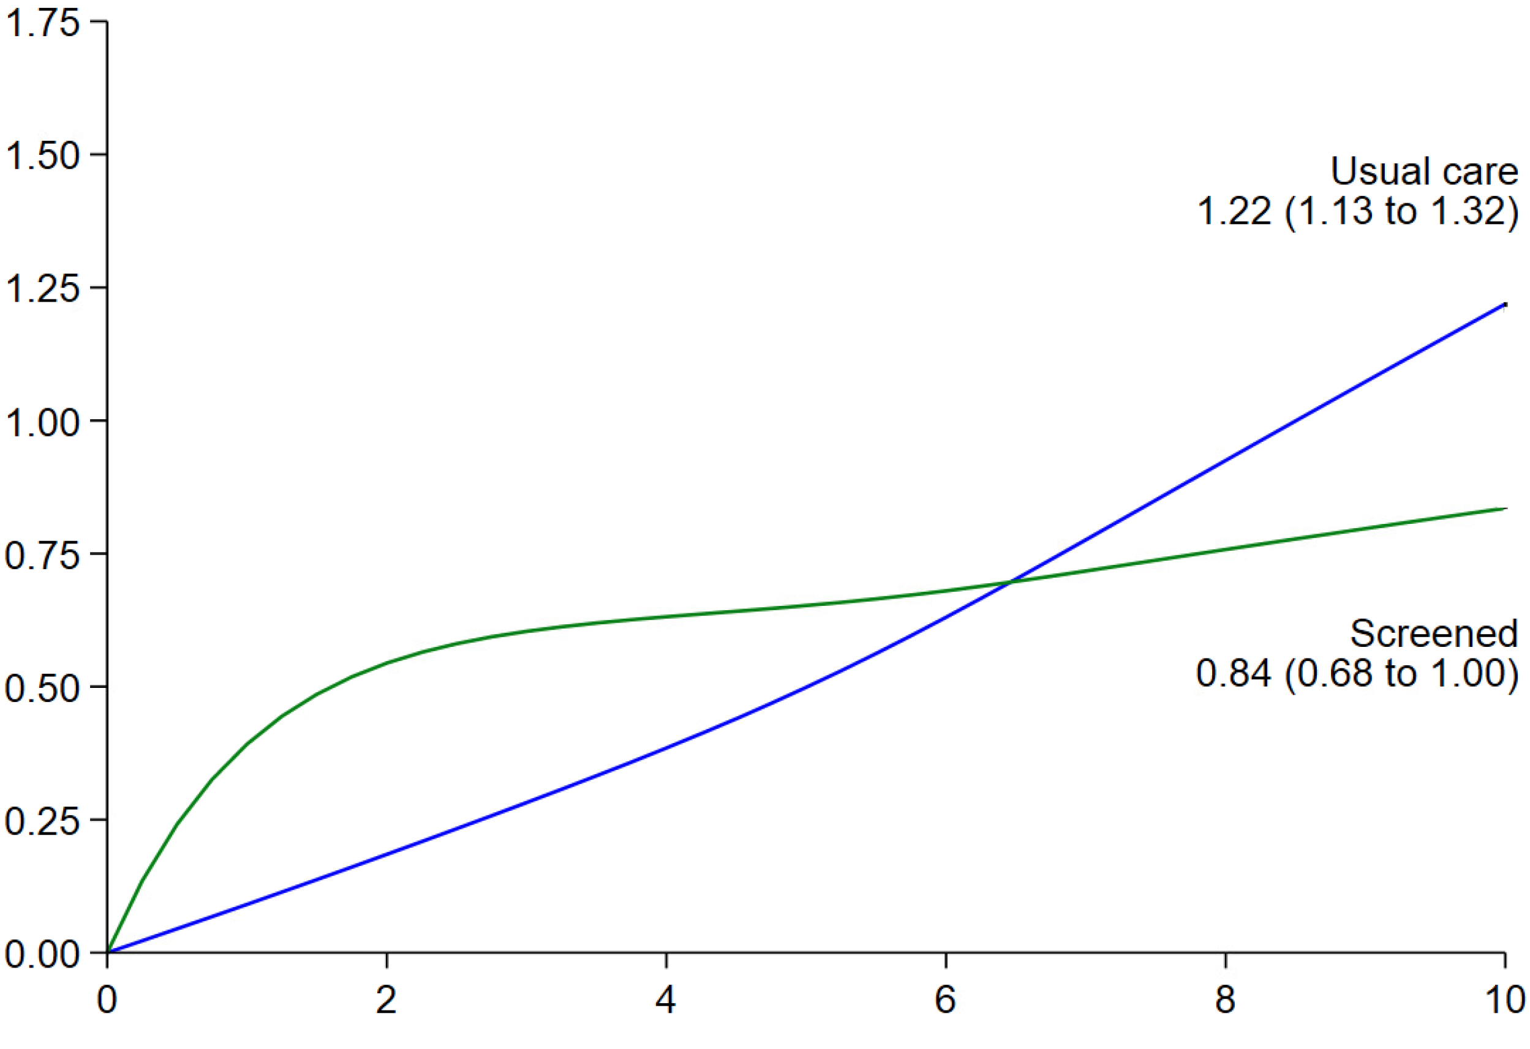
Per protocol

Slide 67
RR = 0.26
RRR = 74%
?

Slide 68
What portion of the remaining cancers were associated with a low-ADR endoscopist?
Bretthauer M, Kaminski MF, Løberg M, et al. Population-Based Colonoscopy Screening for Colorectal Cancer: A Randomized Clinical Trial. JAMA Intern Med. 2016;176(7):894. doi:10.1001/jamainternmed.2016.0960

Slide 69
Bretthauer M, Kaminski MF, Løberg M, et al. Population-Based Colonoscopy Screening for Colorectal Cancer: A Randomized Clinical Trial. JAMA Intern Med. 2016;176(7):894. doi:10.1001/jamainternmed.2016.0960

Slide 70
SUMMARY
“Prevalence bias” and low participation profoundly skewed the intention-to-treat outcomes.
A reverse selection bias occurred among the attendees, making the per-protocol analysis an under-estimate of the true effect.

Slide 71
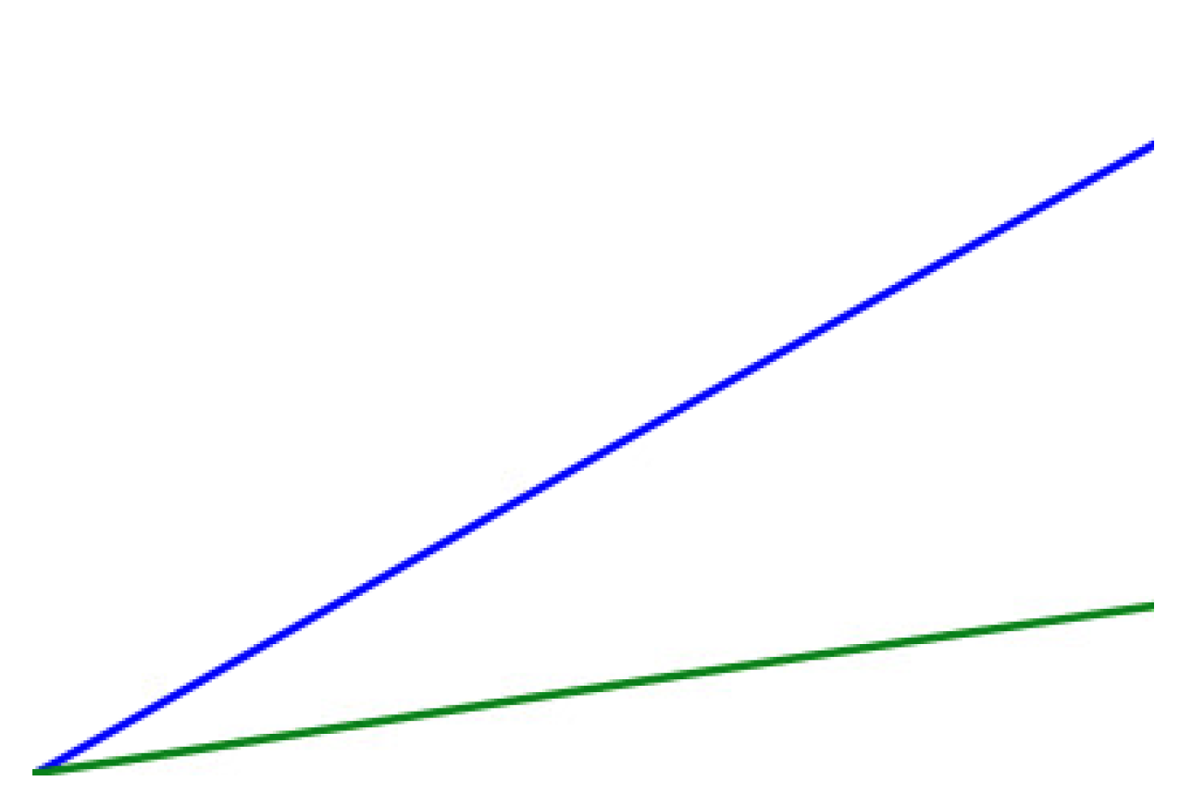
SUMMARY
70%—80% reduction on incident (i.e. subsequent) CRC.
Remaining 20%—30% may be due to low quality examinations.

Slide 73
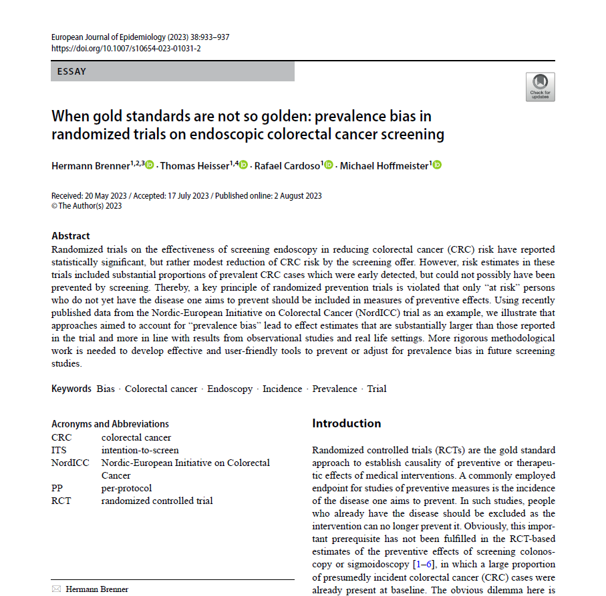
Epilogue
“up to 86%”

Slide 74
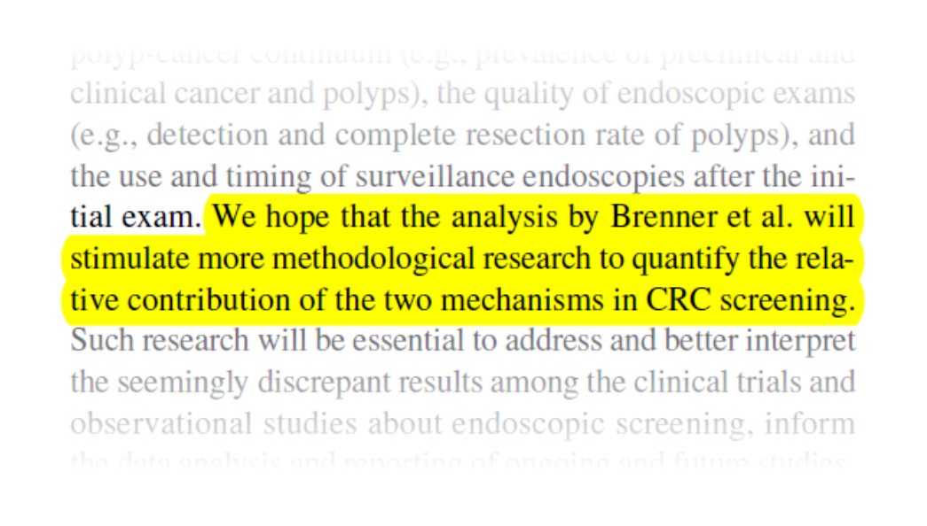
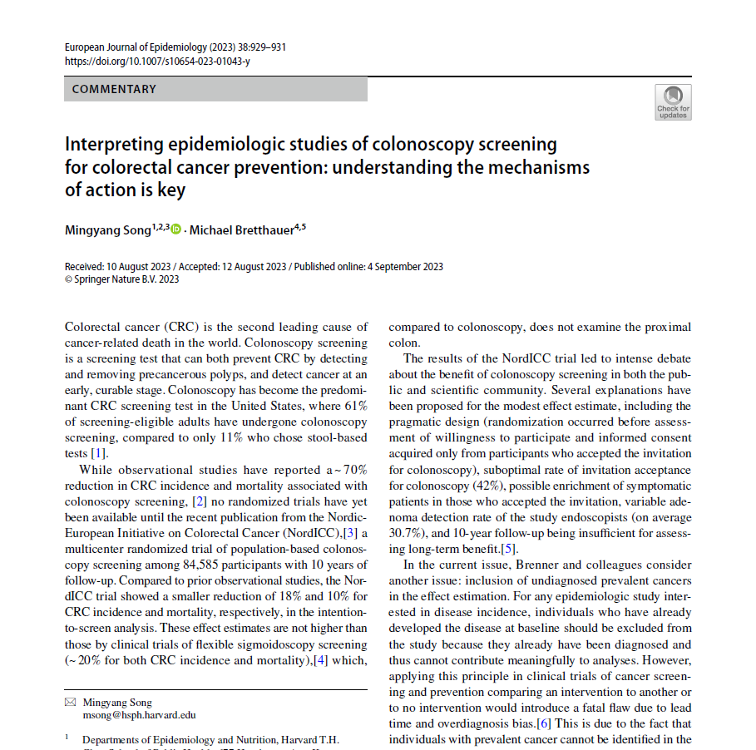
Epilogue
“up to 86%”

Slide 75
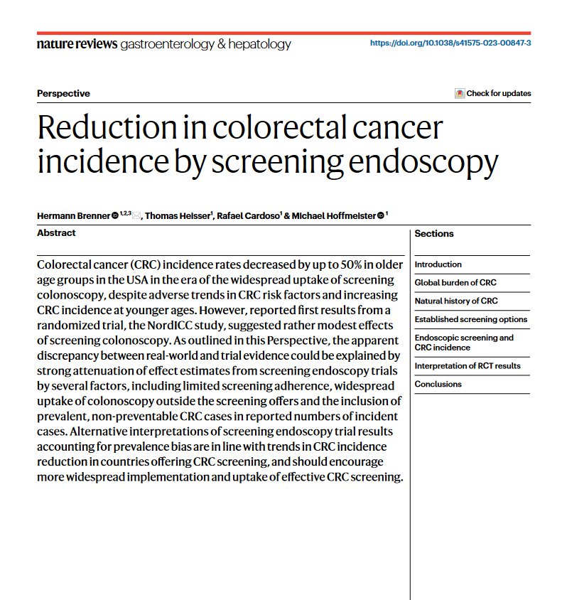
Epilogue…
If there had been 100% prevention of incident CRC’s:
RR = 0.70
RRR = 30%
“up to 86%”

Slide 76
CRC Prevention
and the
NordICC Trial
Friday, November 3, 2023
AAPCE Annual Scientific Congress, Orlando, Florida
Andrew W. Swartz, MD
Departments of Emergency Medicine, Family Medicine, and Surgery
Yukon-Kuskokwim Delta Regional Hospital
Bethel, Alaska
Flight Surgeon, 144th Airlift Squadron
Alaska Air National Guard
Joint-Base Elmendorf-Richardson, Anchorage, Alaska

Slide 77
Epilogue

Slide 78
