Slide 1
A Practical Guide For the Diagnosis and Treatment of Dysphagia and Esophageal Motility Disorders
Chris Reising MD, FACS
Surgical Service Line Medical Director
Saint Alphonsus Health System
Esophageal Health and Reflux Center

Slide 2
Disclosure
I have nothing to disclose

Slide 3
The Ice Breaker
What do you call a Moose with no name?
Anonymoose!

Slide 4
Objectives
Review normal esophageal anatomy and physiology.
Discuss the common symptoms of patients with esophageal motility disorders and the importance of a comprehensive history and exam.
Discuss the tools used in the diagnostic work up of dysphagia and esophageal motility disorders.
Review the manometry findings of esophageal motility disorders.
Discuss the treatment options of common esophageal motility disorders.
Upper endoscopy tips and tricks
My Hope is that you can take something useful back to your practice and implement
Notes:
Review normal esophageal anatomy and physiology.
Discuss the common symptoms of patients with esophageal motility disorders and the importance of a comprehensive history and exam. And documentation with templating for dysphagia and GERD etc.
Discuss the tools used in the diagnostic work up of dysphagia and esophageal motility disorders.
Review the manometry findings of esophageal motility disorders.
Discuss the treatment options of common esophageal motility disorders.

Slide 5
Why is Understanding Dysphagia and Esophageal Motility Disorders Important?
Dysphagia and non cardiac chest pain symptoms are Common
Complex problems to unwind
Family physicians are the front line
Notes:
Why are we talking about dysphagia and esophageal motility disorders?
and should also be familiar with the current understanding and terminology of these less common conditions to ensure timely and appropriate referral for testing and intervention.

Slide 6
Overlapping Symptoms and Prevalence of Esophageal Disorders
Notes:
This is in part what makes this topic messy to discuss
There are a lot of overlapping diagnosis with similar symptoms
What are functional esophageal disorders: conditions characterized by typical esophageal symptoms (chest pain, heart burn, dysphagia, globus) that are not explained by structural abnormalities, major motor disorders, or gastroesophageal reflux.

Slide 7
Functional Esophageal Disorders
Patients with functional esophageal disorders have excellent long-term outcomes: approximately 50% have complete resolution of symptoms, and another 30% improve to some degree over time.
Notes:
Reminder!!

Slide 8
Causes of Oropharyngeal Dysphagia
Structural
Neurologic/Muscular
Drugs
Tumors/Head Neck Surgery/Radiation
Postcricoid web, Stenosis, Cricopharyngeal Bar
Lateral Pharyngeal Diverticula
Zenker’s Diverticulum
Cervical Osteophytes
Stroke
Parkinson’s
Motor Neuron Disease
Postpolio Syndrome
Myasthenia Gravis
Inflammatory Myopathies
Toxic and Metabolic, Oculopharyngeal Muscular Dystrophy
Dopamine antagonists: Phenothiazines and Metoclopramide
Benzodiazapines: Clonazepam
e antagonists: phenothiazines and metoclopramide
Benzodiazapines: Clonazepam
Notes:
I want to pause for a minute to discuss oropharyngeal dysphagia and separate from esophageal causes

Slide 9
Oropharyngeal Dysphagia Workup
Video swallow
Structural
Neuromuscular
ENT
Neurology
Speech Pathology

Slide 10
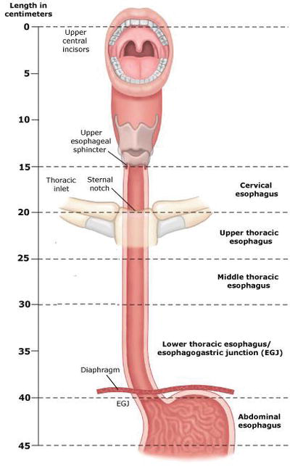
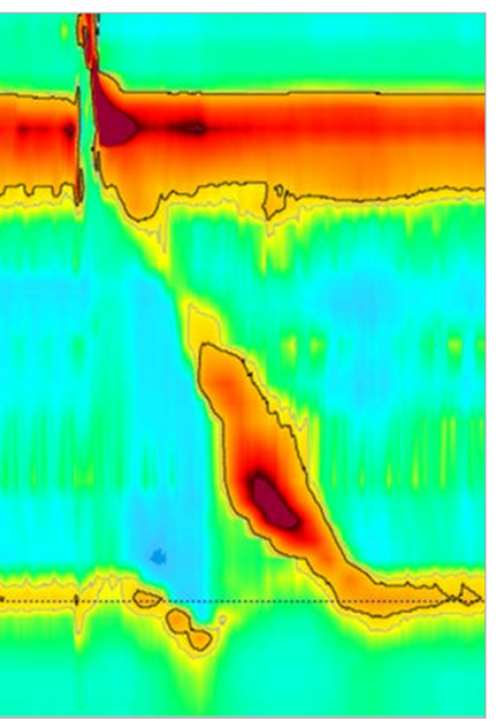
What Does Normal Esophageal Motility Look Like ?
Esophagram
Manometry
Upper 1/3
Striated Muscle
Lower 2/3 Smooth Muscle
Notes:
So to level set and refresh our understanding of esophageal anatomy and physiology lets take a look at esophageal anatomy and a practical look at esophageal physiology through the lens of an esophagram and manometry testing.
The esophagus begins at the level of the upper esophageal sphincter below the cricopharyngeus
The upper two thirds of the esophagus is striated muscle and
The lower two thirds of the esophagus is smooth muscle
There isa very important relationship of the distal esophageal sphincter and the diaphragmatic crua that wraps or envelpoes the distal esophageal sphincter region creating the reflux barrier. When these two important anatomic regions are dissociated form each other as in the case of a hiatal hernia or paraesophageal hernia neither are effective and the reflux barrier is compromised and incompetent. No medication can alter this impact.
Next , if we look at the functional motility of the esophagus by esophagram, I want you to notice the pattern of motility. There is an abrupt and rapid peristalsis that we see on the initial phase of swallow followed by a marked deceleration and then relaxation of the distal esophageal sphincter and diaphragm followed by emptying of the liquid bolus into the stomach.
Comparing this video esophagram to the manometry study on the far right helps us to makes sense of this pressure
CDP is the inflection point along the 30 mmHg contour (black outline) where propagation velocity slows
Demarcating peristalsis from ampullary emptying
The CDP must be within 3 cm of the proximal LES boarder

Slide 11
Symptoms Associated with Esophageal Motility Disorders: What is My Patient Trying to Tell Me?
Common Symptoms
The Right Questions to Ask
Trouble swallowing
Chest Pain
Cough
Foaming
Regurgitation
Heart burn
Don’t ask if they have trouble swallowing.
Ask “Do you feel food getting stuck?”
Solids only? Implies mechanical obstruction.
Or Solids and liquids?
Intermittent or progressive?
What level? Cervical, Mid thoracic, distal esophagus/diaphragm?

Slide 12
Common Tests to Evaluate Dysphagia and Esophageal Motility
EGD
Barium Esophagram
Timed Barium Esophagram (TBE)
High Resolution Manometry (HRM)
Functional Lumen Imaging Probe (FLIP)*
Notes:
EGD
Upper endoscopy with biopsy is the recommended first-line diagnostic test for esophageal dysphagia.
All patients with dysphagia should undergo esophagogastroduodenoscopy (EGD) to rule out malignancy and other structural lesions, as well as eosinophilic esophagitis, infections, and inflammatory conditions.
Retained food in the esophagus and abnormal resistance across the esophagogastric junction strongly suggest achalasia, but manometry is required to confirm the diagnosis.
Barium esophagogram is often performed as an adjunct to EGD to detect obstructive lesions. Although barium esophagography may demonstrate characteristic findings of achalasia, the diagnosis of esophageal motility disorders should not be made solely on the basis of the barium esophagram.
However, the overall sensitivity of barium esophagram for motility disorders is fairly limited, ranging from 56%– 69%.
Addition of 13-mm barium tablet to the esophagram protocol along with evaluation of esophageal emptying (timed barium esophagram [TBE]) at 1, 2, and 5 minutes can increase sensitivity and also be used to monitor treatment response in disorders of EGJOO.
Esophagram can also show classic findings of dilated esophagus with a “bird’s beak” narrowing distally due to hypertonic LES in patients with achalasia. A barium column empties completely in most normal subjects at 1 minute and in all by 5 minutes. Hence, barium column height of >5 cm at 1 minute and >2 cm at 5 minutes should be suggestive of EGJOO and can provide valuable complementary information in patients with manometric diagnosis of EGJOO. TBE can also help with postachalasia treatment monitoring.
Timed Barium Esophagram (TBE) is great for evaluating response to treatment, pre and post
100-200 ml barium
Measure height and width of barium column at 1, 2 and 5 minutes
High Resolution Manometry (HRM):
High-resolution esophageal manometry uses closely spaced pressure sensors affixed to a nasogastric catheter to measure esophageal pressure changes during multiple swallows of standardized foods and liquids. Esophageal motility disorders are classified on the basis of specific contraction and relaxation pressures recorded along the esophageal body during peristalsis and at the lower esophageal sphincter before swallowing and during relaxation (Table 1). 1,4-7 Manometry is indicated in patients who continue to have dysphagia and chest pain despite optimal medical management, especially those who have normal EGD findings and persistent dysphagia to liquids. Because of its low predictive value, manometry is generally not recommended for patients who have chest pain without dysphagia. Manometry is required to confirm the diagnosis of achalasia.
Patients are instructed to be NPO 6 hours, so they don’t throw up on you when you place the catheter.
• Catheter passed trans-nasally into stomach
• Recumbent position for bolus transit and Chicago Classification
• Perform 10 liquid swallows – 5 ml of room temp normal saline – 20-30 seconds apart
• 10 viscous swallows – Used with impedance technology to assess bolus transit
Functional Lumen Imaging Probe (FLIP)
The FLIP catheter includes a distensible balloon encasing multiple pairs of impedance sensors and a single distal pressure sensor.
During a sedated upper gastointestinal endoscopy, the FLIP catheter is placed transorally such that the balloon traverses the EGJ.
Then the balloon is distended with a conductive fluid through a mechanical pump.
The FLIP system converts the readings into a 3-dimensioal rendering of the esophageal lumen in real time and measures the relationship between the cross-sectional area (mm2 ) over the distensive pressure to generate a luminal distensibility.
The most recent FLIP version 2.0 or FLIP topography converts the readings to color-coded luminal diameter plots enabling evaluation of distensibility across the EGJ as well as contractile response to distension in the esophageal body.
Data from healthy volunteers suggests that a normal EGJ distensibility index (EGJ-DI) is >2.8 mm2 / mm Hg and normal EGJ diameter is >13 mm.13 Further, the presence of repetitive antegrade contractions is considered a normal response to distension.
On the other hand, reduced EGJ-DI and/or diameter is often seen in patients with disorders of EGJ outflow such as achalasia or EGJ outflow obstruction (EGJOO). EGJ-DI of

Slide 13
High Resolution Manometry (HRM): Normal Esophageal Study
Median IRP is normal and >50% of swallows are effective
Metric | Normal Threshold | Comments
PB (Peristaltic Break) | < 5 cm | > 50%
DL (Distal Latency) | > 4.5 sec | <20% Premature
Length in cm
DCI | 450-8000 mmHg.s.cm | Normal, > 50% effective swallows
Median IRP | < 20 mmHg.s.cm | Normal
Time in seconds
Notes:
Lets focus in on HRM now as this test is the gold standard for diagnosing esophageal motility disorders.
Integrated Relaxation Pressure (IRP): IRP assesses the adequacy of swallow-induced LES relaxation and is defined by the median of the 4 seconds of maximal deglutitive relaxation in the 10-second wind
ow beginning with UES relaxation. Normal is less than 23.
Distal Contractile Integral (DCI). DCI is a three-dimensional metric to assess the contraction vigor of esophageal smooth muscle, taking length, amplitude, and duration of contraction into consideration. It can help differentiate between normal (DCI of 450 mm Hgscm–8000 mmHg.s.cm), hypercontractile swallow (DCI >8000 mmHg.s.cm), weak contraction (DCI 100 mm Hgscm and
Distal Latency (DL). DL measures timing of peristalsis based on the interval between upper esophageal sphincter relaxation to contractile deceleration point of the peristaltic wave in the distal esophagus. It can help differentiate between a premature (DL

Slide 14
Chicago Classification v3.0 Hierarchical Analysis
No

Slide 15
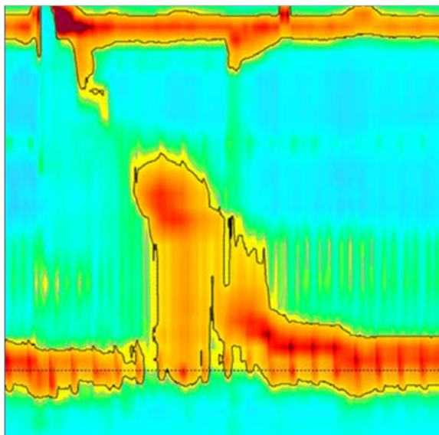
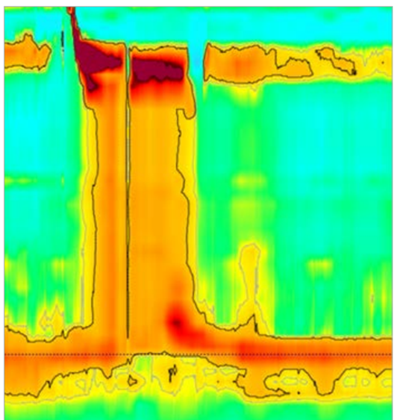
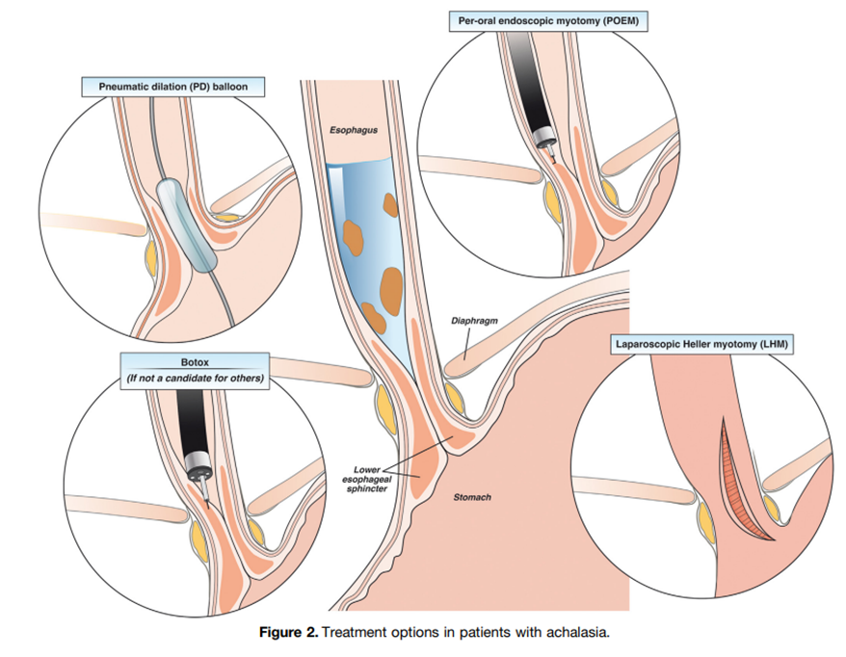
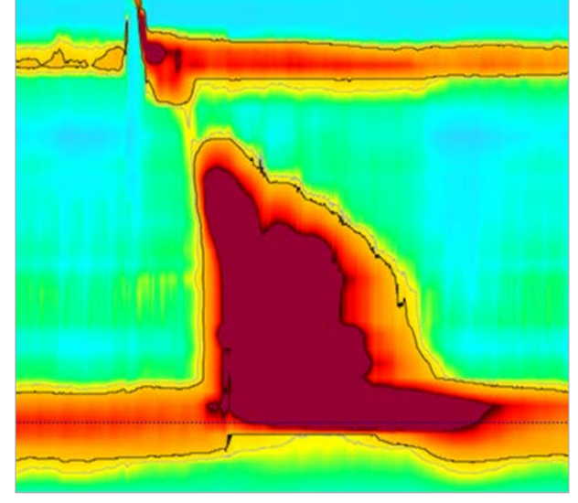
Disorders of Esophagogastric Junction (EGJ) Outflow Obstruction
Achalasia Type I
Median IRP is > 20 mmHg, Abnormal
DCI Absent, 100% failed peristalsis
EGJOO
Median IRP is > 20 mmHg, Abnormal
DCI 450-8000 mmHg.s.cm Normal
Achalasia Type II
Median IRP is > 20 mmHg Abnormal
DCI Absent, 100% failed peristalsis, Panesophageal pressurization
Achalasia Type III
Median IRP is > 20 mmHg, Abnormal
DCI Hypercontractile,
100% failed peristalsis
Notes:
Lets take a closer look at these motility disorders and their manometric appearance starting with
Disorders of Esophagogastric Junction Outflow Obstructions
Achalasia represents the classic esophageal motility disorder thought to arise from a selective loss of inhibitory neurons in the myenteric plexus of the distal esophagus and LES resulting in a neuronal imbalance with unopposed excitatory activity and localized decrease of inhibitory activity, resulting in failure of LES relaxation and disrupted esophageal peristalsis.
Typical symptoms of achalasia include:
progressive dysphagia to solids and liquids,
regurgitation,
chest pain in 40-50%,
respiratory symptoms
and rarely weight loss.
A first step in evaluation of suspected achalasia is upper gastrointestinal endoscopy to rule out mechanical source of symptoms such as esophageal strictures or pseudoachalasia. Endoscopic findings in achalasia include retained saliva with puckered gastroesophageal junction as well as esophagitis from effects of stasis and/or candidiasis. In type I or type II achalasia absence of peristalsis and/or dilation of esophageal lumen is often appreciated, and in type III achalasia an increased presence of peristalsis and/or corkscrewing of esophageal lumen is seen.
HRM is the gold standard to diagnose and subtype achalasia. All 3 subtypes require impaired LES relaxation demonstrated by an elevated median IRP. There are 3 manometric subtypes of achalasia. Type I achalasia is considered the classic presentation of achalasia, and typically a later state of disease progression
Treatment Options:
Treatment options all focus on reducing the pressure gradient by relieving the distal obstruction at the LES
Three first-line treatment options are available for patients with achalasia who are appropriate candidates.
Pneumatic dilation (PD), surgical LHM, and POEM.
1. POEM is one of the more recent therapeutic option available for patients with achalasia with very high clinical success rates of up to 90% response at 5 to 7 years. Due to the ability of POEM to endoscopically extend the myotomy in the proximal esophagus and target areas of esophageal spasticity, POEM is the preferred first-line treatment option in patients with type III achalasia, with superior response rates (93%) compared with LHM (71%).
Overall rates of reflux esophagitis are higher in POEM (44%) compared with 29% with LHM (with partial fundoplication) at 2 years, but rates of severe esophagitis (Los Angeles Classification grade C or D) are comparable between POEM and LHM as demonstrated in a head-to-head randomized controlled trial.59 Because POEM is not classically performed with an antireflux intervention, it is important to discuss higher potential risk of reflux with POEM and potential need for lifelong acid suppression with patients.
2. Pneumatic Dilatation is performed with a nonradiopaque graded size polyethylene balloon (RigiFlex), which comes in 3 sizes (3.0, 3.5, and 4.0 cm) and are often used in graded fashion. PD is overall safe with risk of perforation being 1.0% with 30-mm balloon. The risk of perforation is higher at 3.2% when a 35-mm balloon is used for initial dilation, whereas risk of perforation is lower at 0.97% when graded dilation is used with a long-term success rate of 90% at 6 months and 44% at 6 years. Predictors of favorable clinical response to PD include older age (>45 years), female sex, narrow (nondilated) esophagus, and type II achalasia.64 Hence, most patients undergoing PD should undergo initial dilation using the 30-mm balloon, followed by symptomatic and objective assessment in 4-6 weeks. Endoscopic visualization of the postdilation tear should be performed to rule out a perforation and patients should be monitored for any signs or symptoms in the recovery area. There is no role for routine esophagram after PD unless there is clinical suspicion for perforation.
In those who continue to be symptomatic, graded PD with the next size dilator should be performed and/or POEM or LHM can be offered.
3. Laparoscopic Heller Myotomy (LHM) performed with or without partial fundoplication (Dor or Toupet) also provides excellent symptom relief, with efficacy rates ranging from 88%–95% and lasting 6–10 years. The most common side effect after surgical myotomy is the development of gastroesophageal reflux disease (GERD) and partial fundoplication can reduce the incidence from 41.5% to 14.5%. Hence, the most recent American College of Gastroenterology guidelines recommended doing either Dor or Toupet fundoplication to control esophageal acid exposure in patients with achalasia undergoing surgical myotomy.
Predictors of favorable outcomes with LHM include younger men, tortuous esophagus, and an esophageal diverticulum. Furthermore, similar to PD, patients with type II achalasia respond better (93%) than patients with type I (81%) or III (86%). When comparing outcomes of POEM vs LHM, clinical success rates were similar at 2 years (83% with POEM compared with 81.7% with LHM), but rates of reflux esophagitis were higher in patients who underwent POEM (44%) compared with LHM with Dor fundoplication (29%).
4. Botox. Botox injected into the LES in 4 quadrants, 100 units in 4-5 cc saline can decrease LES pressure by up to 60%. As with all botox injections it is temporary, becomes ineffective after several injections and should be reserved for the elderly frail patients who would not tolerate a more aggressive intervention. Leads to scarring in the submucosal plane where POEM and Heller myotomy are performed.
Finally, in the setting of nonmechanical obstructive symptoms, such as dysphagia and/or noncardiac chest pain, and absence of achalasia on HRM, a diagnosis of EGJOO should be considered in those with high IRP and normal esophageal peristalsis.
Although some of these patients may represent an incomplete or variant form of achalasia, the majority of patients with manometric EGJOO are not related to a primary functional EGJOO and this may be due to falsely elevated IRP.
An estimated 21%–28% of elevated IRP cases have been attributed to structural abnormalities, including:
postoperative anatomic distortion related to fundoplication or bariatric surgery,
cancer or other infiltrative processes,
luminal stricture or extraluminal compression due to paraesophageal hernia (or cardiovascular compression, etc), or an
artifactual increase of the IRP from the catheter effect
Opioid analgesics have also been associated with impaired LES relaxation resulting in functional EGJOO.
The overdiagnosis of EGJOO on HRM without any clinical implications has led to concerns of unneeded treatments and was a driving reason to update the CC. Therefore, a priority in CC v4.0 was to increase the stringency of manometric criteria for EGJOO and provide context as to which clinical scenarios are relevant to EGJOO and may merit therapeutic action. As such, EGJOO is diagnosed on HRM when the median IRP is elevated in both the supine and upright positions. For instance, in patients with a small hiatal hernia or central obesity, an IRP that is elevated in the supine position normalizes in the upright position. Further, intrabolus pressurization must be present in at least 20% or more of swallows, and preserved peristalsis is present such that a diagnosis of achalasia is not met. A clinically conclusive diagnosis of EGJOO requires the presence of obstructive symptoms (dysphagia and/or noncardiac chest pain) as well as corroboration of obstructive findings on a second diagnostic study (such as TBE, preferably with a barium tablet or FLIP). Thus, a clinically conclusive diagnosis of EGJOO requires: (1) conclusive manometric diagnosis, (2) appropriate symptom presentation, and (3) confirmation of findings on supportive testing.

Slide 16
Peroral Endoscopic Myotomy (POEM)
Robotic Heller Myotomy

Slide 17
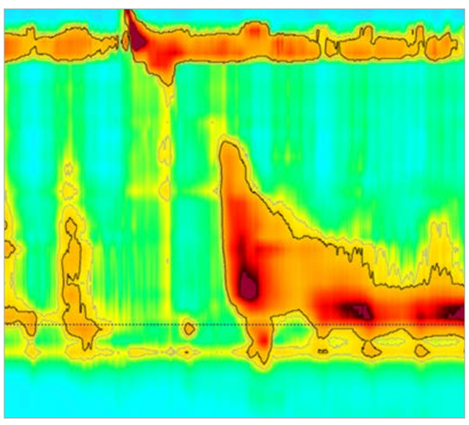
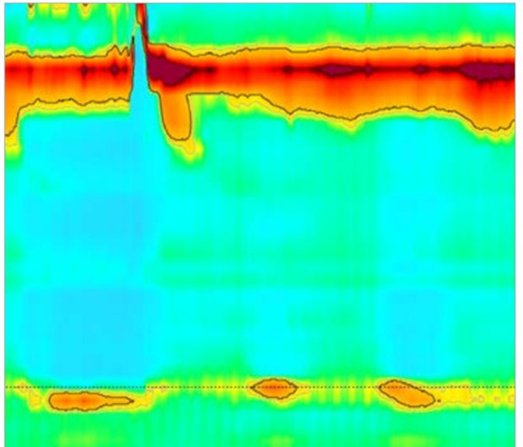
Major Disorders of Esophageal Motility
Jackhammer Esophagus
IRP < 20 mmHg
DCI > 8000 mmHg.s.cm, Abnormal
Hypercontractile, Failed or ineffective swallow
Distal Esophageal Spasm (DES)
IRP < 20 mmHg
DCI 450-8000 Normal
DL < 4.5 sec, Abnormal
Failed or ineffective swallow
Absent Contractility
IRP < 20 mmHg
DCI < 100 mmHg.s.cm, Abnormal Failed or ineffective swallow
Notes:
Next are the Major Disorders of Esophageal Motility
Disordered esophageal motor function can be due to hyperactivity such that peristalsis is premature or contractile vigor is increased.
Symptoms:
Primary symptoms of spastic esophageal motor disorders include dysphagia and noncardiac chest pain and are often accompanied by heartburn and regurgitation.
HRM demonstrates 2 groups of spastic esophageal disorders include:
Distal esophageal spasm (DES) and
Hypercontractile esophagus.
Distal Esophageal Spasm (DES) is characterized by premature contractions in 20% or more of swallows on manometry in the setting of intact deglutitive relaxation (normal median IRP).
Hypercontractile Esophagus: The term “jackhammer esophagus” is no longer synonymous with hypercontractile esophagus. To make a conclusive manometric diagnosis of hypercontractile esophagus, criteria for achalasia and DES must not be met and underlying EGJOO excluded. Supportive findings for manometric hypercontractile esophagus include intrabolus pressurization, abnormal patterns with RDC, or absence of peristaltic reserve on MRS.
A multitude of manometric patterns can meet criteria for hypercontractile esophagus, more commonly single peak hypercontractile peristalsis over jackhammer esophagus with repetitive prolonged contractions, the latter considered to portend greater pathologic significance.
Treatment of Spastic Disorders: Spastic esophageal disorders can be due to:
Primary motor dysfunction,
Opioid-induced, or a
Reactive clearance mechanism to gastroesophageal refluxate.
Evaluation for underlying reflux should be the initial step in determining best treatment option for patients with symptomatic spastic disorders of the esophageal body. Up to a third of patient with DES have pathologic acid exposure. When gastroesophageal reflux is driving the spasticity, treatment should focus on anti-reflux management because antispasmodic therapy has the potential to augment gastroesophageal reflux physiology and worsen symptoms.
In patients with heartburn and/or regurgitation, a regimen of proton pump inhibitor for 6–8 weeks can be trialed and/or ambulatory reflux monitoring off acid suppression can be pursued. Careful inspection for any esophageal strictures should also be performed during endoscopy and empirical esophageal dilation can be considered as a treatment modality given spastic contractions of esophageal body can also be a result of a subtle distal esophageal stricture.
Pharmacotherapy. In patients with a spastic esophageal disorder and dysphagia and noncardiac chest pain, smooth muscle relaxants can be trialed such as calcium channel blockers, nitrates, and phosphodiesterase-5 inhibitors, but their use may be limited due to side effects (headaches, hypotension, and dizziness).
A trial of sublingual hyoscyamine 30 minutes before meals based on anecdotal successes and ease of availability and favorable side effect profile, but this has not been studied for spastic disorders.
In patients with dysphagia as the predominant symptom and lack of response to esophageal dilation or smooth muscle relaxant, esophageal botulinum toxin injection at the LES, 2 cm, and 7 cm above the LES might result in symptom improvement in 50% of patients at 1 month and 30% at 1 year.
In patients with chest pain as the predominant symptom with suspicion of overlapping visceral hypersensitivity, neuromodulation with low-dose tricyclic antidepressants (imipramine or amitriptyline) or trazodone may be more effective than targeting the esophageal dysmotility.
Myotomy. POEM. In patients who fail pharmacotherapy, we recommend performing a TBE and/or FLIP to evaluate esophageal emptying and see if there is significant retention of barium or obstruction at the EGJ. If consistent with an obstructive physiology, myotomy might be considered. In a meta-analysis of 8 observational studies (total of 18 patients with DES and 37 with jackhammer esophagus), POEM had clinical success rates of 88% and 72%, respectively. Another retrospective study involving 11 centers that included 17 patients with DES and 18 with jackhammer esophagus found that POEM improved chest pain in 87% with clinical success (based on Eckardt score) of 84.9% with median follow-up of 272 days.
Surgical myotomy has also been studied in a small prospective study of 20 patients with extended myotomy for DES and found that both dysphagia and chest pain improved in 100% and 90%, respectively, during a 50-month follow-up. Due to lack of well-controlled long-term randomized controlled trials, myotomy for treatment of spastic esophageal body disorders should be reserved for highly selected patients because long-term prognosis even without treatment seems to be good for these disorders.

Slide 18
Minor Disorders of Esophageal Motility: Hypomotility
Ineffective Esophageal Motility (IEM)
IRP < 20 mmHg, Normal
DCI < 450 mmHg.s.cm Abnormal
Fragmented Peristalsis
IRP < 20 mmHg, Normal
DCI 450 – 8000 mmHg.s.cm, Normal
PB > 5 cm Abnormal
Notes:
And Finally, lets look at the Minor Disorders of Esophageal Motility: The Hypomotility Disorders
Treatment of Hypomotility Disorders Management of IEM and absent contractility is very challenging given lack of clear association with symptoms.
There is no effective pharmacotherapy to improve esophageal contractile vigor and management should be focused toward improving predominant symptoms and treating any concurrent reflux if present.
In patients with dysphagia as the predominant symptom, endoscopy to evaluate for a mechanical stricture (such as Schatzki’s ring or peptic stricture) should be performed and, even in cases of normal examination, empiric esophageal dilation might be considered in this group due to lack of other reliable options.
Lifestyle modifications, such as chewing carefully, maintaining positional gravity, and chasing solid bolus with liquids, can be helpful.
Newer agents such as prucalopride may increase the amplitude of primary esophageal contractions in patients with GERD and might have a role in patients with either concomitant gastroparesis or chronic idiopathic constipation, although is not a primary treatment option for esophageal hypomotility.
It is important to recognize that, in most cases, natural history of IEM suggests that it does not progress over time and quality of life is not impacted.
In patients with chest pain as the primary symptom, esophageal hypersensitivity might be the major driving factor and neuromodulators or behavioral therapies might be beneficial based on studies in patients with noncardiac chest pain.

Slide 19
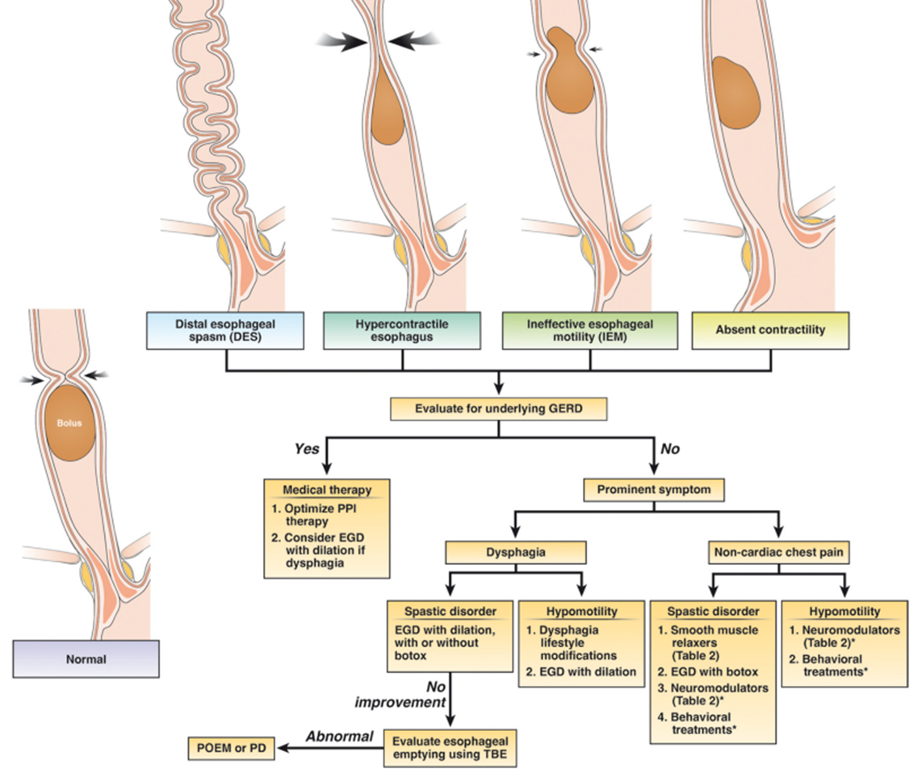
Treatment Algorithm for Major Disorder of Esophageal Motility: Hypercontractile Esophagus to Absent Contractility

Slide 20
Neuromodulators and Smooth Muscle Relaxers

Slide 21
Lifestyle Modifications
Hypercontractile esophageal motility disorders usually respond to lifestyle modifications, although pharmacotherapy may occasionally be needed.
Patients with esophageal symptoms from any cause—even achalasia—typically benefit from eating mindfully; eating smaller, softer, and more frequent meals; and avoiding trigger foods or situations.
Cognitive behavior therapy and other complementary treatments have had some success in the management of functional disorders, but further research is needed.

Slide 22
Connective Tissue Disorders Sjogren’s syndrome and Systemic Sclerosis
Dysphagia is a common symptom reported by 26%–65% of patients
Most common manometric findings:
Hypotensive LES pressure along with
Loss of peristalsis
High incidence of reflux symptoms and erosive esophagitis in up to 32% of patients
Management should be focused on optimal acid suppression esophageal dilation in patients with dysphagia because they are at higher risk of developing peptic stricture.
Notes:
Connective Tissue Disorders Sjogren’s syndrome and systemic sclerosis are the 2 most common connective tissue disorders associated with esophageal motility disorders.
Dysphagia is a common symptom reported by 26%–65% of patients with these disorders. Most common manometric findings include hypotensive LES pressure along with esophageal dysmotility with up to 68.5% with systemic sclerosis having absent contractility and 35% of patients with Sjogren’s syndrome having dysmotility.
However, it should be noted that severity of dysphagia in this population has not been associated with any specific motility pattern. There is also a high incidence of reflux symptoms and erosive esophagitis in up to 32% of patients, which is also associated with hypomotility disorders.
Management of esophageal dysmotility in patients with connective tissue disorders should be focused toward optimization of reflux management (acid-suppressive therapy) and potential consideration of esophageal dilation in patients with dysphagia because they are at higher risk of developing peptic stricture.

Slide 23
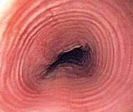
Eosinophilic Esophagitis
Common presenting symptoms
Dysphagia
Chest pain
Esophageal food bolus impaction
HRM abnormal findings are common. Chicken or egg?
How is EoE treated?

Slide 24
Opioid-Induced Esophageal Dysfunction
Opioid-induced esophageal dysmotility is increasingly prevalent
Can produce symptoms and a contraction pattern indistinguishable from other motility disorders mimicking:
Type III Achalasia
EGJOO
DES
Treatment options:
Often reversable, withdraw opioids. Avoid POEM and myotomy
Change to partial agonist
If persists: endoscopic dilatation with Botox

Slide 25
Postsurgical Esophageal Motility Disorders
Fundoplication Postoperative dysphagia after anti-reflux surgery is present in 6%–26% of patients
Persistent dysphagia beyond 12 weeks postoperatively should be evaluated with EGD/Dil, TBE, FLIP, HRM
Bariatric Surgery: Sleeve gastrectomy, dysphagia reported in up to 51% of patients
Notes:
Fundoplication Postoperative dysphagia after anti-reflux surgery is present in 6%–26% of patients.
Esophageal dysmotility can be found in up to 7% of patients after Nissen fundoplication with the majority having nonspecific motility abnormalities followed by secondary achalasia and DES. Evaluation should include esophagogastroduodenoscopy, with FLIP if available, to assess the fundoplication wrap and barium esophagram to evaluate esophageal emptying. Symptom of dysphagia in most of these patients is generated due to inability of the esophageal propulsive force to distend the wrap for bolus transport into the stomach. Lack of contraction reserve on MRS has been independently associated with late postfundoplication dysphagia.
Studies show that conventional endoscopic dilation of the wrap leads to symptom resolution in the majority of these patients with very few needing wrap takedown. In patients with lack of response to conventional esophageal dilation (up to 20 mm), PD can be considered in patients with abnormal esophageal emptying, but might not be effective in patients with dysphagia and no signs of obstruction from the wrap.
Bariatric Surgery The rising incidence of obesity and use of bariatric surgery has brought the impact of altered foregut anatomy on esophageal motility to the forefront of clinical care. Dysphagia has been reported in 51% of patients after laparoscopic sleeve gastrectomy and 46% of patients after Roux-en-Y gastric bypass. In a recent study of 97 patients who underwent high resolution impedance manometry (HRIM) after bariatric surgery, 61.5% had manometric abnormalities per CC v3.0 with 29.9% of them being major motility disorders (achalasia, EGJOO, DES, and jackhammer). The remaining had ineffective esophageal motility. They also found that 5.2% had a unique achalasia-like pattern defined by aperistalsis and increased intragastric pressure, which was defined as postobesity surgery esophageal dysfunction. Hence, secondary esophageal dysmotility may be an under-recognized complication of bariatric surgery

Slide 26
Tips and Tricks
AAPCE
The American Association of Primary Care Endoscopy …,
Improve their individual expertise and raise, with integrity, the general level of primary care endoscopy practice.
Keep it on the straight and narrow
Mindfulness in the endoscopy suite
Avoid dilating cancers unless you are prepared to deal with the consequences
Just because you can doesn’t mean you should
Notes:
Keep it on the straight and narrow

Slide 27
Summary
Reviewed normal esophageal anatomy and physiology.
Discuss the common symptoms of patients with esophageal motility disorders and the importance of a comprehensive history and exam.
Discuss the tools used in the diagnostic work up of dysphagia and esophageal motility disorders.
Review the manometry findings of esophageal motility disorders.
Discuss the treatment options of common esophageal motility disorders.
Upper endoscopy tips and tricks
Notes:
Review normal esophageal anatomy and physiology.
Discuss the common symptoms of patients with esophageal motility disorders and the importance of a comprehensive history and exam. And documentation with templating for dysphagia and GERD etc.
Discuss the tools used in the diagnostic work up of dysphagia and esophageal motility disorders.
Review the manometry findings of esophageal motility disorders.
Discuss the treatment options of common esophageal motility disorders.

Slide 28
Thank you!
Questions?

