Slide 1
Show Me the Money! How to Charge Colonoscopies and EGD’s Like a Boss
Chad Johanning, MD FAAFP
Lawrence Family Practice Center
Lawrence, Kansas
AAPCE 2023 Conference
November 3, 2023
Orlando, Florida

Slide 2
Learning Objectives
Improve knowledge of appropriate charge coding for EGD’s and Colonoscopies
Understand the differences between screening and diagnostic procedures
Identify common pitfalls for charge rejections and patient dissatisfactions for incorrect billing

Slide 3
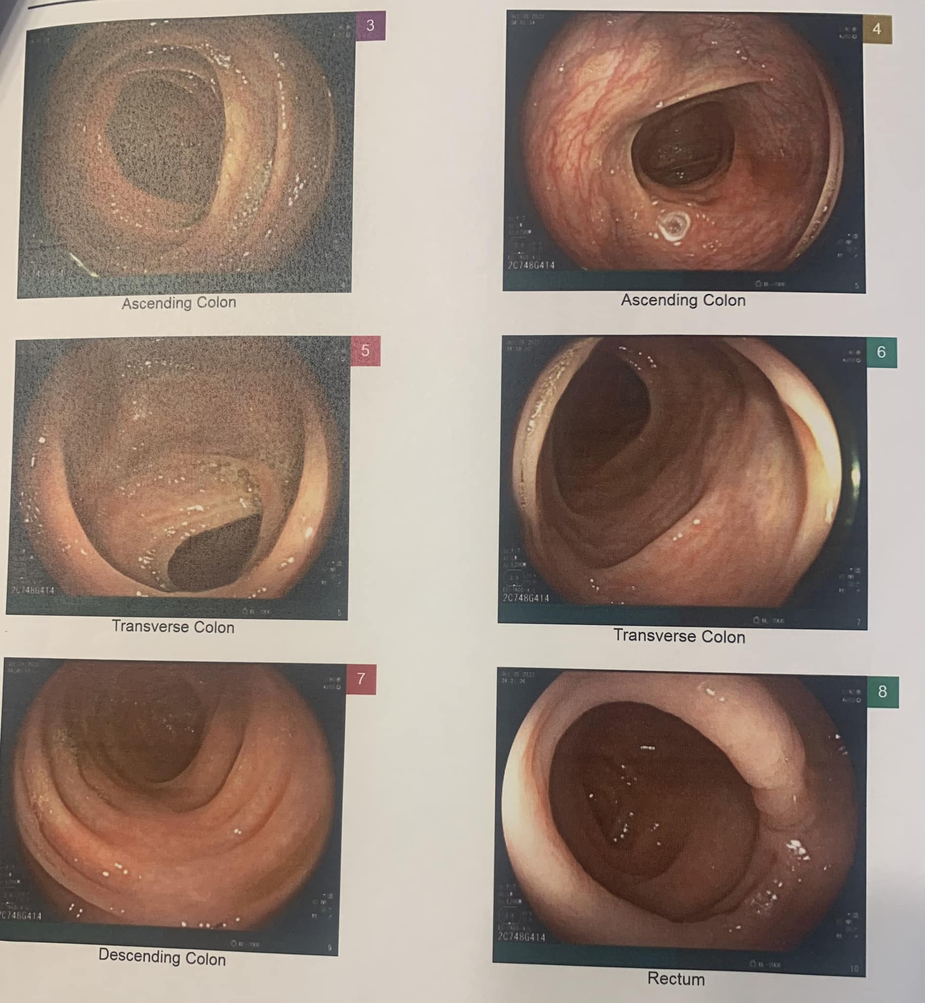
Disclosures
I had my first screening colonoscopy this year.
No other disclosures.

Slide 4
Colonoscopy Indication Definitions
Screening- test performed on an asymptomatic patient to detect the presence of colon cancer or polyps
Diagnostic – test performed because of an abnormal finding, sign or symptom such as abdominal pain, bleeding, diarrhea, etc.
High Risk for Colon Cancer
1st degree relative with colon cancer or adenomatous polyp
Family history of familial adenomatous polyposis
Family history of hereditary nonpolyposis colon cancer
Personal history of colon cancer or colon polyps
Inflammatory bowel disease, including Crohn’s disease and ulcerative colitis

Slide 5
Why are definitions important?
As part of the Affordable Care Act, Medicare and most third-party payors are require to cover services given an A or B rating by the USPSTF without a co-pay or deductible, but the correct CPT code, modifiers and ICD-10 codes must be submitted to trigger coverage at 100%.

Slide 6
CPT coding – Colonoscopy- screening and diagnostic
45378- Colonoscopy, flexible; diagnostic, including collection of specimen(s) by brushing or washing
Commercial- 33 modifier for screening; no modifier for diagnostic
33 modifier created in response to ACA that requires insurance companies to cover at full benefit certain recommended services.
Appending this modifier triggers the 100% screening benefit
Medicare – only use 45378 if the procedure started as a diagnostic procedure and ended without any therapeutic intervention provided.
G0121- Colorectal cancer screening; colonoscopy on individual not meeting criteria for high risk
G0105- Colorectal cancer screening; colonoscopy on individual at high risk (remember those definitions!)

Slide 7
Why are G0121 and G0105 so important?
If a Medicare beneficiary has a G0121 code used, patient is not eligible for a repeat screening for 10 years.
If a Medicare beneficiary has a G0105 code used (high risk), patient is eligible for screening every 2 years. It must be submitted with the diagnosis code that indicates the reasoning for high risk.

Slide 8
Screening diagnosis codes to use
Z12.11- Encounter for screening for malignant neoplasm of colon
this code must be listed first when reporting multiple diagnosis codes
Z12.12- Encounter for screening for malignant neoplasm of rectum
this code must be listed first when reporting multiple diagnosis codes
High Risk Dx code examples:
Z80.0 – Family history of colon cancer
Z83.71- Family history of colonic polyps
Z85.038 - Personal history of other malignant neoplasm of large intestine
Z85.048 - Personal history of other malignant lesion of rectum, rectosigmoid junction and anus
Z86.010 – Personal history of colon polyps

Slide 9
Colonoscopies with Polypectomy -Common Codes
45380 - Colonoscopy, flexible; with biopsy, single or multiple
45381 - Colonoscopy, flexible, proximal to splenic flexure; with directed submucosal injection
45384 - Colonoscopy, flexible; with hot biopsy forceps
45385 - Colonoscopy, flexible; with removal of tumor(s), polyp(s), or other lesion(s) by snare technique
*no difference between cold or hot technique
45388 - Colonoscopy, flexible; with ablation of tumor(s), polyp(s), or other lesion(s) (i.e. Argon)

Slide 10
Screening Modifiers
Appending these modifiers triggers the 100% screening benefit as defined by ACA
33 Modifier (preventative services) - Commercial insurance
33 modifier created in response to ACA that requires insurance companies to cover at full benefit certain recommended services.
PT Modifier (colorectal cancer screening test; converted to diagnostic test or other procedure) - Medicare
CMS developed the PT modifier to indicate when a colonoscopy started as a screening and was converted to a diagnostic or therapeutic procedure (i.e. polypectomy)
If not used, Medicare believes this to be a diagnostic procedure and will be subject to the associated copay/deductible.

Slide 11
Polypectomy diagnosis codes
Z12.11- Encounter for screening for malignant neoplasm of colon
this code must be listed first when reporting multiple diagnosis codes
Z12.12- Encounter for screening for malignant neoplasm of rectum
this code must be listed first when reporting multiple diagnosis codes
Z80.0 – Family history of colon cancer
Z83.71- Family history of colonic polyps
Z85.038 - Personal history of other malignant neoplasm of large intestine
Z85.048 - Personal history of other malignant lesion of rectum, rectosigmoid junction and anus
Z86.010 – Personal history of colon polyps
Same as Screenings
AND
Appropriate Dx code indicating the polyp:
D12.0 – D12.8 – Benign neoplasm of the ____ location
or
K63.5 – Benign Colon Polyp

Slide 12
Coding Example #1
Indication: Colon screening- average risk
Post-endoscopy finding: Normal Colon Exam
Diagnosis code: Z12.11
Procedure code: G0121 (Average risk screening) for Medicare or 45378-33 for commercial insurance

Slide 13
Coding Example #2
Indication: Personal history of colon polyps, Colon screening
Post-endoscopy findings: Normal colonoscopy
Diagnosis code: Z12.11; Z86.010 (personal h/o polyps)
Procedure code: G0105 (High risk screening) for Medicare or 45378-33 for commercial insurance

Slide 14
Coding Example 3
Indication: Colon screening- average risk
Post-endoscopy findings: Polyps in the cecum and sigmoid colon
Procedure: Colonoscopy with snare removal of cecal and sigmoid polyps
Diagnosis code: Z12.11; K63.5 (polyps)
Procedure code: 45385 (Colonoscopy with removal of polyp by snare)
Modifier PT (if Medicare patient) or Modifier 33 (if non-Medicare) should be added to indicate this was a preventive service

Slide 15
Coding Example 4
Indication: Personal history of colon polyps; Colon screening
Post-endoscopy findings: Large sessile polyp in the rectum, unable to resect, pending pathology
Procedure: Colonoscopy with biopsy of rectal polyp. Will await pathology and consider surgical referral.
Diagnosis code: Z12.11; Z86.010 (personal h/o polyps); K63.5
Procedure code: 45380 (Colonoscopy with biopsy)
Modifier PT (if Medicare) or Modifier 33 (non-Medicare) should be added to indicate this was a preventive service

Slide 16
CPT coding for EGD Common Codes
43235- Esophagogastroduodenoscopy, flexible, transoral; diagnostic, including collection of specimen(s) by brushing or washing
43239- Esophagogastroduodenoscopy, flexible, transoral; with biopsy, single or multiple
43251- Esophagogastroduodenoscopy, flexible, transoral; with removal of tumor(s), polyp(s), or other lesion(s) by snare technique
43270 - Esophagogastroduodenoscopy, flexible, transoral; with ablation of tumor(s), polyp(s), or other lesion(s)

Slide 17
Modifiers
Make your patients love you and get the benefits they deserve
33
PT
51
53
59
KX

Slide 18
51 Modifier - Combination EGD/ Colonoscopy
51 modifier- Multiple surgeries performed on the same day, during the same surgical session. (not of the same location)
Colonoscopy and EGD
Append the 51 modifier on the CPT code that is the lesser RVU.
In combination EGD/colon cases, the EGD code would receive the 51 modifier, not the colonoscopy code.
45378 Colonoscopy 43239-51 EGD with biopsy
Payment: Medicare pays 100% of the higher code and typically 50% of additional codes

Slide 19
Coding Example #5
Indication: GERD; Colon Cancer screening- average risk
Findings: GERD- biopsy obtained; Colon polyp in sigmoid
Procedures: EGD with cold forcep bx. Colonoscopy with snare
Diagnosis Codes: z12.11 K63.5 (Colonoscopy) K21.9 GERD (EGD)
Procedure code:
45385 Colonoscopy with snare (33 or PT modifier);
43239 EGD with bx (51 modifier)

Slide 20
59 modifier - Multiple therapies during same Procedure
59 modifier. Use of modifier 59 is only appropriate if the two procedures are performed on separate lesions
Examples:
Colonoscopy with snare technique on one polyp, cold forcep on another polyp
Colonoscopy with biopsy of colon cancer with injection of ink
*Snaring a polyp and using argon on the same polyp to ablate the remnants does not qualify for the use of this modifier. It must be separate
Modifier stresses that a separate/difference procedure took place within the element of the initial procedure
Append 59 modifier on the lesser RVU of the two procedures
CPT 45385 and 45380-59
*Some Medicare payers request “XS” instead of 59*

Slide 21
Details of 59 modifier - payment
Usually, commercial payer payment is 100% of first procedure and 50% for each additional procedure. (differs considerably)
CMS allows payment for more than one endoscopic procedure as long as it is done to a separate lesion / location and the use of a different technique / instrument.
Payment of 100% of highest RVU and then the difference between each additional procedure minus the base code (head of the family) Example: 45385 and 45380 and 45378
45385 has 7.45 RVUs/ 45380 has 5.86 RVUs / 45378 has 5.40 RVUs.
CMS payment would be based on 7.45 RVUS and .46 RVUs (Difference between 45380 and 45378).
.46 RVU’s converts to $15.58

Slide 22
Coding Example #6 : 51/59 modifier
Patient undergoes a diagnostic EGD and screening colonoscopy.
EGD – biopsy of the duodenum (43239) and cold snare polypectomy stomach (43251)
Colon – cold snare of sigmoid polyp (45385); cold forcep bx of rectal polyp (45380)
Always list the more expensive/RVU procedure first
Document locations to be sure to signify specific procedures at specific sites
(box 19/narrative location for coders)
ANSWER
45385-33 (or PT) sigmoid (box 19) ← Screening procedure (Colonoscopy)
45380-59 rectum ← Multiple therapies in the same procedure
43251-51 stomach ← Distinctly different family of procedure codes (EGD)
43239-59 duodenum ← Multiple therapies in the same procedure

Slide 23
Screenings after Positive Stool Tests - NEW
As of Jan 1, 2023, both Medicare and most commercial insurances will pay for both the stool-based test and subsequent screening colonoscopy if stool test is positive, at no cost.
Medicare patients will have to pay some of the cost of the colonoscopy if polyps are removed. (coinsurance) This is consistent with any Medicare procedure that initiates as a screening and ends with an intervention.

Slide 24
Modifiers after positive stool tests - NEW
Commercial insurance – use 33 modifier (same as if they had never had a stool test). Use this on whichever CPT code used
Medicare – if normal colonoscopy after positive stool test, you must use the G0121 or G0105 code with a KX modifier. This will allow patient to access Medicare screening benefits. If G0121 is used and not modified, it will be rejected as “unprocessable” because Medicare sees the previous stool test screening and assumes that benefit has been used.
Medicare – If polyp removal, use PT modifier to the appropriate code (i.e. 45385, 45380)- (same as if they never had a stool test- No KX modifier is needed)

Slide 25
Coding Example #7
Indication: Positive Cologuard; Colon Cancer screening;
Findings: Normal Colon; Hemorrhoids
Procedures: Colonoscopy – no biopsy
Diagnosis Codes: z12.11; R19.5 (+ Cologuard); K64.9 (hemorrhoids)
Procedure code: G0121-KX for Medicare or 45378-33 for commercial insurance

Slide 26
53 Modifier - Discontinued Procedure
53 modifier - A colonoscopy that is attempted but cannot be completed because of extenuating circumstances = an incomplete colonoscopy
Examples: poor preparation; tortuous colon, patient decompensation
The failed procedure is billed and paid using 45378, G0105 or G0121 (or therapeutic code).
When a covered screening colonoscopy is next attempted and completed, insurance will pay for that screening colonoscopy at the original 100% rate.
53 modifiers are generally paid at half the rate of a completed procedure.

Slide 27
53 modifier examples
Screening colonoscopy – clear to transverse colon but unable to get past transverse because of poor prep or tortuous colon.
Appropriate code is 45378/G0121/G0105 (or therapeutic code) with a 53 modifier
Do NOT use the sigmoidoscopy code. While the depth of exam is enough for a sigmoidoscopy, if this code is used, patient will not be allowed to repeat the procedure until the allotted screening duration has elapsed.
If the intention was for a complete colonoscopy, use the appropriate procedure code with 53 modifier.
May be reattempted at any time.
When the next procedure is completed completely, it will be paid at 100%

Slide 28
53 modifier examples
Patient presents for screening colonoscopy and scope is advanced fully to cecum, but visualization was poor, not a high-quality procedure and physician wishes to repeat in 6-12 months.
Given Medicare’s time restriction of 2 year intervals between high risk screenings and 10 years between average risk procedure, if the physician wants to repeat sooner than these intervals due to poor prep, bill this first procedure with a 53 modifier to ensure there is full benefits for the patient at the time of the 2nd procedure.

Slide 29
Medicare Coinsurance for Polyp removal
Medicare waives deductible for colonoscopies initiated as a screening, but patient is responsible for coinsurance on the colonoscopy when it’s converted to therapeutic procedure.
If a polyp is removed during a Medicare screening colonoscopy, the Medicare beneficiary is responsible for 15% of the cost from 2023 to 2026. This falls to 10% of the cost from 2027 to 2029, and in 2030 it will be covered 100% by Medicare.

Slide 30
Conscious Sedation
As of 2018, endoscopists administering conscious sedation for their procedures may add these on to the endoscopic CPT code to show the additional work/risk in administering conscious sedation
Medicare
G0500 – Moderate sedation services provided by the same physician performing a GI endoscopic service that the sedation supports, initial 15 min.
0.16 RVU= $5.42
99153 – each additional 15 min of time
0.33 RVU= $11.88
Commercial
99152 – Moderate sedation service provided by the same physician performing the diagnostic or therapeutic service that the sedation supports, initial 15 min
99153 – each additional 15 min of time

Slide 31
Conscious Sedation
Definitions
Time defined:
Begins the administration of the sedating agent
Ends when the procedure is completed, the patient is stable for recovery status and the provider giving sedation ends the personal continuous face to face time with the patient

Slide 32
References
https://gastro.org/practice-resources/reimbursement/coding/coding-guide-free-crc-screening/
https://gastro.org/practice-resources/reimbursement/coding/coding-faq-screening-colonoscopy/
https://gi.org/practice-management/coding-and-reimbursement-new/
https://gastro.org/news/medicare-requires-new-modifier-for-crc-follow-on-colonoscopy-claims/
https://www.novitas-solutions.com/webcenter/portal/MedicareJH/pagebyid?contentId=00144532&_adf.ctrl-state=86hvagjfk_33
https://codingintel.com/coding-for-screening-colonoscopy/

