Slide 1
FP Essentials GI Conditions The Highlight Reel AAPCE Nov 2023
Justin Bailey MD, FAAFP
Director Procedures Institute, Full Circle Health, Family Medicine Residency of Idaho, Boise ID
Associate Professor of Family Medicine, University of Washington School of Medicine.

Slide 2
Disclosure Statement
It is the policy of the AAFP that all individuals in a position to control CME content disclose any relationships with ineligible companies upon nomination/invitation of participation. Disclosure documents are reviewed for potential relevant financial relationships. If relevant financial relationships are identified, mitigation strategies are agreed to prior to confirmation of participation. Only those participants who had no relevant financial relationships or who agreed to an identified mitigation process prior to their participation were involved in this CME activity. All individuals in a position to control content for this session have indicated they have no relevant financial relationships to disclose.

Slide 3
Learning Objectives
Latest and greatest for
GERD
PUD
Acute Diarrhea
Acute Pancreatitis

Slide 4
GERD
Pathophysiology- Update
Typical vs Atypical
GERD VS PUD
Organic vs Disorders of Brain Gut interaction
Long term risks- Barrett's and Esophageal cancer
EGD- What is it good for
PH impedance/manometry
Management changes Infants, adults, pregnant
When are long term PPI’s guilt free?
Pharm, optimization, reduction, New drugs
Integrative
Surgical referral and options Endoscopic vs laparoscopic

Slide 5
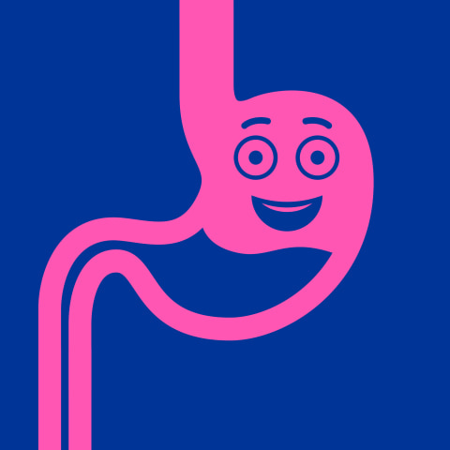
Pathophysiology
LES dysfunction
Increased Intrabdominal pressure
Acid pocket-
Why is reflux most pronounced after eating?
Doesn’t the food buffer?
Proximal stomach high acid sections + poor mixing = regionally lower PH that refluxes into LES

Slide 6
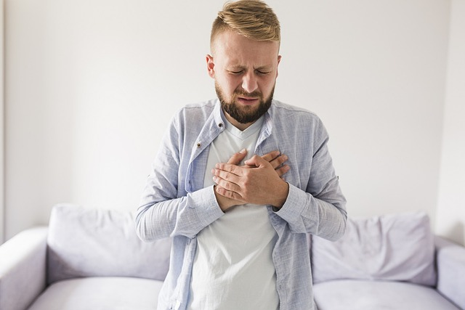
Classic vs Atypical Symptoms
Classic
Retrosternal burning
Heart burning
Regurgitation
Perception of gastric contents in the stomach
Atypical
Belching
Chest pain
Coughing
Dysphonia,
N/V
Dental erosions
Laryngeal/pharyngeal reflux
From glottis and vocal chords,
Hoarseness, globus, persistent throat clearing, globus, cough and regurgitations
This Photo by Unknown Author is licensed under CC BY-NC-ND

Slide 7
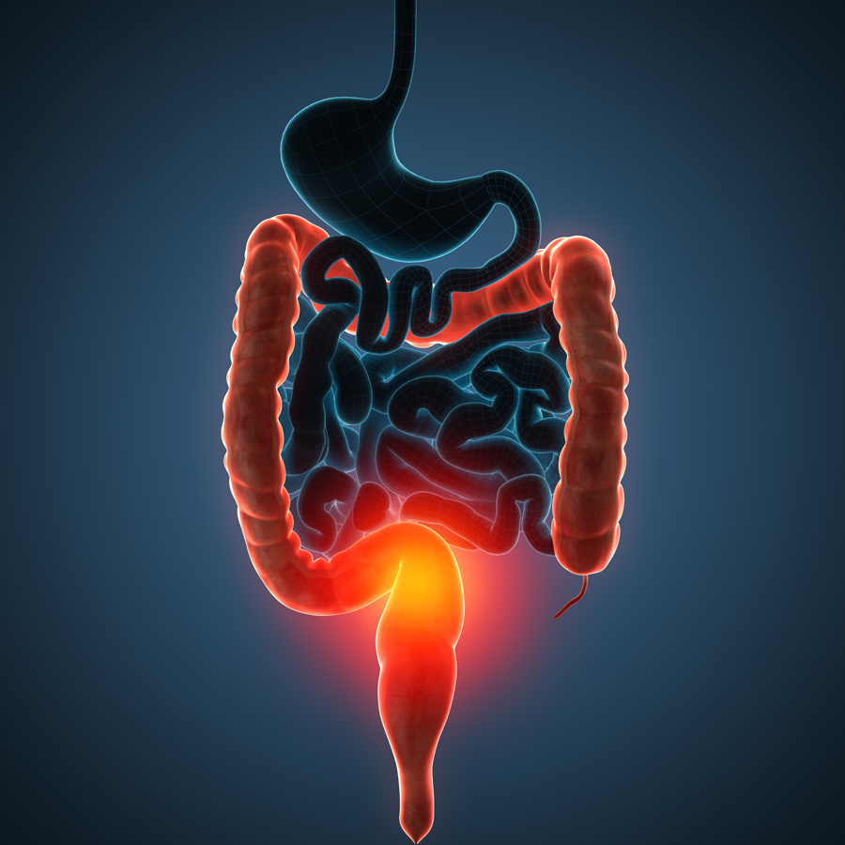
Organic vs DBGI
DBGI focus on patent symptoms management
Do they have structural explanation of there symptoms after there work up?
IF not consider a DBGI
Globus
Functional heartburn
Functional dysphagia
Functional dyspepsia
Rumination syndromes
This Photo by Unknown Author is licensed under CC BY-NC-ND

Slide 8
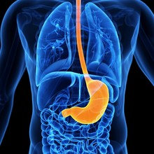
Treatment approach for DBGI
Therapeutic focus
Low-dose antidepressants
Tricyclic antidepressants,
SSRI
Behavioral therapist for
Hypnotherapy
Cognitive behavioral therapy
Diaphragmatic breathing
Relaxation strategies

Slide 9
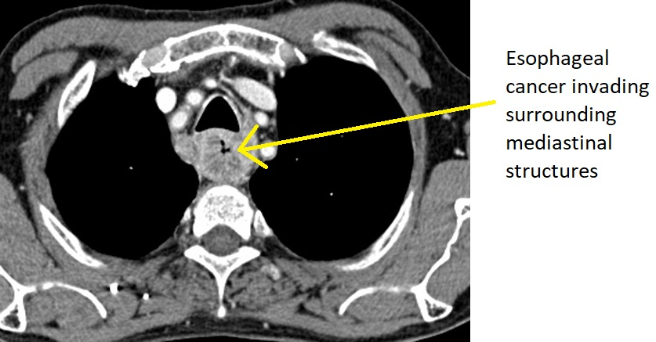
Barrett's and Esophageal Cancer
Cancer
SCJ: Cervix vs anal vs esophageal mucosa
SCC unchanged in rate for years
Adenocarcinoma-
fastest increasing incidence in western populations.
>90% made at late stages,=
associated with inflammation and GE junction migration
Can we screen effectively?
GERD 5-10x more likely to have Barrett’s, of those 0.1-0.3% go on to develop cancer. Or over a 10 year period 1-3% with Barrett’s will progress to esophageal cancer
Low rate of progression in a very common cancer makes hard to effectively screen.
Fhx?, long segment Barretts?
Routine surveillance in those with endoscopic and pathologic changes consistent with dysplasia. = higher rate of cancer.
This Photo by Unknown Author is licensed under CC BY-SA

Slide 10
So who gets an EGD
Alarm Symptoms –
dysphagia, odynophagia, anemia, bleeding, weight loss
Atypical symptoms-
chest pain, globus sensation, chronic cough, hoarseness, wheezing,
Lack or response to anti-secretory therapy
Abnormal imaging
High risk factors for Barrett’s
Allows visual and pathologic exam of tissue
80% of Pt with GERD have no endoscopic evidence

Slide 11
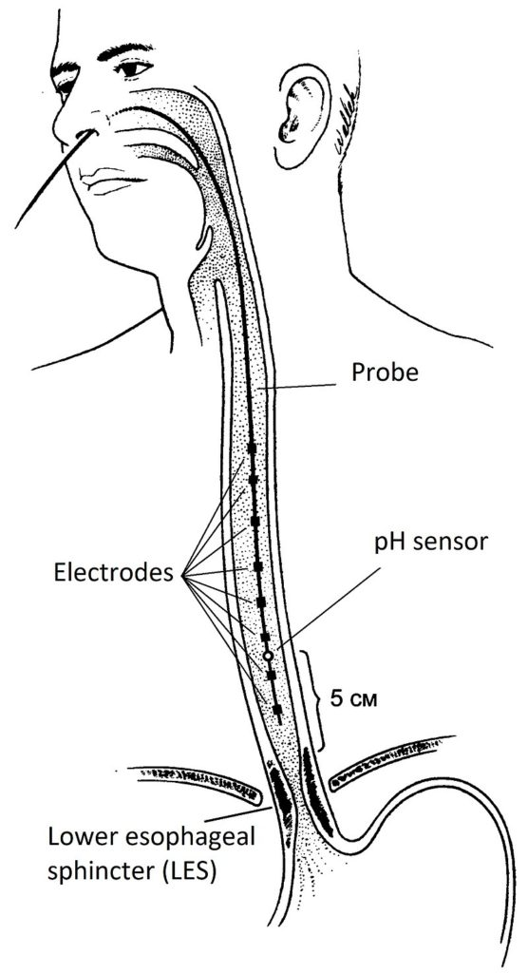
PH/ Impedance/ Manometry
Can be used in patient with typical symptoms that don’t respond to typical anti- secretory therapy
Measure total time ph below 4
Impedance test measure liquids solids and gas that go past the LES.
Good for looking at non acid exposure in esophagus
Manometry
How well is it closing
Often used on surgical staging
This Photo by Unknown Author is licensed under CC BY-NC-ND

Slide 12
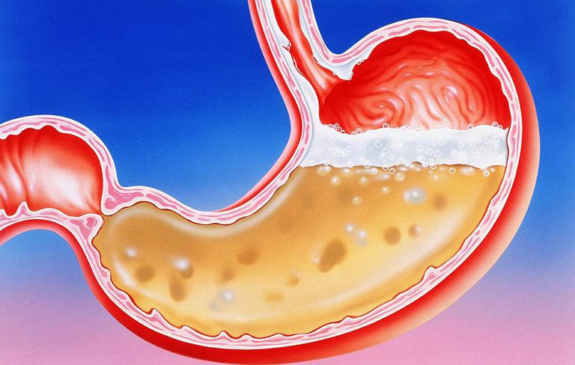
Management
Acid suppression main stay of treatment
PPI
H2RA
K Competitive blocker?
Alginates
Antacids
Cytoprotectants
Prokinetics ?
Muscle Relaxants
50% of patients don’t symptomatically respond to acid suppression
AGA 2022 update suggest EGD and/or Ph, Imp testing if no response to antisecretory therapy
This Photo by Unknown Author is licensed under CC BY-SA

Slide 13
Lifestyle
Weight loss consistently shows benefit.
Quitting tobacco OR 5.67 of improved symptoms
Head of the bed elevation came from a study of 15 patient reduced esophageal pH time <4 from 21%-15%.
This Photo by Unknown Author is licensed under CC BY

Slide 14
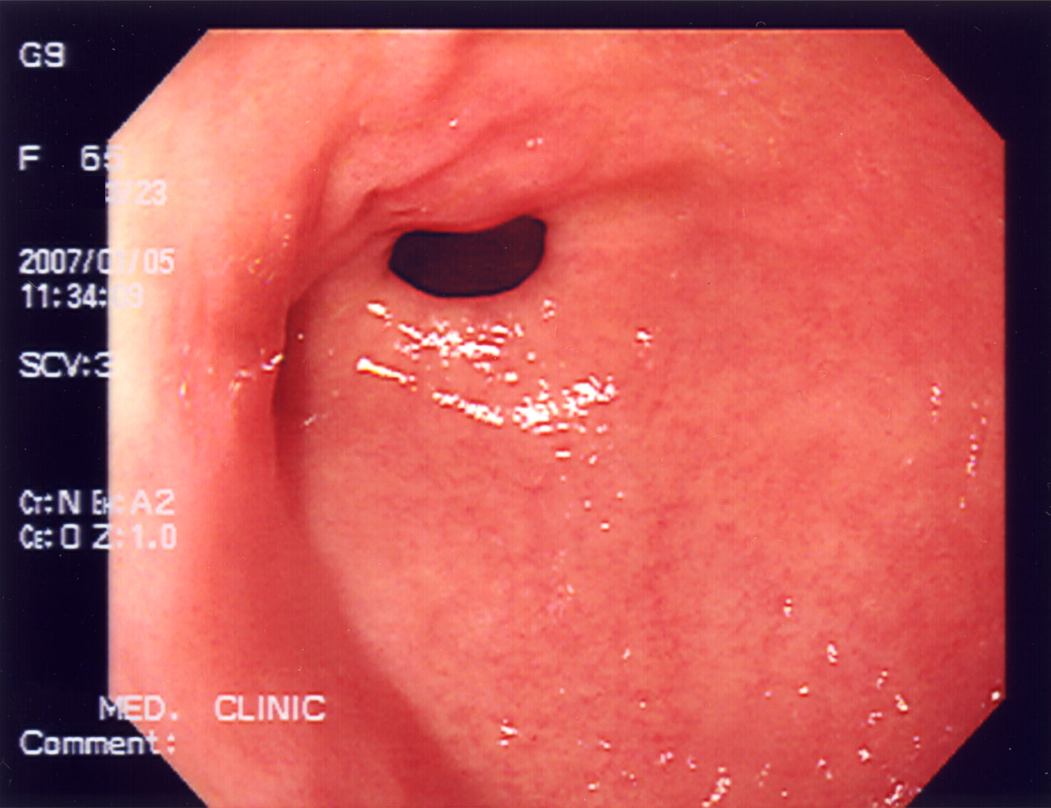
AGA 2022 Guideline
Typical symptoms(heartburn, regurgitation, non-cardiac chest pain) without alarm
How long should I treat?
4-8 weeks without alarm symptoms should be tried on single-dose PPI.
No improvement?
Increase dose to BID
No improvement?
Switch agents (HSRA)
Still no improvement, acid probably isn’t your problem.
Patient improves,
PPI tapered to lowest effective dose.
Personalization of pharmacotherapy should be based on GERD phenotype.
Alginate antacids for breakthrough symptoms,
Nighttime H2 receptor antagonist for nocturnal symptoms,
Baclofen for regurgitation or belch predominant symptoms,
Prokinetics for coexistent gastroparesis.

Slide 15
PPI- is chronic every ok
AGA guidelines
Erosive Esophagitis
Barrett's esophagus
Chronic NSAIDS
Persistent symptoms control
After 12 months on PPI’s is there another cause we can reverse?
“In patients on PPIs for >12 months in unproven GERD, reevaluation of dosing should be done, and consideration of endoscopy or wireless reflex monitor off PPI therapy to confirm diagnosis.”

Slide 16
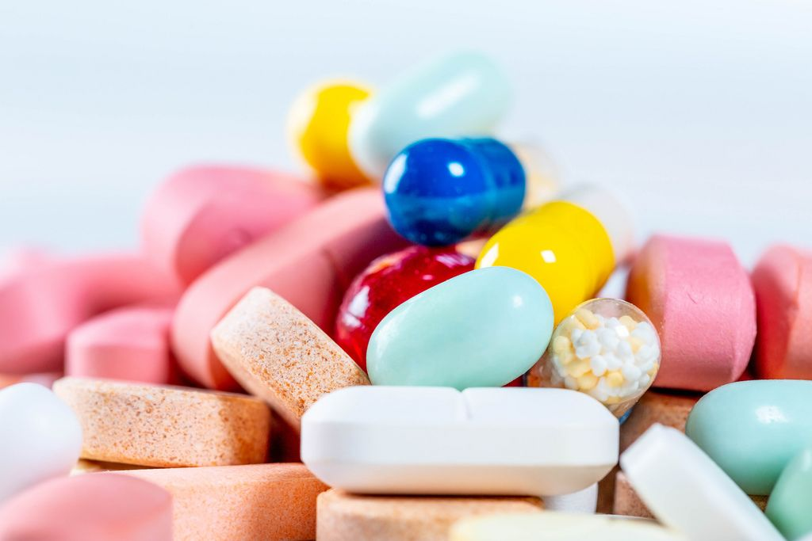
What about the PPI side effects?
Associated vs Caused
Superior to so many other antisecretory meds
Esophagitis (80% vs 49% H2RA)
Esophageal stricture (46% vs 30%)
What have the RCT’s shown
Cardiac disease n=18k no difference
Pneumonia 2,500= no effect.
AsPECT- large RCT showed no difference in all cause mortality
Guidelines recommend not treating to presumed possible effects
This Photo by Unknown Author is licensed under CC BY

Slide 17
PPI- how they work to understand when they don’t work.
How important is the fasting to prodrug activation
BID?
Is your diagnosis correct?
If acid isn’t your problem then acid suppression is not going to be your solutions
This Photo by Unknown Author is licensed under CC BY

Slide 18
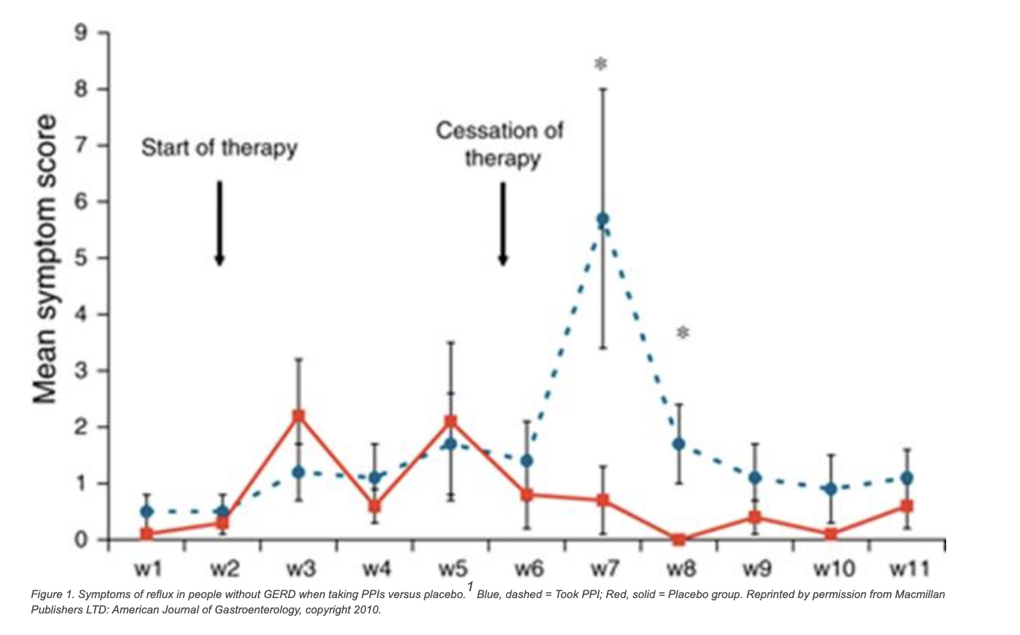
PPI Reduction Strategies
PPI ingested
Decreased acid,
Increase gastrin,
Hypertrophy enterochromaffin,
PPI stops =dramatic acid increase.
On Demand vs placebo.
83% vs 56% Placebo symptom control at 6 months
50% reduction in dose/ week to lowest tolerated dose.
6 months 44% decreased or and discontinued
79% able to reduce dose with concomitate used of H2 blocker

Slide 19
New Kid on the Block Approved Nov 1, 2023!!!
Vonoprazan –
Potassium competitive acid blocker
Able to keep more even acid suppression
Wider ph activation of prodrug so able to keep more even acid suppression
10 year track record in Japan, Korea, and Russia
Superiority to PPI in healing or
Severe esophagitis (97% vs 93%)
Peptic Ulcer Treatment (95% vs 78%)
H pylori eradication (95.8% vs 69.6%)
Gastric and duodenal ulcer therapy (92% vs 75.9%)
Less side effects then PPI (32% vs 40% most SE GI related, nausea and diarrhea)
This Photo by Unknown Author is licensed under CC BY-NC-ND

Slide 20
Management in Pregnancy
Antacids- RCTs NNT-3.7
Antacid + H2 vs antacid= No superiority
Mag OH, Al OH superior to placebo
No PPI RCT but cohort with 2.3 million showed no difference in safety,
All are category B except omeprazole category C (harm in animals)

Slide 21
Infants
50% are happy spitters
90% resolved by 12 months
Treatment not needed unless alarm features
FTT, irritability, feeding difficulties, sleeping difficulties, prolonged crying, anemia, bile or blood in the emesis, chocking or coughing with feeding.
Reassurance
1st Interventions
Hypoallergenic formula or removed dairy products from Mom’s diet
PPI recommend in some guidelines but RCT’s failed to show improvement of symptoms in studies.

Slide 22
Adolescents
There just baby adult’s!
Short trial of PPI to start
2-4 weeks
Lifestyle
Avoidance of caffeine, chocolate, abstinence for alcohol and tobacco
Wean after 12 weeks.

Slide 23
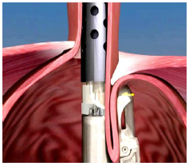
Surgery
Best patients
Responded well to PPI
Known hiatal hernia
Erosive esophagitis
Can’t wean from acid suppression
Barrett's esophagus
Laparoscopic
5-year outcomes with laparoscopic fundoplication, in which
29% of patients still use daily PPIs,
41% have persistent heartburn, and
24.5% have other reflux symptoms, plus a higher side effect rate of 14-23%.⁷⁰
Endoscopic (TIF)
Short-term 99% success 2% reporting adverse events.
5-10 years 74%-86%. Patients satisfied with procedures
75% of PPI
No guarantee of long term effectiveness.
One Danish study n=3456 >50% patient back on PPI at 10 years]
The 5-year PPI cessation rate for magnetic sphincter augmentation is 85%, and 6-12 year data indicates a 79% cessation rate.
This Photo by Unknown Author is licensed under CC BY

Slide 24
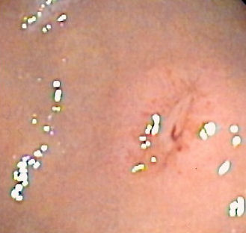
PUD
Case rate?
Pathophysiology
Symptoms
Long term
Diagnosis
Management
Ulcer bleeding prophylaxis
Integrative
This Photo by Unknown Author is licensed under CC BY-SA

Slide 25
Case Rate
Greater then 50% decrease in the last 20 years!!!
PPI’s, effective H pylori treatment, more judicial NSAID use
Seen in low and high socioeconomic countries

Slide 26
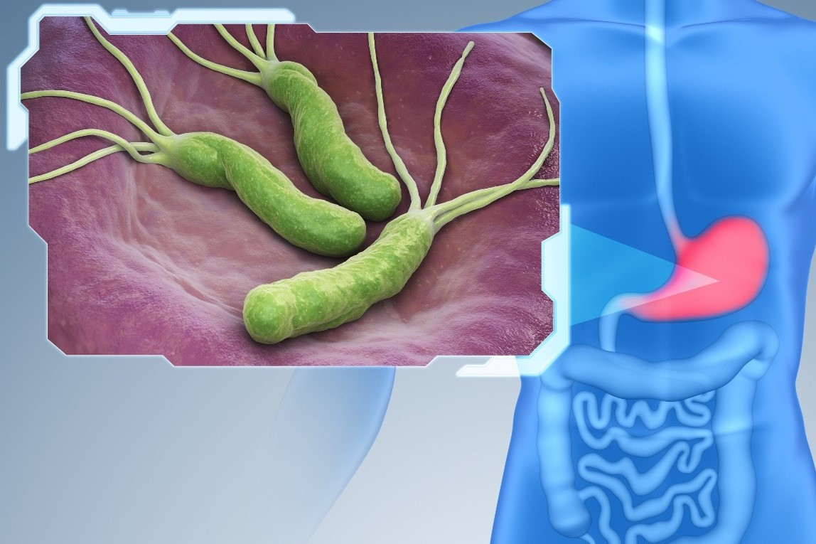
Cause
H pylori
Urease creates an alkaline environment allowing bacteria to live in mucosal barrier.
Inflammatory cascade creates ulcer, wide variety of inflammatory protein expression creates wide variety of symptoms in patients
NSAID
Cycloxygenase-1 limited by NSAID
Decreased mucosal production
Decrease bicarbonate secretion,
Reduced cell proliferation,
Decreased blood flow to mucosa
This Photo by Unknown Author is licensed under CC BY

Slide 27
Test | Sen/ Spec | When to consider
Noninvasive tests
Urease Breath Test | 95.9%/95.7% Can be affected by PPI within 2 weeks, antibiotics within 4 weeks, any active bleeding can decrease specificity. | Good test for pretreatment diagnosis and post treatment test of cure. May be less accurate in a pediatric population
Fecal Antigen | 94% / 97% Stool sample needs to be refrigerated. Decrease accuracy with PPI, antibiotics, bismuth, bleeding, and N-acetylcysteine treatments. | Good test to diagnose initial infection. If using to test for cure, should wait 3 months before repeat testing. Good test to use in children.
Serum antigen | 74-84% / 79=90% High negative predictive value | IgG only reliable test measure of IgG, IgM, and IgA Less affected by patients on or unable to stop antibiotics, PPIs, or bismuth, active gastric bleeding or carcinoma, MALT lymphoma, or atrophic gastritis. Inexpensive, Good Negative predictive value Unable to use as a test of cure since IgG antibodies will likely stay positive for a prolonged period after eradication.
Invasive/ Endoscopic Testing
Rapid Urease Test | >90%/ >90% Results usually available in a few hours PPI, bismuth, antibiotics may cause false negative results. | Biopsies placed in urea-containing solution and pH indicator. Best results if biopsies taken from gastric antrum and corpus Bacteria from mouth and stomach can cause false positive (K. pneumoniae, S. aureus, P. mirabilis, E. cloacae, C. freundii)
Mucosal Pathology Biopsy | 80-95% / 99-100% based on number of biopsies and location of biopsies. | Considered the gold standard for diagnosis.
Culture | 65% | Not Routinely done. Need specialized conditions to allow growth, used to help guild management in failed treatment
PCR | >95% >95% | Accurate in patients with gastric bleeding Expensive, Used in research settings, not routinely in clinical practice.

Slide 28
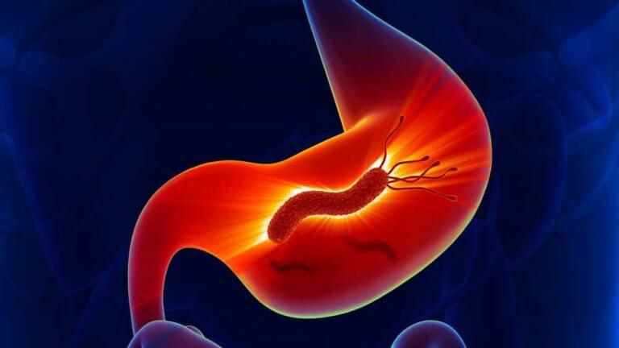
Find and Treat- Don’t look in asymptomatic individuals.
Find and treat- no specific 1st line
Retest for cure after 6 weeks (breath test, vs endoscopy)
Long term NSAIDS should combine PPI with use
Failed treatments
Should we go to vonoprazan treatment
Why should effective acid suppression be the key to kill a bacteria that thrives in acid?
This Photo by Unknown Author is licensed under CC BY-SA-NC

Slide 29
Lifestyle
Alcohol
Tobacco
Sleep apnea doubles risk of developing

Slide 30
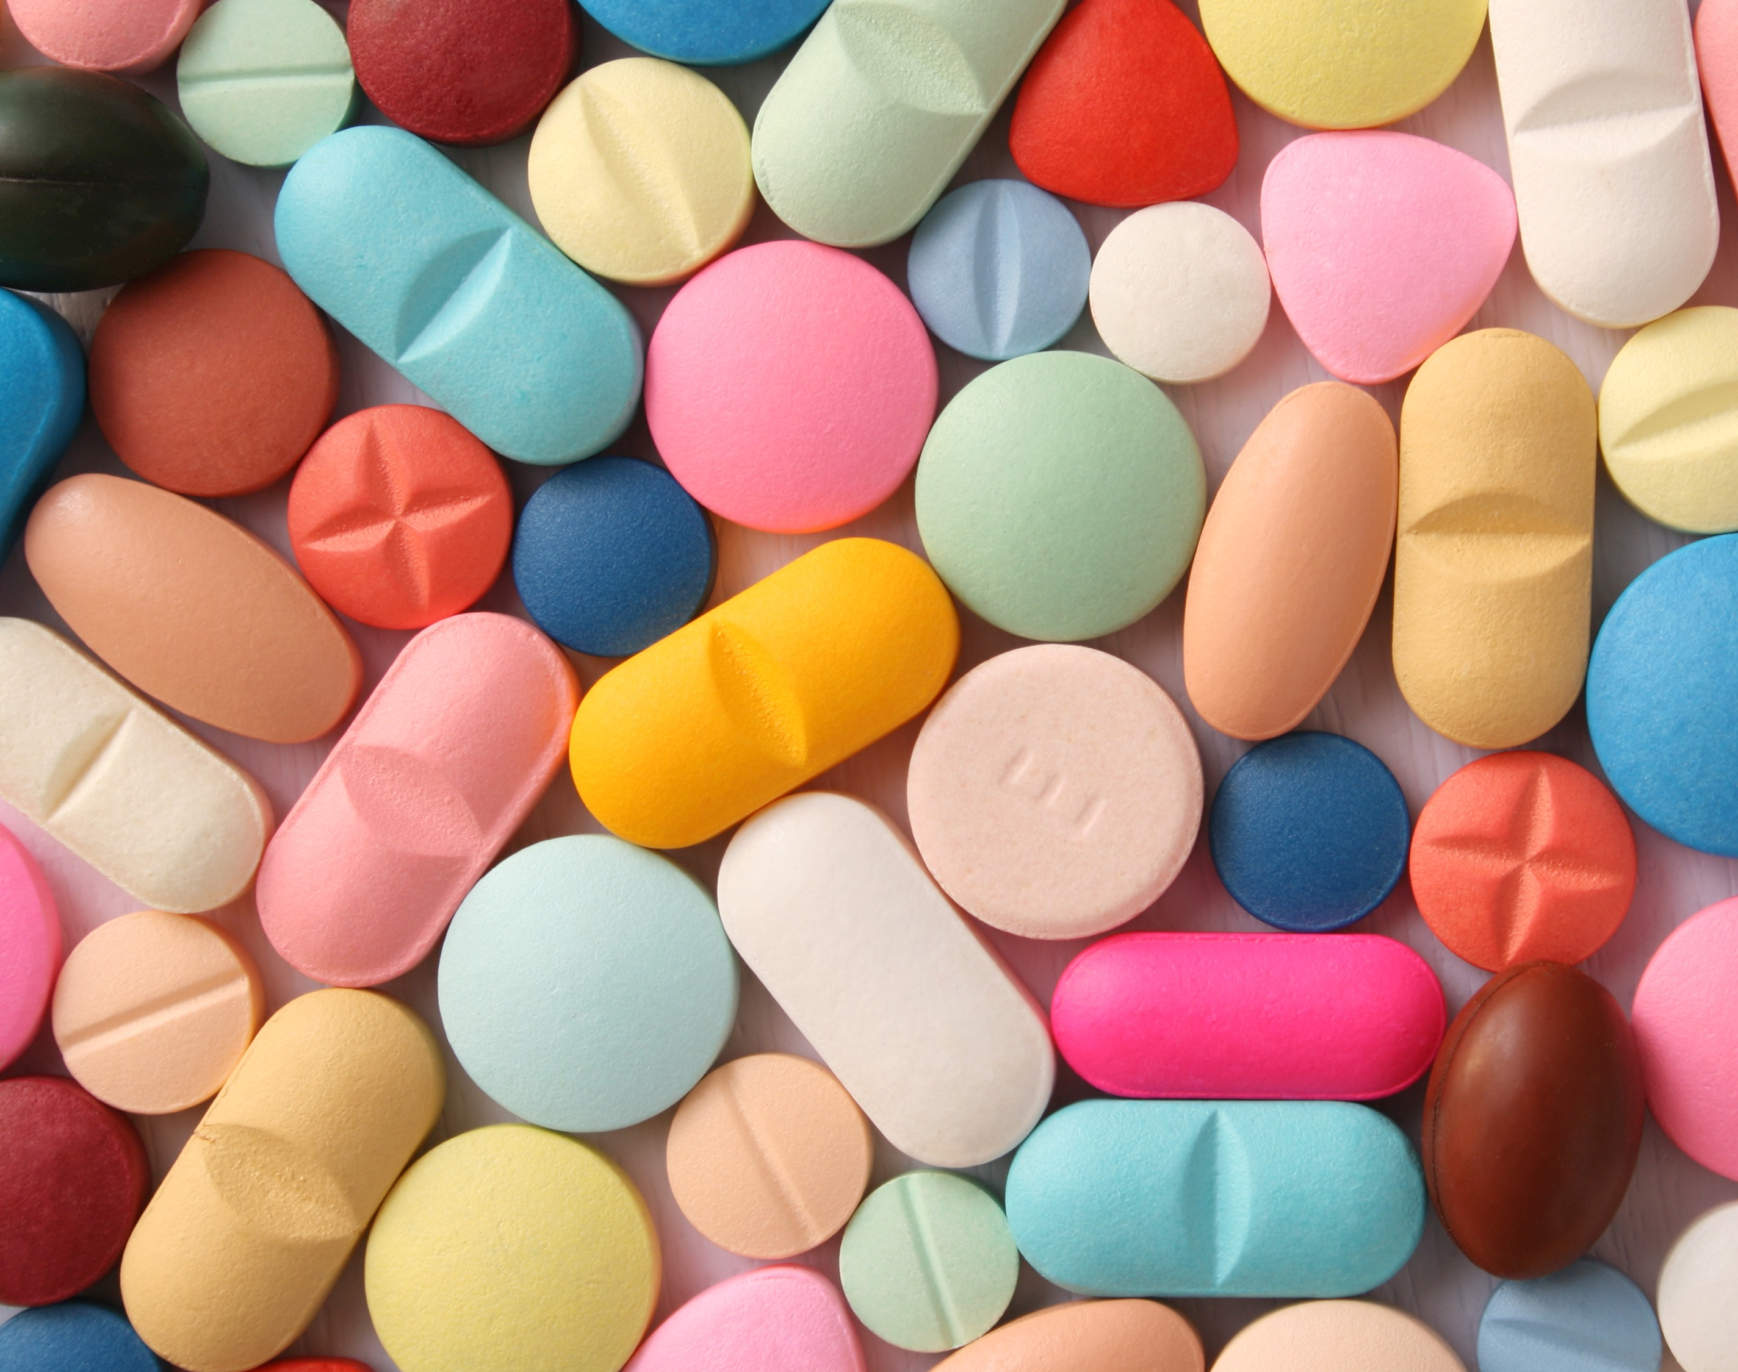
Integrative
Probiotics
May help reduce side effects of eradication therapies
H pylori vaccination?
Once Chinese study showed 71.8% effectiveness at 3 years

Slide 31
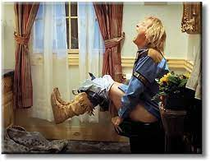
Acute Diarrhea
Post infection complications
Lab Testing
Treatment
Diet
Rehydration
Medications
Prevention

Slide 32
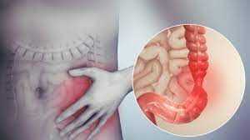
Post infection Complications
9% of patients with infections will go onto develop IBS from it,
This accounts for 50% of current cases.
Increase diarrhea predominance by 5% and pain rates by 38%

Slide 33
Has your lab changed testing?
Culture / Ova and parasites are out,
PCR nucleic acid amplification test/ toxin multi bug tests are in.
Speed to diagnosis, sensitivity and specificity improved (1-2 hours sn 75-85%, sp 95-100%)
Increased number of bugs found that may not have pathologic problems.
No need to test of cure in patients with improvement of symptoms.
(high false negatives due to residual protiens left)
Fecal Leukocytes, calprotectin are not useful in an acute diarrhea setting.
This Photo by Unknown Author is licensed under CC BY-NC

Slide 34
Treatment
No Diet is superior.
Oral rehydration for mild to moderated, IV for severe
Antibiotics for travelers diarrhea.
Azithromycin, ciprofloxacin, Levofloxin, ofloxacin, rifaximin
Most have 1 day vs 3 day dosing
C diff
Fidaxomicin 1st line, 2nd vancomycin, 3rd metronidazole
Fecal Transplants for abx resistant conditions
National registry shows 96% effectiveness with enema and capsule group.

Slide 35
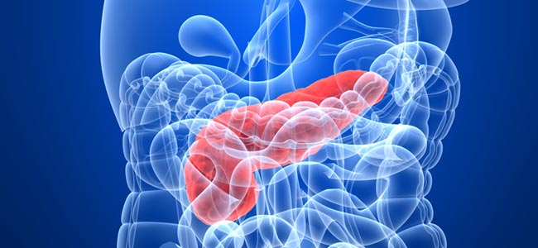
Acute Pancreatitis
Management
Fluid Resuscitation,
Pain management,
Nutrition
Chronic pancreatitis
Pancreatic insufficiency
Prevention
Surgery
This Photo by Unknown Author is licensed under CC BY-SA-NC

Slide 36
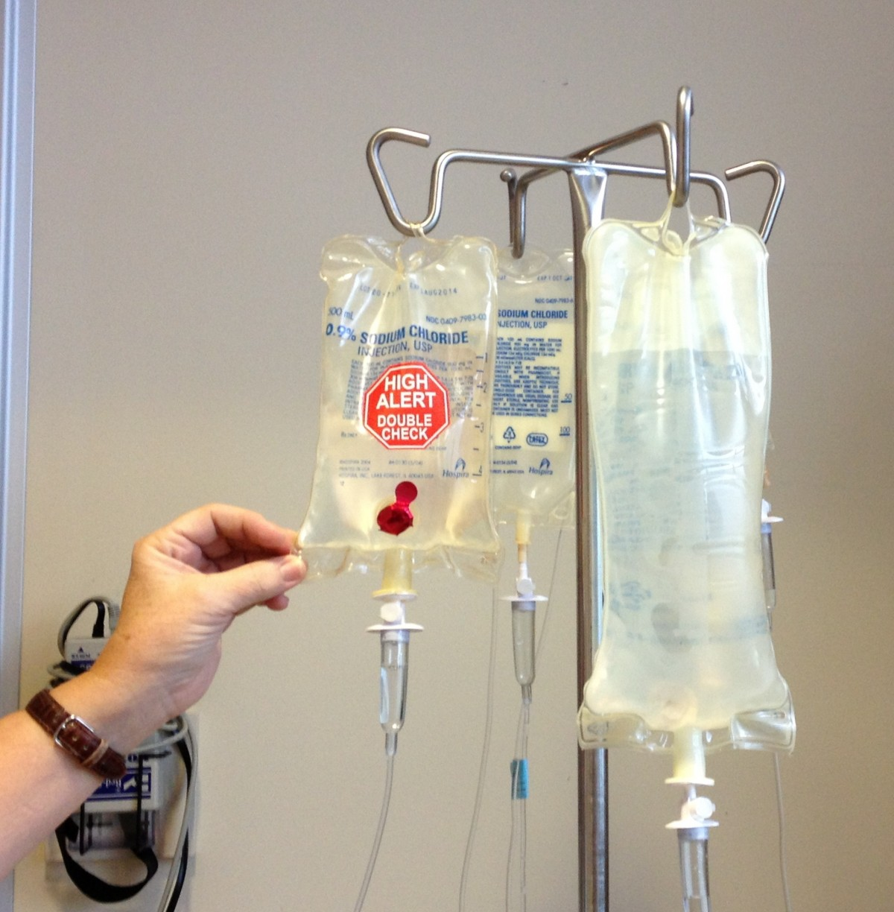
Fluid resuscitation
Lactated Ringer is superior to Normal Saline
2018 meta-analysis, n=428,
Significant decreased odds of developing SIRS
OR 0.38 95% CI, 0.15-0.9 at 24 hours
Nonsignificant trend towards decreased mortality
OR=0.61; 95% CI 0.28-1.29.

Slide 37
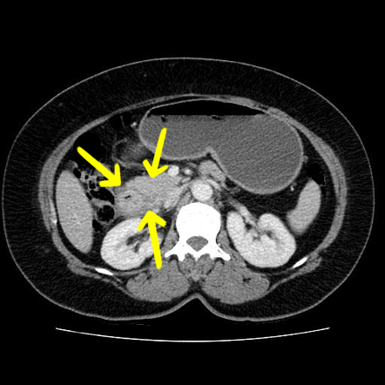
Moderate vs Aggressive Fluid Hydration
RCT, N=249
Moderate
10ml/kg of LR bolus in hypovolemic
No bolus without hypovolemia + 1.5ml/kg/hr
Aggressive
20 ml/kg in hypovolemia
No hypovolemia 3 ml/kg/hr
20.5% vs 6.3% of aggressively hydrated patients developed fluid overload
6 vs 5 days mean hospitalization (NNH 7)
RCT, n=76, china
Severe pancreatitis mod (5-10 ml/kg/hr) vs agg (10-15ml/kg/hr)
Moderate =
less fluid sequestration (4215 ml vs 5378ml)
lower rate of mechanical ventilation (65% vs 94.4%)
lower abdominal compartment syndrome(32% vs 72%) and
sepsis (37% vs 64
lower mortality rate (69.4 vs 90%).
This Photo by Unknown Author is licensed under CC BY-SA-NC

Slide 38
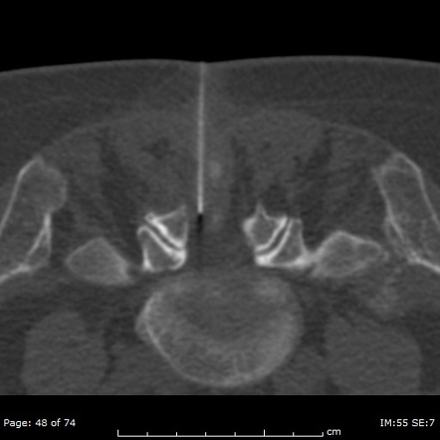
Pain
No specific pain management is superior in most pancreatitis
What’s on the horizon
Epidural Anesthesia is severe pancreatitis?
Retrospective cohort (n=1003)
Reduced 30 day mortality (2% versus 17%) in those who received epidural vs parental opioids for pain management in the ICU.
This Photo by Unknown Author is licensed under CC BY-SA-NC

Slide 39
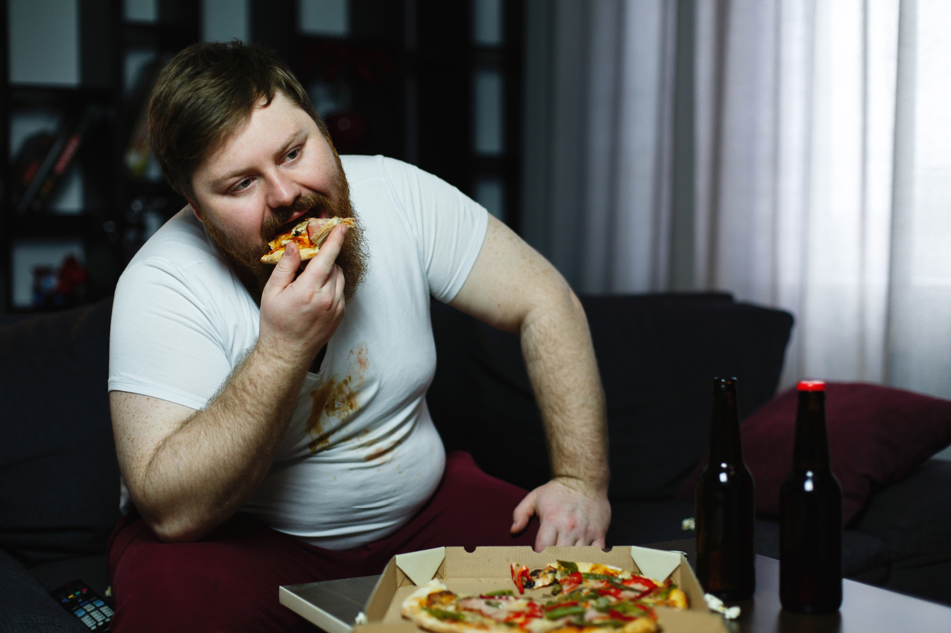
To eat of not to eat, that is the question
Eating is the new NPO for pancreatitis!
Guidelines suggest starting feeds in the 1st 24 hours, if unable to tolerate starting even in severe or necrotizing pancreatitis.
Metanalysis of 9 RCTs, n=500,
Total enteral nutrition vs total parental nutrition has a lower mortality rate (OR 0.31 95%CI 0.18-0.54).
Shorter hospital stay,
Lower risk of infection,
Organ failure, and
Surgical intervention.
Meta-analysis, 10 RCT’s n=1051 of early vs late enteral feeding (<48hrs vs >48hrs)
Decreased mortality (OR 0.53 95% CI 0.35 to 0.81)
Reduced multi-organ failure
Operative intervention
Systemic infection and septic complications.

Slide 40
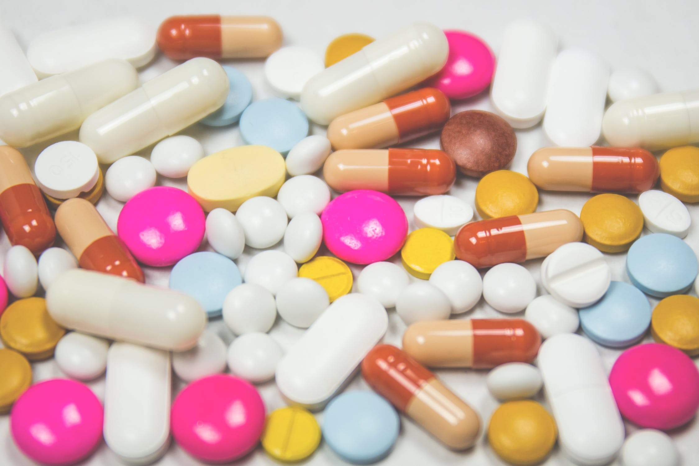
“Biotics”
Antibiotics?
No longer for pancreatitis, pancreatic necrosis unless image proven to be infectious pancreatitis.
Probiotics
RCT n=298
Severe pancreatitis probiotic’s increased complications
Bowel ischemia (9% vs 0% NNH=11)
Mortality (16% vs 6%, NNH=10)

Slide 41
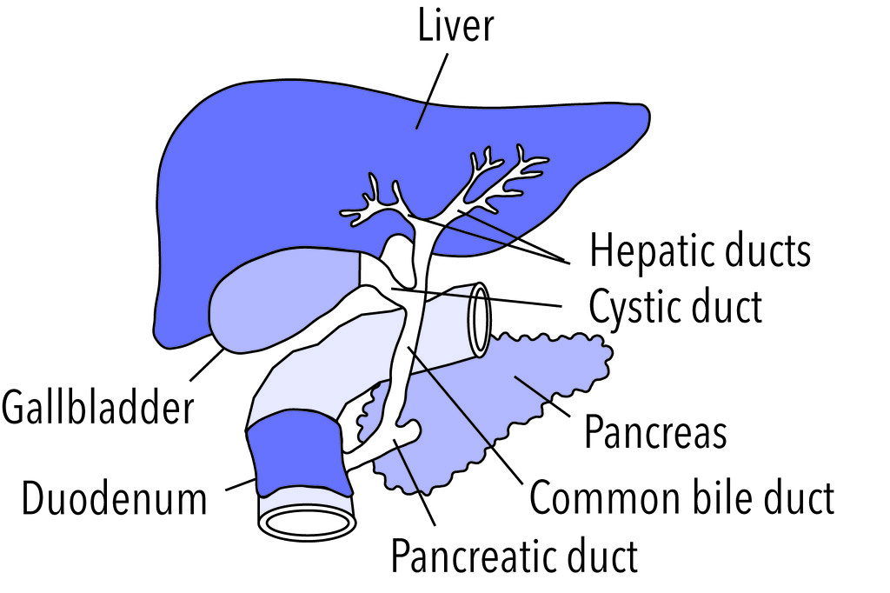
Surgery
If pancreatitis is secondary to biliary pancreatitis consider a surgical consult for cholecystectomy.
Most mortality in recurrent pancreatitis comes from patients with biliary pancreatitis.
If the cholecystectomy on the same admission mortality is lowered (5% vs 17%).
If necrotizing pancreatitis wait to remove gallbladder until resolved.
Obstructive pancreatitis with cholangitis should be considered for ERCP with sphincterotomy to decompress.
This Photo by Unknown Author is licensed under CC BY-NC

Slide 42
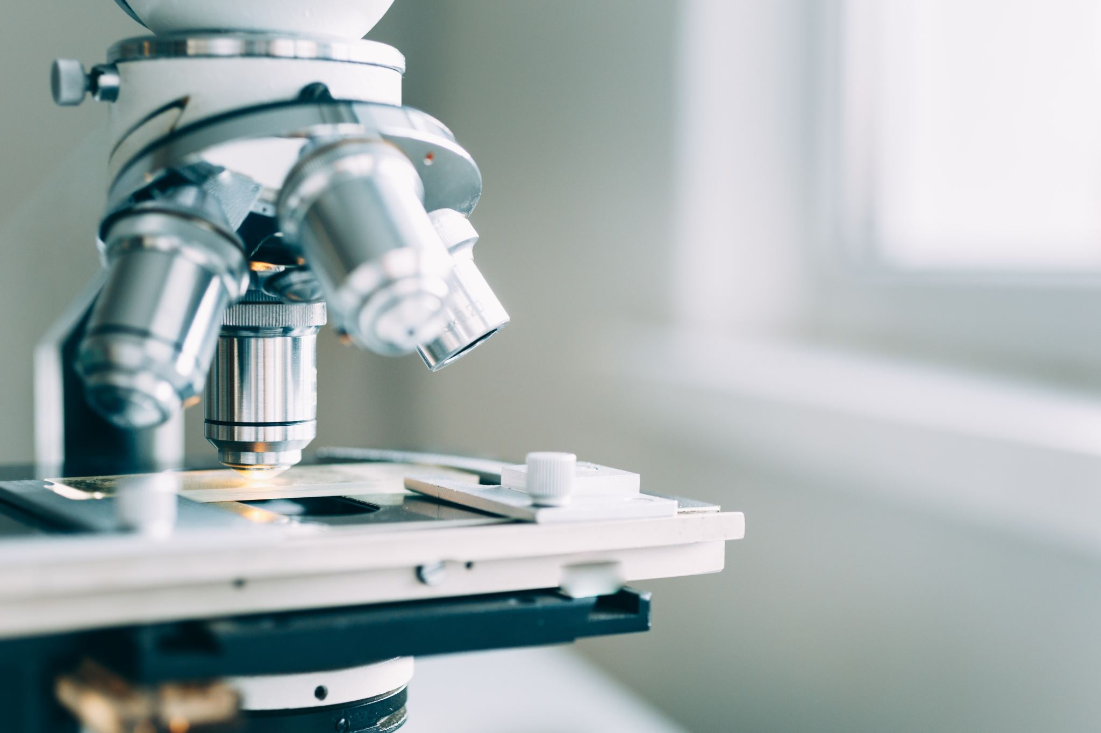
Practice Recommendations
Current American Gastroenterological Association guidelines recommend long-term PPIs for confirmed GERD, for patients taking long-term non-steroidal anti-inflammatory drugs, and for acid-related complications such as erosive and Barrett’s esophagitis
If H pylori is identified in patients with proven or suspected peptic ulcer disease, treatment or H pylori eradication should be started. Numerous treatment regimens are available, nearly all of which include PPIs in addition to antibiotic therapy. However, the FDA recently approved vonoprazan (which blocks acid secretion) as a combination pill with amoxicillin and clarithromycin for triple therapy of H pylori, and studies suggest it is superior to therapy with PPIs plus antibiotics.
After completing treatment for H pylori infection, documentation of H pylori eradication should be performed. However, this testing should occur 4-6 weeks after discontinuation of treatment.
When pathogen identification is needed in patients with diarrhea, classic stool culture is no longer be the recommended first-line test. Non-culture based multiplex nucleic acid amplification tests should performed instead to allow for more rapid simultaneous detection of bacteria, viral and parasitic infections.
For patients with acute pancreatitis, the American Gastroenterological Association guidelines recommend early oral feedings, within 24 hours if tolerated. If not tolerated, enteral feeding via nasogastric or nasojejunal tubes should be begin within the first 24-72 hours. Keeping patients “NPO” is no longer recommended.
For patients with acute pancreatitis, lactated Ringers solution is preferred over normal saline. Moderate-rate fluid administration (5-10 ml/kg/hr) is superior to more aggressive fluid administration.

Slide 43
Freedberg DE, Kim LS, Yang YX. The Risks and Benefits of Long-term Use of Proton Pump Inhibitors: Expert Review and Best Practice Advice From the American Gastroenterological Association. Gastroenterology. 2017;152(4):706-715. doi:10.1053/j.gastro.2017.01.031
Shehryar M, Ahmad RU, Kareem HK, et al. Efficacy, safety, and cost-effectiveness of vonoprazan vs Proton Pump Inhibitors in reflux disorders and H. pylori eradication: A literature review. Ann Med Surg. 2022;82:104760. doi:10.1016/j.amsu.2022.104760
Lanas A, Chan FKL. Peptic ulcer disease. Lancet Lond Engl. 2017;390(10094):613-624. doi:10.1016/S0140-6736(16)32404-7
Chey WD, Leontiadis GI, Howden CW, Moss SF. ACG Clinical Guideline: Treatment of Helicobacter pylori Infection. Off J Am Coll
Gastroenterol ACG. 2017;112(2):212. doi:10.1038/ajg.2016.563Chey WD, Leontiadis GI, Howden CW, Moss SF. ACG Clinical Guideline: Treatment of Helicobacter pylori Infection. Off J Am Coll Gastroenterol ACG. 2017;112(2):212. doi:10.1038/ajg.2016.563
Shah SC, Iyer PG, Moss SF. AGA Clinical Practice Update on the Management of Refractory Helicobacter pylori Infection: Expert Review. Gastroenterology. 2021;160(5):1831-1841. doi:10.1053/j.gastro.2020.11.059
Source: Shane AL, Mody RK, Crump JA, et al. 2017 Infectious Diseases Society of America Clinical Practice Guidelines for the Diagnosis and Management of Infectious Diarrhea. Clin Infect Dis. 2017;65(12):e45-e80. doi:10.1093/cid/cix669
Source: Song J, Zhong Y, Lu X, et al. Enteral nutrition provided within 48 hours after admission in severe acute pancreatitis: A systematic review and meta-analysis. Medicine (Baltimore). 2018;97(34):e11871. doi:10.1097/MD.0000000000011871
Evidence Rating: SORT A Consistent evidence from meta-analyses of RCTs
Sources:
Iqbal U, Anwar H, Scribani M. Ringer’s lactate versus normal saline in acute pancreatitis: A systematic review and meta-analysis. J Dig Dis. 2018;19(6):335-341. doi:10.1111/1751-2980.12606
de-Madaria E, Buxbaum JL, Maisonneuve P, et al. Aggressive or Moderate Fluid Resuscitation in Acute Pancreatitis. N Engl J Med. 2022;387(11):989-1000. doi:10.1056/NEJMoa2202884
Bailey, Justin FP Essentials Gastrointestinal Intestinal Conditions, Accepted for publication, Publication pending

