Slide 1
Gastric Intestinal Metaplasia (GIM)
Friday, November 3, 2023
AAPCE Annual Scientific Congress, Orlando, Florida
Andrew W. Swartz, MD (Andy)
Board Certified Family Physician
Emergency Medicine Physician
GI Endoscopist
Flight Surgeon, Alaska Air National Guard (Lt Col)

Slide 2
Disclosures
COI’s
Am a member of a profession (and specialty) which profits from illness and it’s treatment
No financial interest in any patents or products
Not trying to get any votes
Not paid for this presentation
Biases
Practice in fear of the legal liability associated with “missing something”
Am a member of a society whose health care system is in financial jeopardy
I thoroughly enjoy determining what is wrong with someone and fixing it

Slide 3
Objectives
Understand the two major types of gastric cancer
Understand the Correa Cascade
    Role of H. pylori
    Significance of intestinal metaplasia
Understand the implications of the Correa cascade upon EGD screening for gastric cancer
Understand how to manage Intestinal Metaplasia
    Current guidelines
    Quick access to this information

Slide 4
Outline
Terms
Gastric Cancer: view from 30,000 feet
GIM
  Significance
    Correa cascade
  Diagnosis + classification
  Management
    Treatment of H. pylori
    Surveillance
Guidelines
Evidence
H. pylori Asian Enigma

Slide 5
Terms
Gastric Cancer (GCa)
Gastric Intestinal Metaplasia (GIM or IM)
Correa Cascade
Diffuse Gastric Cancer
H. Pylori Asian enigma

Slide 6
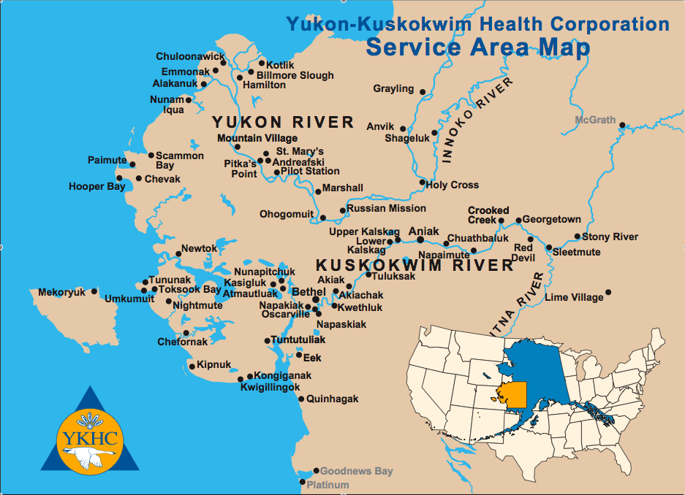

Slide 7

Bethel, Alaska

Slide 8
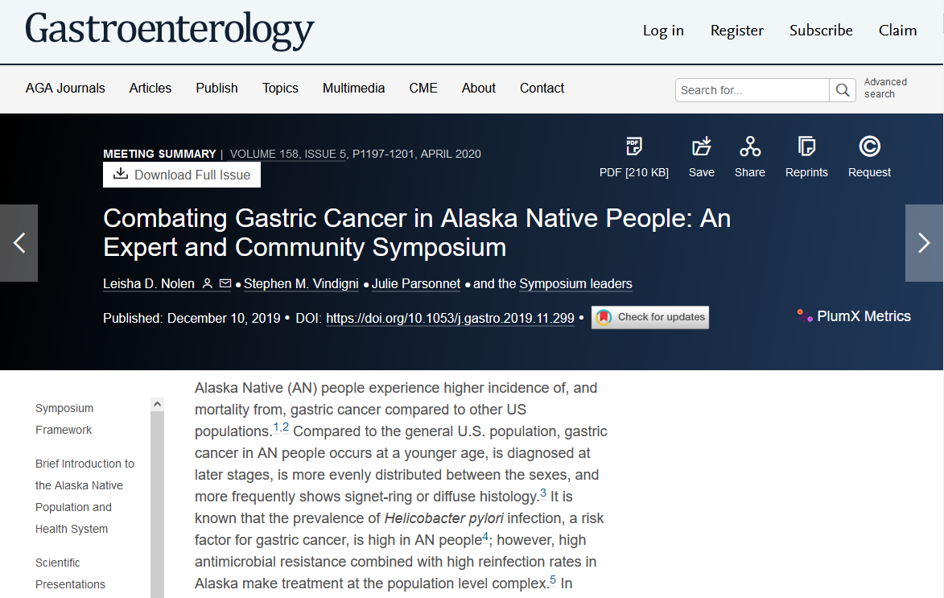

Slide 9
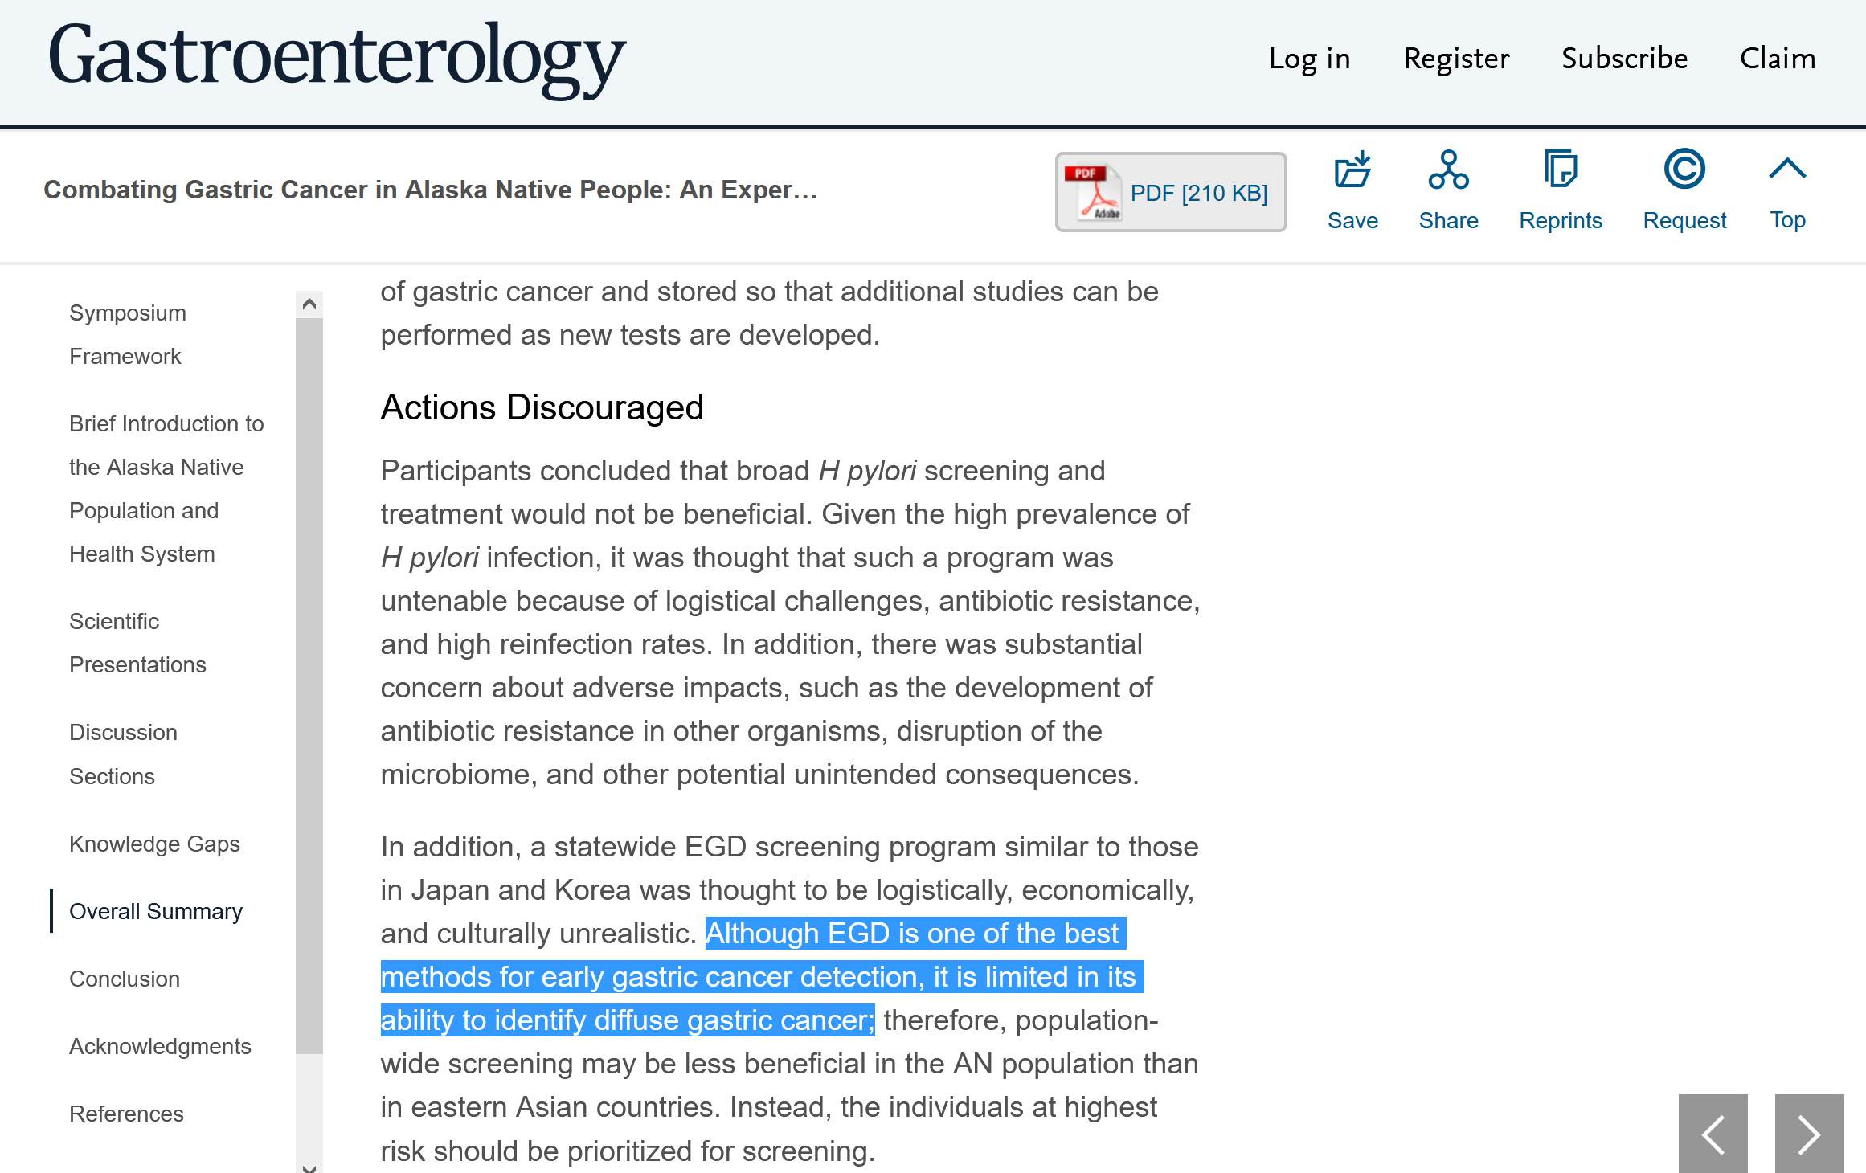

Slide 10

Gastric Cancer: From 30,000 feet

Slide 11
“Histologically, stomach carcinoma is almost always adenocarcinoma”¹
1. Schneider AS, Szanto PA. Pathology. Williams & Wilkins ; Harwal; 1993.

Slide 12
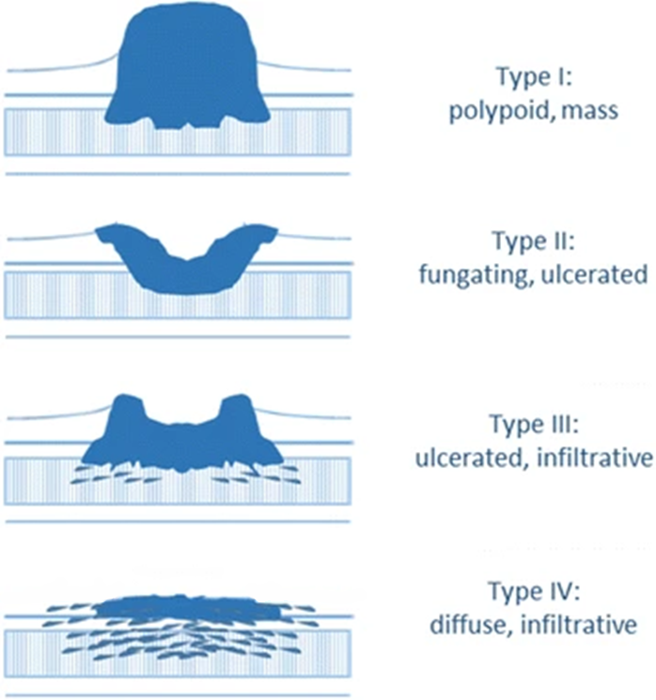
Borrmann¹
Lauren¹
Intestinal
sporadic
diffuse
hereditary
Agnes A, Estrella JS, Badgwell B. The significance of a nineteenth century definition in the era of genomics: linitis plastica. World J Surg Onc. 2017;15(1):123. doi:10.1186/s12957-017-1187-3

Slide 13
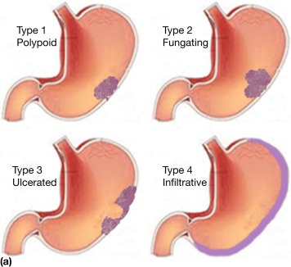
Borrmann types

Slide 14
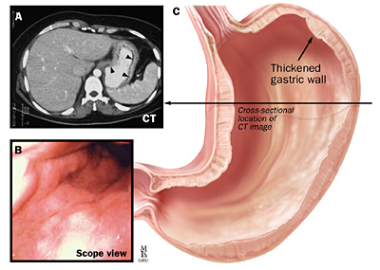
Diffuse Gastric Cancer

Slide 15
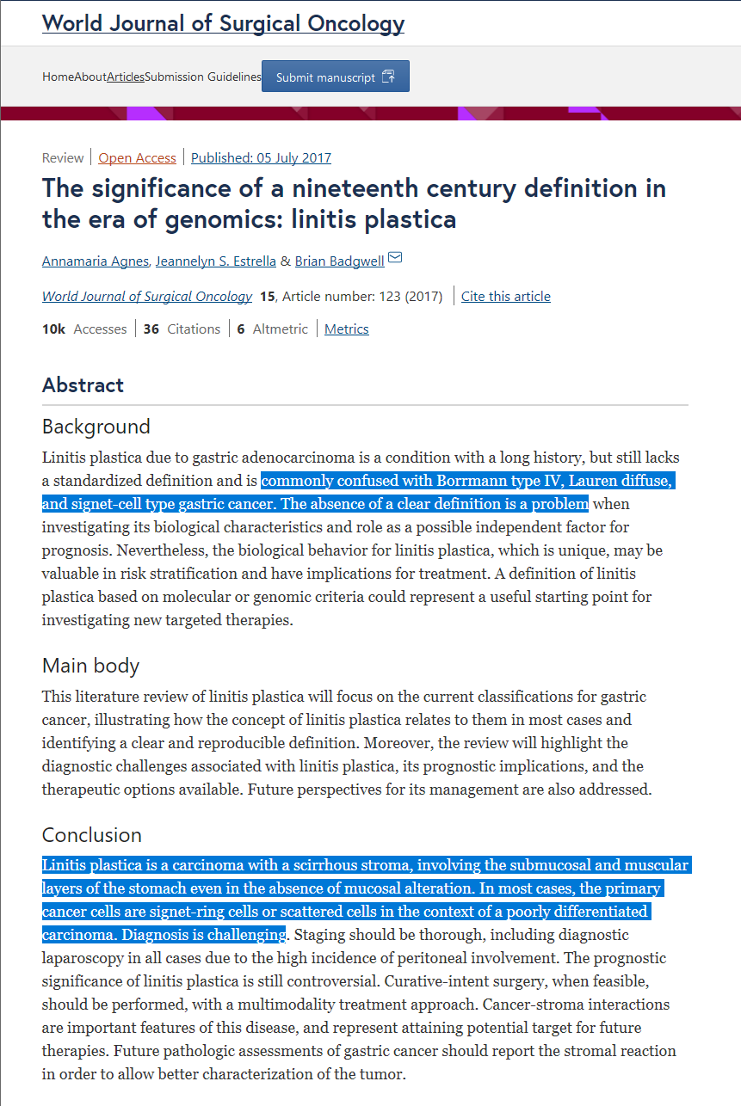

Slide 16
Gastric Cancer: view from 30,000 feet
“Histologically, stomach carcinoma is almost always adenocarcinoma.”¹
“Gastric carcinoma may assume a wide variety of gross morphological forms such as malignant ulcer, fungating polypoid polypoid and diffuse infiltration of the wall (linitis plastica). Nevertheless, the histologic form is invariably that of adenocarcinoma.”²
Schneider AS, Szanto PA. Pathology. Williams & Wilkins ; Harwal; 1993.
Wheater PR, ed. Basic Histopathology: A Colour Atlas and Text. 2nd ed. Churchill Livingstone; 1991.

Slide 17
Gastric Cancer: view from 30,000 feet
Generally, “diffuse gastric cancer” is synonymous with “hereditary diffuse gastric cancer.”

Slide 18
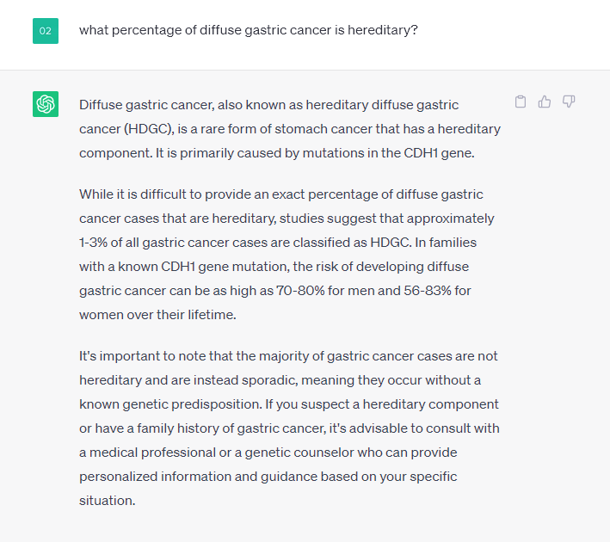
https://chat.openai.com/share/7091dd36-9f74-441c-ac48-54a1a2077648

Slide 19
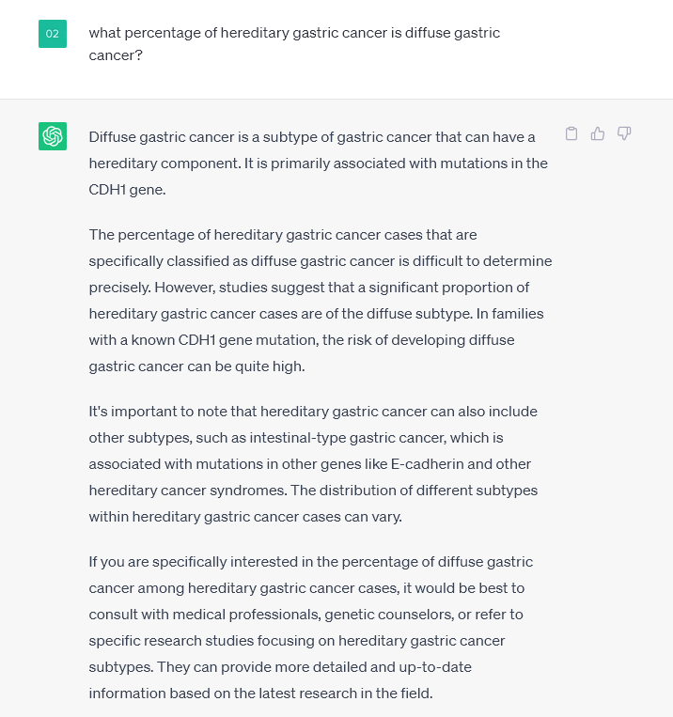

Slide 20
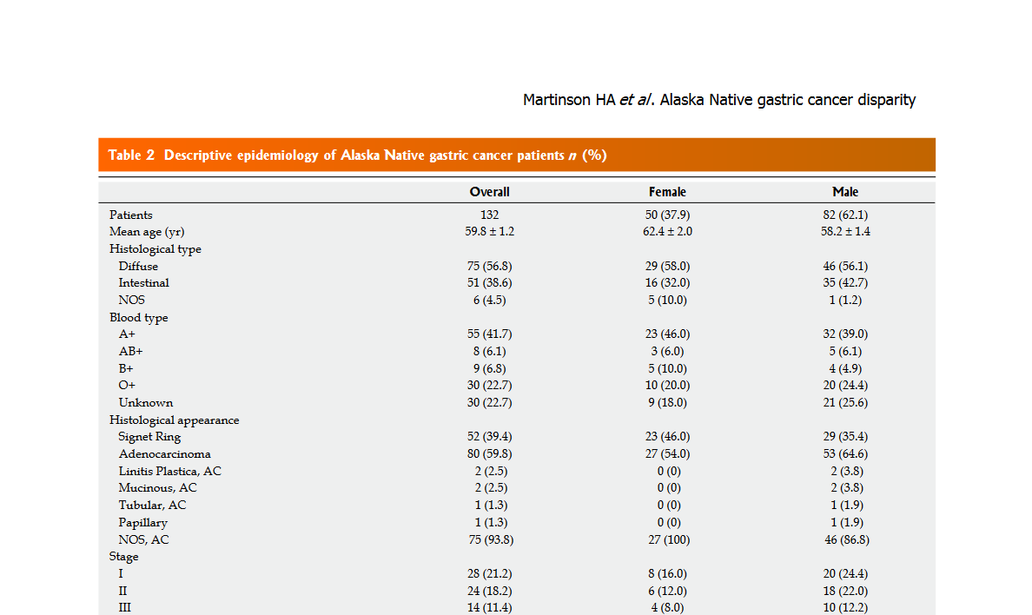
Martinson HA, Shelby NJ, Alberts SR, Olnes MJ. Gastric cancer in Alaska Native people: A cancer health disparity. World J Gastroenterol. 2018 Jul 7;24(25):2722-2732. doi: 10.3748/wjg.v24.i25.2722. PMID: 29991877; PMCID: PMC6034149.

Slide 21
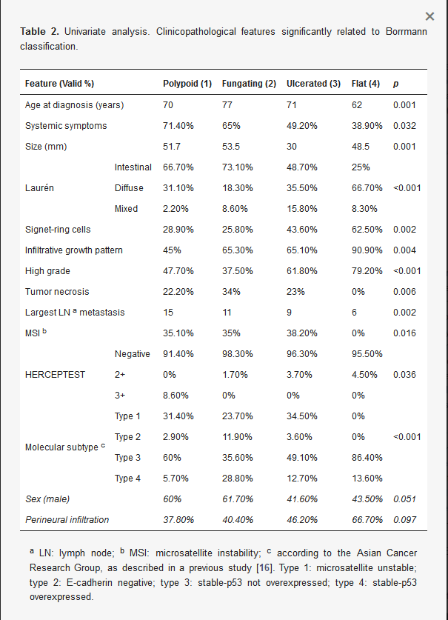

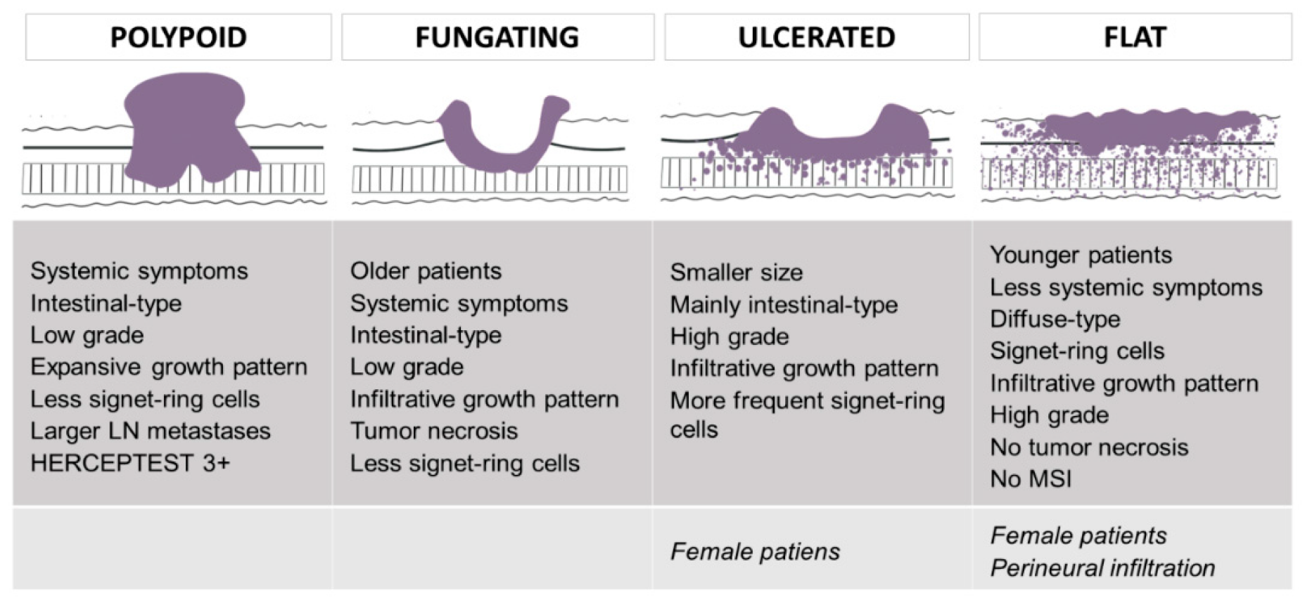
Borrmann Classificaton (1926)
Díaz del Arco C, Ortega Medina L, Estrada Muñoz L, Molina Roldán E, Cerón Nieto MÁ, García Gómez de las Heras S, Fernández Aceñero MJ. Are Borrmann’s Types of Advanced Gastric Cancer Distinct Clinicopathological and Molecular Entities? A Western Study. Cancers. 2021; 13(12):3081. https://doi.org/10.3390/cancers13123081

Slide 22
Gastric Cancer: view from 30,000 feet
Gastric adenocarcinoma
  Lauren classification (1965)
    Intestinal type
    Diffuse type (a.k.a. diffusely infiltrating)
        Signet ring cell
        Lauren diffuse
        Hereditary Diffuse
        Linitis plastica
“interchangeable terms”
Vs.
“frequently confused”

Slide 23
GIM

Slide 24
Vignette
You perform a diagnostic EGD on a 63yo male with a 12 month history of mild, vague, epigastric pain which is unrelieved by proton pump inhibitor therapy.
You note some mild erythema in the gastric antrum and obtain two random biopsies.
Four days later the pathology report arrives:
  intestinal metaplasia, no H. pylori
  intestinal metaplasia, no H. pylori

Slide 25
Why is GIM Important?
Pooled prevalence of GIM among 897,371 individuals with gastric biopsies was estimated to be 4.8% (95% CI, 4.8%–4.9%).¹⁰
As such, the panel recognizes that any recommendations for surveillance of GIM could impact a significant proportion of individuals undergoing endoscopy with biopsy.
A limitation of this meta-analysis is that most of the data were from a single study reporting on prevalence of GIM among gastric biopsies routinely submitted for pathologic review to a single national gastrointestinal pathology service company in the United States.¹
¹Gupta S, Li D, El Serag HB, et al. AGA Clinical Practice Guidelines on Management of Gastric Intestinal Metaplasia. Gastroenterology. 2020;158(3):693-702. doi:10.1053/j.gastro.2019.12.003

Slide 26
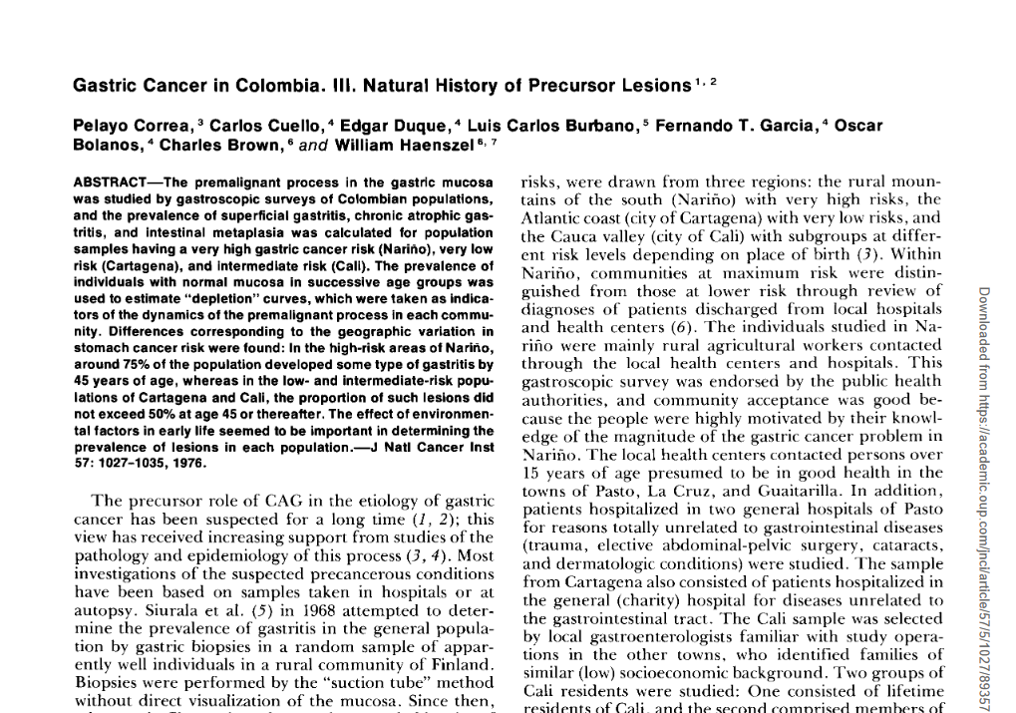
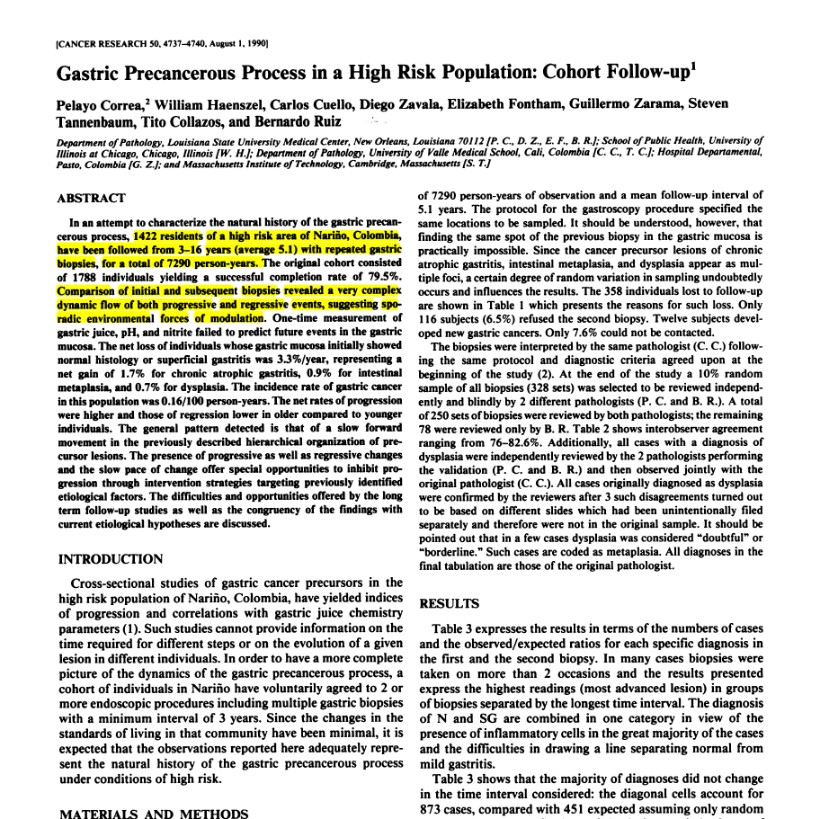
1976
1990

Slide 27
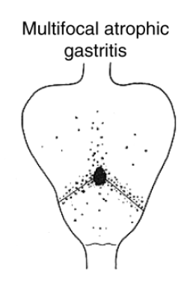
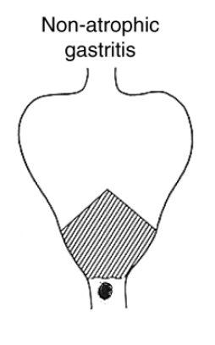
Correa Cascade
Figure 1
Schematic representation of the main clinical outcomes of Helicobacter pylori (H. pylori) infection. The right side of the figure shows the sequential steps of the precancerous cascade.
Correa P, Haenszel W, Cuello C, et al. Gastric precancerous process in a high risk population: cohort follow-up. Cancer Res. 1990;50(15):4737-4740.

Slide 28
Correa Cascade
Complete IM (small bowel)
Incomplete IM (colonic)
Low-grade dysplasia
High-grade dysplasia
Figure 1
Schematic representation of the main clinical outcomes of Helicobacter pylori (H. pylori) infection. The right side of the figure shows the sequential steps of the precancerous cascade.

Slide 29
Correa Cascade
Complete IM (small bowel)
Incomplete IM / Low-grade dysplasia
High-grade dysplasia
Figure 1
Schematic representation of the main clinical outcomes of Helicobacter pylori (H. pylori) infection. The right side of the figure shows the sequential steps of the precancerous cascade.

Slide 30
Correa Cascade
Figure 1
Schematic representation of the main clinical outcomes of Helicobacter pylori (H. pylori) infection. The right side of the figure shows the sequential steps of the precancerous cascade.

Slide 31
Correa Cascade
Figure 1
Schematic representation of the main clinical outcomes of Helicobacter pylori (H. pylori) infection. The right side of the figure shows the sequential steps of the precancerous cascade.

Slide 32
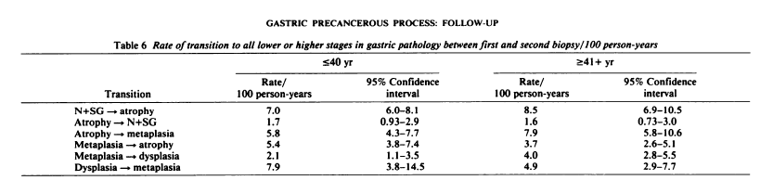
Correa P, Haenszel W, Cuello C, et al. Gastric precancerous process in a high risk population: cohort follow-up. Cancer Res. 1990;50(15):4737-4740.

Slide 33
Correa Cascade
Correa P, Haenszel W, Cuello C, et al. Gastric precancerous process in a high risk population: cohort follow-up. Cancer Res. 1990;50(15):4737-4740.

Slide 34
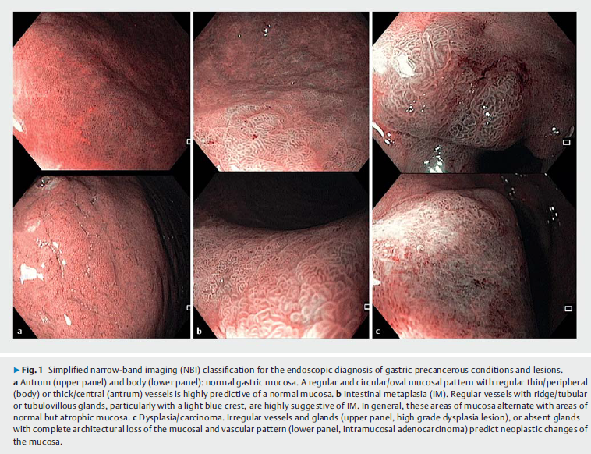
Optical Diagnosis: Narrow-band imaging
Normal
GIM
Dysplasia/Ca
Antrum
Body
Pimentel-Nunes P, et al. Management of epithelial precancerous conditions and lesions in the stomach (MAPS II): European Society of Gastrointestinal Endoscopy (ESGE), European Helicobacter and Microbiota Study Group (EHMSG), European Society of Pathology (ESP), and Sociedade Portuguesa de Endoscopia Digestiva (SPED) guideline update 2019. Endoscopy. 2019 Apr;51(4):365-388. doi: 10.1055/a-0859-1883. Epub 2019 Mar 6. PMID: 30841008.

Slide 35
Biopsies: The Sydney Protocol (Houston)
a.k.a Mapping

Slide 36
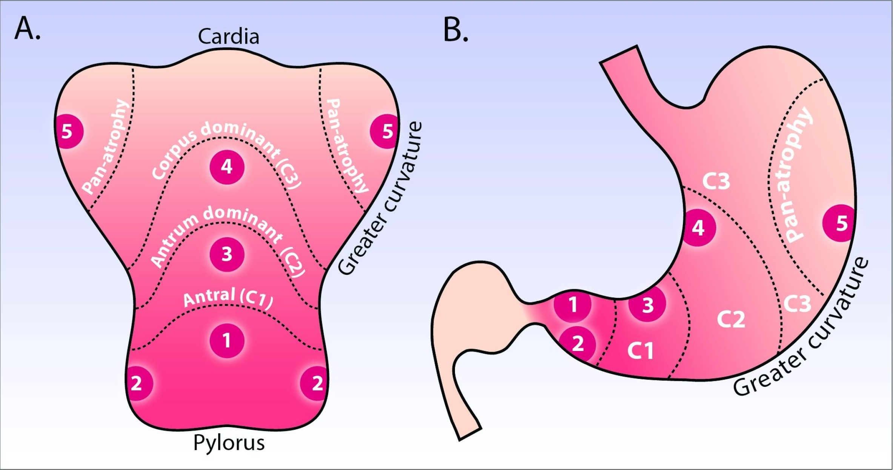
Waddingham W, Graham D, Banks M and Jansen M. The evolving role of endoscopy in the diagnosis of premalignant gastric lesions [version 1; peer review: 4 approved]. F1000Research 2018, 7(F1000 Faculty Rev):715 (https://doi.org/10.12688/f1000research.12087.1)

Slide 37
Surveillance: [Updated] Sydney Biopsy Protocol
Waddingham W, Graham D, Banks M and Jansen M. The evolving role of endoscopy in the diagnosis of premalignant gastric lesions [version 1; peer review: 4 approved]. F1000Research 2018, 7(F1000 Faculty Rev):715 (https://doi.org/10.12688/f1000research.12087.1)

Slide 38
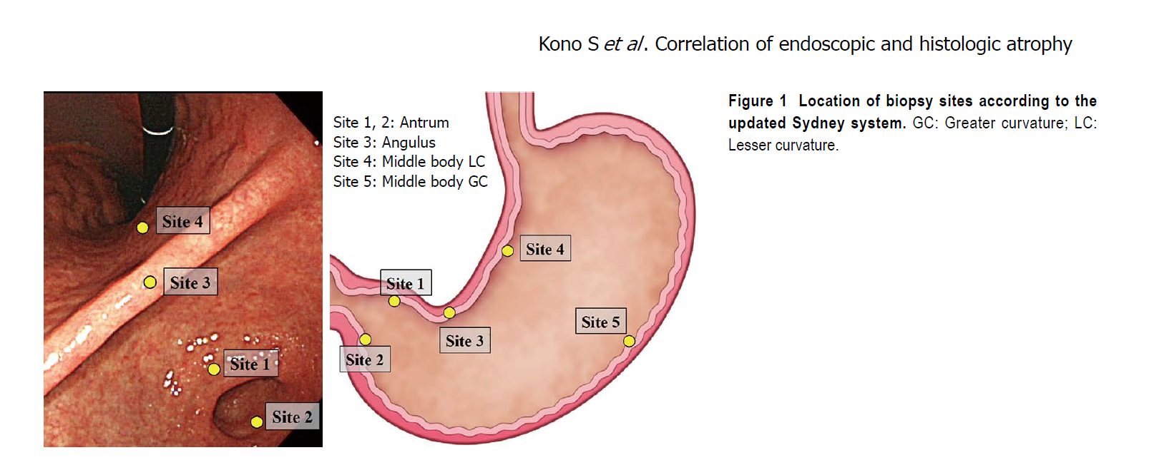
Surveillance: [Updated] Sydney Biopsy Protocol
Kono S, Gotoda T, Yoshida S, et al. Can endoscopic atrophy predict histological atrophy? Historical study in United Kingdom and Japan. World J Gastroenterol. 2015;21(46):13113-13123. doi:10.3748/wjg.v21.i46.13113

Slide 39
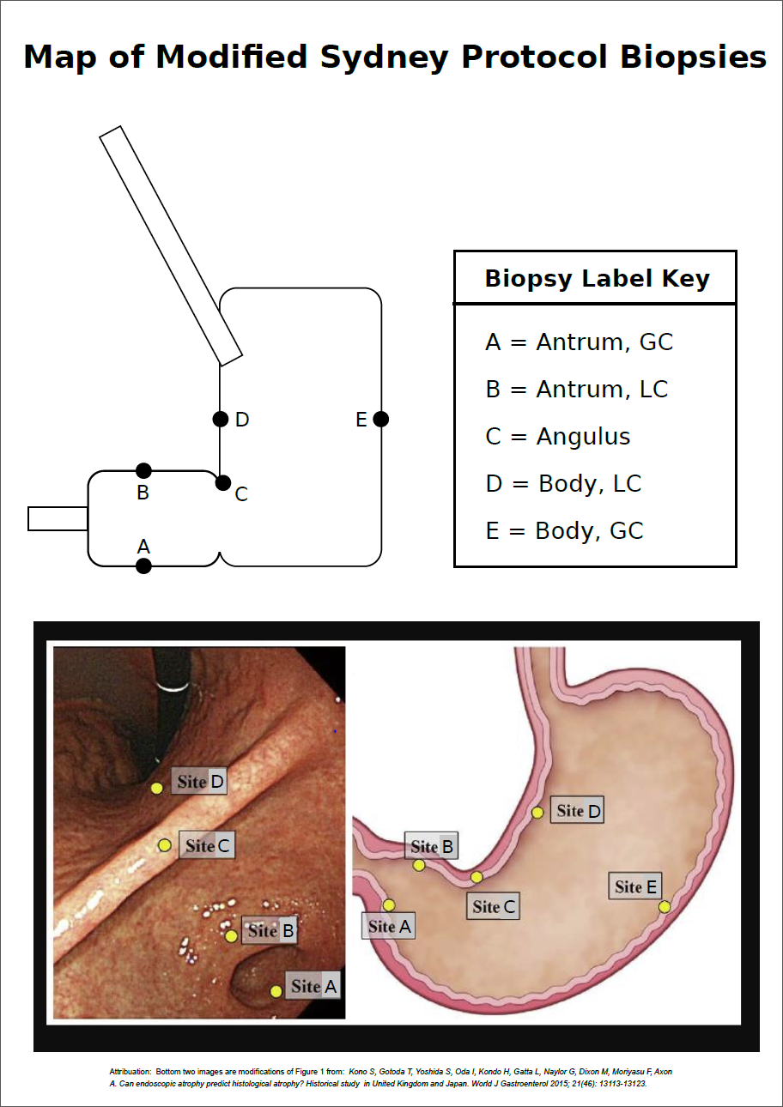

Slide 40
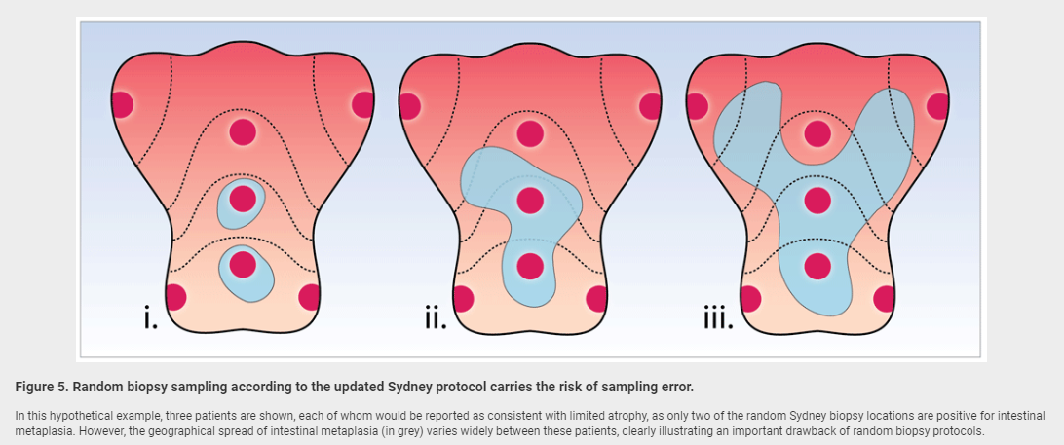
Surveillance: [Updated] Sydney Biopsy Protocol
Potential Sampling Error
Waddingham W, Graham D, Banks M and Jansen M. The evolving role of endoscopy in the diagnosis of premalignant gastric lesions [version 1; peer review: 4 approved]. F1000Research 2018, 7(F1000 Faculty Rev):715 (https://doi.org/10.12688/f1000research.12087.1)

Slide 41
Sydney Protocol biopsies have been obtained.
What next?

Slide 42
OLGA
Figure 1. Gastritis staging: the OLGA system
Rugge M, Meggio A, Pennelli G, Piscioli F, Giacomelli L, De Pretis G, Graham DY. Gastritis staging in clinical practice: the OLGA staging system. Gut. 2007 May;56(5):631-6. doi: 10.1136/gut.2006.106666. Epub 2006 Dec 1. PMID: 17142647; PMCID: PMC1942143.

Slide 43
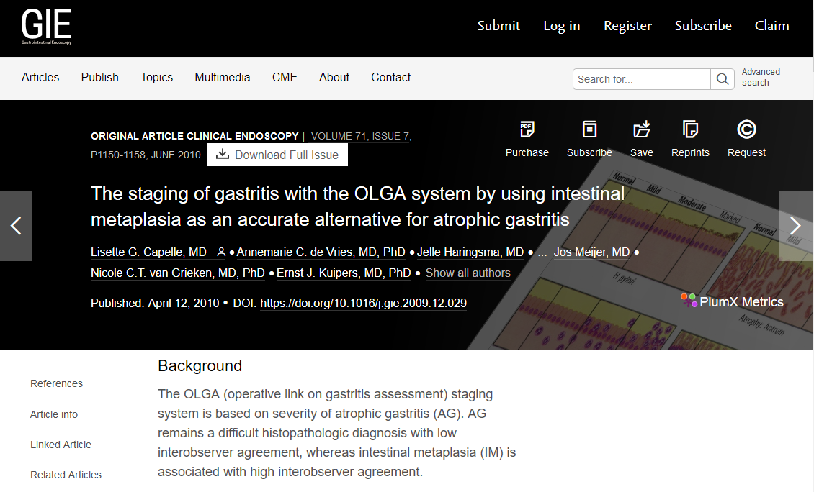
OLGIM

Slide 44
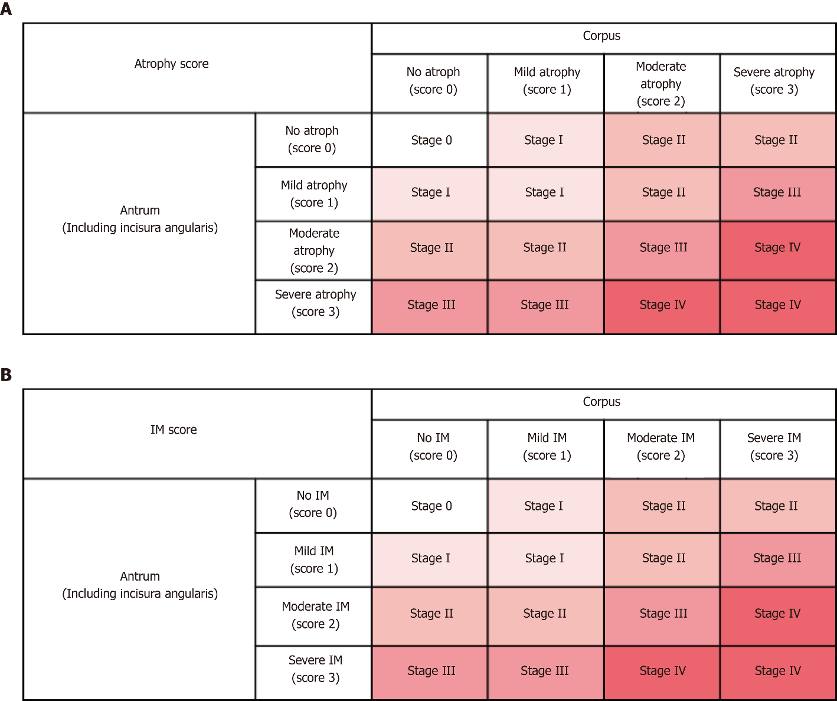
OLGA
OLGIM
Weng CY, Xu JL, Sun SP, Wang KJ, Lv B. Helicobacter pylori eradication: Exploring its impacts on the gastric mucosa. World J Gastroenterol 2021; 27(31): 5152-5170 [PMID: 34497441 DOI: 10.3748/wjg.v27.i31.5152]

Slide 45
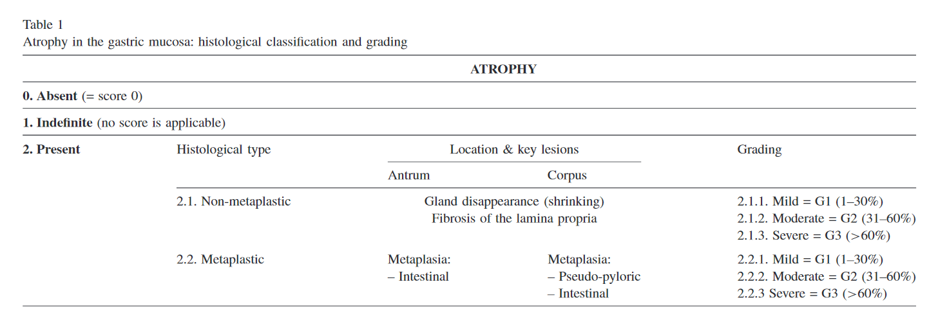
OLGA
Figure 1. Gastritis staging: the OLGA system
Rugge M, Pennelli G, Pilozzi E, Fassan M, Ingravallo G, Russo VM, Di Mario F; Gruppo Italiano Patologi Apparato Digerente (GIPAD); Società Italiana di Anatomia Patologica e Citopatologia Diagnostica/International Academy of Pathology, Italian division (SIAPEC/IAP). Gastritis: the histology report. Dig Liver Dis. 2011 Mar;43 Suppl 4:S373-84. doi: 10.1016/S1590-8658(11)60593-8. PMID: 21459343.

Slide 46
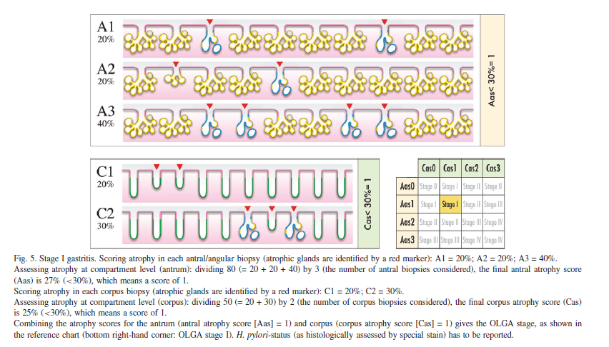
OLGA Scoring
Rugge M, Pennelli G, Pilozzi E, Fassan M, Ingravallo G, Russo VM, Di Mario F; Gruppo Italiano Patologi Apparato Digerente (GIPAD); Società Italiana di Anatomia Patologica e Citopatologia Diagnostica/International Academy of Pathology, Italian division (SIAPEC/IAP). Gastritis: the histology report. Dig Liver Dis. 2011 Mar;43 Suppl 4:S373-84. doi: 10.1016/S1590-8658(11)60593-8. PMID: 21459343.

Slide 47
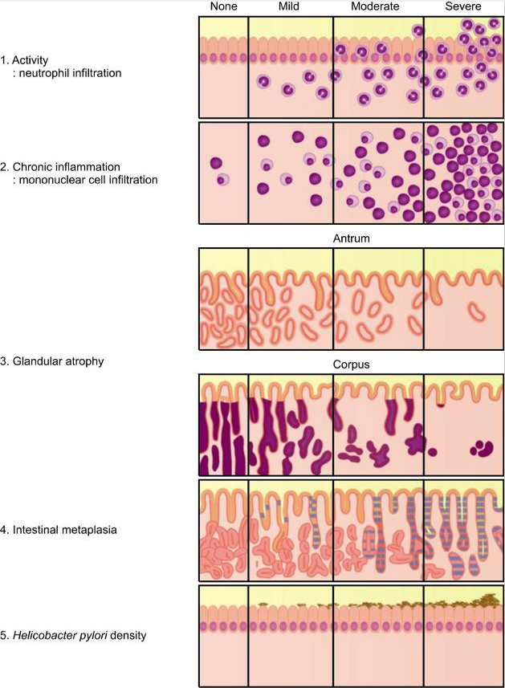
0 1 2 3
Park YH, Kim N. Review of atrophic gastritis and intestinal metaplasia as a premalignant lesion of gastric cancer. J Cancer Prev. 2015 Mar;20(1):25-40. doi: 10.15430/JCP.2015.20.1.25. PMID: 25853101; PMCID: PMC4384712.

Slide 48
Endoscopist: obtains Sydney Protocol biopsies.
Pathologist: reports OLGIM stage.

Slide 49
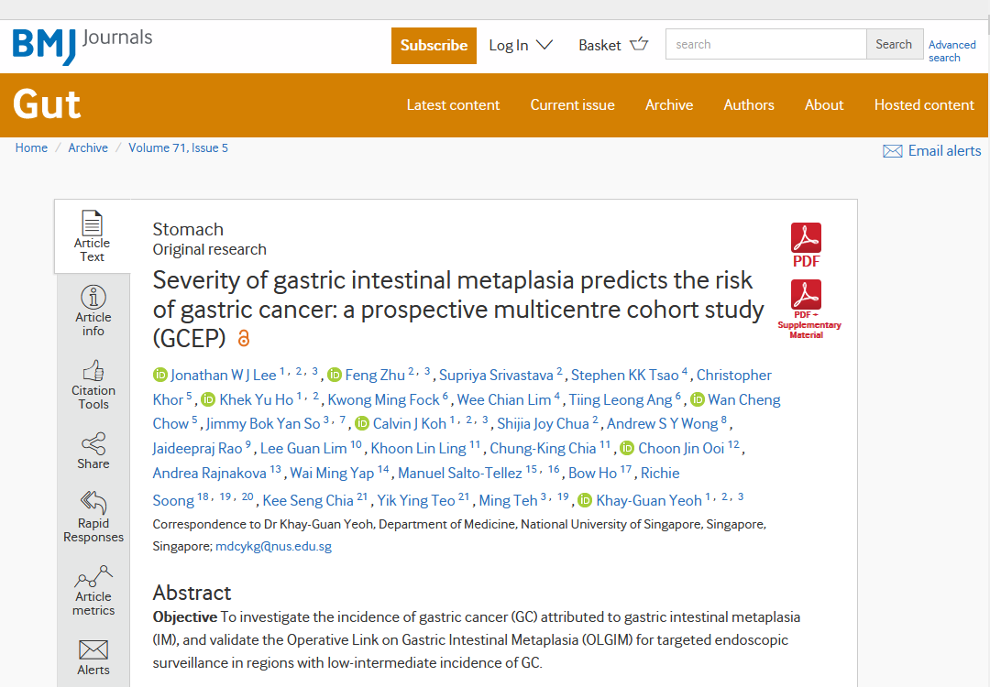
Video Abstract

Slide 50
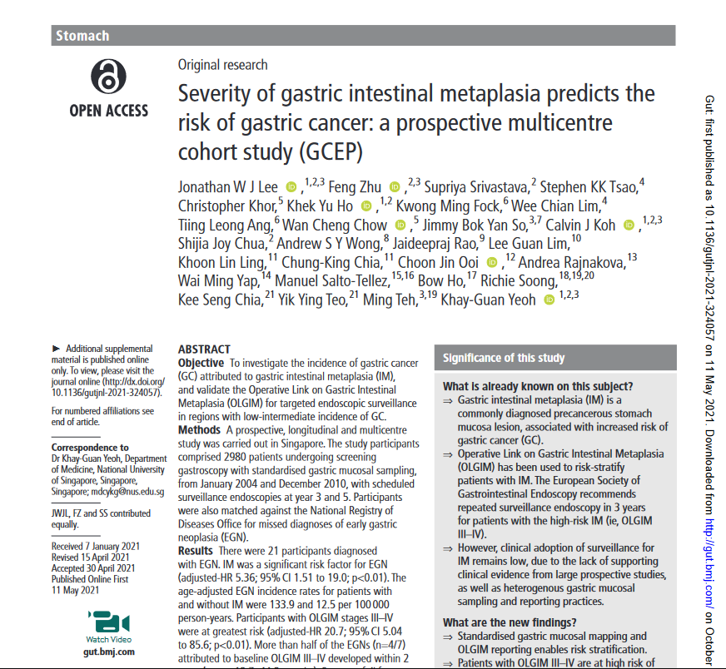
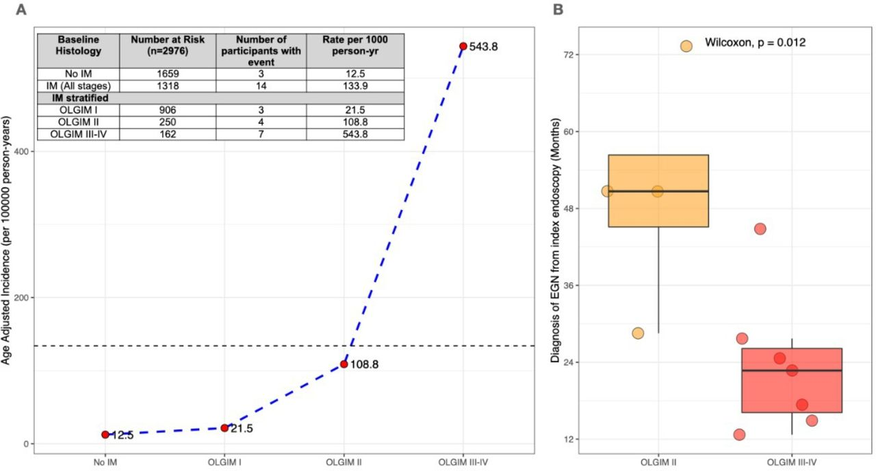

Slide 51
EGGIM
Endoscopic Grading of GIM
Visual grading using
Image Enhanced Endoscopy (IEE)
Narrow-band imaging (NBI)
Linked color imaging (LCI)
Blue laser imaging (BLI)

Slide 52
EGGIM
Endoscopic Grading of GIM
Pimentel-Nunes P, et al. A multicenter prospective study of the real-time use of narrow-band imaging in the diagnosis of premalignant gastric conditions and lesions. Endoscopy. 2016 Aug;48(8):723-30. doi: 10.1055/s-0042-108435. Epub 2016 Jun 9. PMID: 27280384.
Esposito G, et al. Endoscopic grading of gastric intestinal metaplasia (EGGIM): a multicenter validation study. Endoscopy. 2019 Jun;51(6):515-521. doi: 10.1055/a-0808-3186. Epub 2018 Dec 21. PMID: 30577062.
Fang S, Fu Y, Du S, Wang L, et al. The role of the endoscopic grading of gastric intestinal metaplasia in assessing gastric cancer risk: A systematic review and meta-analysis. Front Oncol. 2022 Nov 8;12:1018248. doi: 10.3389/fonc.2022.1018248. PMID: 36425561; PMCID: PMC9679375.

Slide 53
Significance of Grading Schemes
Risk prediction (i.e. accuracy)
Who performs them
Scheme | Who Performs | Cost
Complete v. Incomplete | Pathologist | $$$$
OLGA OLGIM | Pathologist | $$$$
EGGIM | Endoscopist | $

Slide 54
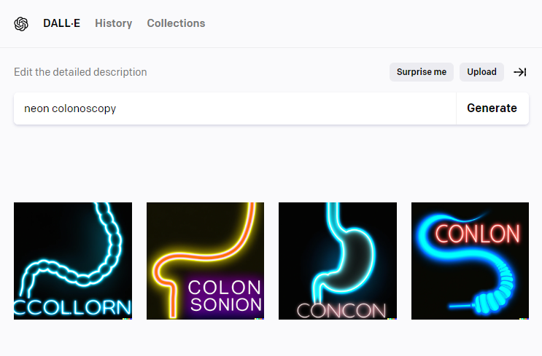

Slide 55


Evidence
10.1002/14651858.CD005583.pub2

Slide 56


Evidence

Slide 57
Risk Stratification Schemes
OLGIM (based upon 5 biopsies)
Complete versus Incomplete
IM subtypes
  Type-1 (complete)
  Type-2 (incomplete)
  Type-3 (incomplete)
Studies conflict as to which scheme better predicts neoplasia risk, but all studies conclude that worse IM is associated with markedly increased risk of neoplasia.

Slide 58
Correa Cascade
Intestinal adenocarcinoma
(i.e. sporadic gastric cancer)
Correa P, Haenszel W, Cuello C, et al. Gastric precancerous process in a high risk population: cohort follow-up. Cancer Res. 1990;50(15):4737-4740.

Slide 59
Implications for Screening for GCa
Gastric cancer screening is most applicable to areas/ethnicities with high rates of sporadic (i.e. intestinal) gastric cancer.
      Korea
      Japan
      Columbia
Early diffuse gastric cancer is poorly detected with imaging or EGD. This includes the vast majority of hereditary (i.e. familial) gastric cancers.

Slide 60
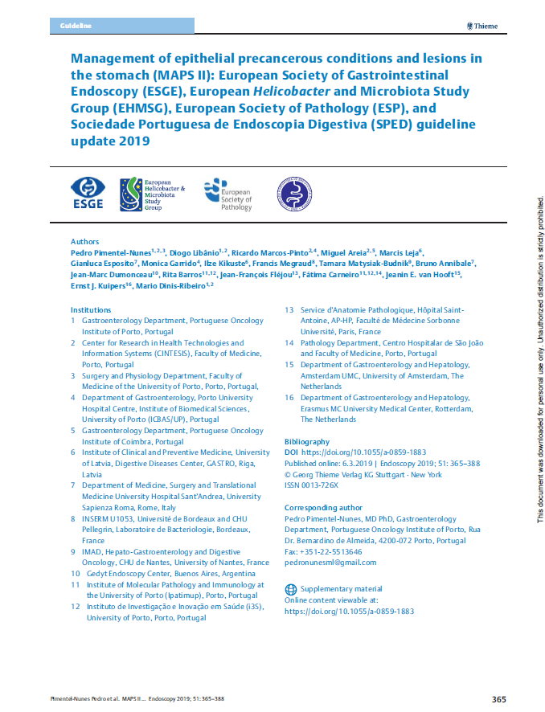
Guidelines

Slide 61
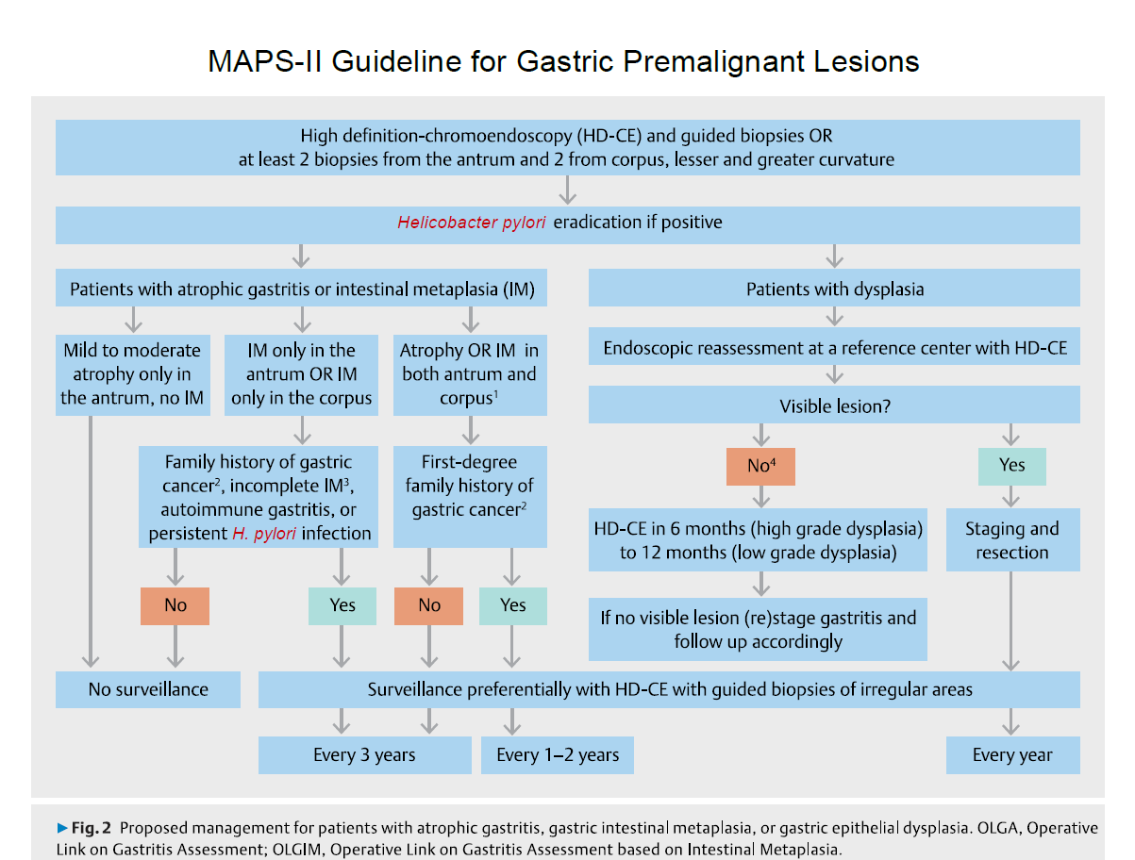

Slide 62
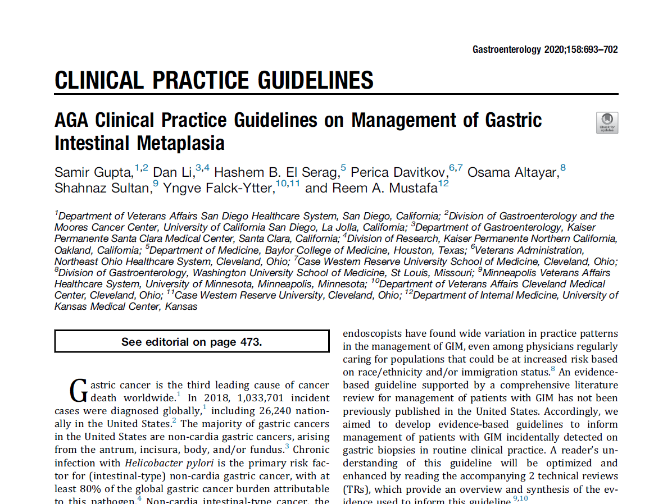

Slide 63
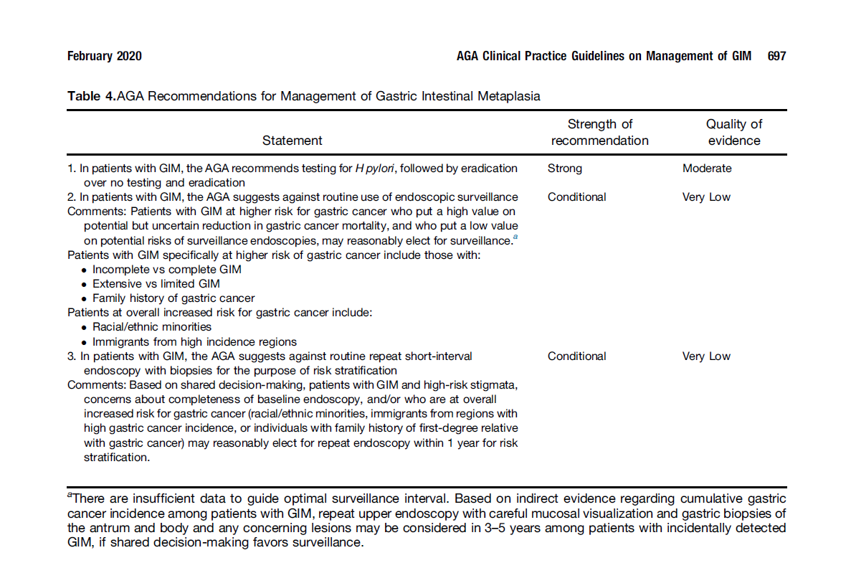

Slide 64
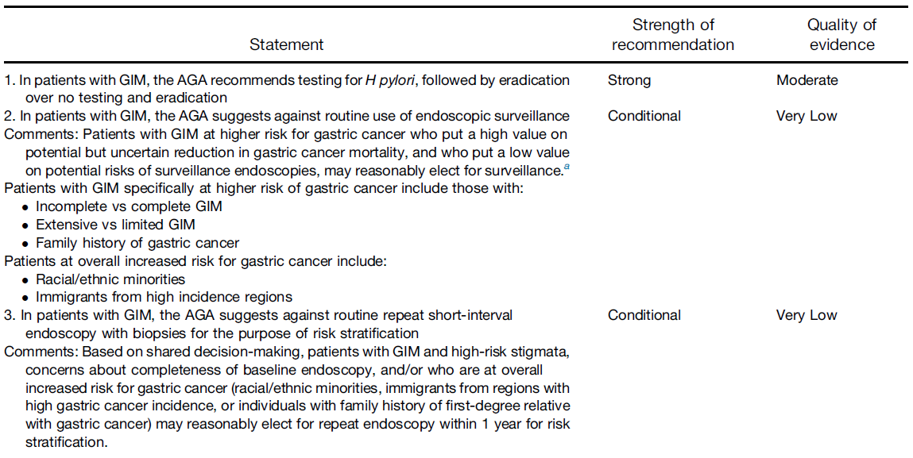
?
Sydney protocol biopsies?
Translation:
If present, eradicate H. pylori
Otherwise, do whatever you judge to be appropriate for your patient

Slide 65
Vignette
You perform a diagnostic EGD on a 63yo male with a 12 month history of mild, vague, epigastric pain which is unrelieved by proton pump inhibitor therapy.
You note some mild erythema in the gastric antrum and obtain two random biopsies.
Four days later the pathology report arrives:
  intestinal metaplasia, no H. pylori
  intestinal metaplasia, no H. pylori
Plan: Treat H. pylori if present.
Consider Sydney protocol biopsies in 1-3 years.
Consider subsequent surveillance per biopsy results and risk factors.

Slide 66
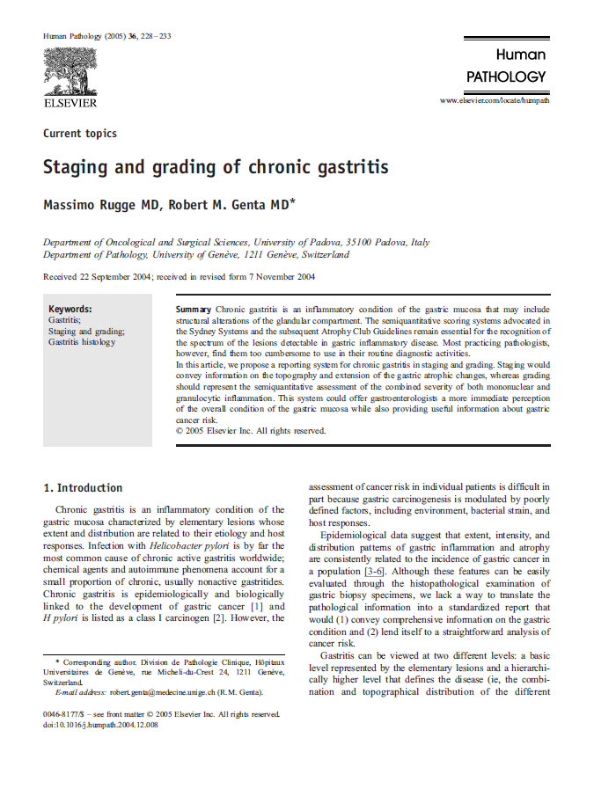
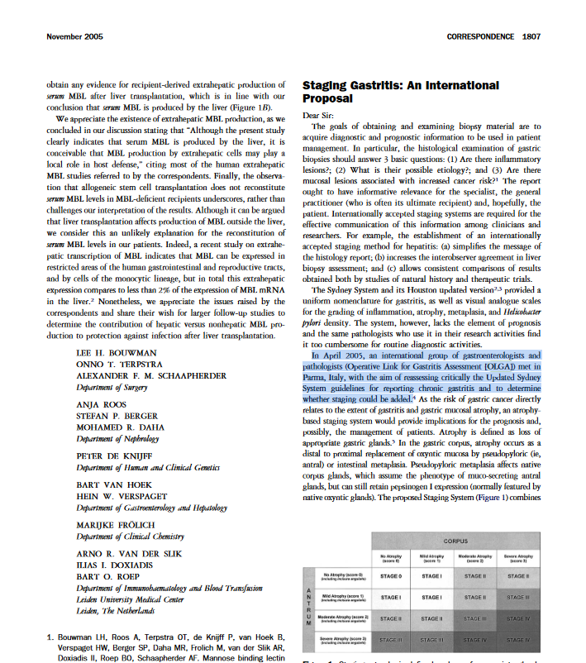

Slide 67
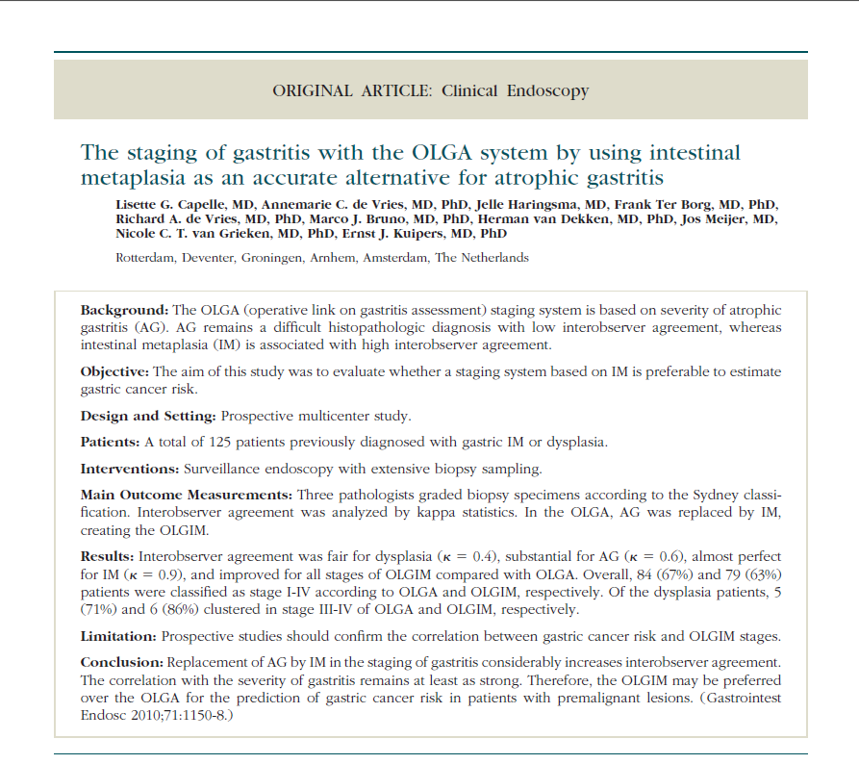
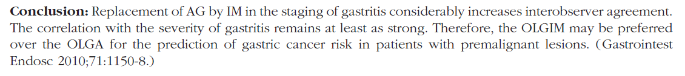

Slide 68
GIM Disease Classifications
(Risk Stratifications)
OLGA → OLGIM
Complete vs. Incomplete
EGGIM
Shoot from the hip?

Slide 69
Takaways
Correa cascade describes the precancerous steps from gastritis to gastric cancer (intestinal type).
  GIM immediately precedes dysplasia.
GIM can be staged with OLGIM.
  Endoscopist obtains Sydney protocol biopsies.
  Pathologist reports OLGIM staging.
  Alternatives: “complete” versus “incomplete”, EGGIM.
There is no RCT evidence pertaining to surveillance of GIM.
Two guidelines for surveillance of GIM:
  MAPS-II (2019)
  ASGE (2020)
Diffuse gastric cancer:
  Synonymous with “hereditary” or “familial”
  not a product of the Correa cascade; relationship to H. pylori is unclear
  is not amenable to screen detection.

Slide 70

Screener’s Dilemma
My dad had gastric cancer. I want to get checked.
Dad
90-95%
5-10%
Sporadic (intestinal)
No increased risk for GCa
Is screen detectable
MUCH more likely to detect GIM
  Surveillance of GIM is possibly beneficial for early detection or prevention of GCa.
Hereditary (diffuse)
Profoundly increased risk
Is NOT screen detectable
Correa cascade / GIM is not in the diffuse cancer developmental pathway

Slide 71


Slide 72
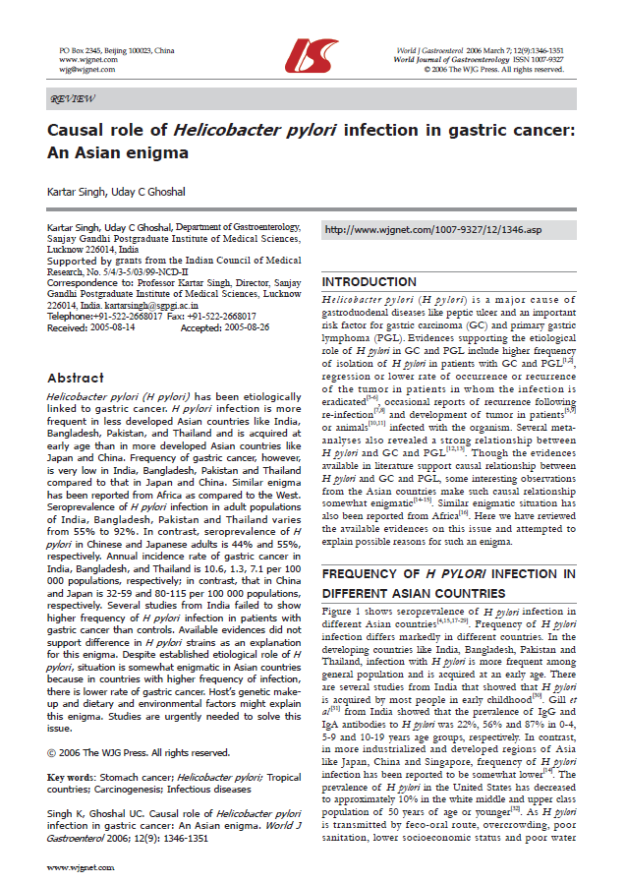
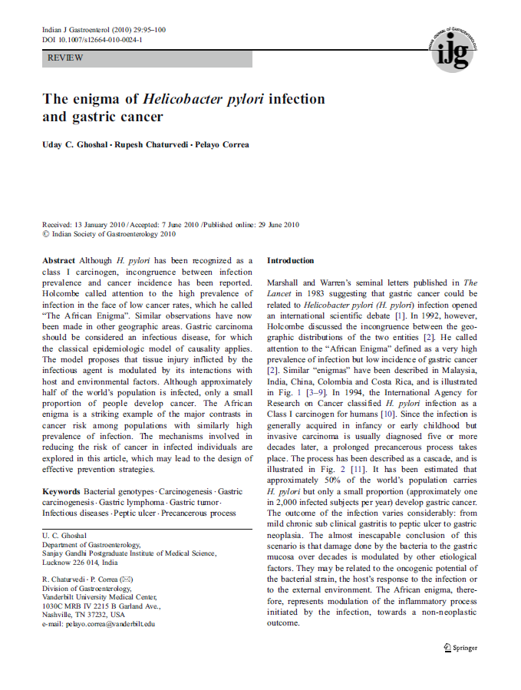

Slide 73
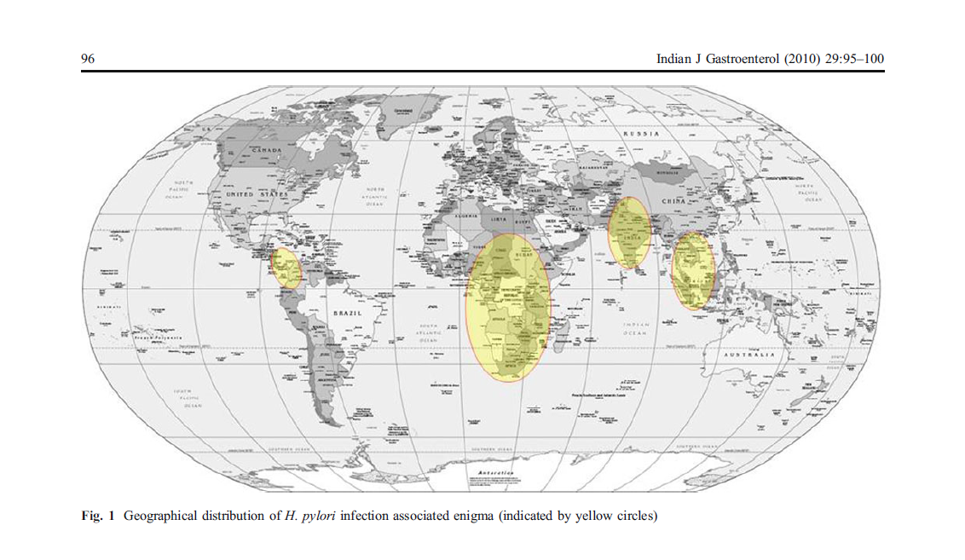

Slide 74
If you think you understand gastric cancer and H. pylori…
.. then you don’t know enough about it.

Slide 75
The End

