Slide 1
Difficult Procedures: Tips & Tricks
AAPCE 2023
Mark Koch, MD FAAFP Dale Agner, MD
JPS Health Network Clarkson Family Medicine
Fort Worth, Texas Omaha, Nebraska

Slide 2
Pre-difficult procedure
Personal details: How do you feel today?
Room temperature
Gurney height
Patient positioning and location on the gurney

Slide 3
Pre-difficult procedure
Where do you stand?
How do you hold the scope?
Where is your monitor?

Slide 4
After you are in a Pickle
Do you know why?
Scene Safety and Risk Evaluation
Decision: Give up and remove scope, Back up or Press on
Re-evaluate ergonomics

Slide 5
Back Up
Deflate, Reduce loops, and withdraw until motion is normal
Reposition and apply abdominal pressure AFTER withdrawing scope
Rotate the scope and approach from a different direction
Force wheel navigation over torque steering

Slide 6
Press On – Cecum in Sight
Don’t spend time on Brownian motion
Use all of your instrument
Rotating Corkscrew

Slide 7
Lesion Visualization
Use simethicone to abolish foam (on insertion)
Rinse lesions and polyps well
Suction BEFORE putting in the snare
Your best view might be retroflexed

Slide 9
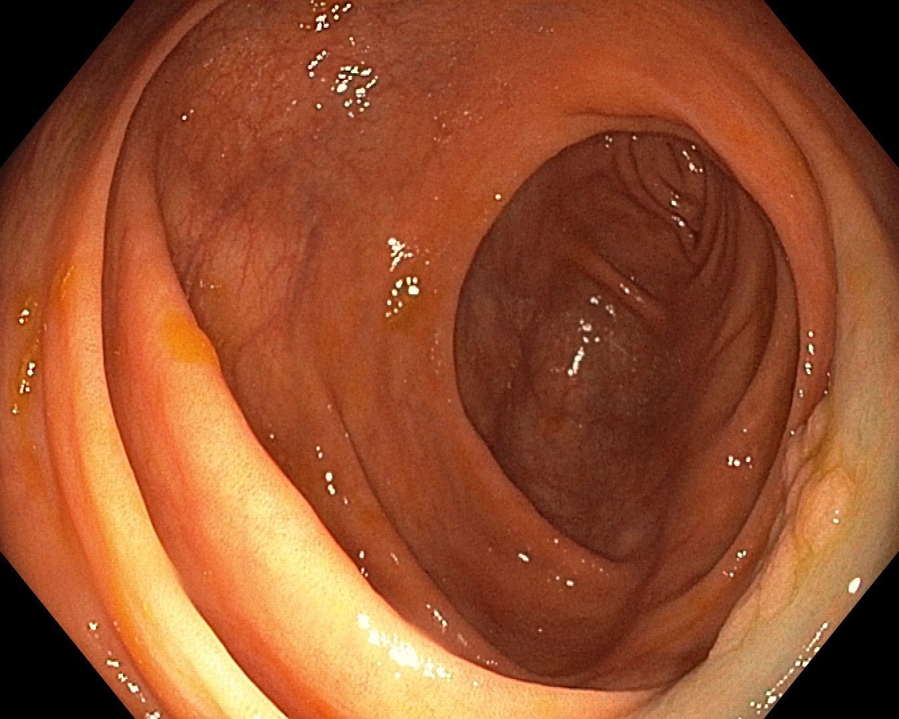
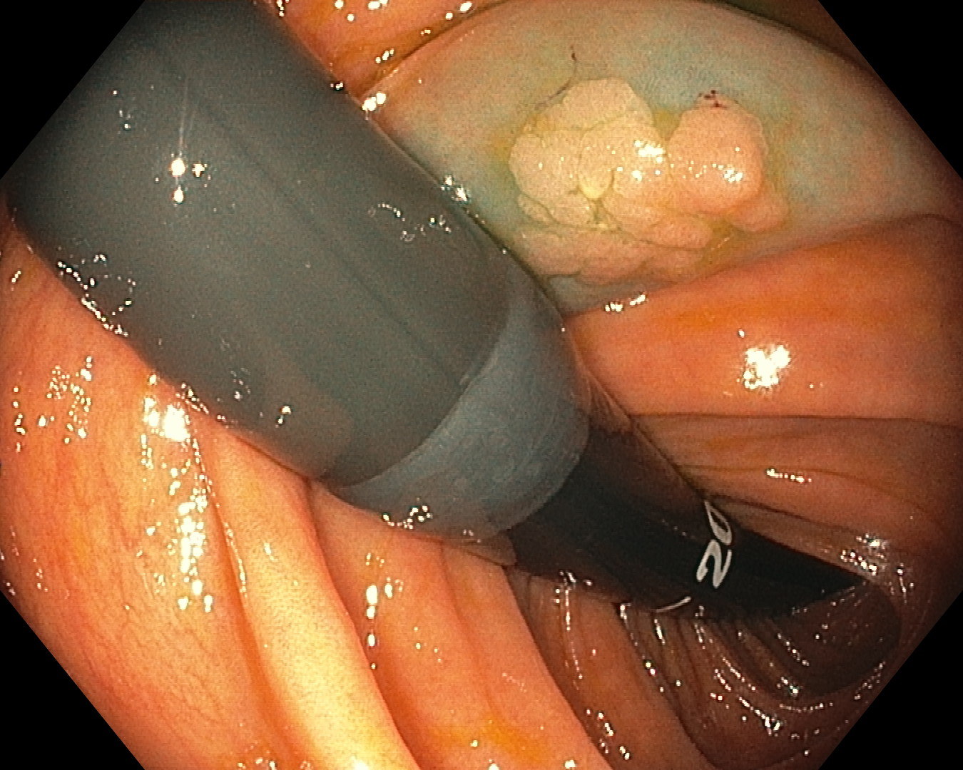
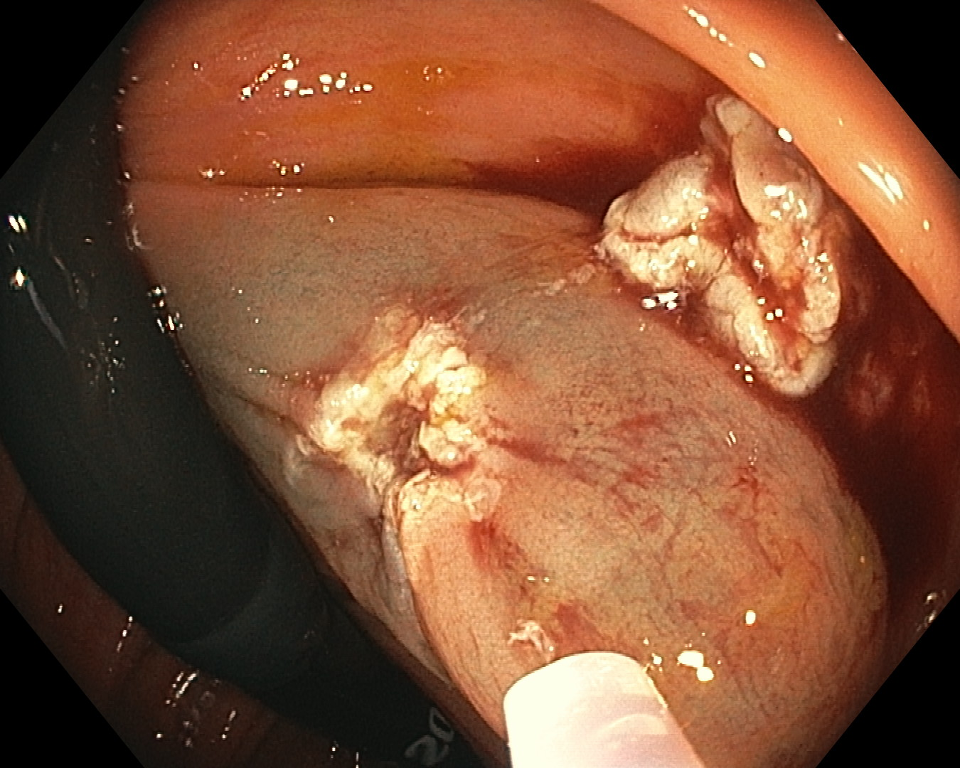

Slide 10
Injections
Inject EMR agent at distal margin of lesion
Allow the fluid to find the plane
Be generous with injection
Use epinephrine before you need it.
Location for tattoo

Slide 11
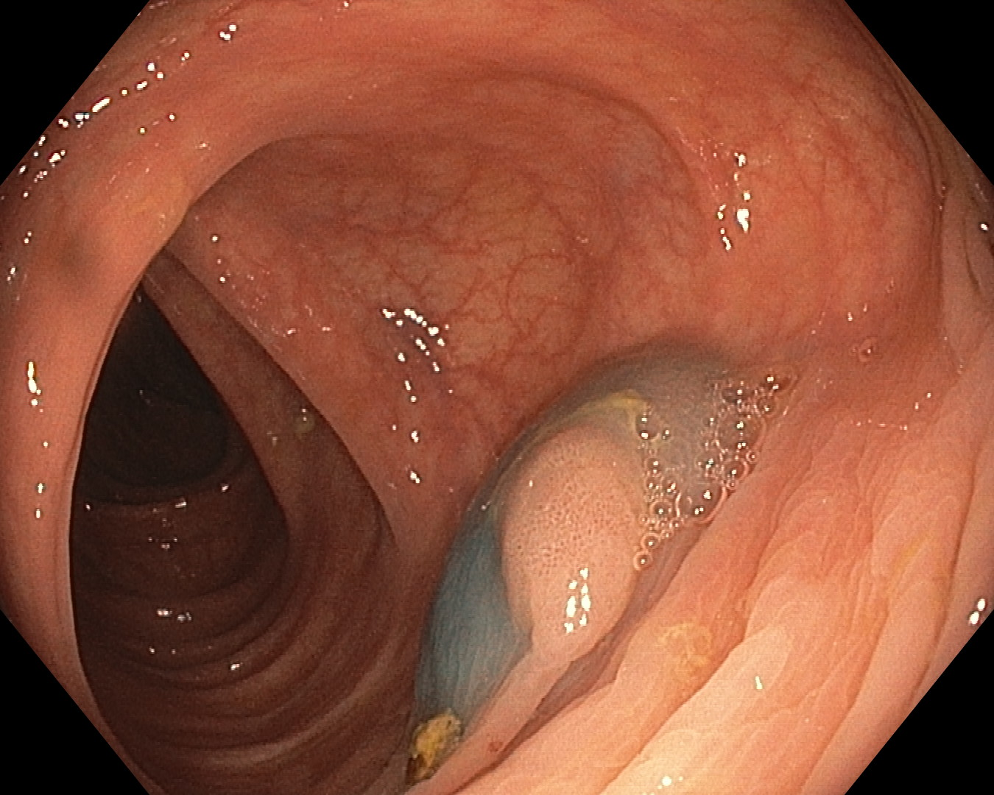
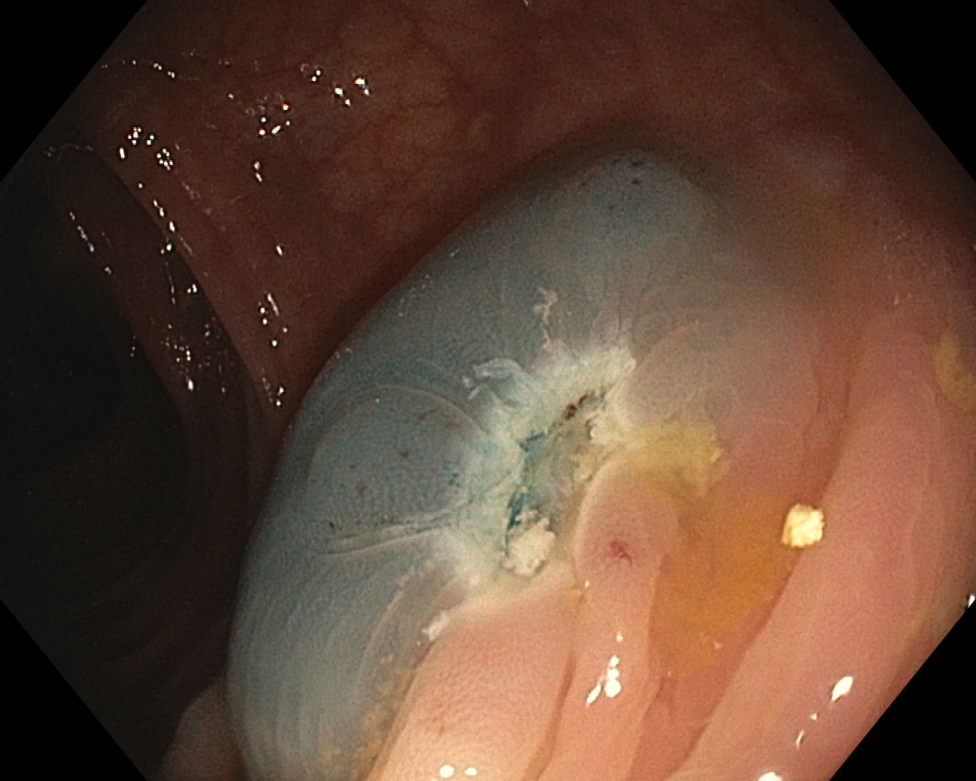

Slide 12
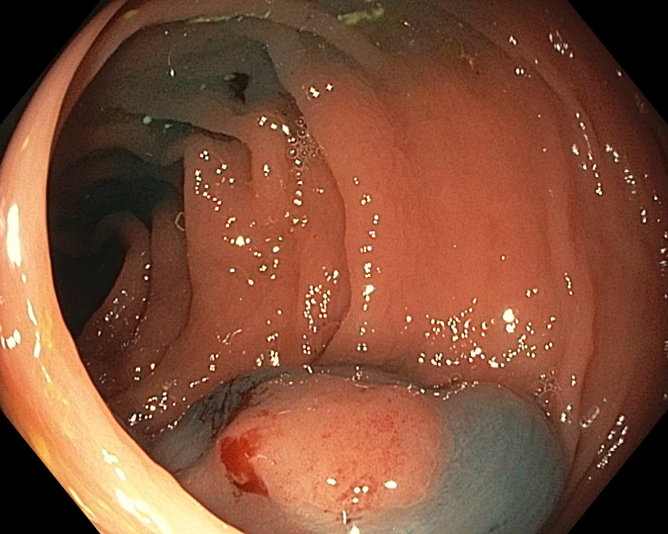
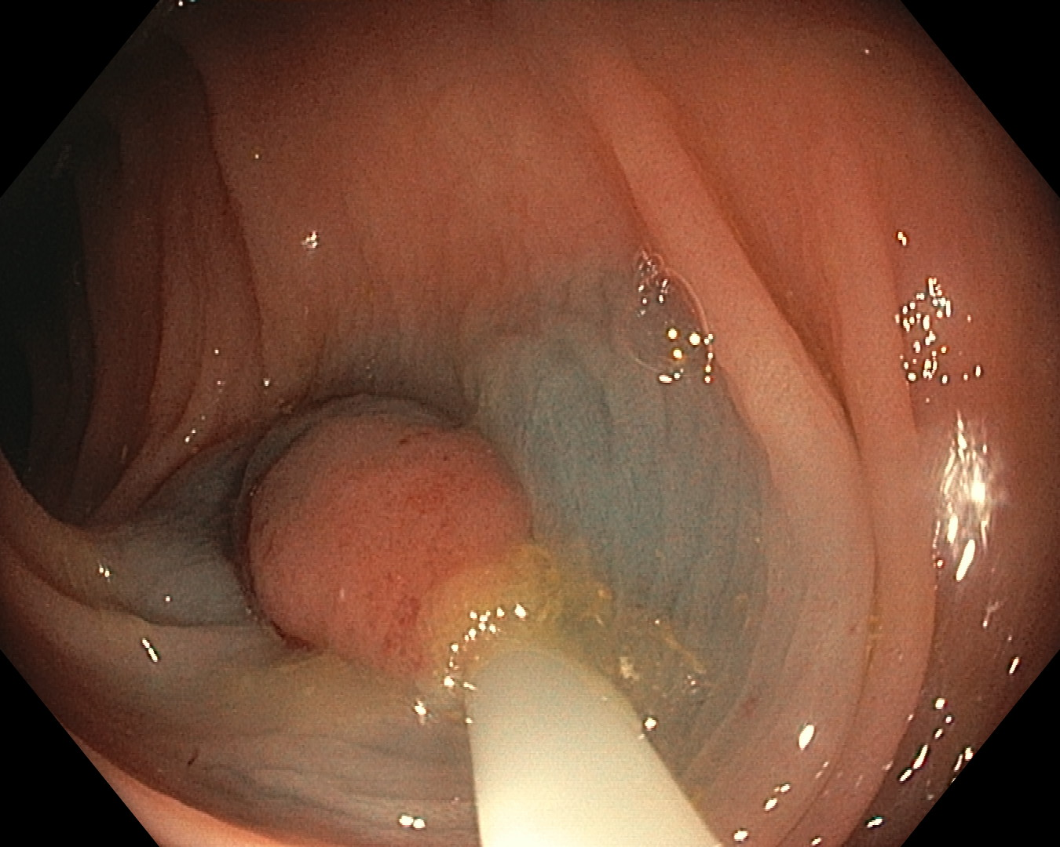
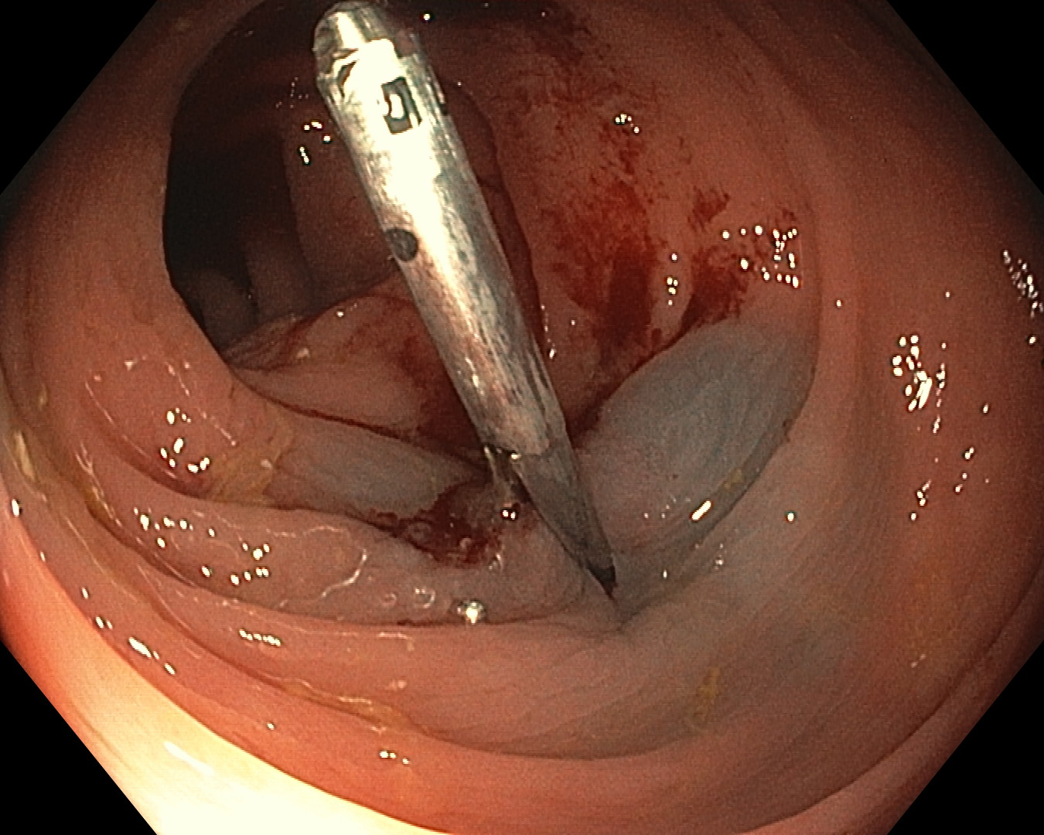

Slide 13
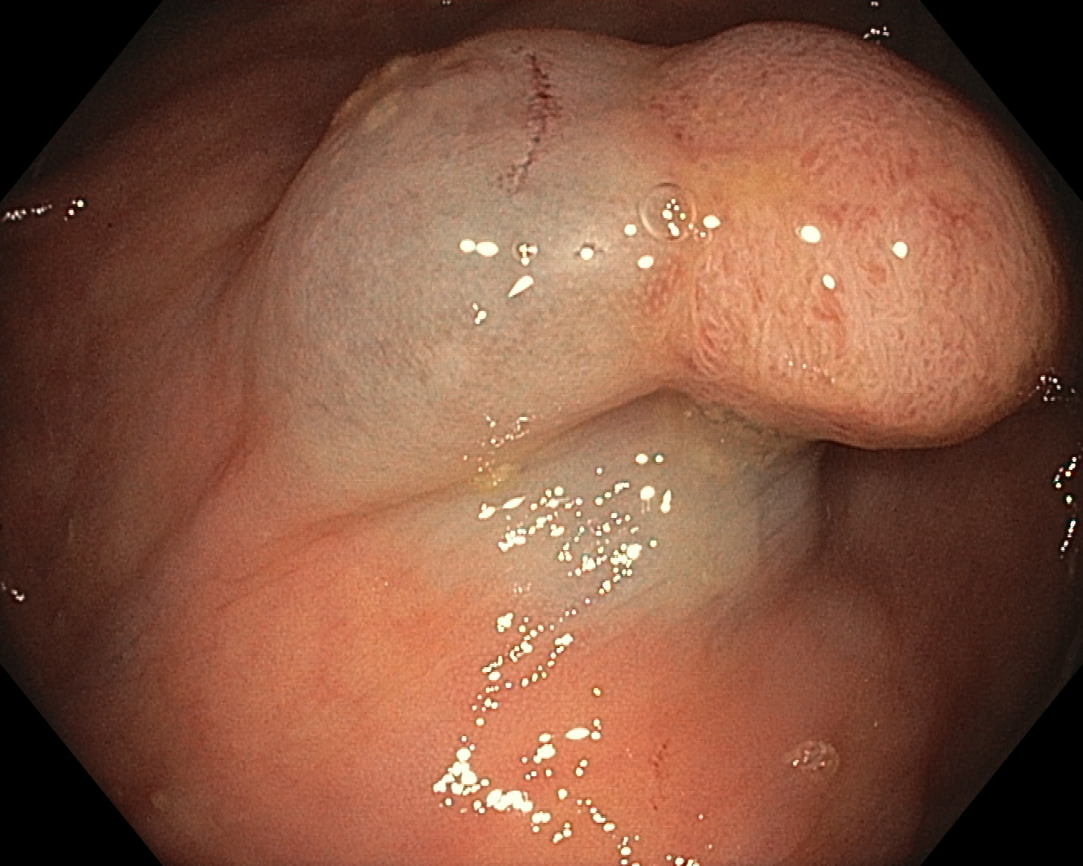
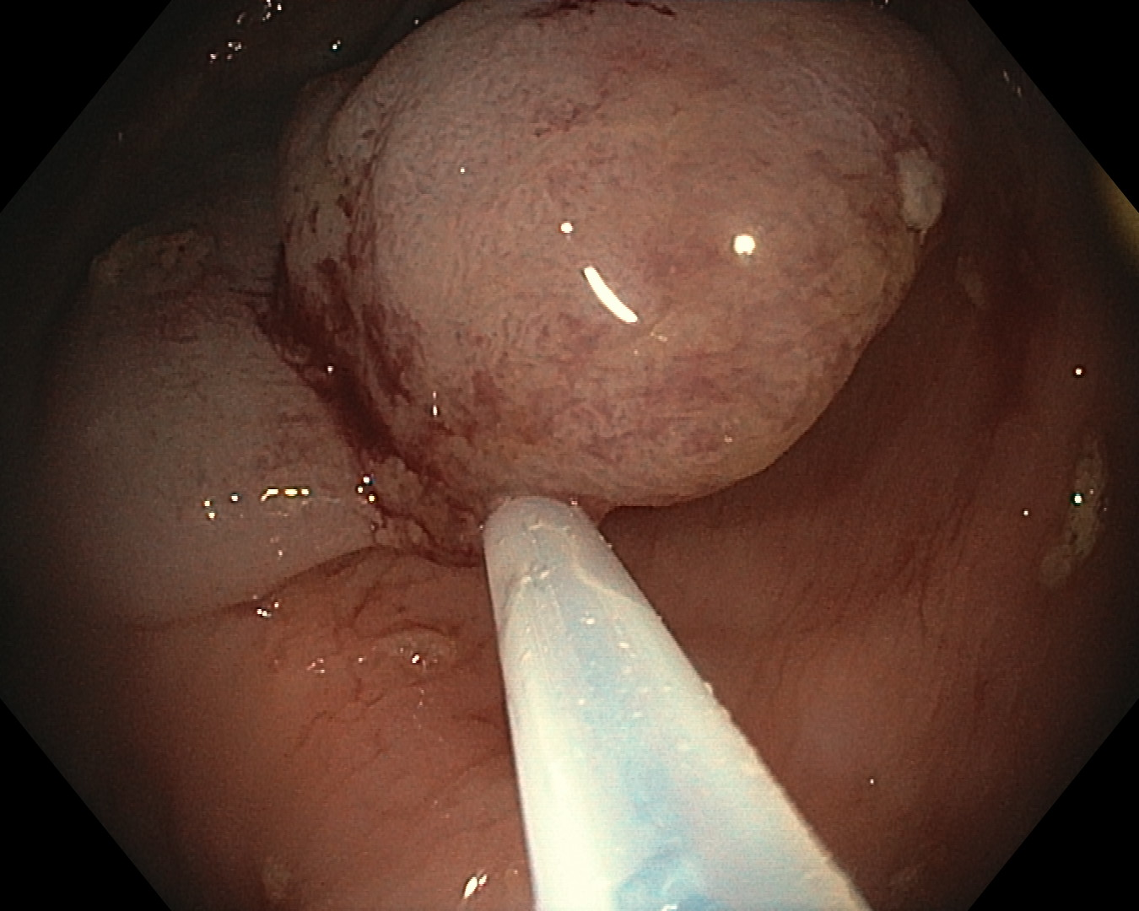
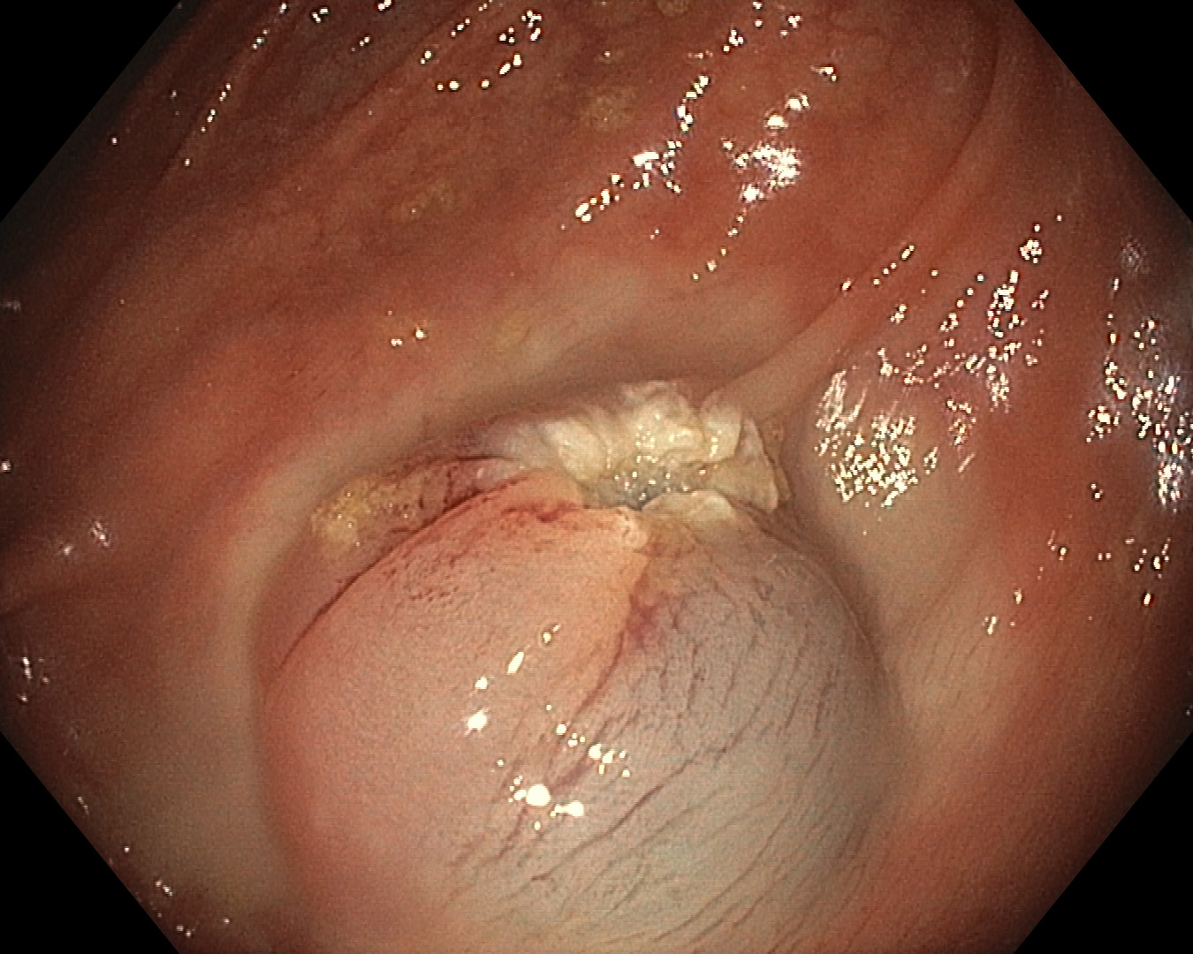

Slide 14
Dr Rex’s Tips to Mastering the Colon
Anticipate Altered Sigmoid Anatomy
Never push against fixed resistance
MAXIMIZE scope sensory feedback
Master the left colon
Problem solve in algorithmic fashion
Change solutions quickly
Change instruments in the difficult sigmoid
Be subtle in passing the hepatic flexure
See the medial cecal wall
Be willing to quit
Michael J. Bourke, MBBS,FRACP1 and Douglas K. Rex, MD,FACG2
Am J Gastroenterol 2012;107:1467–1472; doi:10.1038/ajg.2012.81

Slide 15
Anticipate Altered Sigmoid Anatomy
History of diverticulosis/diverticulitis
I usually start with a pediatric scope
About once per hundred scopes or so I will switch to a gastric scope
Water immersion is recommended by the “experts” to navigate difficult diverticuli (the more air you add, the longer the colon becomes)
Hysterectomy often “introduces” looping (I have “splinted” the scope)
Pelvic Radiation—can be painful, be aware of potential complications
Be quick to change from adult to pediatric scope in the sigmoid

Slide 16
MAXIMIZE scope sensory feedback
NEVER let go of the scope
Maintains the torque and sensation
Helps prevent looping
“Pencil grip” can assist with this “feel”
I use this for more difficult colons
I have one-thumb for each rotational knob, and loop the scope between my 4th & 5th fingers—this gives me three dimensional movement at all times

Slide 17
This is how I hold the colonoscope
Each thumb/finger has a knob/rotation
Grasping between 4-5th or 3rd-4th fingers facilitates a full 3D simultaneous motion
Each thumb can turn a knob while I advance or withdraw the scope
I sometimes will also rotate my arms/body

Slide 18
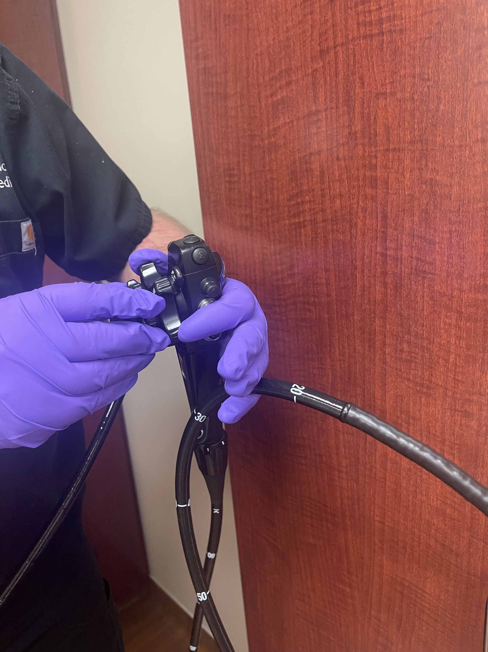

Slide 19
Problem solve in algorithmic fashion
Have your “set way” (or “same way every time”) for problem solving a difficult turn or section of the scope
“Football” on the left side for a large panus (large surgical gel block)
Loop reduction needed once reaching the transverse colon?
Starting to loop?—reduce scope, “Football” on the left side
Problem “getting to the cecum”; after reduction/football, roll onto belly OR TURN ONTO BACK; deflate, reduce/withdraw, adjust tension
SOMETIMES the pressure is in the middle of the belly

Slide 20
Our “Football”
Originally a “nerf football”
Often used when there is a large panus
Place it above the pubic symphysis
I have also rolled up a couple of towels
Often no longer need any pressure from an assistant
Sometimes “preposition” before sedation on the extra large belly

Slide 21
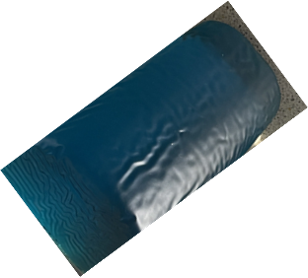
Patient is then rolled onto the gel block

Slide 22
Change solutions quickly
Be quick to turn or roll a patient if having difficulty
Do not be afraid to ask for a different scope
If things aren’t going as planned, remember to check equipment
Sometimes just start over; loops are reduced and generally the colon is straighter

Slide 23
Be subtle in passing the hepatic flexure
Not uncommon to have a “dip” or “S-curve” before the hepatic flexure
Often need to “pull back” and see where the haustral folds might be leading
Might need to turn the patient onto their back

Slide 24
See the medial cecal wall
Spend extra time in the cecum
I “deflate” the cecum to “pucker” the ileocecal valve (becomes an easier “target” to introduce the scope into the TI
Alternatively, fill the cecum with water and “float” the scope into the TI
Do not be afraid to biopsy anything in the cecum—I have been surprised at the subtlety that has returned as an adenoma or serrated polyp
See the medial cecal wall

Slide 25
Be willing to quit (or ask for help)
Think through, “what are my limits”
Better to come back another day than manage a perforation
Who is available as a “phone a friend”
100% cecal intubation rate is not necessarily the goal

Slide 26
Anticipate what to do with a complication
Hemostatic clips—available? Jumbo? Rotating?
What does a perforation look like?
If there is a perforation, can it be clipped? (first part of the sigmoid is retrocecal, and can often be managed conservatively
Recognize symptoms of how a perforation or complication can happen

Slide 27
Things to think through
What am I going to do if upon “entering” I observe active bleeding
diagnostic EGD for anemia, patch of “ischemic colitis”
Who can I call for assistance?

