Slide 1
Web 2.0
and the
AAPCE Knowledge eXchange

Slide 2
Web 2.0
Definition
Web 2.0 (also known as participative (or participatory) web and social web) refers to websites that emphasize user-generated content, ease of use, participatory culture and interoperability (i.e., compatibility with other products, systems, and devices) for end users. ¹
1. Wikipedia contributors. Web 2.0. Wikipedia, The Free Encyclopedia. June 22, 2023, 22:54 UTC. Available at: https://en.wikipedia.org/w/index.php?title=Web_2.0&oldid=1161470562. Accessed July 1, 2023.

Slide 3
Web 2.0
History
Term coined in 1999
Examples:
  Amazon product reviews (1995)
  Classmates.com (1995)
  Wikipedia (2001)
  Modern Social Media Platforms (e.g. Facebook)

Slide 4
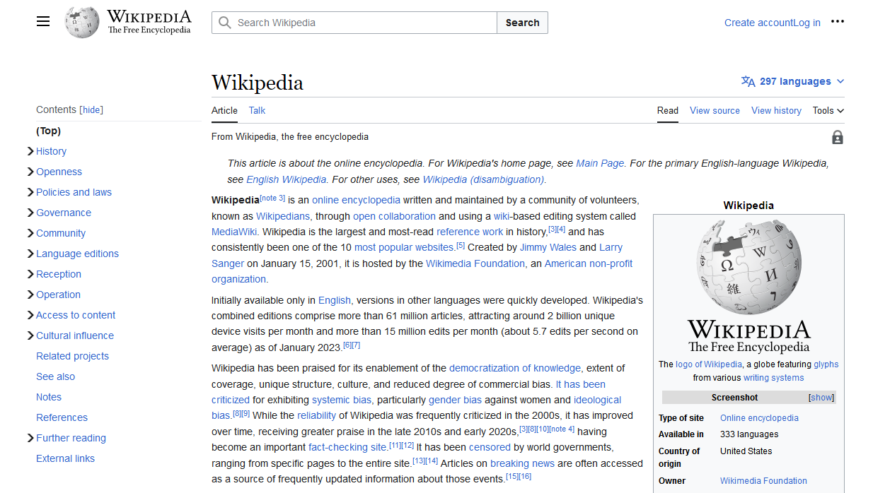

Slide 5
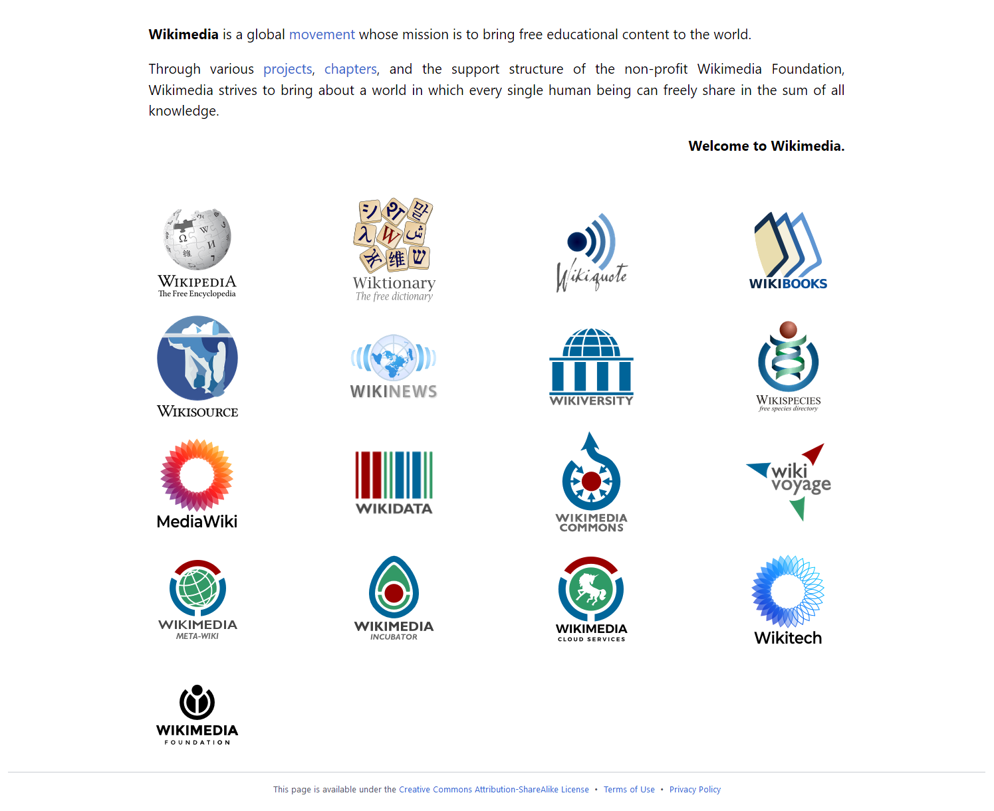

Slide 6
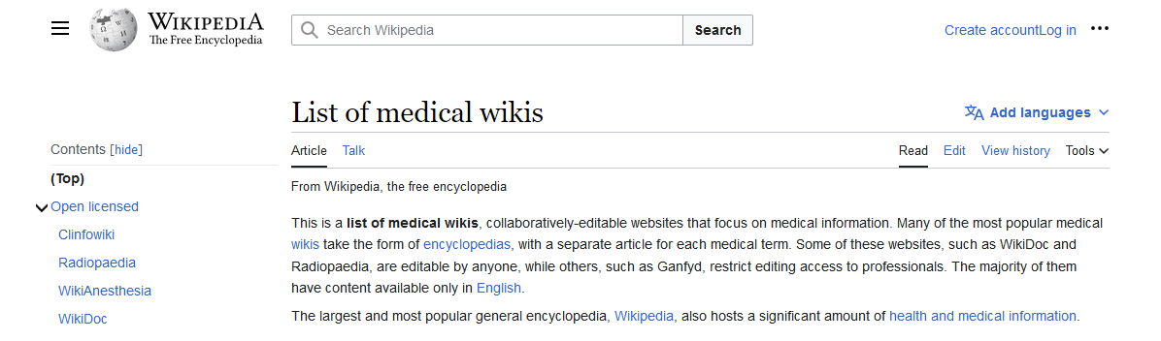

Slide 7
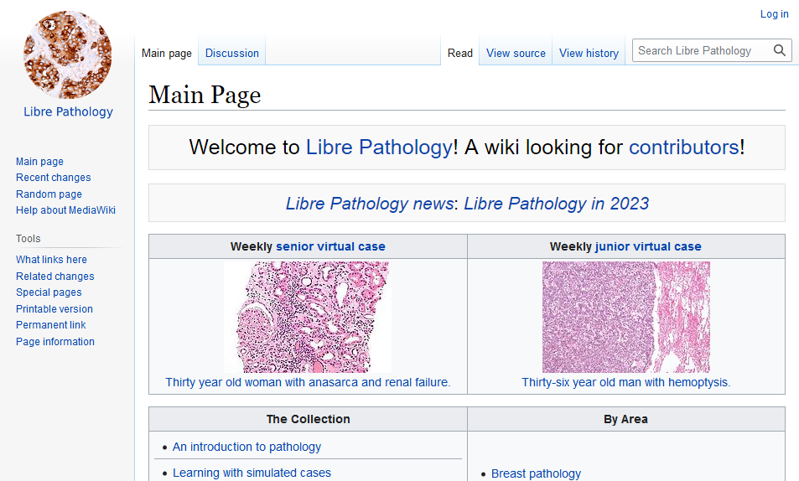
Libre Pathology

Slide 8
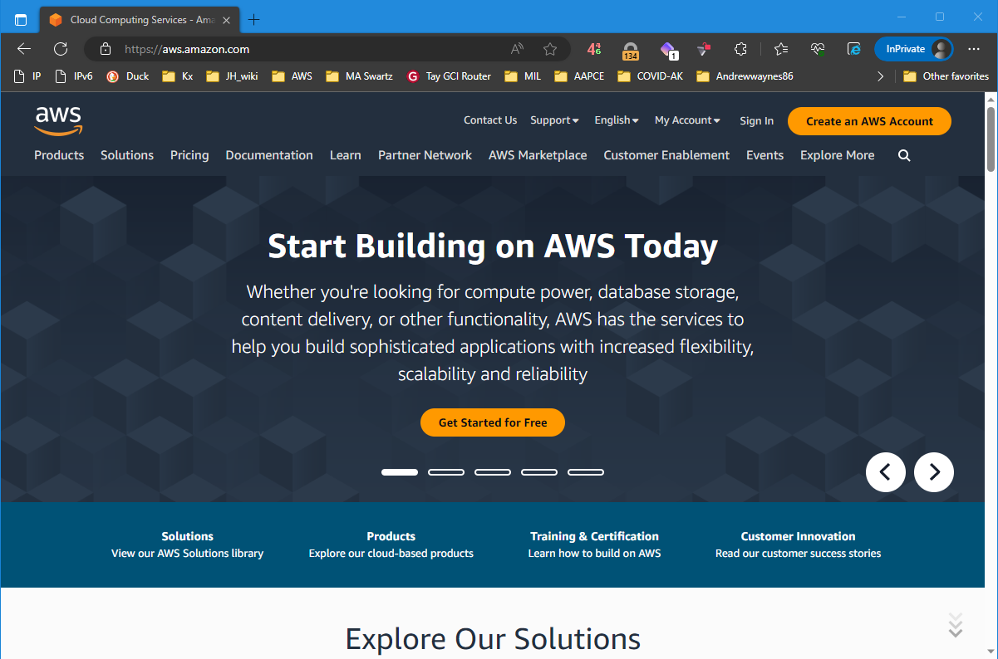

Slide 9
Stack and Backup Strategy
Internet
Mediawiki 1.39.3
MariaDB
Auto-snapshots
1st of each month
Two maintained
Docker
Debian 11 (Linux)
Virtual Hardware: x86-64, dual core, 4Gb Ram, 8Gb/30Gb

Slide 10
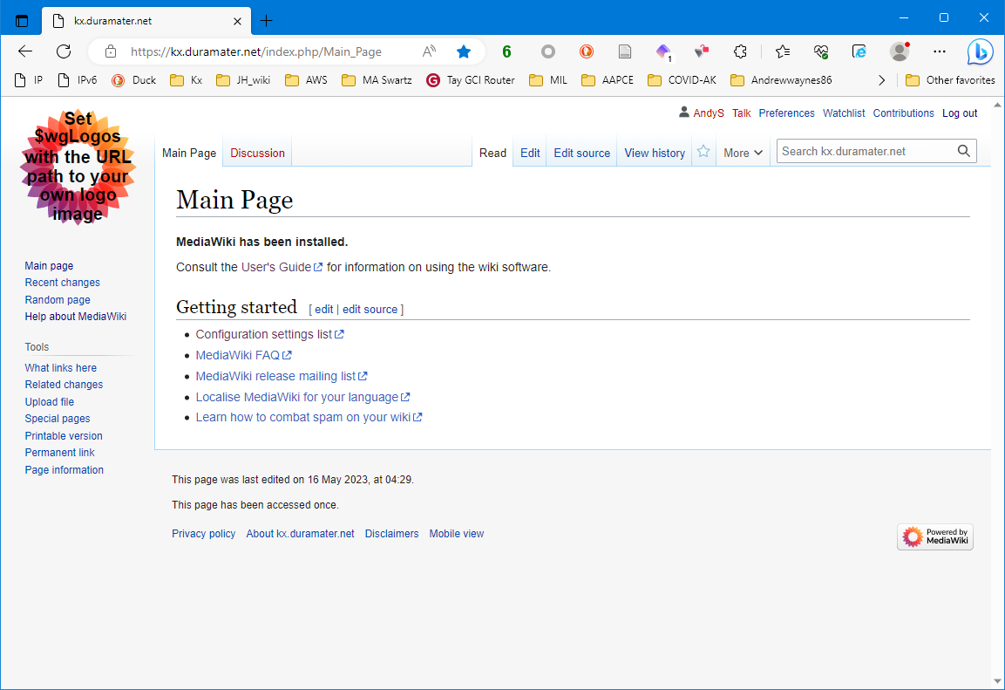
https://kx.aapce.org/index.php/Main_page
Search kx.aapce.org

Slide 11
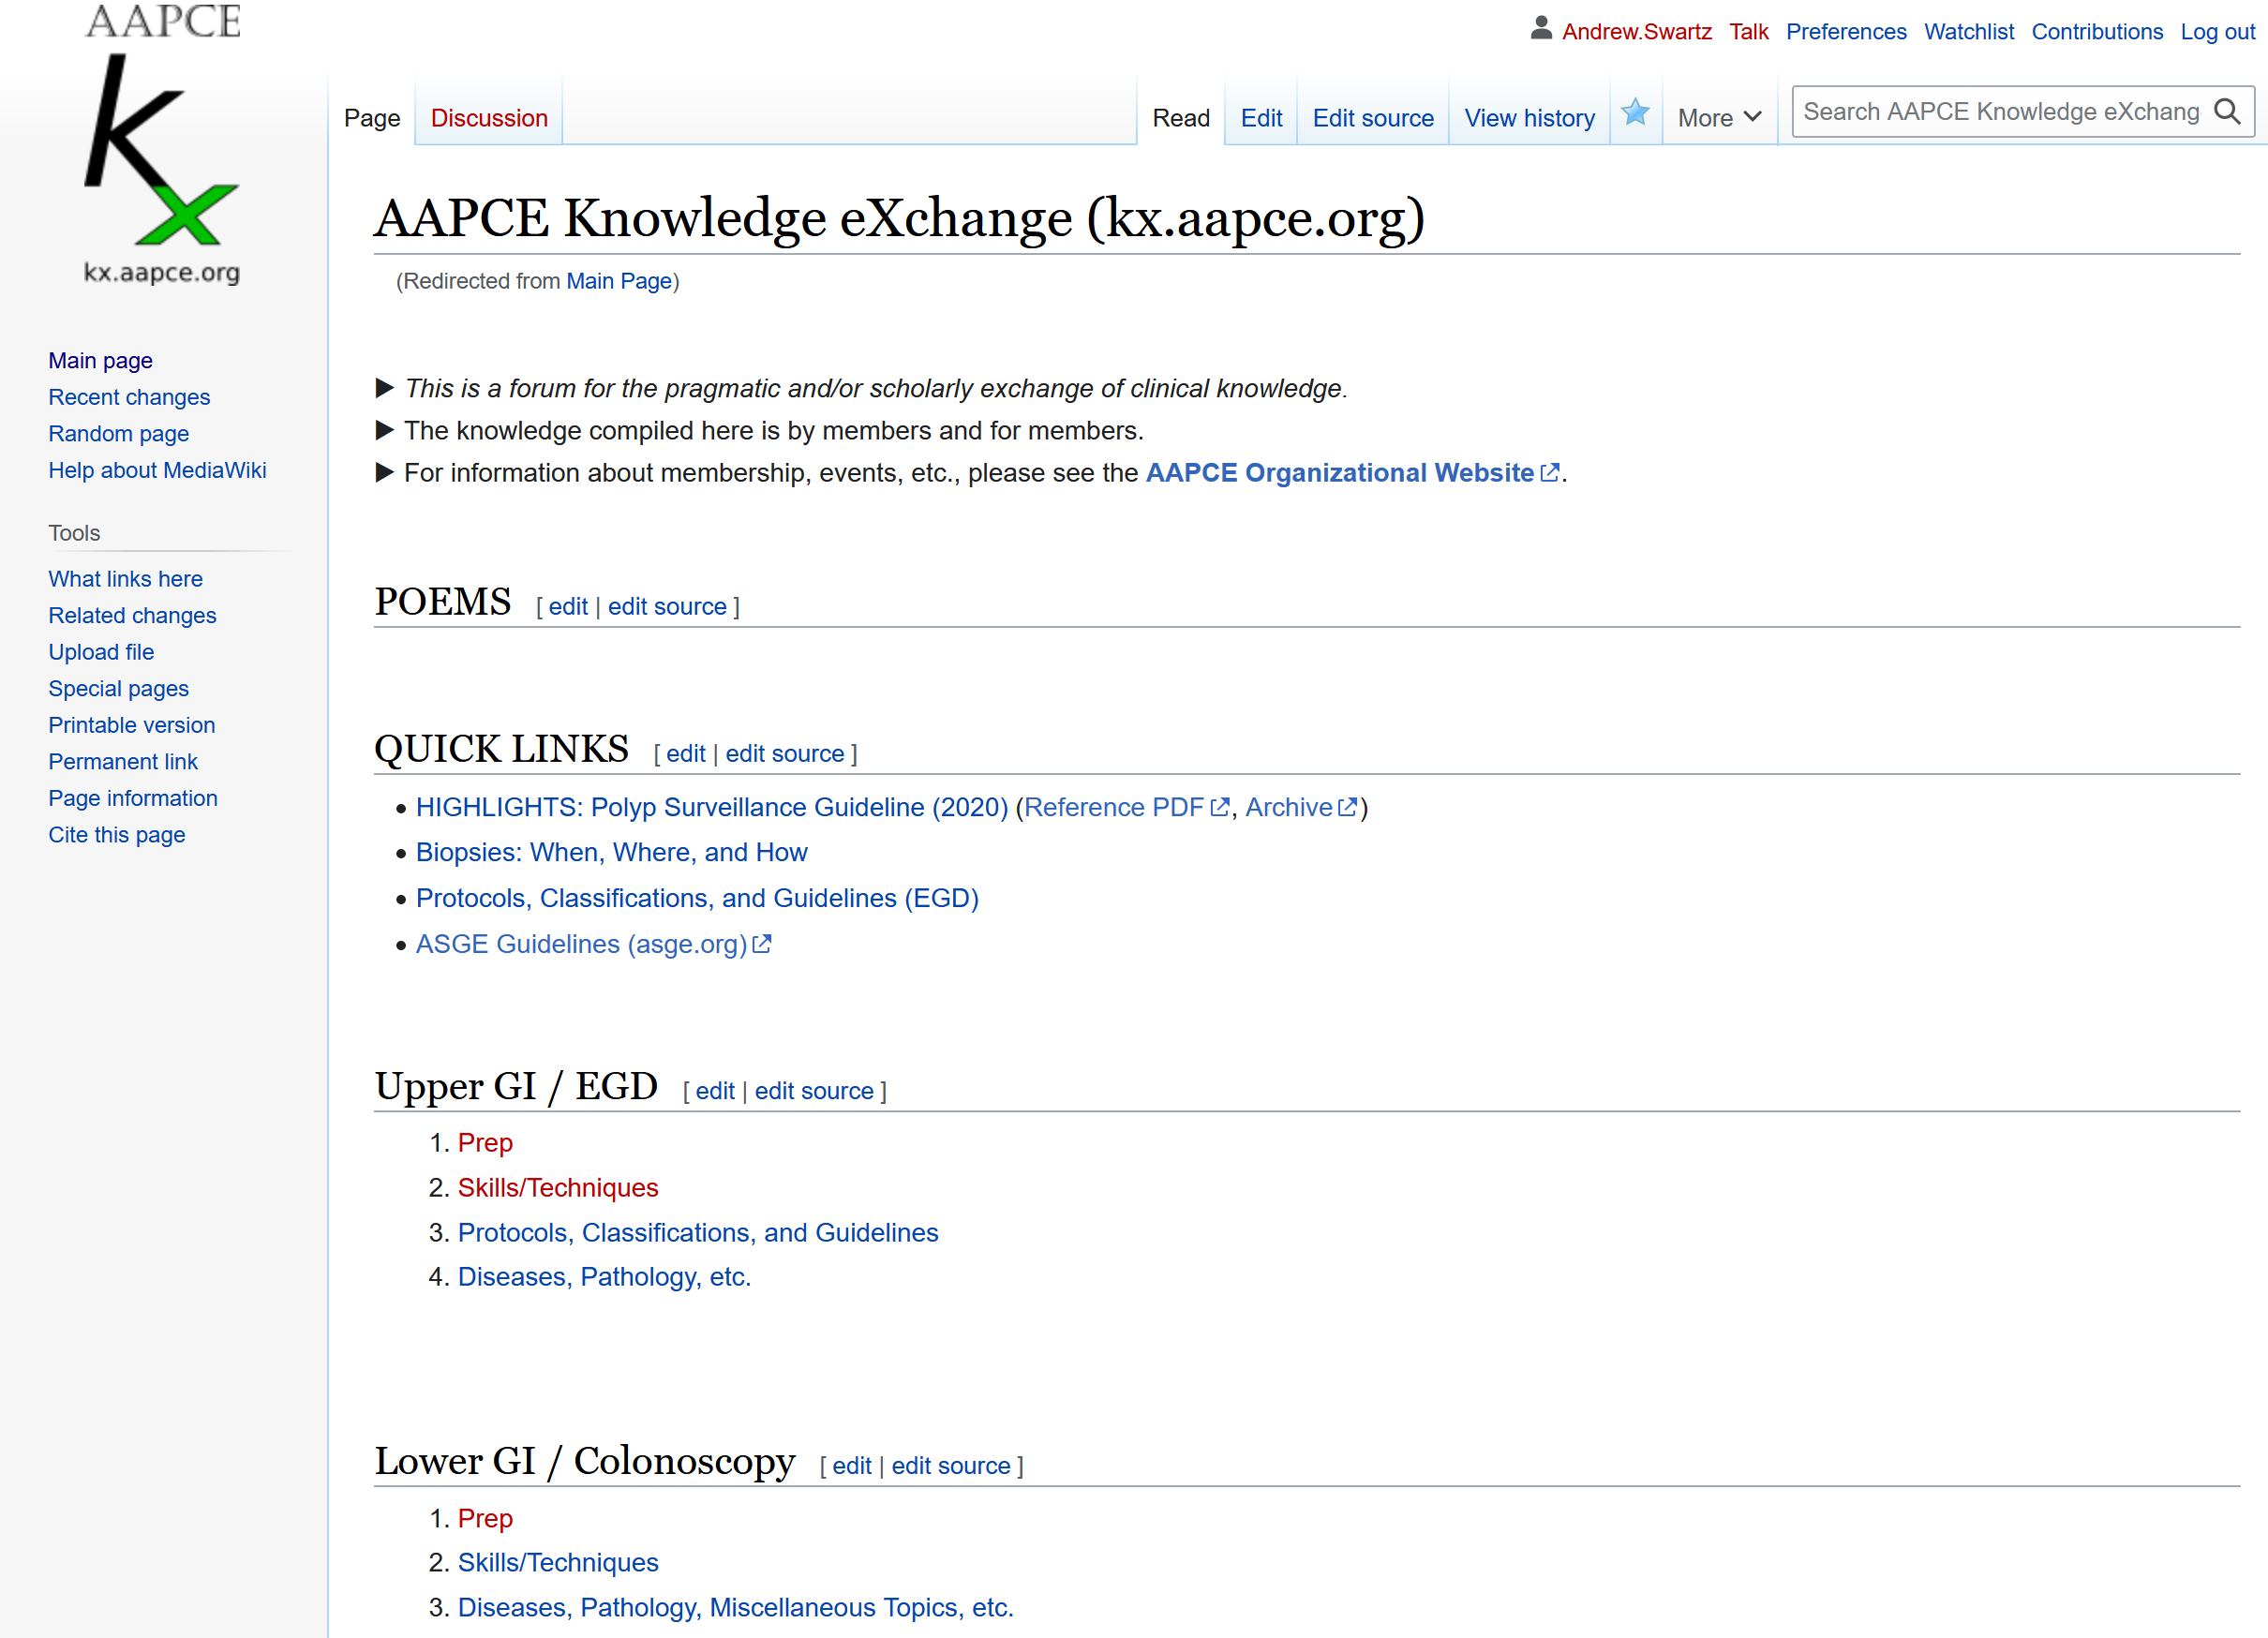

Slide 12
Mobile Frontend

Slide 13
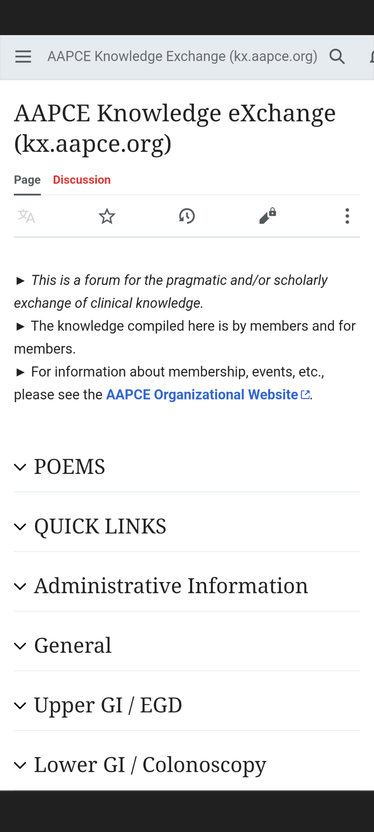

Slide 14
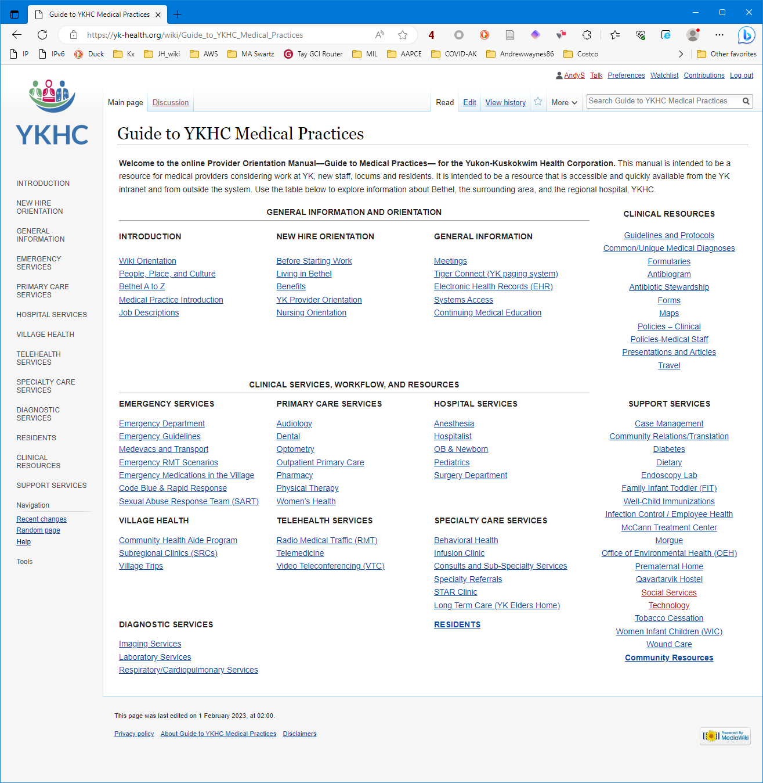

Slide 15
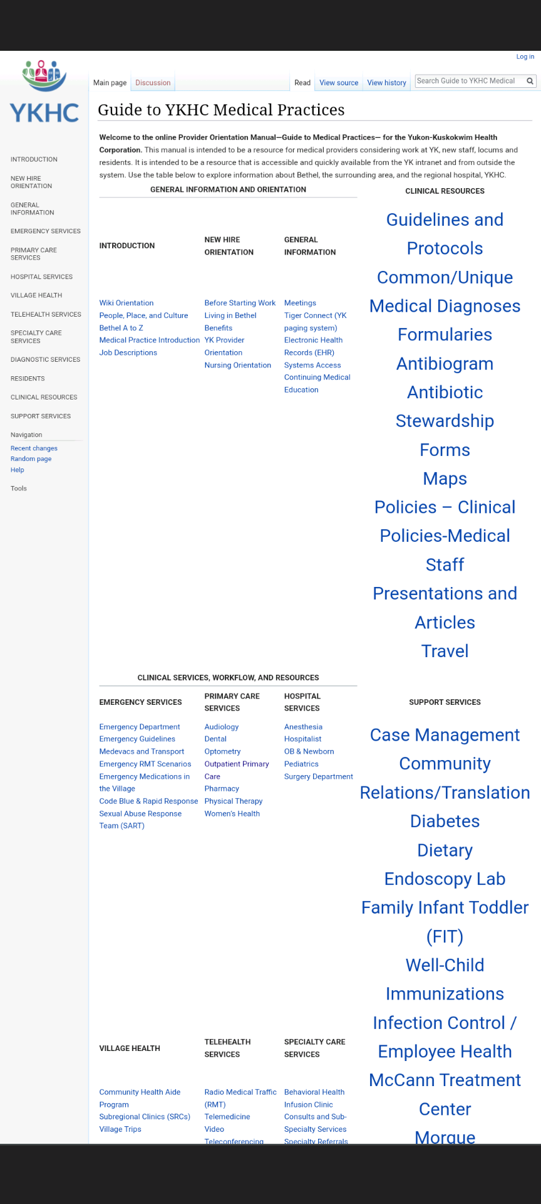

Slide 17
Visual Editor

Slide 18
Privileges
 | View Main Page | View pages | Edit pages | Create pages
Visitors | X
Users | X | X
Authors | X | X | X
Editors | X | X | X | X

Slide 19
Privileges
Bureaucrats
1–2 Senior editors
(move pages)
3–4 Editors (create pages)
8–10 Authors (edit pages)

Slide 20
Page Growth
20
5
0
3y

Slide 21
Name Options
kx.aapce.org
Endopedia
Endoscopedia
?

Slide 23
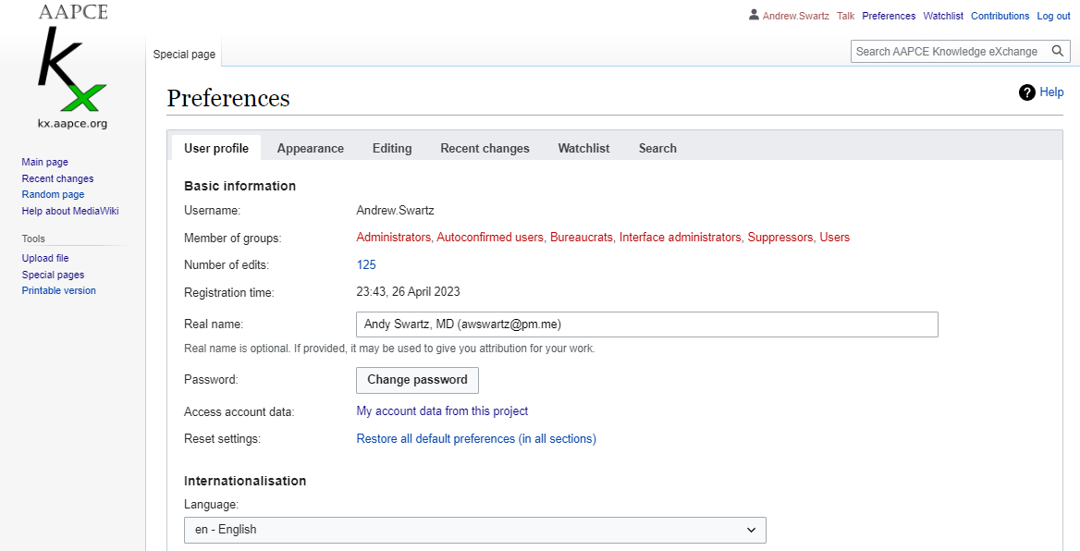

Slide 24
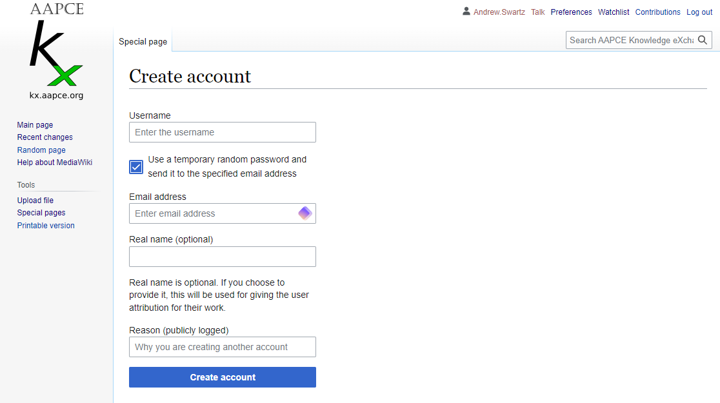

Slide 25
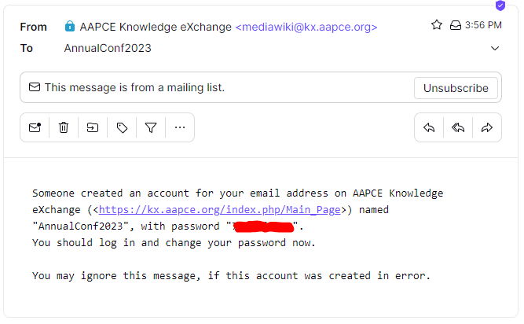

Slide 26
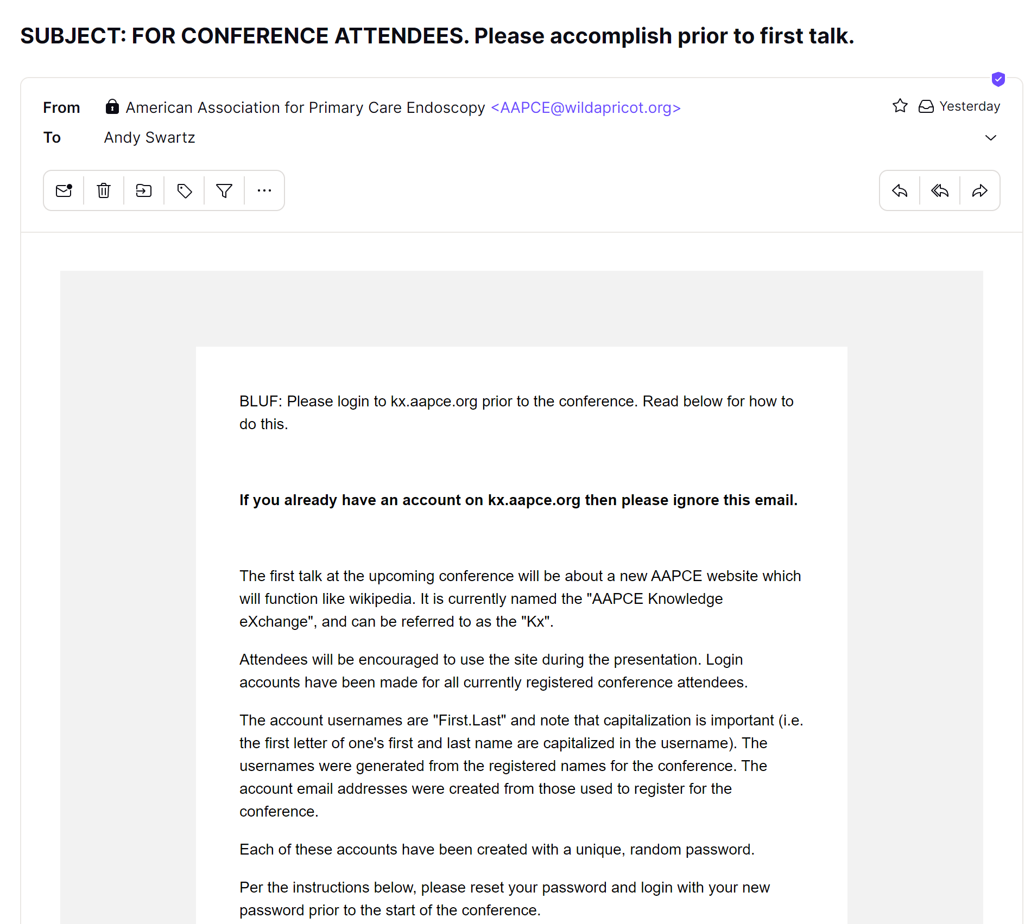

Slide 27
https://kx.aapce.org

Slide 28
Listserv
+
coms

Slide 29
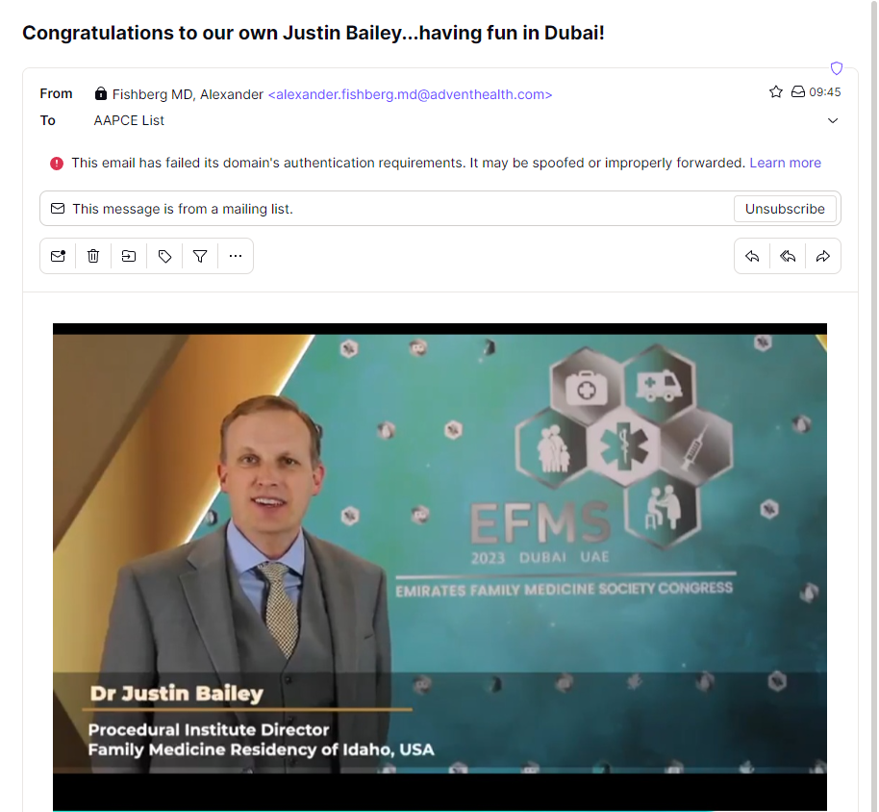

Slide 30
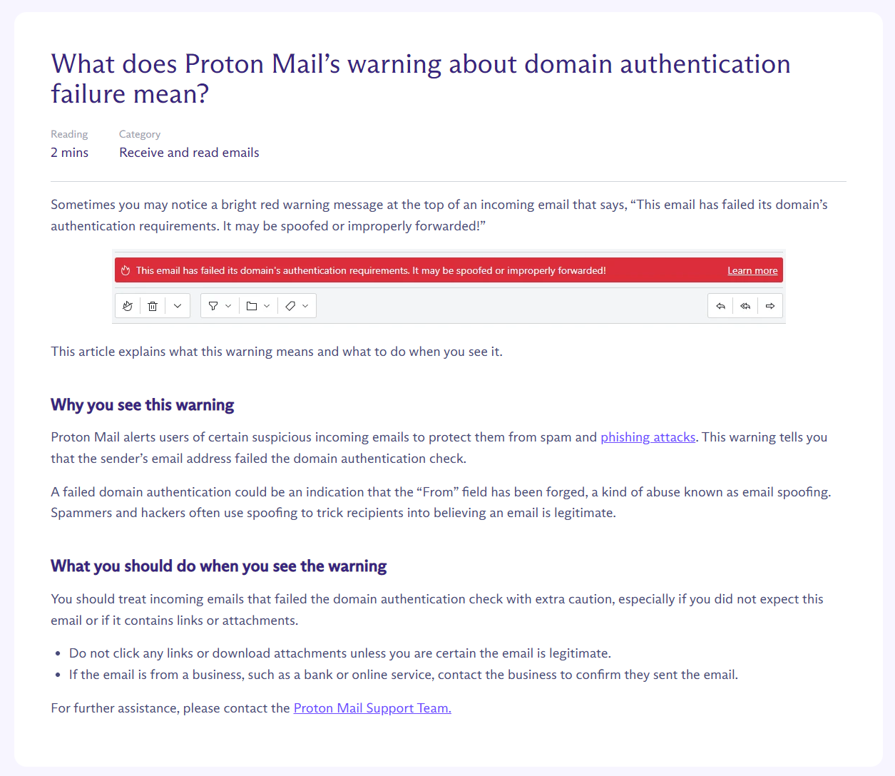

Slide 31
eMail: Strengths and Weaknesses
Strengths
  Universal
  Ideal for one-to-one conversations and one-to-many broadcasts
Weaknesses
  Security: vulnerable to
    Spam
    Attacks
  Clunky for group conversations
    Clunkiness seems to scale exponentially with number of participating members

Slide 32
eMail Alternatives
Simple message apps (WhatsApp, Signal, etc.)
  Group messaging is better than email
Team Communication Software
  SLACK is the prototype.
  MS TEAMS
  MatterMost (open source, military experimenting with)
  Others

Slide 33
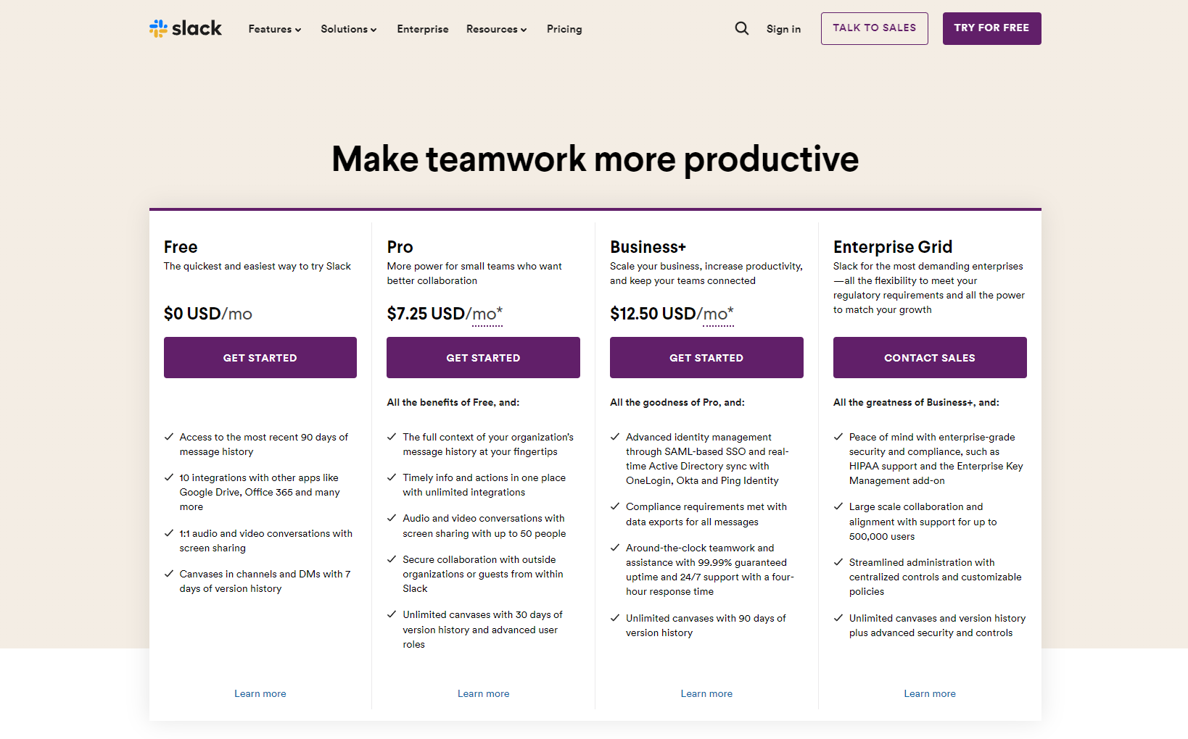

Slide 34
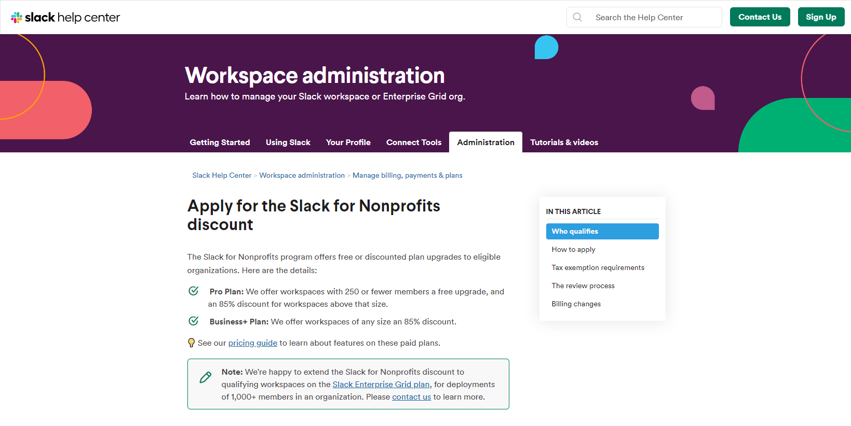

Slide 35
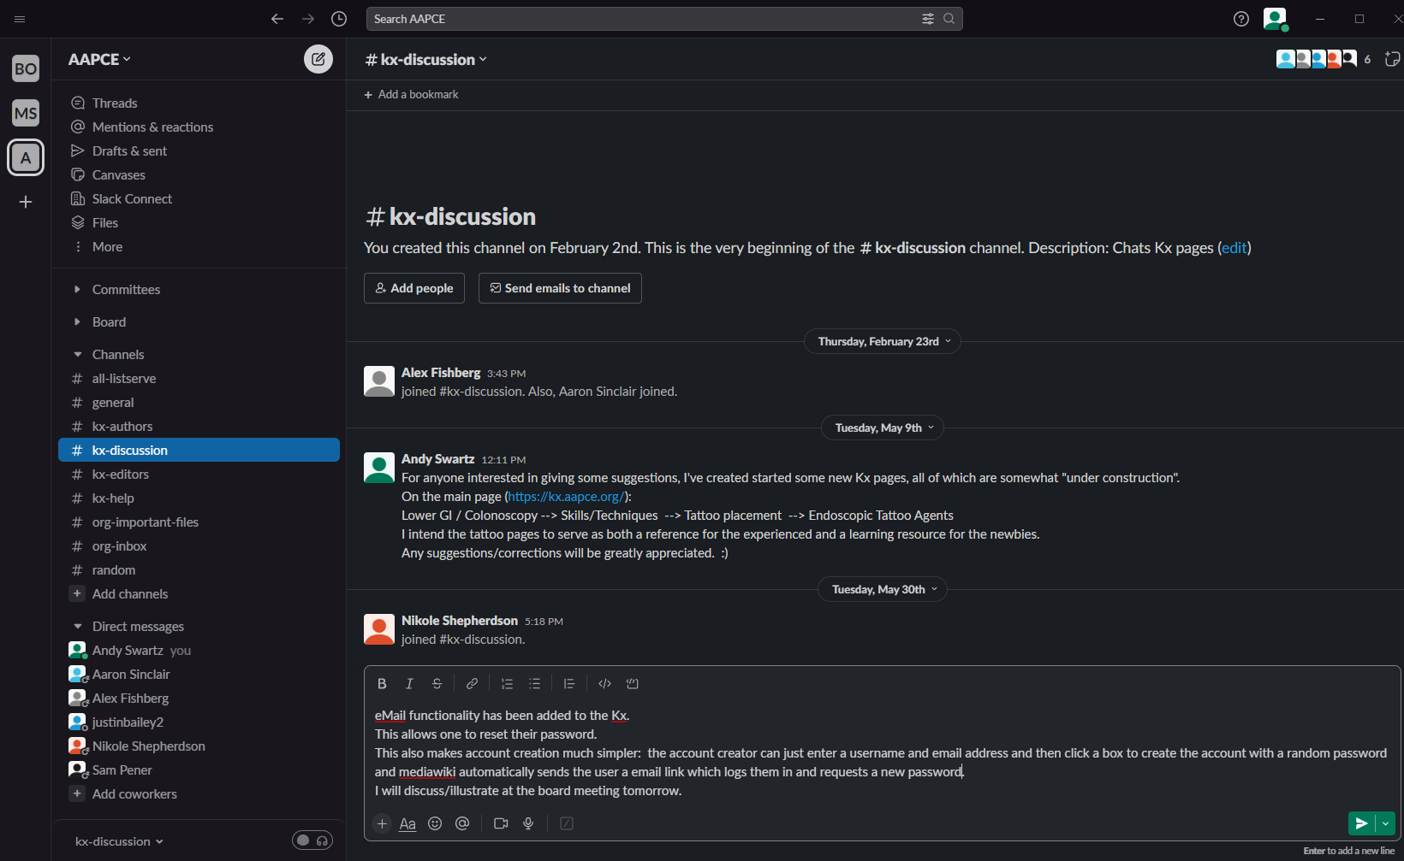

Slide 36
eMail is Dead!
Long Live eMail!

