Slide 1
Microscopic colitis
Ethan Zimmerman, M.D.
AAPCE, Nov 2023

Slide 2
Case 1
63 yo F
PMH: hyperlipidemia, vit B12 deficiency
SH: ½ ppd tobacco, 2 glasses red wine/night
Frequent diarrhea, mornings for two years
1st colonoscopy 2022; random biopsies

Slide 3
Case 2
50 yo M
Diarrhea x 6 weeks: loose, liquid, occasionally explosive, 3-5x/day
Imodium constipates
Cholestyramine helped a little
Started daily omeprazole 2 months ago
2nd lifetime colonoscopy 2022; 6mm TA in AC; random biopsies

Slide 4
Case 3
46 yo M
PMH: CLL 2013, spherocytosis, Hodgkin’s lymphoma 2019, vit B12 deficiency
PSH: splenectomy & cholecystectomy 2011
Sepsis twice → prophylactic abx → C. diff 2018-2019
Brentuximab + AVD 2020, recent ibuprofen 800mg up to tid
6 yrs sporadic diarrhea/urgency mixed with constipation…IBS dx
Occasionally loses 1h of work day in restroom
1st colonoscopy 2023; random biopsies taken

Slide 5
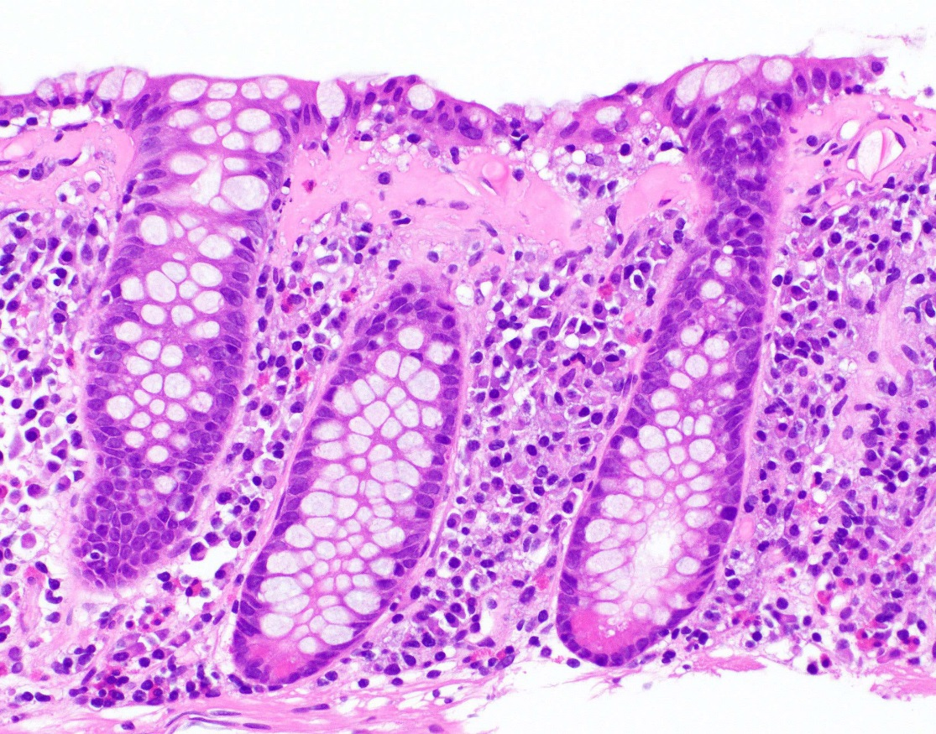
Lymphocytic & collagenous colitis
First described 1980
Incidence 7 per 100,000 per yr (LC)
Median: age 55-65
3:1 female to male (CC)
collagen
Van Treeck BJ, Hagen CE. Collagenous colitis. PathologyOutlines.com website. https://www.pathologyoutlines.com/topic/coloncollagenous.html. Accessed October 10th, 2023.

Slide 6
Etiology…?
Medications
Smoking
DM-I, autoimmune thyroiditis/arthritis, et al
HLA-DQ2
Mucosal immune response
Luminal factors

Slide 7
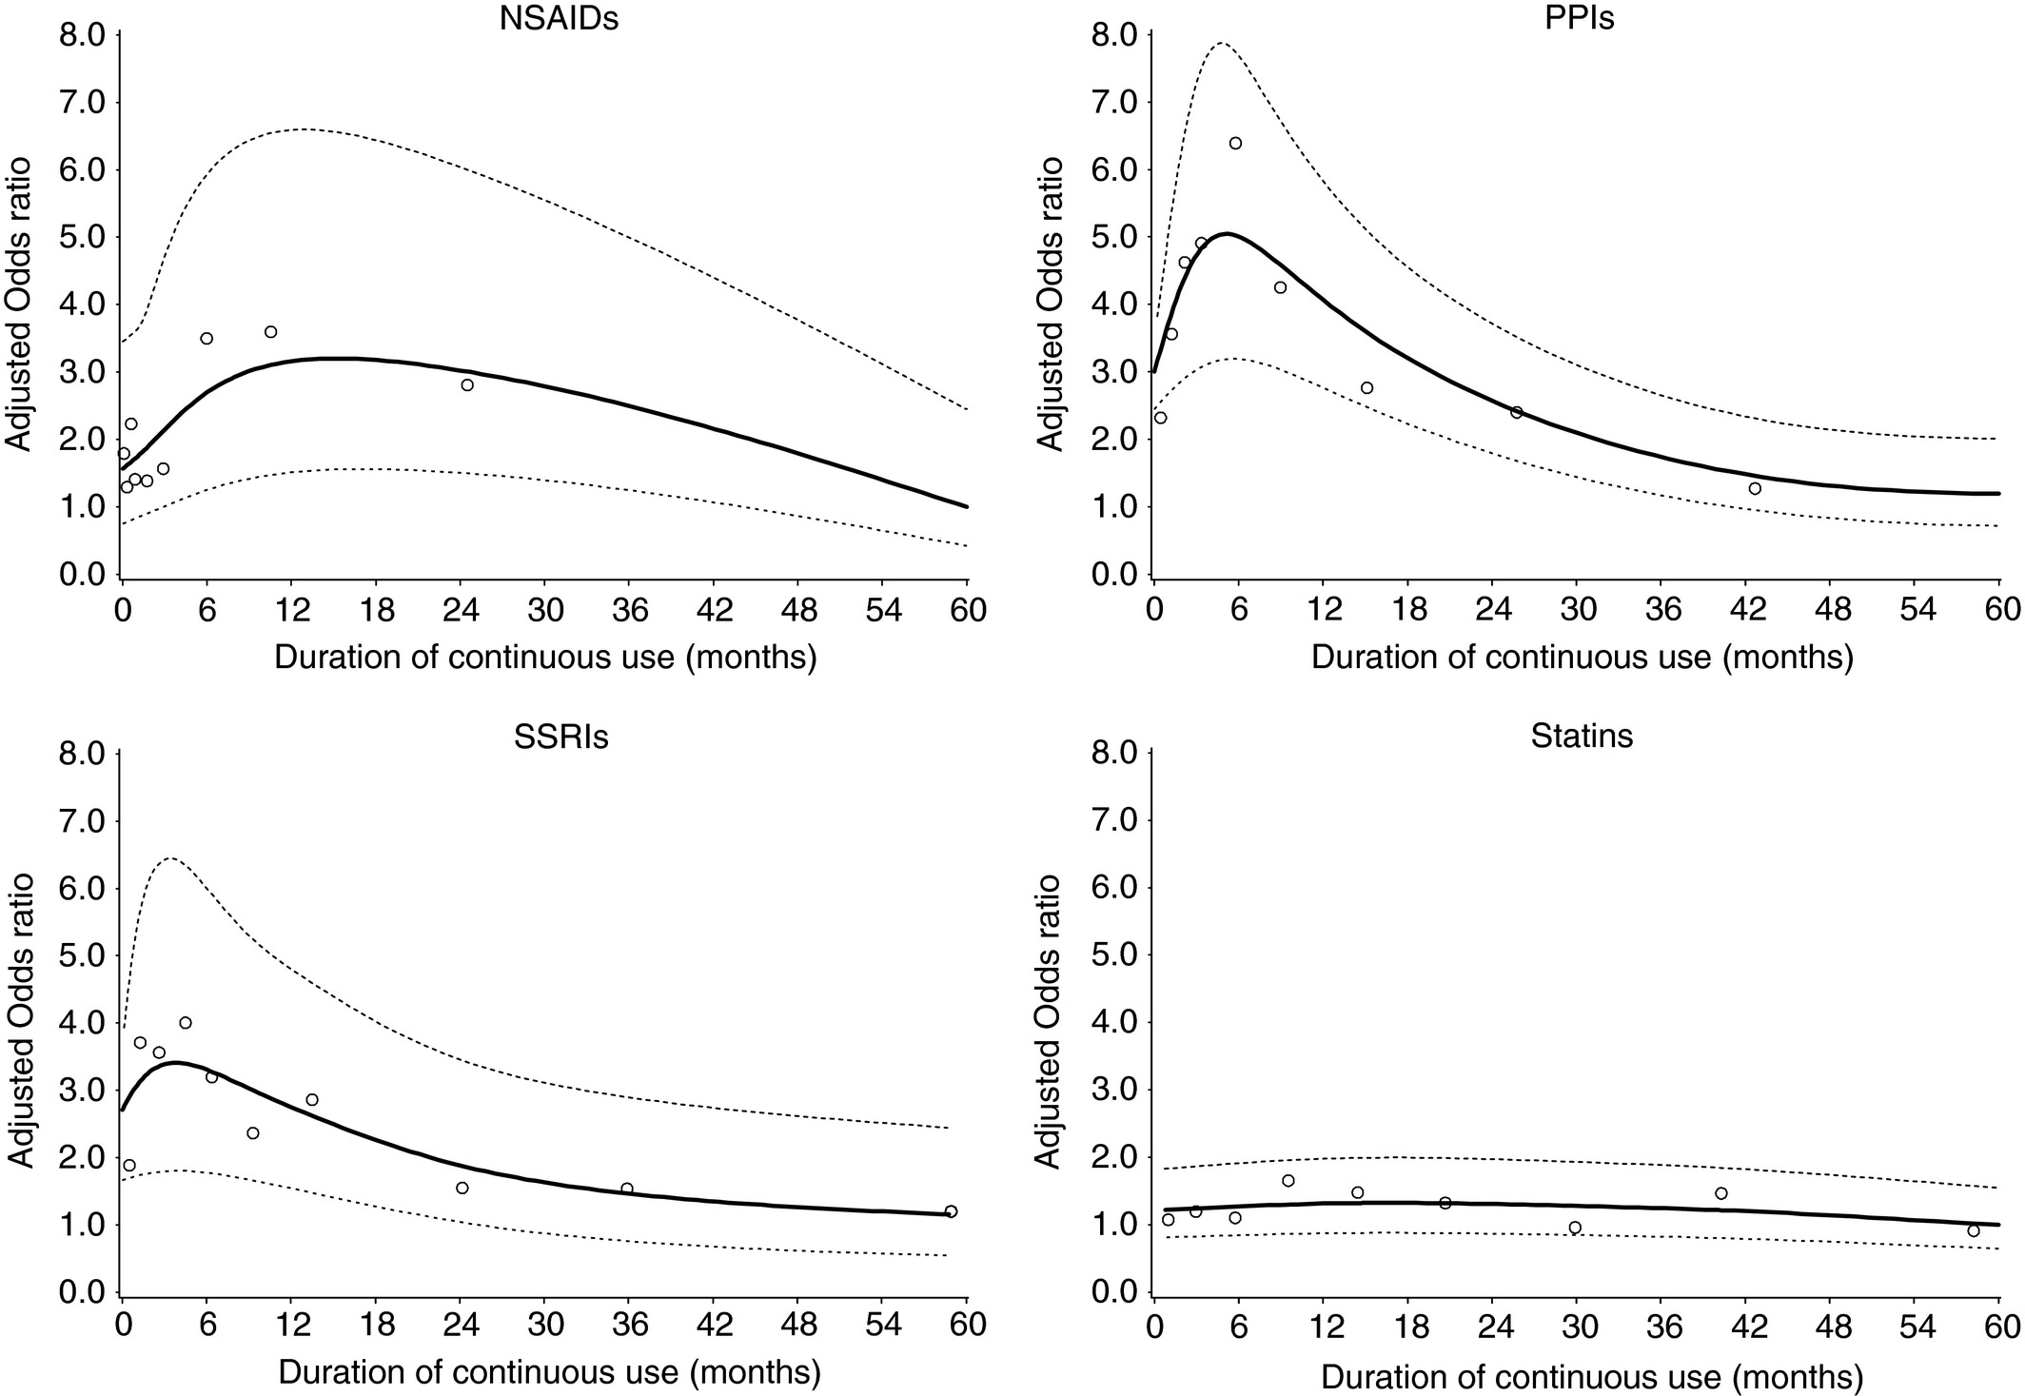
High risk of drug‐induced microscopic colitis with concomitant use of NSAIDs and proton pump inhibitors
Aliment Pharmacol Ther, Volume: 43, Issue: 9, Pages: 1004-1013, First published: 09 March 2016, DOI: (10.1111/apt.13583)

Slide 8
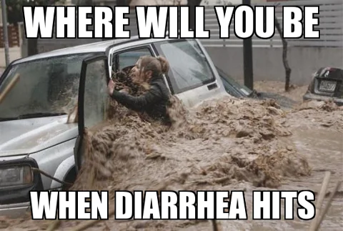
Clinical Features
Diarrhea
Fecal urgency (70%)
Incontinence (40-50%)
Nocturnal (27%)
Abdominal pain (41-50%)
Weight loss (42%)
Arthralgia
Uveitis
Bohr J, Gut 1996.

Slide 9
Evaluation
Stool: C diff toxin, culture, E coli 0157:H7, O&P x 3, Giardia antigen
fecal leukocytes (typically +)
± calprotectin
Serology: celiac, CBC, electrolytes, albumin
Endoscopy:
Slight edema, erythema, friability, exudative lesions, and scars (uncommon)
Separate sampling of R and L colon
Miehlke S, United European Gastroenterol J 2021.

Slide 10
Treatment
Goals
Clinical remission: < 3 stools/day, < 1 watery stool/day
Histologic remission (?)
Hjortswang H. Inflamm Bowel Dis, 2009.

Slide 11
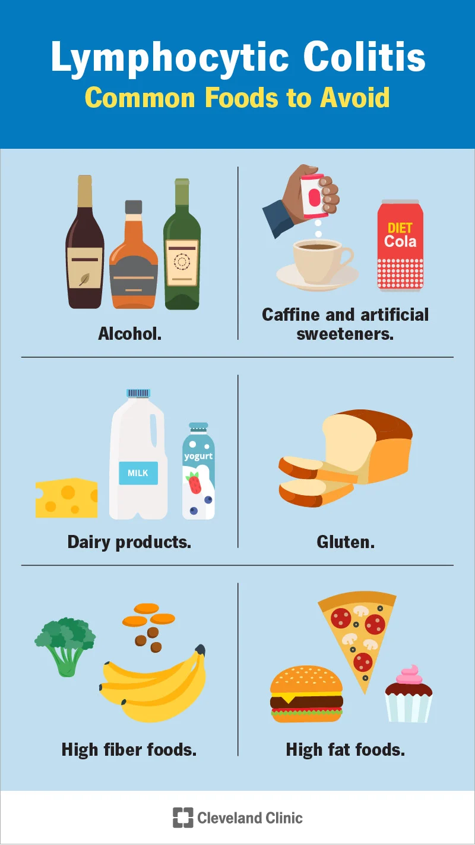

Slide 12
treatment
Budesonide (Grade 1B)¹
For “active disease”
9mg daily, 6-8 weeks
Tapering: 2 weeks each 6mg, 3mg
Adjunctive
Anti-diarrheals
Cholestyramine ± mesalamine (Grade 2C)²
Bismuth subsalicylate (Grade 2C)³
Anti-TNF, ileostomy/colectomy
Maintenance therapy⁴
¹Chande N, Cochrane Database Syst Rev 2017.
²Calabrese C, J Gastroenterol Hepatol 2007.
³Fine K, Gastroenterology 1999.
⁴Münch A, Gut 2016.

Slide 13
Case 1
63 yo F
Rx’d budesonide…never took
Diarrhea resolved after eliminating oatmeal and nuts for 3 months
Successfully re-introduced oatmeal; walnuts still cause some soft stool

Slide 14
Case 2
50 yo M
Budesonide ER 9mg x 3 weeks → diarrhea resolved…hasn’t recurred since
Dropped omeprazole to “on demand”…every 2-4 days

Slide 15
Case 3
46 yo M
Budesonide trial possibly helped
Elimination diet seems to completely resolve
Dairy: diarrhea
Gluten: constipation

