Slide 1
(Mostly) Practical approach to Polyp Classification
Kade Klippenstein
St Luke’s McCall Medical Center - McCall, Id
AAPCE 2023 Conference – Orlando, FL

Slide 2
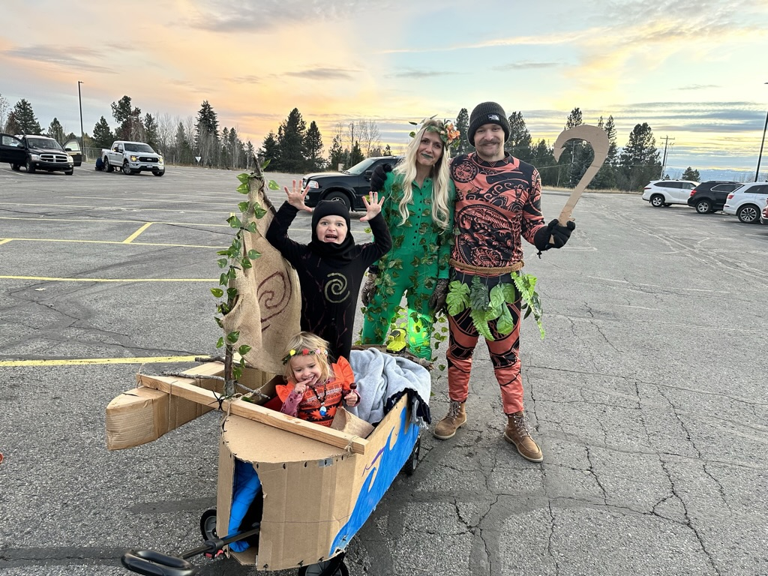
Disclosures
I am a huge fan of Taylor and Travis (though I am a Dolphins fan)
I am also a fan of nuts and butts (hence why I am here)
While I may not always be professional, I have no professional disclosures

Slide 3
Abstract
Review Polyp Classification Systems
Briefly Review Polypectomy Decision Making
Practice Classification of Polyps

Slide 4
Learning Objectives
The Participants will be able to define Parris Classification, NBI International Colorectal Endoscopic (NICE) classification and Kudo Pit patterns
The participants will get practice characterizing polyps using the above patterns
The participants will practice using polyp characterization to assist in determining polypectomy approach
The participants will feel facile in implementing these polyp characteristics into their documentation

Slide 5
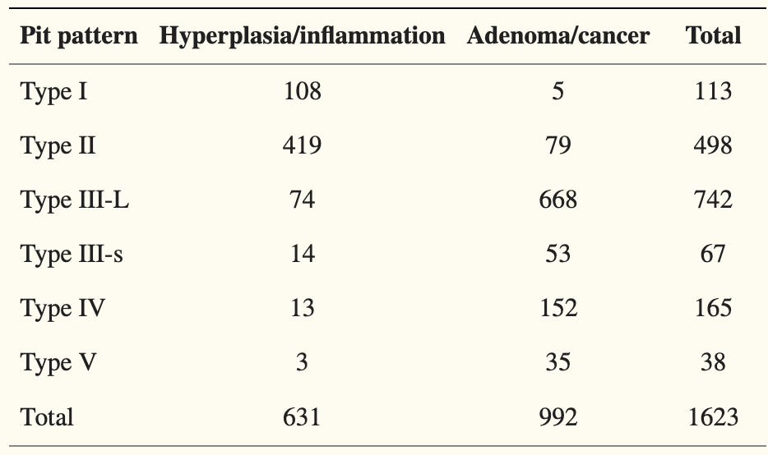
Classification: Kudo Pit Pattern ^{1,2,4}
Kudo (researcher’s name) Pit (the things on polyps) Pattern (how they appear).
Validated diagnostic method for the differentiation of neoplastic colorectal lesions

Slide 6
KP Patterns Continued
How I remember them:
Type I -> Round Pit (Same as surrounding tissue)
Type II -> Stars
Type IIIS -> S for small dots
Type IIIL -> For long dots or lines
Type IV -> Brains
Type V -> Amorphous

Slide 7
Classification: PARIS ¹

Slide 8
CLASSIFICATION: NICE ³
NICE Classification is probably the simplest endoscopic classification system and accurately can predict deep submucosal invasive carcinoma

Slide 9
Using polyp characterization to guide polypectomy ^{1,5,6}
Cold snare polypectomy (CSP) as the preferred technique for removal of diminutive polyps (size ≤ 5 mm) (HQE, SR)
CSP for sessile polyps 6 – 9 mm in size because of its superior safety profile, although evidence comparing efficacy with (\HSP is lacking. (MQE, WR)
HSP (with or without submucosal injection) for removal of sessile polyps 10 – 19 mm in size. In most cases deep thermal injury is a potential risk and thus submucosal injection prior to HSP should be considered. (LQE, SR)
HSP for pedunculated polyps. To prevent bleeding in pedunculated colorectal polyps with head ≥ 20 mm or a stalk ≥ 10 mm in diameter, ESGE recommends pretreatment of the stalk with injection of dilute adrenaline and/or mechanical hemostasis. (MQE, SR)
Goals of EMR are to achieve a completely snare-resected lesion in the safest minimum number of pieces, with adequate margins and without need for adjunctive ablative techniques. (LQE, SR)
Careful lesion assessment prior to EMR to identify features suggestive of poor outcome (lesion size > 40 mm, ICV location, prior failed attempts at resection, and size, morphology, site, and access (SMSA) level 4). (MQE, SR)

Slide 10
7

Slide 11
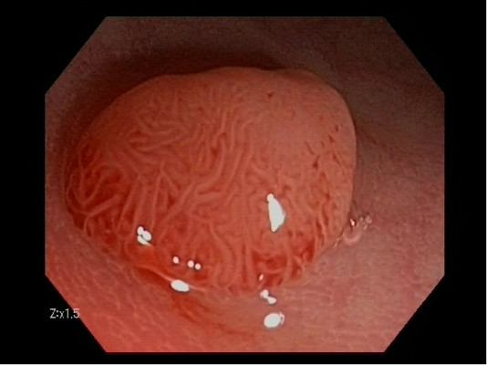
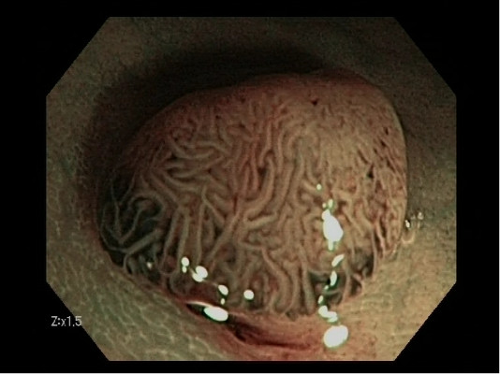
Paris/ KP/ NICE
Paris – Ip
KP – KP 4 (Brains)
NICE – Type II (Brown vessels surrounded by white/ adenomatous)
Histopath: TA

Slide 12
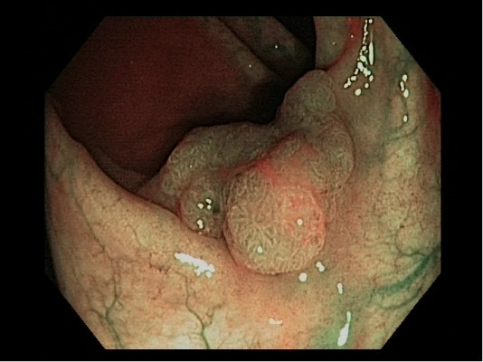
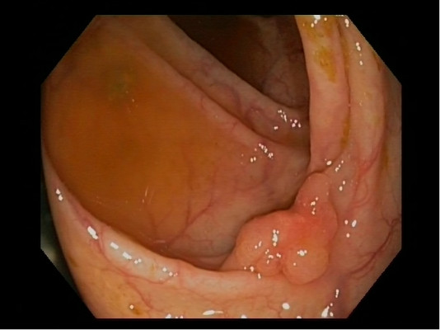
Paris/ KP/ NICE
Paris – Is
KP – KP 4 (Brains)
NICE – Type II (Brown vessels surrounded by white/ adenomatous)
Histopath: TA

Slide 13
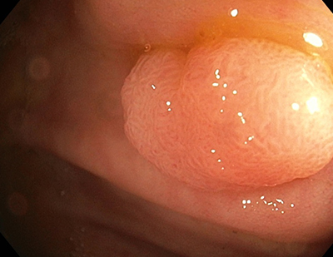
Paris/ KP/ NICE
Paris – Is
KP – KP 4 (Brains)
NICE – No NBI available
Histopath: TVA

Slide 14
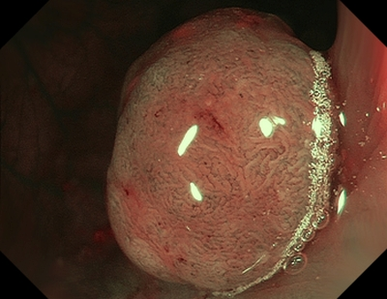
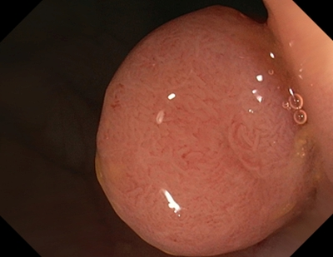
Paris/ KP/ NICE
Paris – Is vs Ip
KP – KP 4 vs KP 5
NICE – Type II
Histopath: Not available

Slide 15
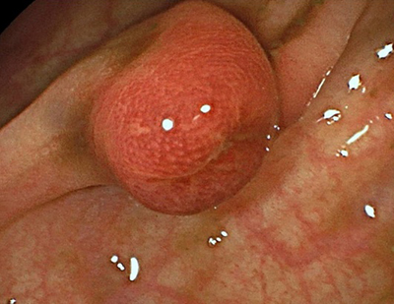
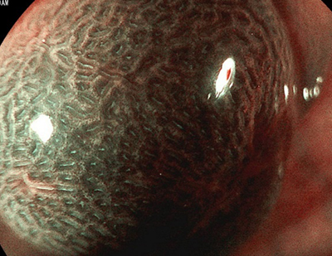
Paris/ KP/ NICE
Paris: Is
KP: KP2
NICE: Type 1
Histopath: Benign inflammation

Slide 16
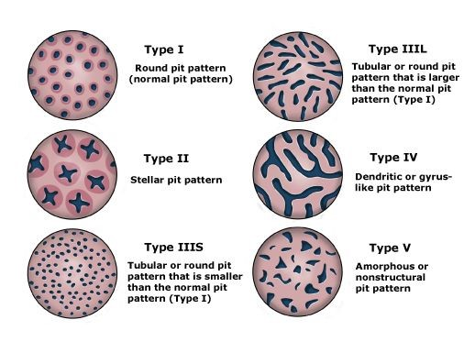

Slide 17
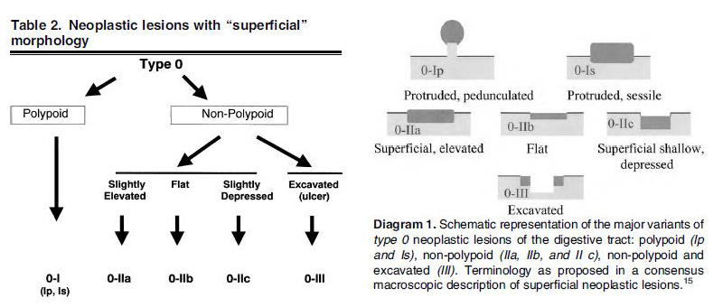

Slide 19
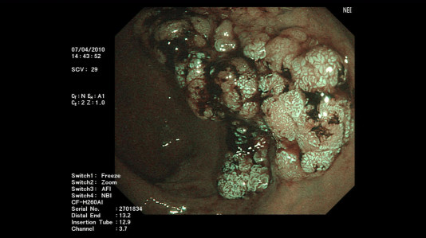
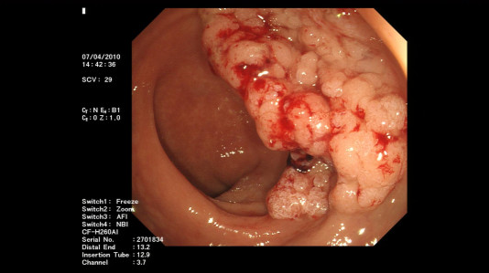
Paris/ KP/ NICE
Paris: IIa – LST - Glandular
KP: Type IV vs Type V
NICE: Type II
Histopath: Not available

Slide 20
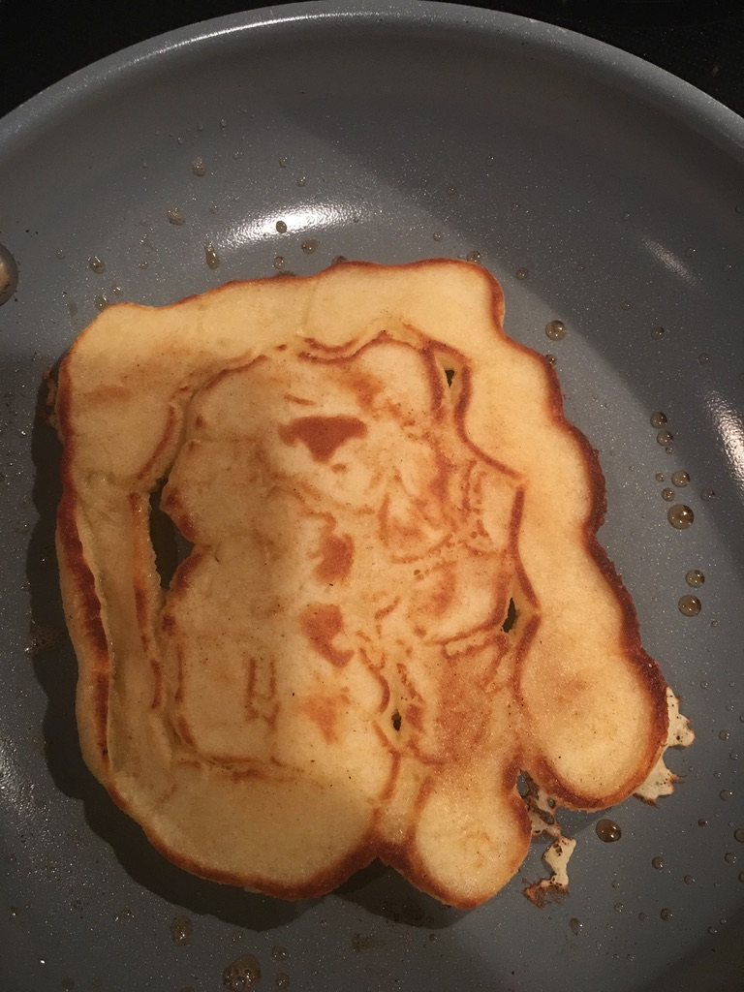
Clearly, this is a sessile lesion
It has a nodular lateral expansion
However, it is pale
My jokes really couldn’t be batter

Slide 21
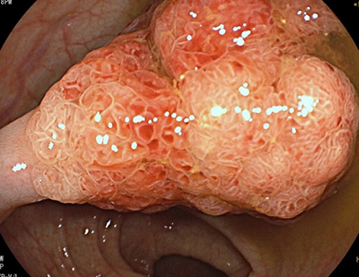
Paris/ KP/ NICE
Paris: Ip
KP: V
NICE: Type III
Histopath: High grade IEN

Slide 22
Paris/ KP/ NICE
Paris: Is (vs. IIa LSA-G)
KP: IV
NICE: Type II
Histopath: TVA

Slide 23
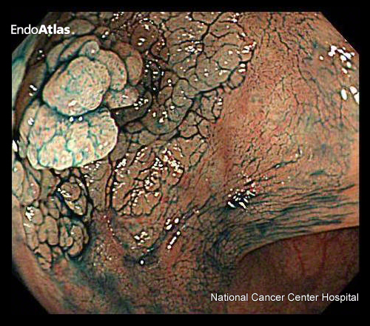
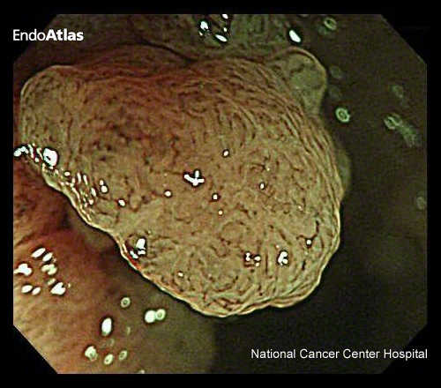
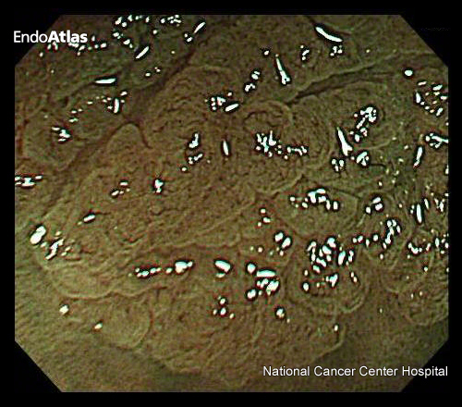
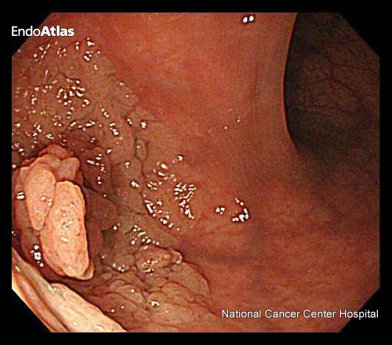
Paris/ KP/ NICE
Paris: Is+IIa (vs IIa LSL Nodular)
KP: V
NICE: Type III
Histopath: CRC

Slide 24
18mm IIa, KP V with Lymphatic Infiltration – Path: CRC

Slide 25
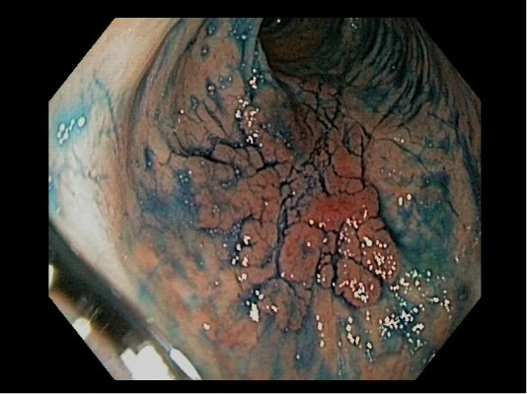

Slide 27
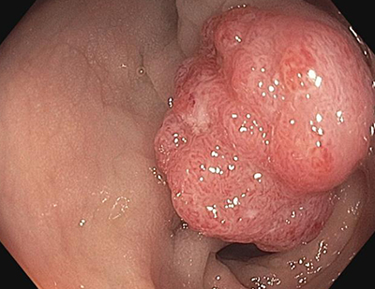
Paris/ KP/ NICE
Paris: Is
KP: V
NICE: No NBI
Histopath: CRC

Slide 29
Notes:
NICE I, KP 1, Ip

Slide 30
Notes:
NICE-2; KP 2; IIa+IIc,

Slide 31
Notes:
NICE-2; Is, KP4, TA

Slide 32
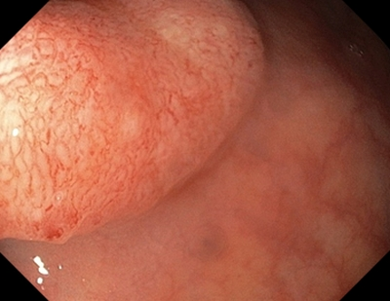
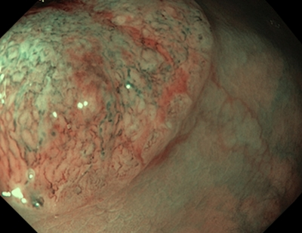
Notes:
Is, KPV, NICE-3, CRC

Slide 33
Notes:
IIa, KP1, NICE-1, HPP

Slide 34
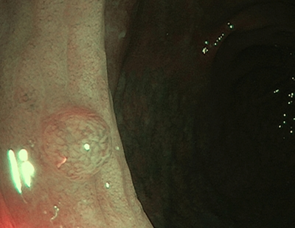
Notes:
Left is IIa, KP1, NICE 1; Right is Is vs IIa, KP2, NICE 1

Slide 35
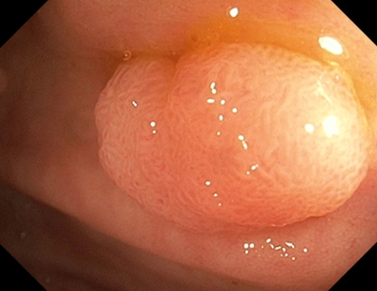
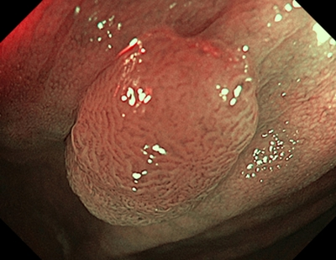
Notes:
Is, KP4, NICE-2

Slide 36
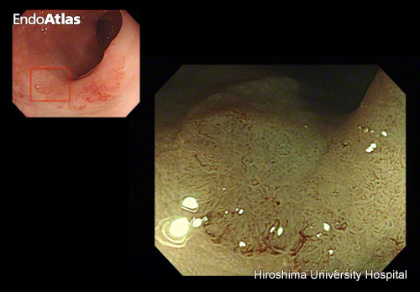
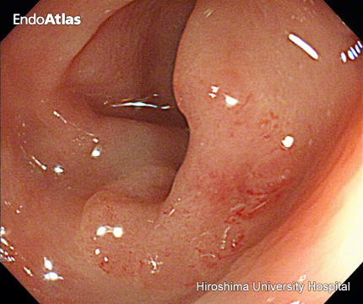
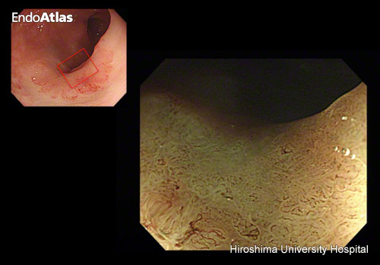
Paris/ KP/ NICE
Paris: IIa
KP: V
NICE: 3
Histopath: CRC

Slide 37
Notes:
Is, KP4 vs KP5, Type II

Slide 38
Notes:
IIa (LSL), KP4, NICE-2

Slide 39
Citations:
Sadeghi A, Salarieh N, Ketabi Moghadam P. A step-by-step guide to approaching colon polyps. Gastroenterol Hepatol Bed Bench. 2023;16(3):347-356. doi: 10.22037/ghfbb.v16i2.2512. PMID: 37767319; PMCID: PMC10520385.
Li M, Ali SM, Umm-a-OmarahGilani S, Liu J, Li YQ, Zuo XL. Kudo's pit pattern classification for colorectal neoplasms: a meta-analysis. World J Gastroenterol. 2014 Sep 21;20(35):12649-56. doi: 10.3748/wjg.v20.i35.12649. PMID: 25253970; PMCID: PMC4168103
Hayashi N, Tanaka S, Hewett DG, Kaltenbach TR, Sano Y, Ponchon T, Saunders BP, Rex DK, Soetikno RM. Endoscopic prediction of deep submucosal invasive carcinoma: validation of the narrow-band imaging international colorectal endoscopic (NICE) classification. Gastrointest Endosc. 2013 Oct;78(4):625-32. doi: 10.1016/j.gie.2013.04.185. Epub 2013 Jul 30. PMID: 23910062.
Kudo S, Tamura S, Nakajima T, Yamano H, Kusaka H, Watanabe H. Diagnosis of colorectal tumorous lesions by magnifying endoscopy. Gastrointest Endosc. 1996 Jul;44(1):8-14. doi: 10.1016/s0016-5107(96)70222-5. PMID: 8836710.
Ferlitsch M, Moss A, Hassan C, Bhandari P, Dumonceau JM, Paspatis G, Jover R, Langner C, Bronzwaer M, Nalankilli K, Fockens P, Hazzan R, Gralnek IM, Gschwantler M, Waldmann E, Jeschek P, Penz D, Heresbach D, Moons L, Lemmers A, Paraskeva K, Pohl J, Ponchon T, Regula J, Repici A, Rutter MD, Burgess NG, Bourke MJ. Colorectal polypectomy and endoscopic mucosal resection (EMR): European Society of Gastrointestinal Endoscopy (ESGE) Clinical Guideline. Endoscopy. 2017 Mar;49(3):270-297. doi: 10.1055/s-0043-102569. Epub 2017 Feb 17. PMID: 28212588.
Gupta S, Miskovic D, Bhandari P, Dolwani S, McKaig B, Pullan R, Rembacken B, Riley S, Rutter MD, Suzuki N, Tsiamoulos Z, Valori R, Vance ME, Faiz OD, Saunders BP, Thomas-Gibson S. A novel method for determining the difficulty of colonoscopic polypectomy. Frontline Gastroenterol. 2013 Oct;4(4):244-248. doi: 10.1136/flgastro-2013-100331. Epub 2013 Jun 1. PMID: 28839733; PMCID: PMC5369843.
Endoscopic Classification Review Group. Update on the paris classification of superficial neoplastic lesions in the digestive tract. Endoscopy. 2005;Jun;37(6):570-8.
Images from:
http://www.endoatlas.org
https://www.endoatlas.net/
https://www.endoscopy-campus.com

