Slide 1
Evidence Regarding Prep Types and Endoscopic Outcomes
By Summer Szumski DO
Assisted by Nikole Shepherdson DO
Nov 4, 2023 AAPCE Annual Conference

Slide 2
Disclosures
No financial or sponsorship disclosures.

Slide 3
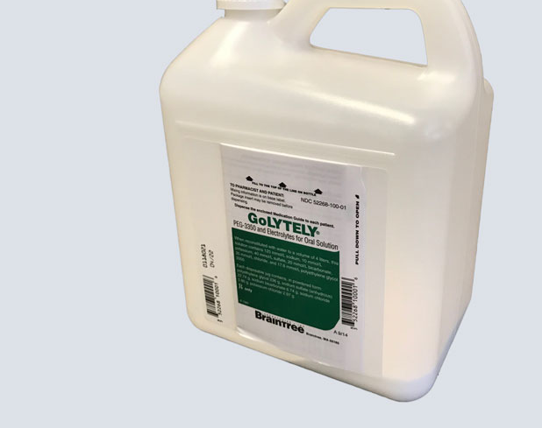
Objectives
Review recent research regarding prep types.
Be able to identify differences in prep types currently being used in practice in the US.
Be able to recognize which prep types are advantageous in different populations based on current literature.

Slide 4
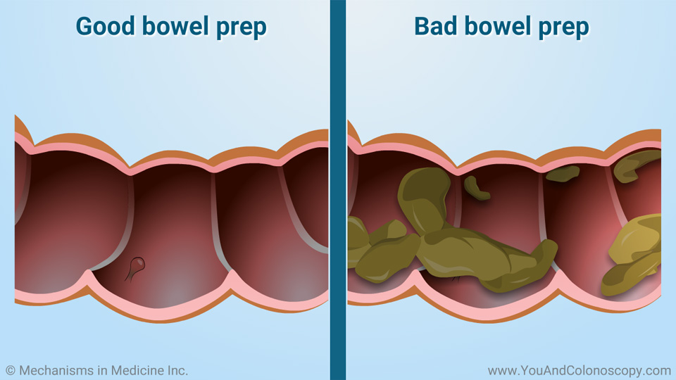
The importance of prep....
Decreased procedure time
Increased polyp detection
Subsequent increased adenoma detection rate (popular quality indicator)
Poor preparation affects as many as 30% of colonoscopies.
Decreased adenoma detection rate
Increased cost of colonoscopies
More frequent follow up intervals
Risk for incomplete colonoscopy
**Poor tolerability is associated with lower quality bowel preparations.
Notes:
The quality of bowel preparation impacts the success of colonoscopy.

Slide 5
Prep Types
Polyethylene Glycol
4L
2L + adjuvuncts
1L plus ascorbate
Moviprep
Sodium Phosphate
Oral Sulfate Solution
Sodium picosulfate
Lactulose
Plenvu
MiraLax

Slide 6
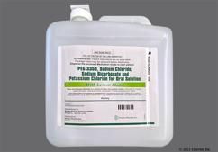
Polyethylene Glycol - 4 liters electrolyte lavage solution
High volume osmotically balanced solutions containing PEG and electrolytes impair the intestinal absorption of water and sodium.
Few contraindications
Considered safe in most patients.
The volume is challenging for patients and has led to the use of low-volume of PEG-ELS with an adjunct.
A split doses --> standard other bowel preparations are judged against
**Standard**
Notes:
Can be unpalatable, high incidence of N/V. Unwillingness to repeat.

Slide 7
Polyethylene Glycol - 2 liters
Plus bisacodyl or magnesium citrate
RCT's comparing to 4L PEG,
no difference in adequate bowel cleansing (73.6 % vs. 72.3 %, 95 %CI difference −7.5 to 10.1), safety, and compliance
Better gastrointestinal tolerability (25.4 % vs. 37.0 %, P < 0.01)
acceptability was higher (93.9 % vs. 82.2 %, P < 0.001)
Plus bisacodyl (10-20mg) and simethicone
meta-analysis [105] of 6 RCTs found that, compared with 4 L PEG, 2 L PEG plus bisacodyl provided:
similar bowel cleansing with no difference in abdominal pain
less nausea, vomiting, and bloating.
Plus ascorbate
noninferior efficacy for bowel cleansing (OR 1.08, 95%CI 0.98–1.28)
better compliance for 2 L PEG plus ascorbate (OR 2.23, 95 %CI 1.67 – 2.98),
reduced nausea and vomiting.

Slide 8
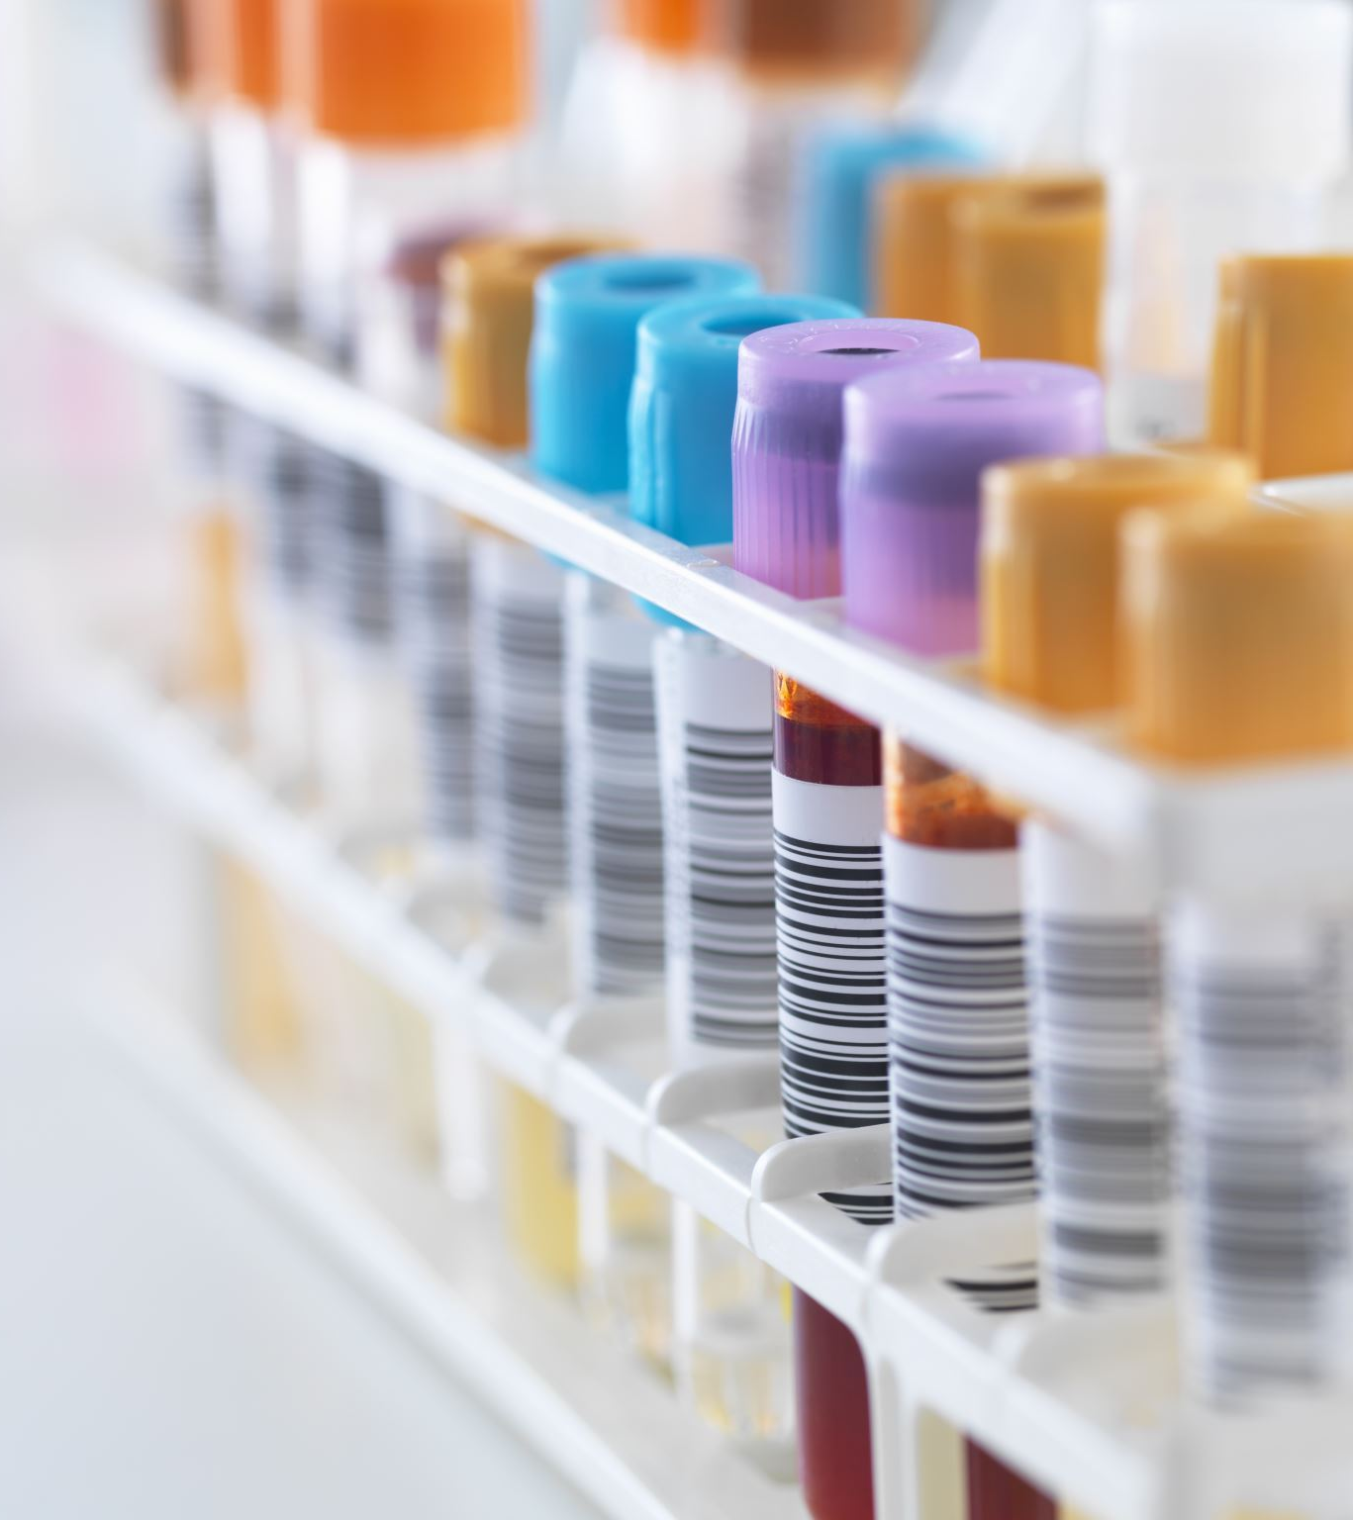
Polyethylene Glycol – 1L + Ascorbate
large prospective, multicenter observational study
Equivalent to superior prep compared to 4L and 2 L PEG
noninferior polyp and adenoma detection rates.
Tolerability and adherence were high
mild adverse events in the 1 l PEG plus ascorbate group (17.0 % vs. 10.0 %; P = 0.03).
Notes:
afternoon-only or afternoon-morning preparation with 4 L-PEG with Selgesse (Alfasigma, Milan, Italy), 2 L-PEG with Moviprep (Norgine, Harefield, United Kingdom) or Clensia (Selgesse, Alfasigma, Milan, Italy) and 1 L-PEG with Plenvu
noninferior overall cleansing (62.0 % vs. 53.8 %; P = 0.04) and high quality cleansing in the right colon (4.4 % vs. 1.2 %; P = 0.03) in the intention-to-treat analysis (and superiority in the per- protocol analysis)

Slide 9
CLEANSE study
Plenvu
Moviprep
The first 1 liter PEG-based bowel cleansing agent.
Increasing the ascorbate in the very low volume 1L PEG enhances the laxative effect permitting the delivery of a solution in a smaller volume.
Showed high efficacy in RCTs, with a non-inferiority compared to a higher volume solution.
Higher bowel cleansing effectiveness both as average BBPS score overall and in the right colon.
Showed higher adherence to preparation
Not given to patients with cardiac, liver, or renal disease.
2 Liter of PEG 3350, 15 grams of sodium sulfate, 5.38 grams of sodium chloride, 2.03 grams KCL, 9.4 grams ascorbic acid, 11.8 grams sodium ascorbate + sweeteners
No difference in polyp detection between the groups

Slide 10
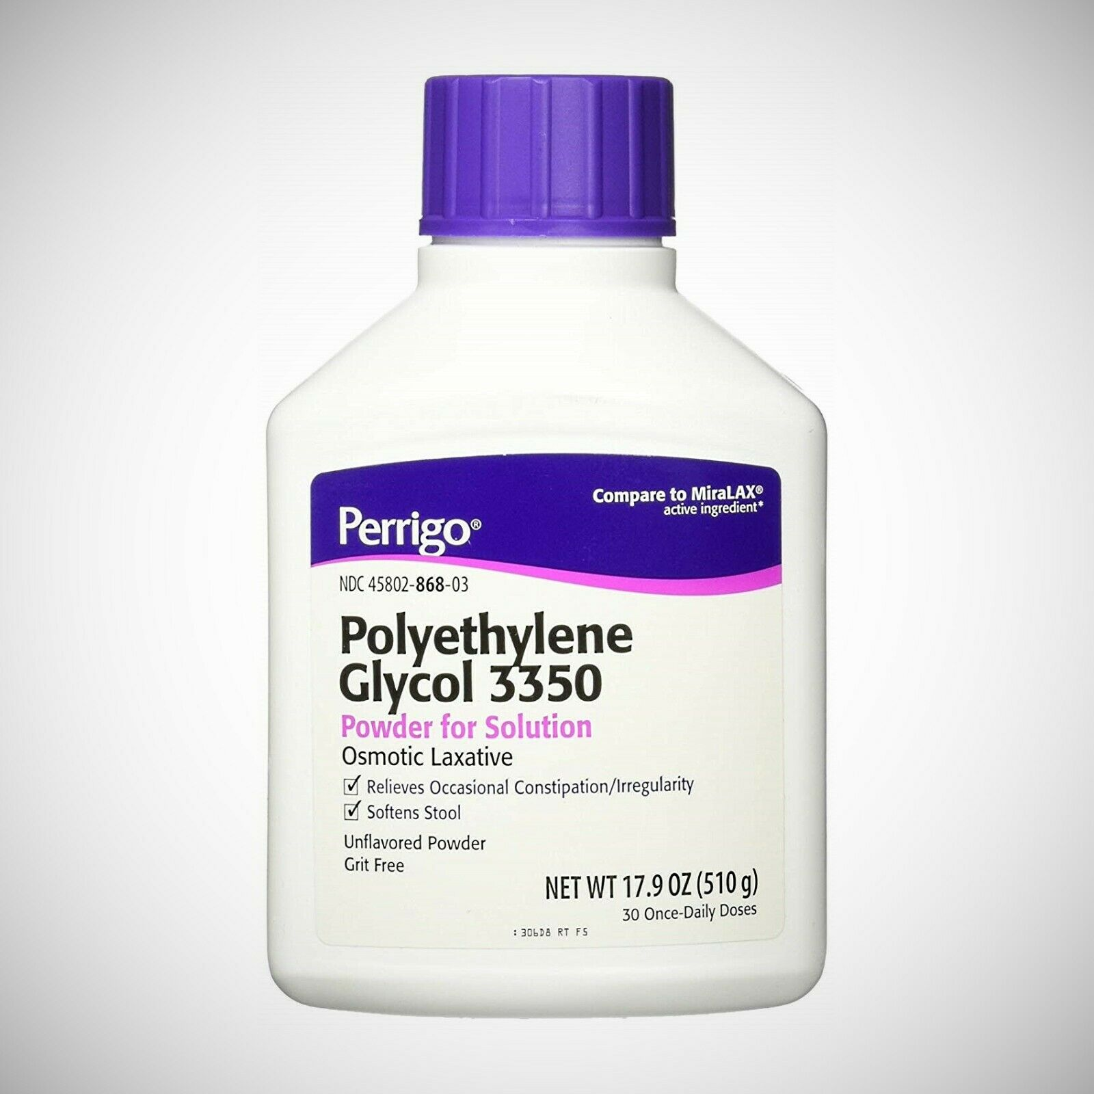
At home Polyethylene Glycol
238 mg of OTC PEG in 64oz of Sports Drink
Low volume PEG without electrolytes.
Not FDA approved
Generally more tolerable
Data is mixed on quality though larger number of studies showing inferior
it is becoming widely used and pt preferred
Initial studies showed concern for hyponatremia, but subsequent studies have demonstrated comparable safety to PEGELS
Notes:
Miralax
a meta-analysis of five randomized controlled trials in 2014 revealed the Miralax-Gatorade preparation was inferior to PEG-ELS in satisfactory bowel preparations (OR 0.65; 95% CI: 0.43-0.98; P=0.04)
Enestvedt et al[32] follow up study comparing MiraLAX with PEG-ELS showed that, in addition to less frequently achieving a BBPS greater than or equal to 7, MiraLAX was associated with a lower adenoma detection rate (16.1% vs 26.2% with PEG-ELS).
Hjelkrem et al[27] compared split doses of 4 L PEGELS with MiraLAX (alone and with either bisacodyl or lubriprostone) and demonstrated inferior preps with all of the MiraLAX based preps (Ottawa score of 5.1 vs 6.9, 6.3, and 6.8).
Enesvedt et al[29] when comparing MiraLAX with 4 L PEG-ELS. PEG-ELS produced a mean BBPS of 9% and 70% of preps were rated excellent which was superior to a mean BBPS of 8% and 55% of preps rated excellent for MiraLAX.
Both MiraLAX and PEG-ELS produced equivalent BBPS (7.0 vs 7.2) and had similar percentages of patients achieving adequate bowl preps (BBPS ≥ 6, 81.3% vs 84.3%).
no difference in time to cecal intubation or withdrawal time
Samarasena et al[28] comparing split dose MiraLAX with split dose PEG-ELS. Again, no significant difference in BBPS (8.01 vs 8.33) was observed and the MiraLAX based prep was given significantly better ratings in terms of taste and tolerability with 96.8% vs 75% of subjects willing to repeat the prep in the future.

Slide 11
Sodium Phosphate
Hyperosmotic
As effective as PEG-ELS. Still requires larger volumes.
Not fully evaluated in patients with comorbidities.
Limited use in USA and Europe. Being used in Japan.
Side effects:
Nausea and vomiting
Hyperphosphatemia
Electrolyte imbalances
Colonic mucosal damage
Grand-mal seizures
Black bock warning:
Rare acute phosphate nephropathy leading to deposition of calcium phosphate crystals in the renal tubules resulting in irreversible kidney damage
Can occur even in patients with normal renal function, but especially in patients with decreased renal function, Ace inhibitor use, and diuretics
ESGE recommends against the routine use of oral sodium phosphate for bowel preparation. The most feared AE following OSP intake is kidney injury.
Contraindications:
Absolute contraindications: pregnancy, age <18 years, stage 3–5 chronic kidney disease (glomerular filtration rate < 60 mL/min/1.73 m2), inability to maintain adequate fluid intake, pre-existing electrolyte disturbances, ascites, symptomatic congestive heart failure, and recent (within <6 months) symptomatic ischemic heart disease (unstable angina or myocardial infarction).
Relative contraindications include active inflammatory bowel disease, parathyroidectomy, and delayed bowel transit [133–137].
Recognized risk factors for acute phosphate nephropathy following the use of OSP include age > 55 years, hypovolemia, baseline kidney disease, bowel obstruction, or active co- litis, as well as intake of drugs that affect renal perfusion or function such as diuretics, angiotensin-converting enzyme (ACE) inhibitors, angiotensin receptor blockers and, possibly, nonsteroidal anti-inflammatory drugs
Notes:
Many side effects and contraindications.
Black box warning – acute phosphate nephropathy

Slide 12
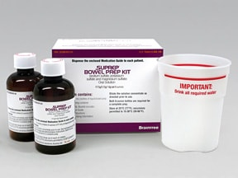
Oral Sulfate Solution
SuPrep
Suclear
compared with 4L PEG in three RCTs
noninferiority of split OSS versus split high volume PEG in terms of efficacy,
a high OSS safety
OSS better tolerability.
A 2009 study by Di Palma et al
equivalent bowel cleansing with OSS and 2 L PEGELS given as single and split doses.
Split dosing was superior to single dose for both preparations (82.4% and 80.3% vs 97.2% and 95.6% for OSS and PEGELS respectively).
Have been noted small changes in serum electrolytes with OSS, reported as clinically insignificant.
two doses of sodium, phosphate, and magnesium sulfate; Braintree Laboratories, Braintree, MA
one dose of sodium, phosphate, and magnesium sulfate followed by a second dose of PEG 3350 in 2 L of water; Braintree Laboratories, Braintree, MA

Slide 13
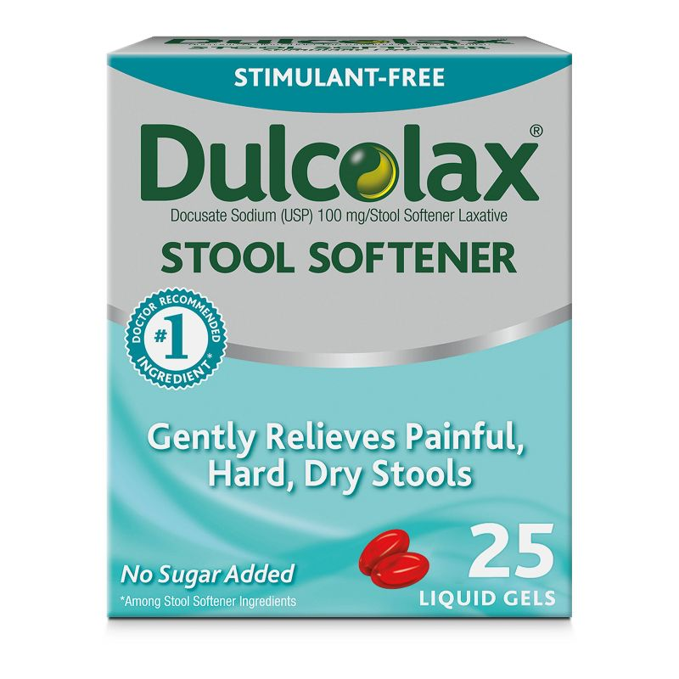
Sodium picosulfate
Used in Canada and Europe for 20+ years
Magnesium citrate with sodium picosulfate (MCSP)
meta-analysis including 25 RCTs comparing MCSP with PEG (but with different regimens),
no difference was found in colon cleansing, polyp detection rate, and ADR.
adverse events were less frequent in the MCSP group (RR 0.78, 95 %CI 0.66 – 0.93; i. e. nausea, vomiting, bloating, but not dizziness),
higher proportion of patients were likely to complete the MCSP regimen (RR 1.08, 95 %CI 1.04 – 1.13) and willing to repeat the same regimen (RR 1.44, 95 % CI, 1.25 – 1.67).
Katz et al[48] compared PMC, given as single and split doses, with single dose 2 L PEG and bisacodyl administered the day before. Single dose PMC compared favorably with single dose PEG producing successful cleansing in 83.0% vs 79.7%
May not be suitable for patients with heart failure, renal insufficiency, end stage liver disease, or baseline electrolyte abnormalities. --> increased risk clinically significant hyponatremia

Slide 14
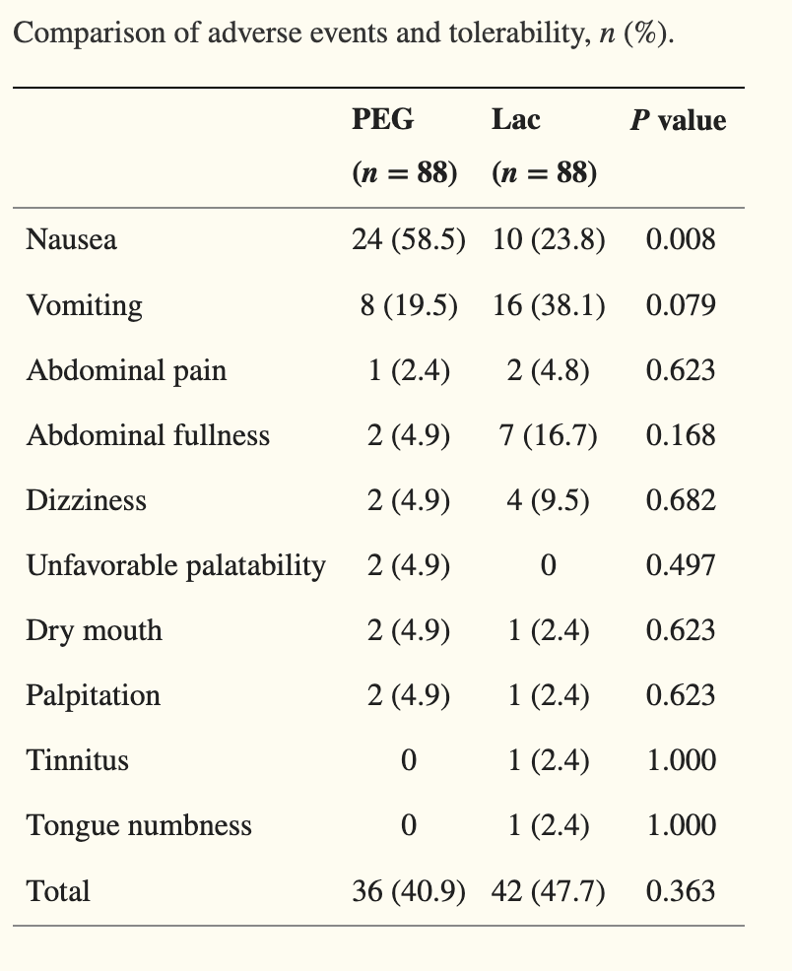
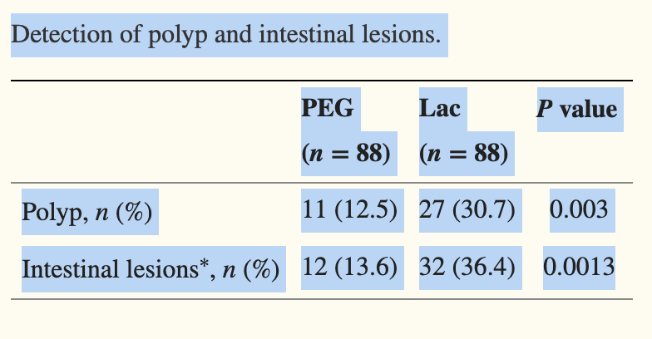
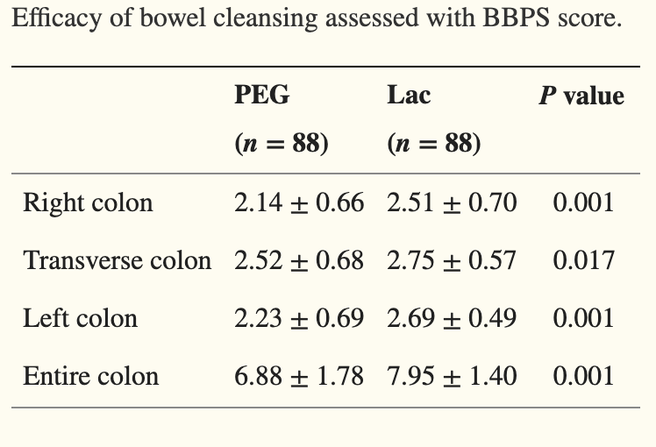
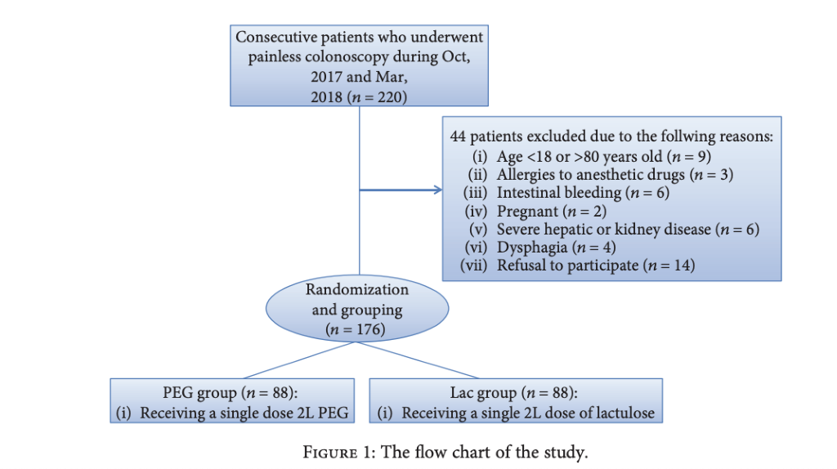
Lactulose 2L
prospective, randomized, single-blind clinical trial
lactulose oral solution, as compared with the PEG solution, was associated with a lower incidence of nausea (23.81% in the Lac group vs. 58.54% in the PEG group, P = 0 008;
Lactulose tastes sweeter.
More studies needed, but promising
Comparison of Polyethylene Glycol versus Lactulose Oral Solution for Bowel Preparation prior to Colonoscopy Gastroenterol Res Pract. 2019; 2019: 2651450.
Published online 2019 Apr 11. doi: 10.1155/2019/2651450
Notes:
The lactulose solution showed a superior bowel cleansing compared to PEG, since the Lac group had higher BBPS scores in all colon segments compared to the scores from the PEG.
Pts were more satisfied with the lactulose solution

Slide 15
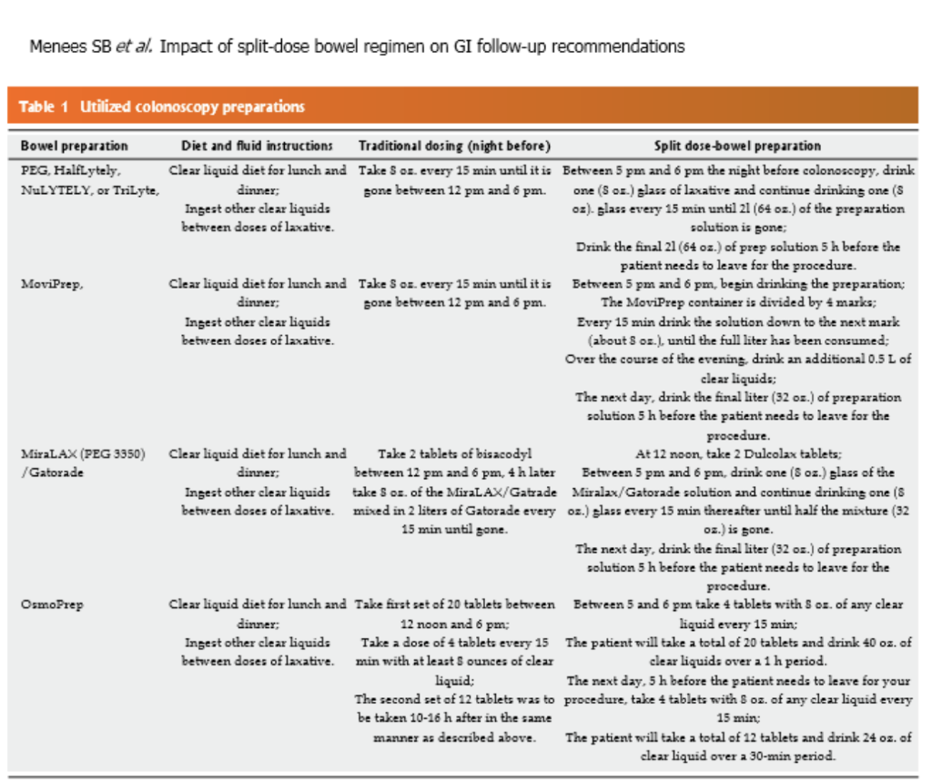
Split-dose
Multiple RCT's showing split prep regardless of the volume of preparation, split dose administration produced significantly more successful preps (75.2% vs 43.0%)
~5ml residual fluid content more than regular prep at time of procedure if fluids stopped 2+ hrs before procedure(Huffman et al[60)
3 to 5 h interval between last dose and scope produced the best cleansing
Notes:
The split-dosing regimen, where patients take a portion of the laxative the evening prior to the colonoscopy and the other half the day of, improves bowel preparation quality.
Studies have consistently shown that split-dose regimen is superior to administration of preparation on the day or night before the colonoscopy.
Concerns have been raised about the risk of periprocedural aspiration with split dose regimens
New studies have shown that split-dose bowel preparation with last drink of bowel preparation at least 2h prior to colonoscopy results in similar gastric residual volumes (~5ml more) compared to those with full-dose night before preparations.

Slide 16
Multiple meta-analysis and RCTs Show:
low residue diet was associated with higher willingness to repeat the procedure
No differences between groups were found in terms of
adequate bowel preparation
adverse events (except increased hunger in clear liquid diet groups)
No difference in ADR's
https://www.giejournal.org/article/S0016-5107%2820%2934269-3/fulltext
Notes:
Many don't adhere to or tolerate a clear liquid diet the day prior, and certainly don't like it.
Many studies demonstrated that with a low-residue diet prior to outpatient colonoscopy, patients were more willing to have a repeat colonoscopy performed, improved tolerability of preparation, and no differences in quality of bowel preparations or adverse effects.
A systematic review, including 28 RCTs, 2 controlled trials, and 10 observational studies (22 936 patients) did not show any association between shorter “nothing per mouth” intervals prior to colonoscopy and pulmonary aspiration risk

Slide 17
Patient factors
Small study looking at health literacy vs patient activation
Low health literacy scores did not alter bowel prep
Patient activation was an independent predictor of lower bowel preps.
More studies needed
Notes:
In terms of health literacy, directions should be written in easy language, 5th grade level however low health literacy was not associated with bowel prep quality.
Activation - “an individual’s knowledge, skill, and confidence for managing his/her own health and health care.”
Findings suggest that any efforts that focus on simply improving education or the readability of colonoscopy instructions may not be the root cause of poor preparation quality if individuals are not properly activated/motivated to complete this task

Slide 18
Special Populations
Renal failure
Bowel prep should not result in massive fluid shifts or electrolyte absorption
No NaP
Avoid sodium sulfate – lack of studies
Avoid sodium picosulfate
Congestive heart failure
Bowel prep should not result in massive fluid shifts or electrolyte absorption
No NaP
Avoid sodium sulfate – lack of studies
Inflammatory bowel disease
Avoid NaP --> can cause mucosal damage and colitis

Slide 19
Liver Disease
PEG solutions with osmotically balanced electrolytes are recommended
Pregnant/Lactating
ESGE found insufficient evidence to determine for or against the use of specific regimens in pregnant/breastfeeding women. However, if colonoscopy is strongly indicated, PEG regimens may be considered
Chronic constipation
recognized as a risk factor for inadequate bowel prep
Evidence is still lacking
Notes:
Constipation: evidence lacking for additional recommendations of a special regimen for bowel prep

Slide 20
Special populations con't
Elderly (65+)
large number with renal insufficiency so avoid NaP
PEG solutions are theoretically the safest and are preferred
High volume products often poorly tolerated in elderly patients
DM on GLp1 – observational Study looking 3L PEG split prep
liraglutide, sitagliptin and control
No significant difference in BBS, cecal intubation or polyp detection
More n/v and bloating in Liraglutide group
Liraglutide pts with Peripheral neuropathy did have lower BBS on subgroup analysis

Slide 21
European Society of Gastrointestinal Endoscopy (ESGE) Guideline
Low fiber diet on the day preceding colonoscopy
Adding oral simethicone to bowel prep
Split-dose bowel prep for elective colonoscopy
To start the last dose of bowel prep within 5 hours of colonoscopy, and to complete it at least 2 hours before the beginning of the procedure
Use of high volume or low volume PEG-based regimen as well as that of non-PEG-based agents that have been clinically validated for routine bowel prep. In patients at high risk for hydroelctrolyte disturbances, the choice of laxative should be individualized
Notes:
2019 update

Slide 22
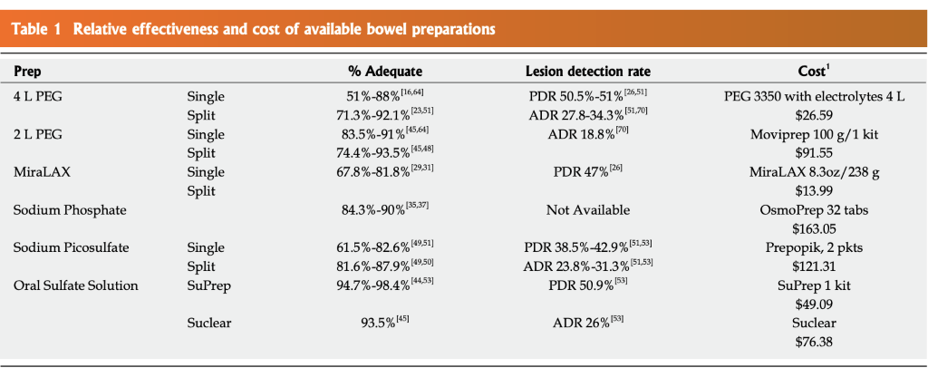
Notes:
Plenvu, good RX $147

Slide 23
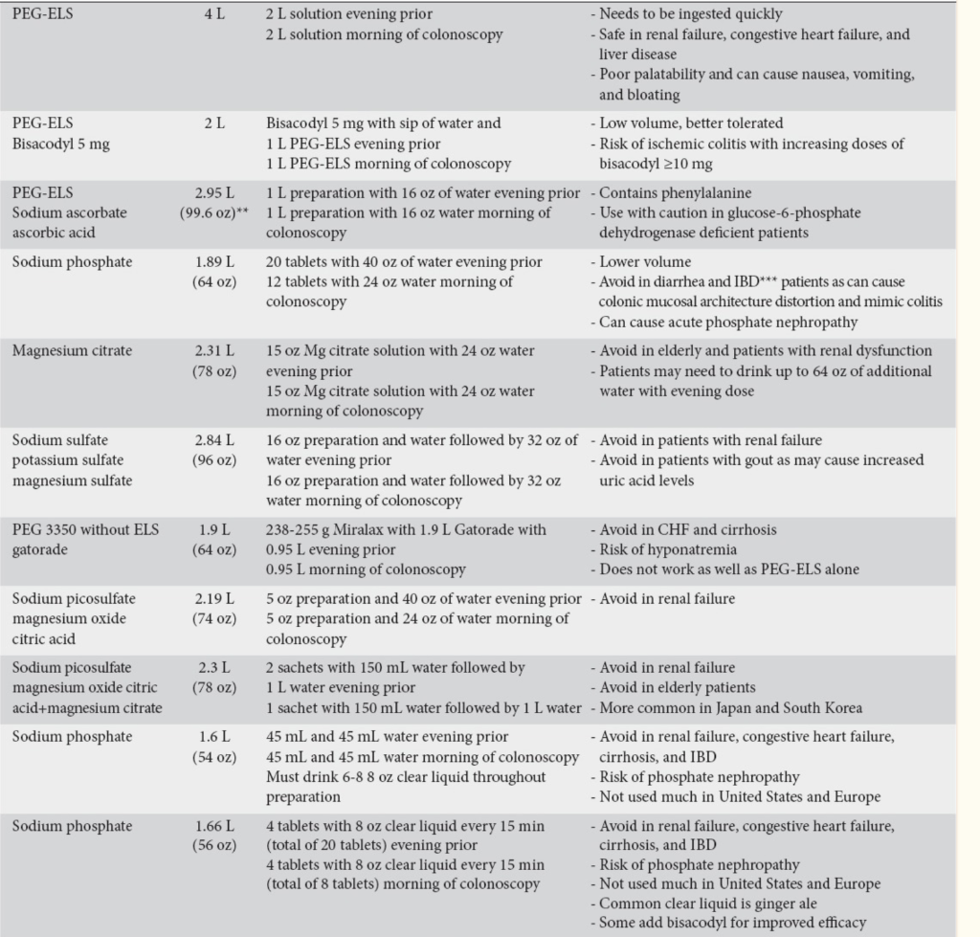

Slide 24
Take Home
Split prep!!
Diet doesn’t matter as much! Low residue diet for breakfast and lunch the day before--> your patients will thank you
Prep type --> shared decision based on comorbidities and patient/provider preference

Slide 25
Consider your whole patient when considering prep type as the body is a unit and the person represents a combination of body, mind, and spirit.

Slide 26
References
Ahmad, A., Marshall, S., Bassett, P., Thiruvilangam, K., Dhillon, A., Saunders, B. (2023). Evaluation of bowel preparation regimens for colonoscopy including a novel low volume regimen (Plenvu): CLEANSE study. BMJ Open Gastroenterology, 10:e001070. https://bmjopengastro.bmj.com/content/bmjgast/10/1/e001070.full.pdf
Bartnik Menees, S., Kim, H M., Schoenfeld, P. (2018). Split-dose bowel preparation improves adequacy of bowel preparation and gastroenterologists’ adherence to National Colorectal Cancer Screening and Surveillance Guidelines. Wold Journal of Gastroenterology, 24(6): 716-724. https://www.ncbi.nlm.nih.gov/pmc/articles/PMC5807674/
Bechtold, M., Mir, F., Puli, S., Nguyen, D. (2016). Optimizing bowel preparation for colonoscopy; a guide to enhance quality of visualization. Ann Gastroenterol, 29(2): 137-146. https://www.ncbi.nlm.nih.gov/pmc/articles/PMC4805732/
Harrison, N., Hjelkrem, M. (2016). Bowel cleansing before colonoscopy: Balancing efficacy, safety, cost and patent tolerance. World Journal of Gastrointestinal Endoscopy, 8(1): 4-12. https://www.ncbi.nlm.nih.gov/pmc/articles/PMC4707321/
Hassan, C., East, J., Radaelli, F., Spada, C., Benamouzig, R., Bisschops, R., Bretthauer, M., Dekker, E., Dinis-Ribeiro, M., Ferlitsch, M., Fuccio, L., Awadie, H., Gralnek, I., Jover, R., Kaminski, M., Pellise, M., Triantafyllou, K., Vanella, G., Mangas-Sanjuan, C., Frazzoni, L., Van Hooft, J., Dumonceau, J-M. (2019 update). Bowe preparation for colonoscopy: European Society of Gastrointestinal Endoscopy (ESGE) Guideline. ESGE, 51: 775-794. Https://doi.org/10.1055/a-0959-0505
Li, C-X., Guo, Y., Zhu, Y-J., Zhu, J-R., Xiao, Q-S., Chen, D-F., Lan, C-H. (2019). Comparision of Polyethylene Glycol versus Lactulose Oral Solution for Bowel Preparation prior to Colonoscopy. Gastroenterology Research and Practice, v.2019; PMC6487087. https://www.ncbi.nlm.nih.gov/pmc/articles/PMC6487087/
Maida, M., Sinagra, E., Morreale, G., Sferrazza, S., Scalisi, G., Schillaci, D., Ventimiglia, M., Macaluso, F., Vettori, G., Conoscenti, G., Bartolo, C., Garufi, S., Catarella, D., Manganaro, M., Virgilio, C., Camilleri, S. (202). Effectiveness of very low-volume preparation for colonoscopy: A prospective, multicenter observational study. World Journal of Gastroenterology, 26(16): 1950-1961. Doi: 10.3748/wjg.v26.i16.1950
Serper, M., Gawron, A., Smith, S., Pandit, A., Dahlke, A., Bojarski, E., Keswani, R., Wolf, M. (2014). Patient Factors That Affect Quality of Colonoscopy Preparation. Clinical Gastroenterology and Hepatology, 12: 451-457. https://fmridaho-my.sharepoint.com/personal/summerszumski_fullcircleidaho_org/_layouts/15/onedrive.aspx?id=%2Fpersonal%2Fsummerszumski%5Ffullcircleidaho%5Forg%2FDocuments%2FOneNote%20Uploads%2Fpt%20characteristics%2Epdf&parent=%2Fpersonal%2Fsummerszumski%5Ffullcircleidaho%5Forg%2FDocuments%2FOneNote%20Uploads&ga=1
Tong, Y., Huang, J., Chen, Y., Tu, M., Wang, W. (2023). Impact of glucagon-like peptide 1 receptor agonist liraglutide and dipeptidyl peptidase-4 inhibitor sitagliptin on bowel cleaning and gastrointestinal symptoms in type 2 diabetes. Frontiers in Pharmacology, 14: 1176206. doi: 10.3389/fphar.2023.1176206

Slide 27
Questions?

