Slide 1
Invited Commentary
15 minutes
Skepticism about published findings
Andrew W. Swartz, MD
Departments of Emergency Medicine, Family Medicine, and Surgery
Yukon-Kuskokwim Delta Regional Hospital
Bethel, Alaska
Flight Surgeon, 144th Airlift Squadron
Alaska Air National Guard
Joint-Base Elmendorf-Richardson, Anchorage, Alaska

Slide 2
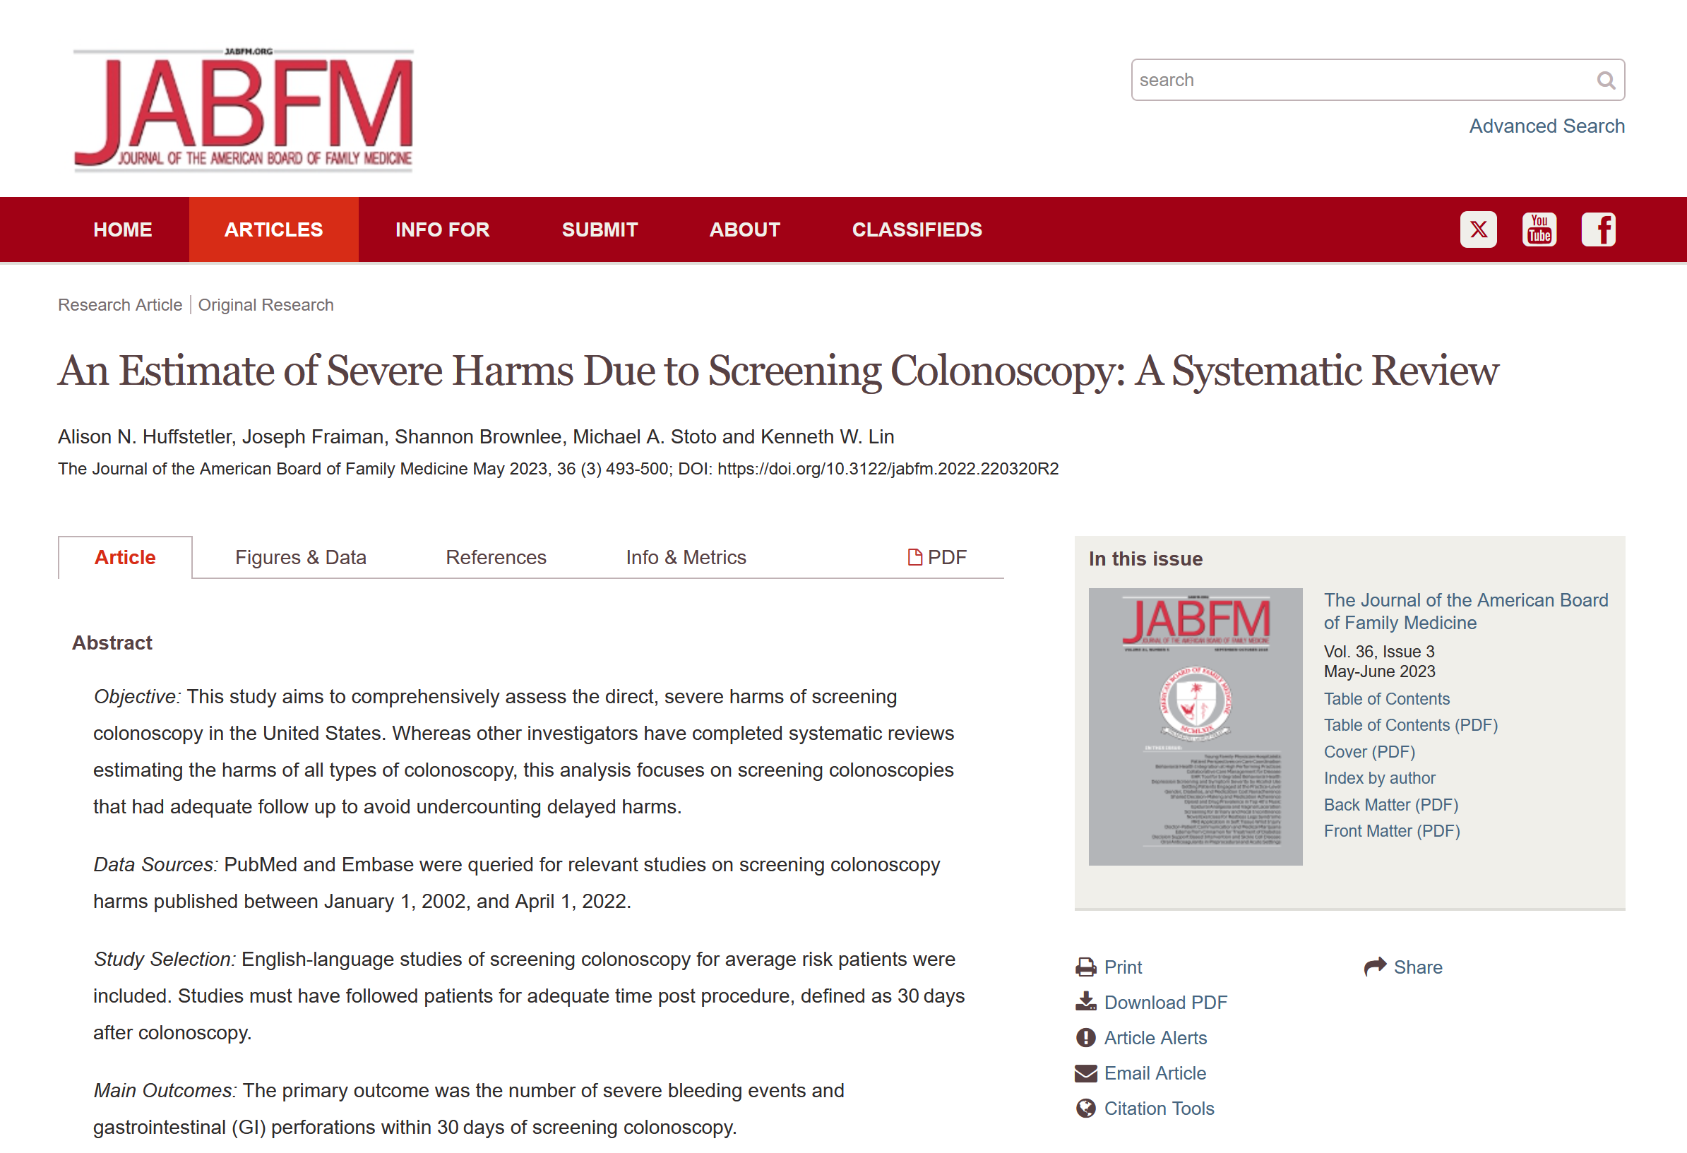

Slide 4
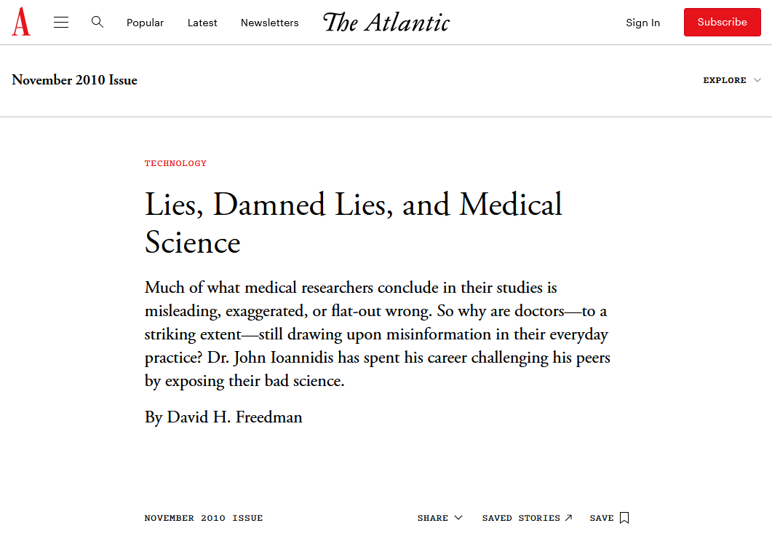
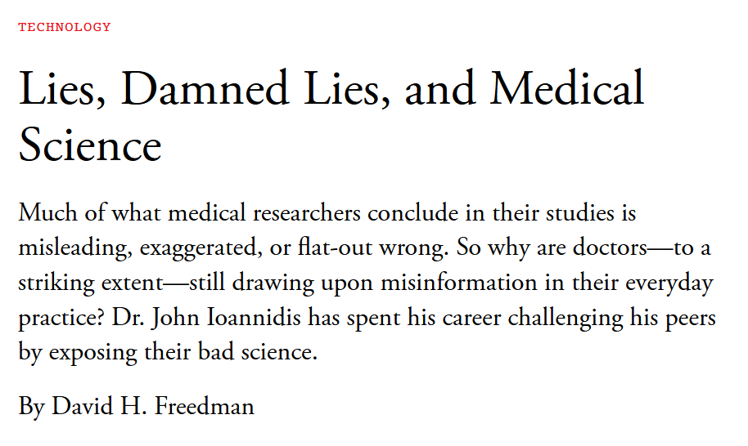

Slide 6
Science REQUIRES Skepticism

Slide 7
Outline
Background: recent LtE
Scientific Method + Hierarchy of Evidence
Users’ Guides to the Medical Literature
Bullshit (Frankfurt and Cohen)
The PICO is not enough
ex.: a failure analysis of breast cancer deaths
The parachute reviews and trial
LtE HowTo’s

Slide 8
Scientific Method
Observe the World
(for apparent associations, etc)
[Re] Form Hypothesis
Test Hypothesis with Experiment
Hypothesis disproved
Hypothesis NOT disproved
Test further,
Incorporate into Theory,
etc.

Slide 9
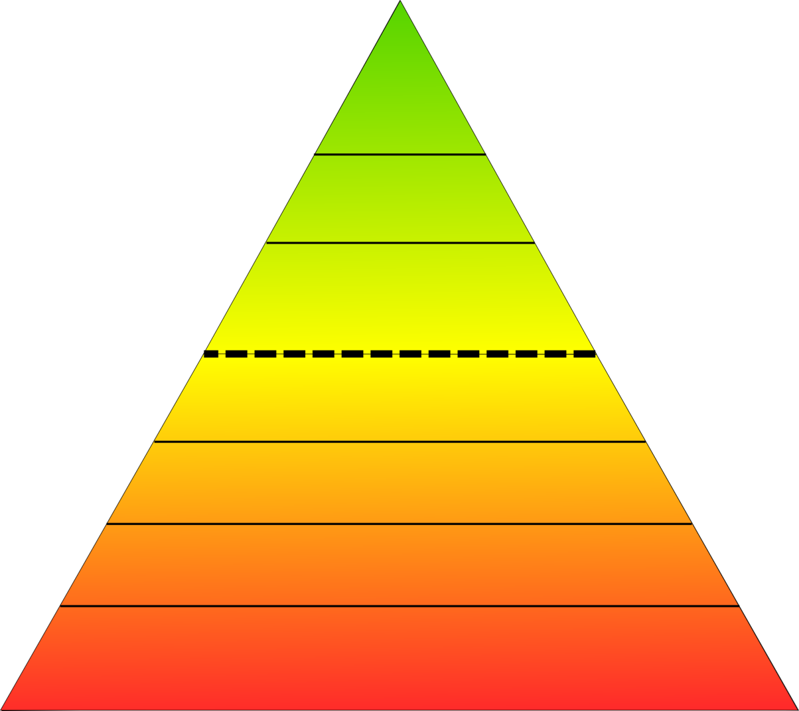
Hierarchy of Evidence
Reviews + Meta-analyses of RCT’s
RCT’s
Experiments
Non-randomized Controlled Trials
Cohort Studies
Less Bias + Confounding
Case-Control Studies
Observations
Case-Series and Reports
Expert Opinion

Slide 10
USERS’ GUIDES TO THE MEDICAL LITERATURE
SKEPTICS’

Slide 11
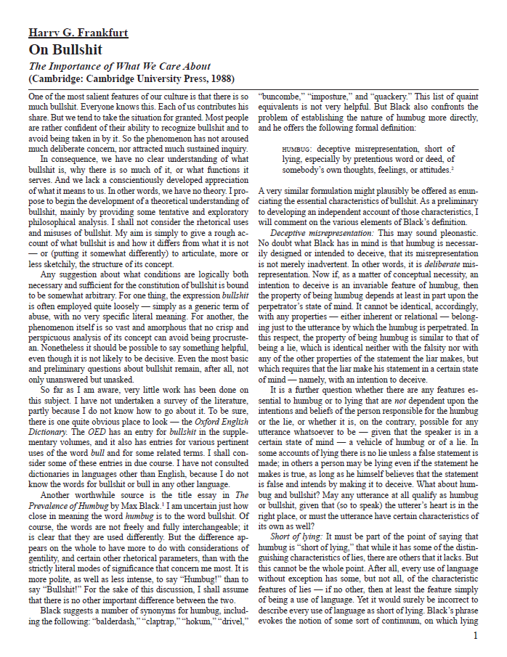
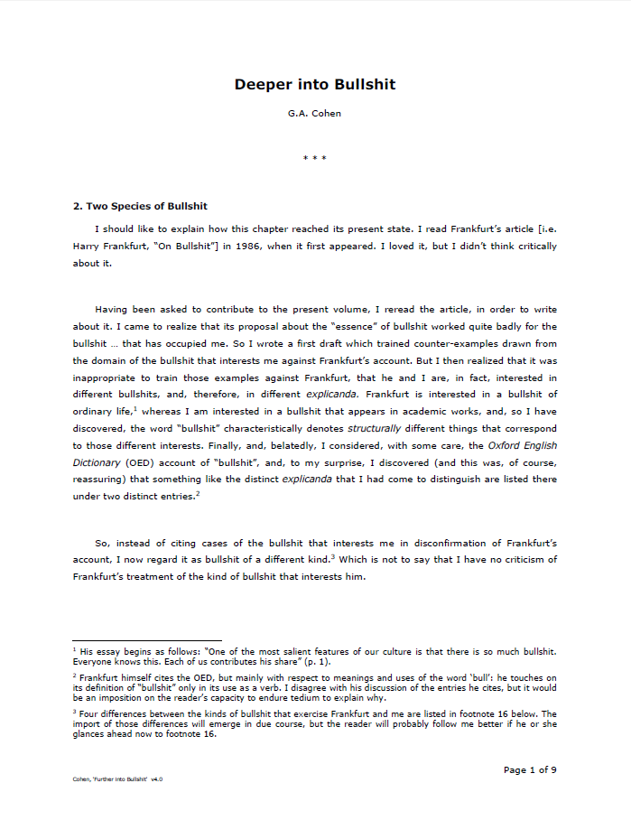
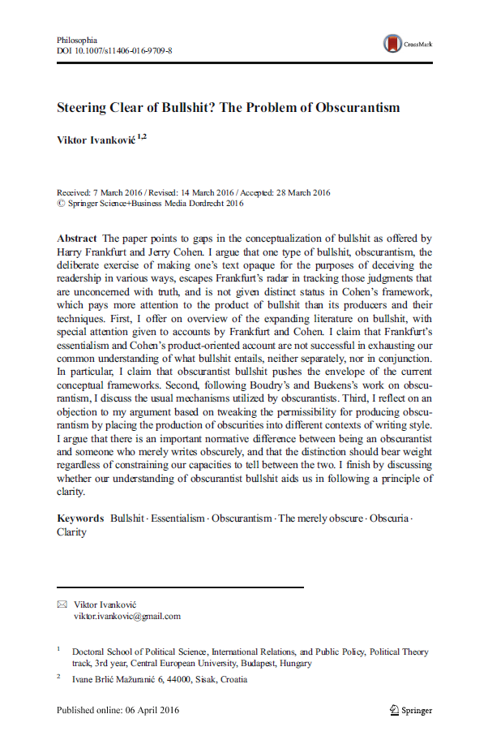
Bullshit

Slide 12
PICO
Patient or problem
Intervention or exposure
Comparison or control
Outcome(s)

Slide 13
The PICO is NOT Enough
What do we already know?
What is the basis of that knowledge?

Slide 14
Mammography RCT’s
US
1 RCT
62,000 (10%)
Canada
2 RCT’s
89,835 (15%)
Sweden
4 RCT’s
290,057 (48%)
UK
1 RCT’s
160,000 (27%)
N = 602,732

Slide 15
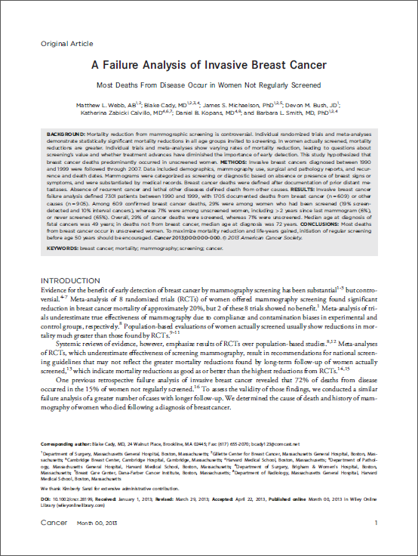
Webb ML, Cady B, Michaelson JS, Bush DM, Calvillo KZ, Kopans DB, Smith BL. A failure analysis of invasive breast cancer: most deaths from disease occur in women not regularly screened. Cancer. 2014 Sep 15;120(18):2839-46. doi: 10.1002/cncr.28199. Epub 2013 Sep 9. PMID: 24018987.
Notes:
This article was published in Sept. 2013 and received a lot of media discussion because it showed such a massive benefit of mammograms, especially at younger ages.

Slide 16
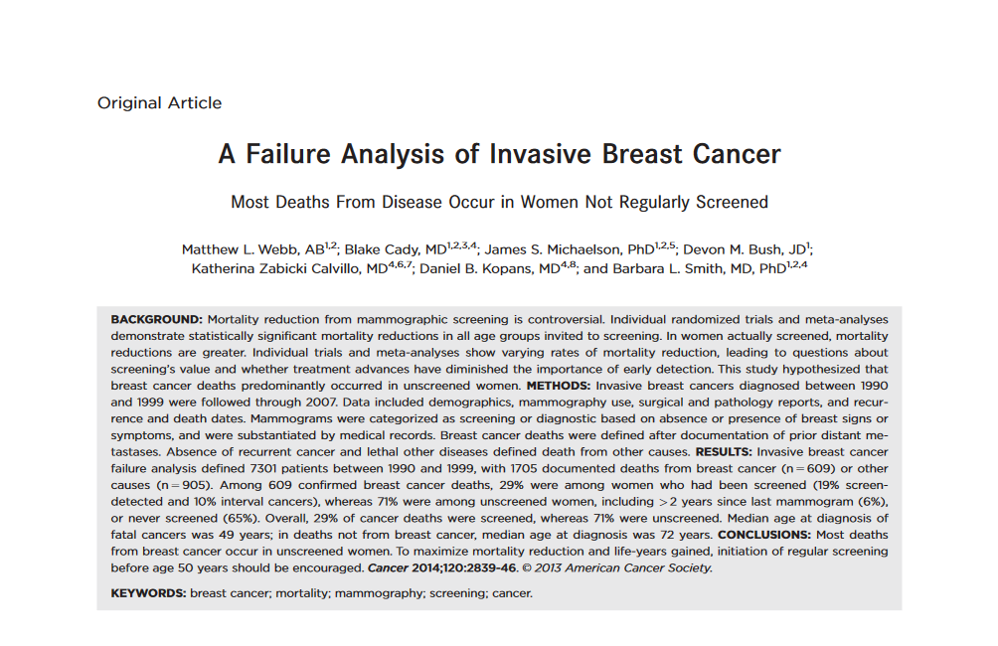
Propaganda
Bullshit
Webb ML, Cady B, Michaelson JS, Bush DM, Calvillo KZ, Kopans DB, Smith BL. A failure analysis of invasive breast cancer: most deaths from disease occur in women not regularly screened. Cancer. 2014 Sep 15;120(18):2839-46. doi: 10.1002/cncr.28199. Epub 2013 Sep 9. PMID: 24018987.
Notes:
This is an impressive sounding outcome! How can we possibly ignore it?

Slide 17
Science REQUIRES Skepticism
NOT enthusiasm
NOT cynicism

Slide 18
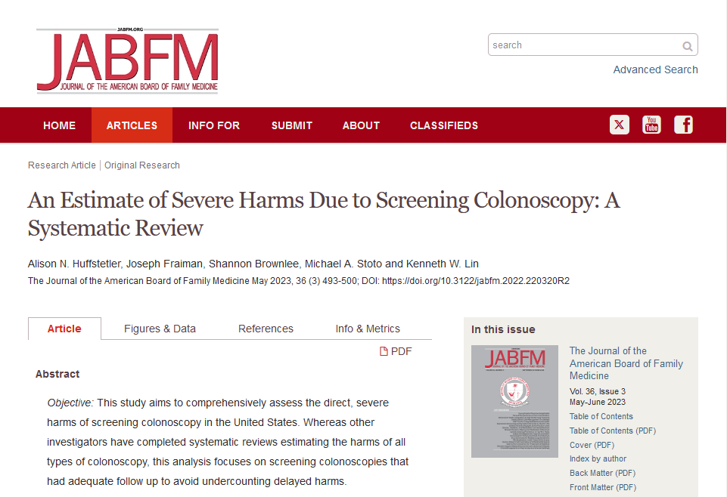

Slide 19
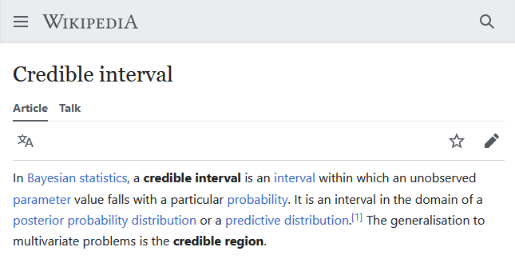

Slide 20
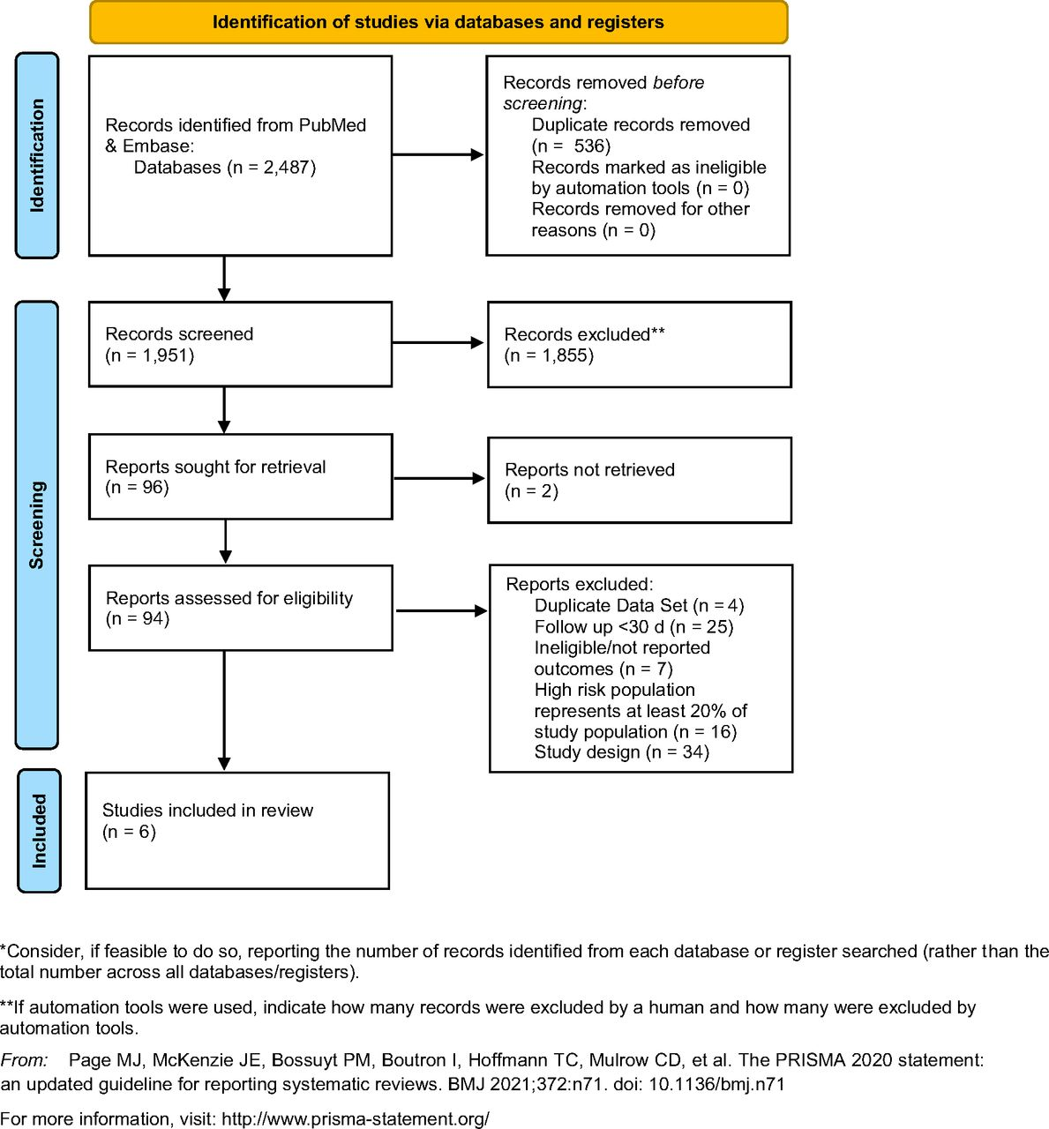
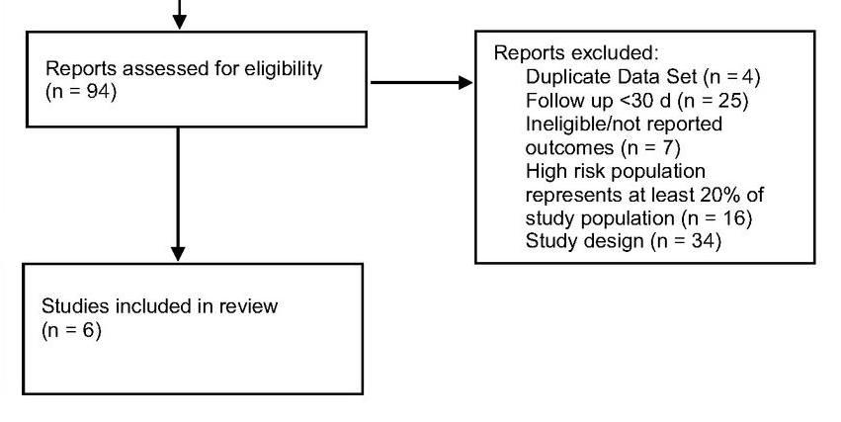

Slide 21
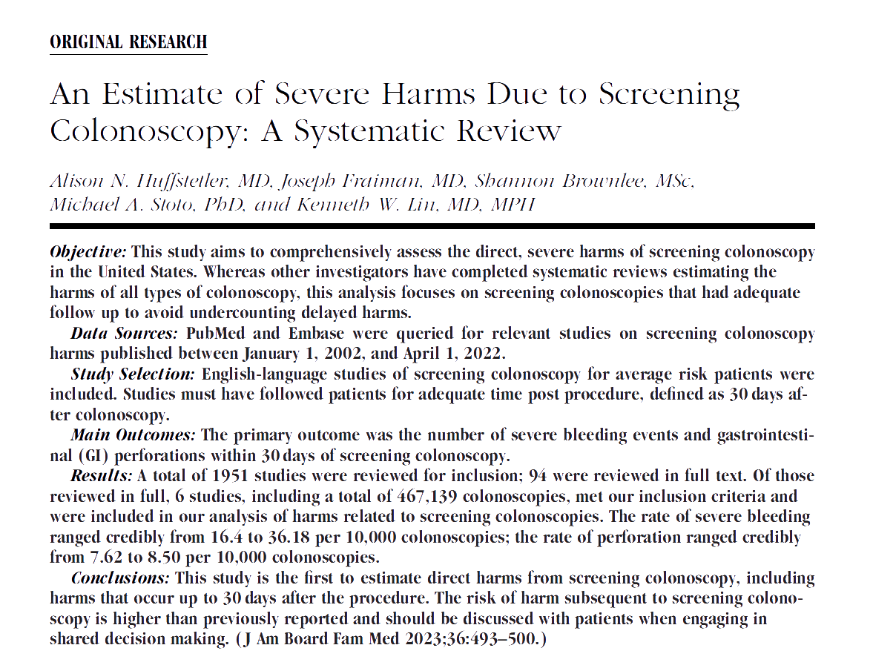

Slide 23
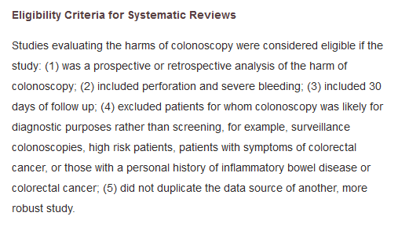

Slide 25
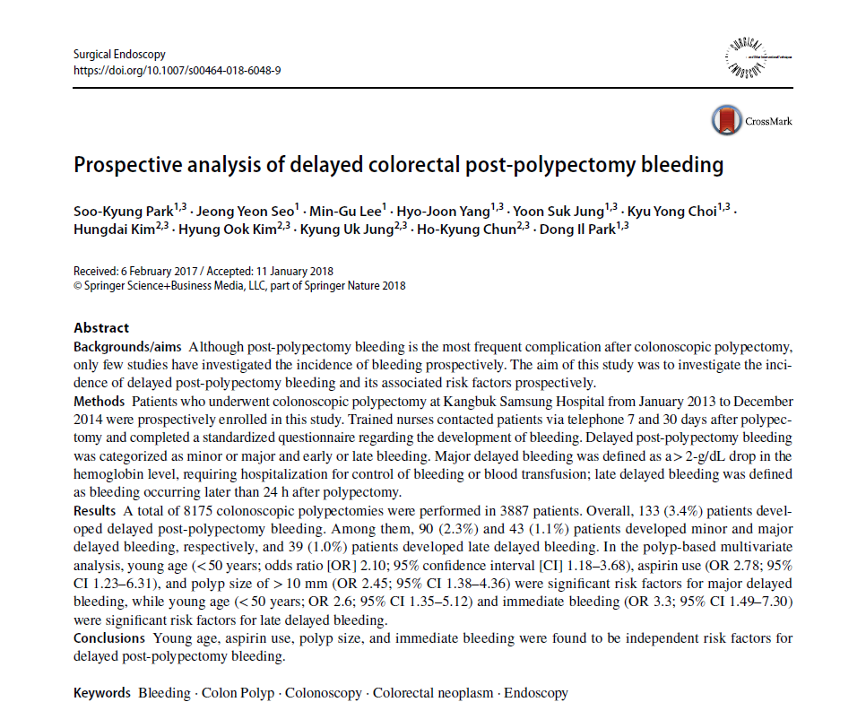

Slide 26
“The time interval from the procedure to delayed PPB ranges from 0 to 16 days.^{2,4”}
Kapetanos D, Beltsis A, Chatzimavroudis G, Katsinelos P. Postpolypectomy bleeding: incidence, risk factors, prevention, and management. Surg Laparosc Endosc Percutan Tech. 2012 Apr;22(2):102-7. doi: 10.1097/SLE.0b013e318247c02e. PMID: 22487620.

Slide 27
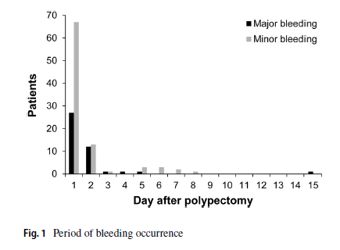
Park SK, Seo JY, Lee MG, Yang HJ, Jung YS, Choi KY, Kim H, Kim HO, Jung KU, Chun HK, Park DI. Prospective analysis of delayed colorectal post-polypectomy bleeding. Surg Endosc. 2018 Jul;32(7):3282-3289. doi: 10.1007/s00464-018-6048-9. Epub 2018 Jan 17. PMID: 29344790.
Prospective
Limited to polypectomies
8175 polypectomies, 3887 patients
133 delayed post-polypectomy bleeds

Slide 29
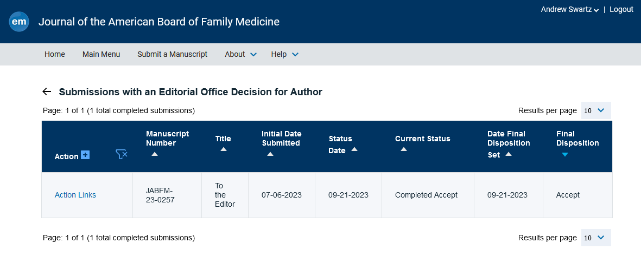

Slide 30
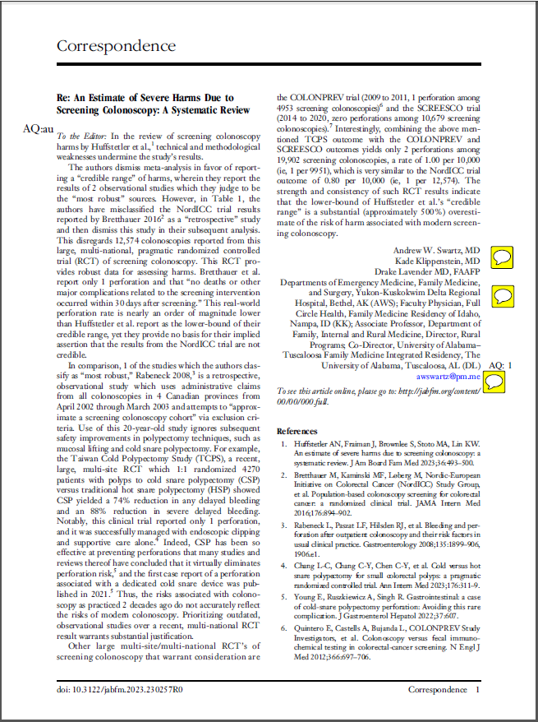

Slide 31
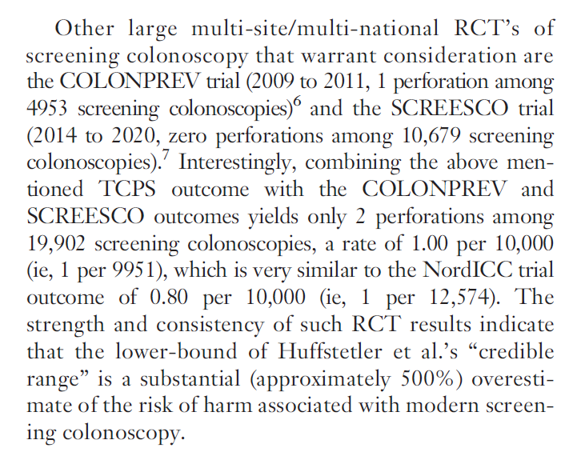

Slide 32
Letters to the Editor

Slide 33
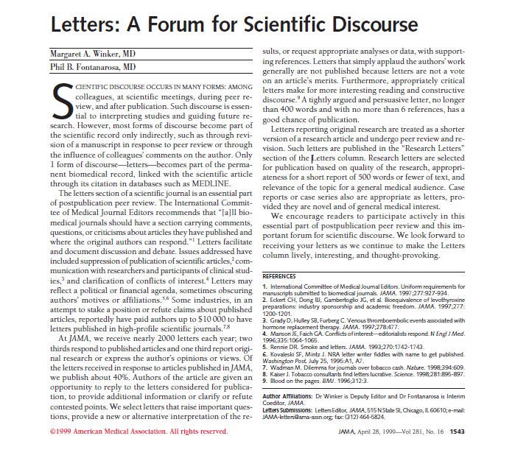
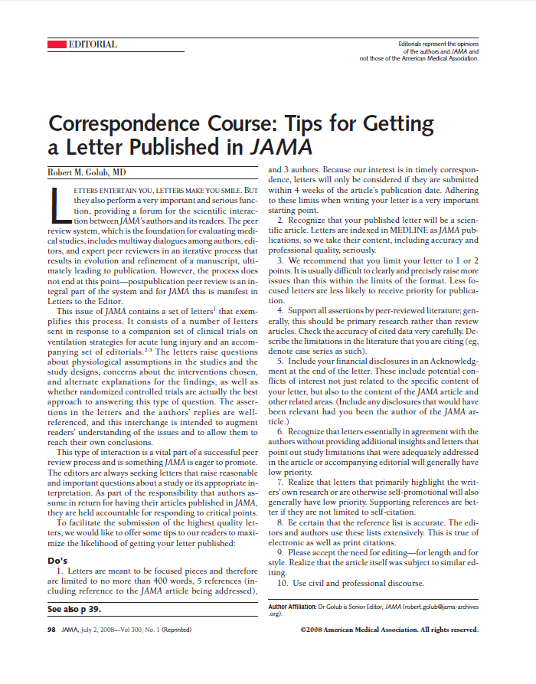

Slide 34
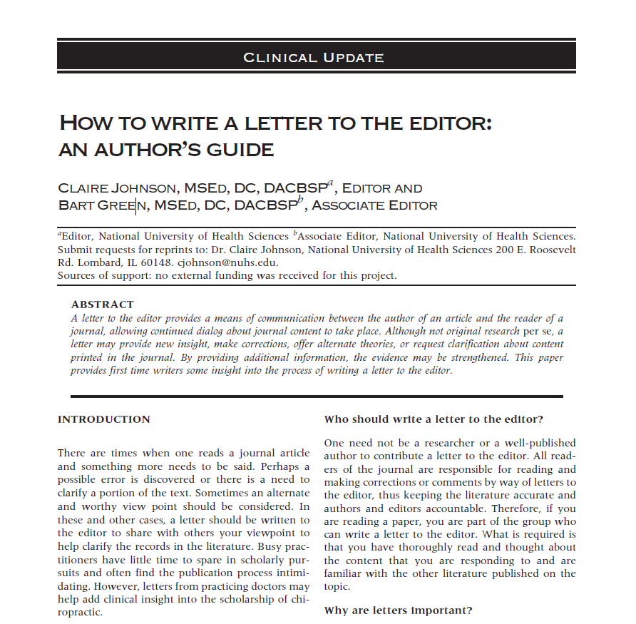

Slide 35
Science REQUIRES Skepticism

Slide 36
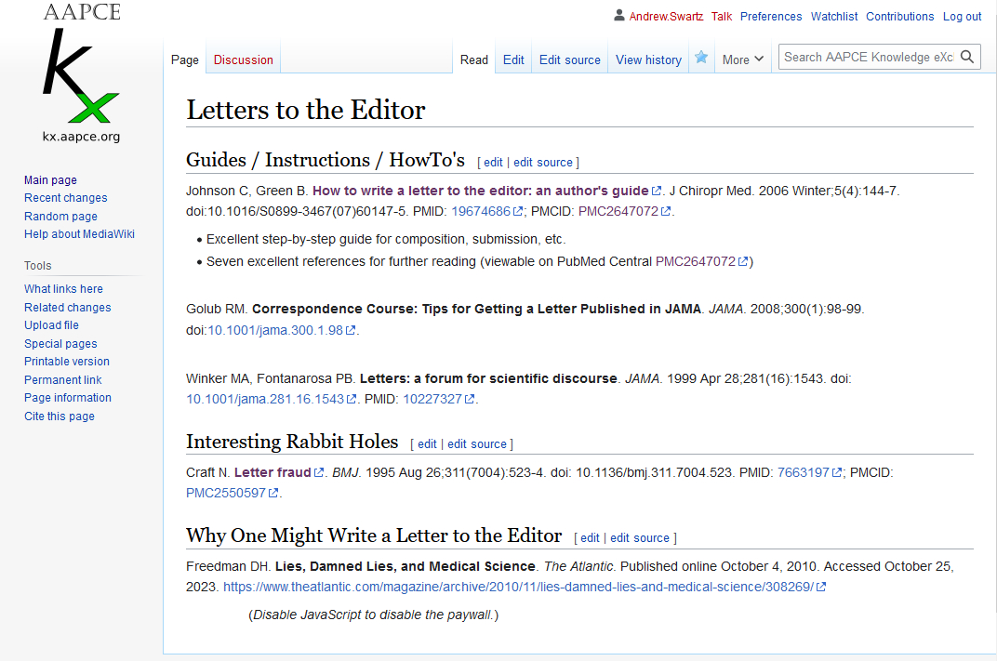

Slide 37
