Slide 1
Top 10 GI POEMs 2022-2023
Scott M. Strayer, MD, MPH
Professor and Chair
Department of Family Medicine and Population Health
Virginia Commonwealth University Health System
AAPCE Founding Member and Past-President

Slide 2
Objectives
Describe and use the principles of “Information Mastery,” including relevance, validity and usefulness of information.
Define patient oriented evidence that matters (POEMs)
Know the top 10 GI POEMs for 2022-23 that apply to primary care endoscopists.
Develop an approach for reviewing medical literature that is based on identifying POEMs as they are published.

Slide 3
Notes:
Otherwise known as decreasing the bed-side stack

Slide 4
POEM
Patient-Oriented
Evidence
that Matters
matters to the clinician, because if valid, will require a change in practice
Shaughnessy AF, Slawson DC, Bennett JH. Becoming an Information Master: A Guidebook to the Medical Information Jungle. The Journal of Family Practice 1994;39(5):489-99.
Notes:
Answering the “relevance” question. So what is pt-oriented….see next slide.

Slide 6
Relevance: Type of Evidence
POE: Patient-oriented evidence
mortality, morbidity, quality of life
Longer, better or both
DOE: Disease-oriented evidence
pathophysiology, pharmacology, etiology
Notes:
For example, when Vioxx first came out….pts found better pain relief and it became a $2b/yr drug. However, when large population-based analyses were performed, it was determined that pts were more likely to die from CVD as a result of using this drug. Most pts would care more about that outcome as would physicians, thus necessitating a change in practice. There are many other trials like that annually, albeit less dramatic, but that should constantly be prompting us to examine our practice and standard of care.

Slide 7
Determining Validity
Levels of Evidence (LOE):
1a, b, c; 2a, b, c; etc., 5- expert opinion
A, B, C, D
SORT Criteria
Therapy, diagnosis, prognosis, reviews, etc.
Notes:
4

Slide 8
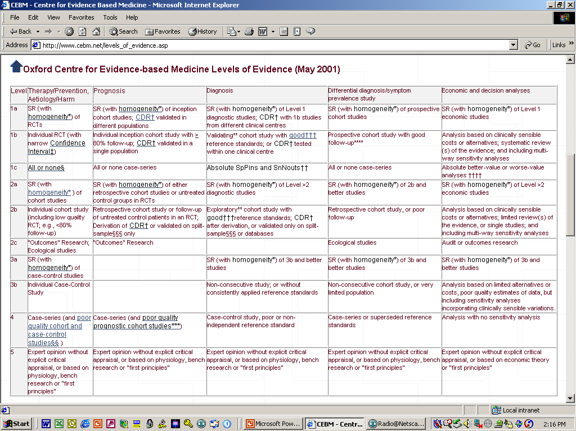

Slide 9
“It ain’t what you don’t know that gets you into trouble, it’s what you know for sure that just ain’t so.”
Mark Twain
Notes:
USE QUOTE FROM ROLAND’S DOSSIER

Slide 10
Finding the POEMS
Reviewed all Essential Evidence Plus (http://www.essentialevidenceplus.com/) daily updates from Nov. 2022-Oct. 2023 identifying studies that are relevant to primary care endoscopists.
EE+ reviews over 100 journals each month including JAMA, BMJ, Lancet, NEJM, ER, Surgery, Psychiatry, Dermatology, Urology and Family Medicine journals
Also reviews Cochrane library
Pubmed clinical queries from Nov. 2022-Oct 2023, with keywords: “colonoscopy technique,” “screening colonoscopy.”
Notes:
ONLY APPROX 75 STUDIES THAT MET THESE CRITERIA IN PUBMED
Used to use several other foraging tools including Physician’s First Watch, BMJ Updates, Cochrane Pearls, Dynamed, Medscape, etc.
But, after looking at quality of various foraging tools (show slides from USC lecture) have streamlined my email inbox to include only these
HOW TO GET EE+ in AF?

Slide 11
#1 Consider not screening average-risk adults aged 45-49 years for colorectal cancer; stick to usual means of screening
Bottom line
This guideline updates recommendations issued in a 2019 guideline from the same group, based on the publication of 2 new guidelines from other groups. There are 2 new recommendations. One is to consider not screening patients aged 45 to 49 years. The other recommendation is against screening using stool DNA, computed tomography colonography, capsule endoscopy, urine, or serum screening tests for colorectal cancer. (LOE = 5)
Ann Intern Med 2023;176(8):1092-1100.
Notes:
Going to focus more on provocative ideas on screening to enhance overall population health and also some of the nuances around surveillance, f/u and age to stop screening.
When formulating its recommendations, ACP emphasized the importance of clinical and empirical data in the context of absolute disease prevalence, rather than relying solely on disease modeling. In addition, unlike the guidelines of USPSTF and the American Cancer Society, the ACP guidance statements took cost into consideration. The ACP panel also paid attention to the risks and burden for patients and societal issues, such as equality, with the different screening tests.
-some unrealistic assumptions in modeling by USPSTF and ACS (e.g. 100% participation). Potential harms increase in younger age due to absolute #’s needed to screen given low incidence of dz in this popl’n.
-The ACP clarifies that it does not endorse fecal DNA stool testing because no comparative clinical trial data that show its effectiveness on colorectal cancer incidence or mortality against standard fecal immunochemical tests are available.

Slide 12
This guidance from the American College of Physicians focused on how best to avoid premature death due to colorectal cancer by screening adults at average risk (ie, those without a family history or other risks).
The guidelines are based on a review of existing guidelines that provide discrepant recommendations.
All guidelines except one were from North America, and all were less than 5 years old.
Notes:
A search of databases yielded 5 guidelines from the
following organizations that met inclusion criteria (Appendix
Figure, available at Annals.org): American Cancer Society
(ACS), American College of Gastroenterology, American
College of Radiology, U.S. Multi-Society Task Force on
Colorectal Cancer, and U.S. Preventive Services Task
Force (USPSTF).

Slide 13
The guidelines were evaluated using the Appraisal of Guidelines for Research & Evaluation (AGREE) II instrument.
The guideline committee reported no financial conflicts of interest and, unusual for guideline developers, recused members with intellectual conflicts of interest.
The working group included a patient representative.
They considered benefits, risks, and costs in their recommendations (some groups, such as the United States Preventive Services Task Force, do not consider cost).

Slide 14
The guideline continues to suggest beginning screening at age 50 years and stopping at age 75 years, or earlier if patients have a life expectancy of 10 years or less.
They suggest not screening asymptomatic average-risk adults between the ages of 45 to 49 years; at the very least, benefits and harms of screening should be discussed before setting up screening.
Notes:
CRC incidence slightly increased in persons younger than 50 years (6.0 to 8.7 per 100 000), decreased in those aged 50 to 64 years (85 to 74 per 100 000), and more sharply decreased in persons aged 65 years or older (305 to 158 per 100 000); decreases may be attributable to screening (2).
NO RCTS SCREENING < 50 YO; MIGHT EXCACERBATE HEALTH CARE DISPARITIES; OF 3 MODELS, ALL ASSUME 100% SCREENING AND 100% PROGRESSION TO CRC WHICH WILL OVERESTIMATE BENEFIT IN SCREENING YOUNGER POPLN (SIM-CRC, CRC-SPIN, MISCAN)
causemortality (14, 15).
The modeling study evaluated FIT, sDNA, colonoscopy, CTC, and FS for starting screening at age 45 years versus 50 years (11). Starting screening at age 45 years compared with 50 years yielded more life-years gained (LYG; range: 22 to 27 per 1000 screened or 8 to 10 life-days gained per person) and prevented a small number of CRC cases (range, 2 to 3 per 1000 screened) and deaths (range, 0.9 to 1 per 1000 screened). However, there was also an increase in the
number of colonoscopies (range, 161 to 784 per 1000 screened) and colonoscopy complications, such as cardiovascular and gastrointestinal events (for example, serious bleeding, perforation, myocardial infarction, and angina) (range, 0.1 to 2more per 1000 screened) (11).

Slide 15
The modeling study evaluated FIT, sDNA, colonoscopy, CTC, and FS for starting screening at age 45 years versus 50 years (11).
Starting screening at age 45 years compared with 50 years yielded
more life-years gained (LYG; range: 22 to 27 per 1000 screened or 8 to 10 life-days gained per person) and
prevented a small number of CRC cases (range, 2 to 3 per 1000 screened) and
deaths (range, 0.9 to 1 per 1000 screened). However, there was also an increase in the

Slide 16
Increases number of colonoscopies (range, 161 to 784 per 1000 screened) and
colonoscopy complications, such as cardiovascular and gastrointestinal events (for example, serious bleeding, perforation, myocardial infarction, and angina) (range, 0.1 to 2more per 1000 screened) (11).

Slide 17
They continue to suggest presenting benefits, harms, costs, and frequency data to patients and letting them decide whether they want to be screened via
(1) fecal immunochemical test (FIT) or high sensitivity guaiac-based fecal occult blood testing every 2 years;
(2) colonoscopy every 10 years; or
(3) flexible sigmoidoscopy every 10 years with FIT every 2 years.
The guideline recommends against screening using stool DNA, computed tomography colonography, capsule endoscopy, urine, or serum screening tests for colorectal cancer.
Notes:
RECOMMEND AGAINST THE SELECTED TESTS DUE TO NO EFFECTIVENESS STUDIES AND COST FOR SDNA IS MUCH HIGHER THAN OTHER EFFECTIVE STOOL-BASED STUDIES

Slide 18
#2 Re-Consider rescreening interval after initial negative colonoscopy
Bottom line
Rates of colon cancer prevalence 14 years or longer after an initial negative colonoscopy are only slightly increased (1.3 percentage points) over rates occurring at 10 years. Current recommendations for every-10-year screening for colon cancer with colonoscopy can likely be extended. And rescoping within 10 years makes even less sense. Until national guidelines change, maybe we should continue to offer repeat colonoscopy every 10 years but don’t push too hard. (LOE = 1b)
JAMA Intern Med 2023;183(3):183-190.

Slide 19
These researchers used a registry of screening colonoscopy in Germany, which captures data on 90% of adults.
They identified patients who were screened after age 55 years and had a follow-up colonoscopy 10 years or later after an initial negative screening (N=120,298; 49% of the initial cohort).
The included patients had no findings (71.1%) or non-neoplastic findings (28.9%) at the time of initial screening.

Slide 20
At follow-up, colorectal cancer and advanced adenomas were identified in 3.6% of women and 5.2% of men tested at 10 years, gradually increasing to 4.9% and 6.6% 14 years or longer after the initial negative screening.
These rates were 40-50% lower than the overall rate of advanced neoplams found among all people receiving colonoscopy (N=1.25 million people, 7.1% for women and 11.6% for men).
The prevalence of advanced neoplasms was at least 40% lower in women vs men, and particularly low for repeated colonoscopies conducted for those younger than 75 years.

Slide 21
#3 When to stop surveillance colonoscopy--subsequent colon cancer is rare in older patients with polyps
Bottom Line
In a population of older patients (65 years and older) with colon polyps identified by colonoscopy, few — 0.2% — will develop colon cancer. It may be time to re-evaluate the current recommendations for 5-year surveillance in older patients with previously identified polyps, especially for patients with a calculated shorter life expectancy.
JAMA Intern Med 2023;183(5):426-434.
Notes:
Overuse alert: This POEM aligns with the Canadian Association of General Surgeons’ Choosing Wisely Canada recommendation: Avoid colorectal cancer screening tests in asymptomatic patients with a life expectancy of less than 10 years and with no personal or family history of colorectal neoplasia. (LOE = 1b)

Slide 22
5.6 million patients over age 75 undergo annual surveillance colonoscopy
These investigators used the registry from a single state in the United States to determine the outcome of surveillance colonoscopies performed on 9831 people 65 years or older.
Surveillance colonoscopies are performed on individuals with preexisting polyps.
The participants were an average of 73.2 years of age, 46.2% were women, and 83.5% were white.
Overall, 8% of patients were found to have advanced polyps and 0.2% had colorectal cancer
Notes:
The primary outcome was the detection of advanced neoplasia during colonoscopy, defined as advanced polyps (ie, adenomas
≥10 mm, adenomas with high-grade dysplasia or villous features, sessile serrated polyps orhyperplastic polyps ≥10 mm,sessile serrated polypswith dysplasia, or traditional serrateda denomas) orCRC.19However,

Slide 23
Notes:
Life expectancies were calculated using Elixhauser co-morebities from Medicare claims data 1 year prior to colonoscopy

Slide 24
When synthesizing this information in the cohort in the present study, the estimated risks of complication (approximately 26 per 1000 people) were nearly 10 times greater than the potential benefits (ie, identification of CRC in 23 of 9831 people, or approximately 2.3 per 1000 people).
Mortality from SCREENING is 1/1000 in this age group
Consider age and life-expectancy based recommendations for surveillance colonoscopy
Notes:
Considering the balance of benefits and risks of colonoscopy, the rare finding of CRC during surveillance colonoscopy
is coupledwith an increasing risk of potential complications by ageandcomorbidities.Thepooledincidenceratesamongpeople
aged65 years or older undergoing colonoscopy are estimatedat 26 per 1000 people for cumulative gastrointestinal (GI) adverseevents,
1per1000peopleforperforation,6per1000people for GI bleeding, 19 per 1000 people for cardiovascular or pulmonary complications, and 1 per 1000 people for mortality.
Clinicians could use evidence regarding life expectancy and neoplasia progression to modify their recommendations for surveillance colonoscopy in older adults in the following ways: (1) if life expectancy is less than 5 years, recommend against surveillance; (2) if life expectancy is 5 to less than 10 years and the patient has only low-risk polyps, recommend against surveillance; (3) if the patient is healthy with a life expectancy of 10 or more years and has recent advanced polyps, provide a recommendation for future surveillance colonoscopy with a caveat that the ultimate decision is dependentonhealthandpriorities
at the time the colonoscopy is due; and (4) if future health is unknownor unclear, avoid giving definitive recommendations for future surveillance to allowthe
flexibility of deciding based on risk and benefit when the time comes.

Slide 25
Clinicians could use evidence regarding life expectancy and neoplasia progression to modify their recommendations for surveillance colonoscopy in older adults in the following ways:
(1) if life expectancy is less than 5 years, recommend against surveillance;
(2) if life expectancy is 5 to less than 10 years and the patient has only low-risk polyps, recommend against surveillance;
(3) if the patient is healthy with a life expectancy of 10 or more years and has recent advanced polyps, provide a recommendation for future surveillance colonoscopy with a caveat that the ultimate decision is dependent on health and priorities at the time the colonoscopy is due;

Slide 26
(4) if future health is unknown or unclear, avoid giving definitive recommendations for future surveillance to allow the flexibility of deciding based on risk and benefit when the time

Slide 27
#4Once-and-done screening colonoscopy has higher rates of adherence than yearly fecal-based blood testing
A single screening colonoscopy had higher rates of participation than 5 years of fecal occult blood testing in this study of patients offered free screening (84% vs 73%; P ≤ .001). After 5 years, only 38.4% of participants assigned to fecal occult blood testing
completed all the recommended yearly testing. As a result, advanced neoplasia or large serrated lesions were more likely to be identified by colonoscopy than testing. (LOE = 1b)
Gastroenterology 2023;165(1):252-266.

Slide 28
These researchers enrolled 3523 healthy volunteers, recruited from 3 sites in the United States, who were between the ages of 40 years and 69 years.
The participants were randomized, using concealed allocation to receive one no-cost colorectal cancer screening by colonoscopy or annual high-sensitivity guaiac-based fecal occult blood tests (HSgFOBTs) using the Hemoccult II SENSA kit for 5 years.
The participants were an average of 55.5 years and most (75%) identified as White.
Notes:
University of Minn, KPW in Washington and LSU Shreveport; had high facilitation with study coordinators

Slide 29
From the start, more people completed colonoscopy screening as compared with HSqFOBT: 84% versus 73% (P ≤ .001).
Adherence to all 5 years of HSqFOBT screening was accomplished by only 38.4% of participants, with one-quarter of these participants switching to colonoscopy screening.
Using intention-to-treat analysis, adenomas or serrated lesions were identified in 22.7% of the screening colonoscopy arm and 12.2% of the HSqFOBT arm (P < .001).
Notes:
Need to stress that this is “facilitated” colonoscopy

Slide 30
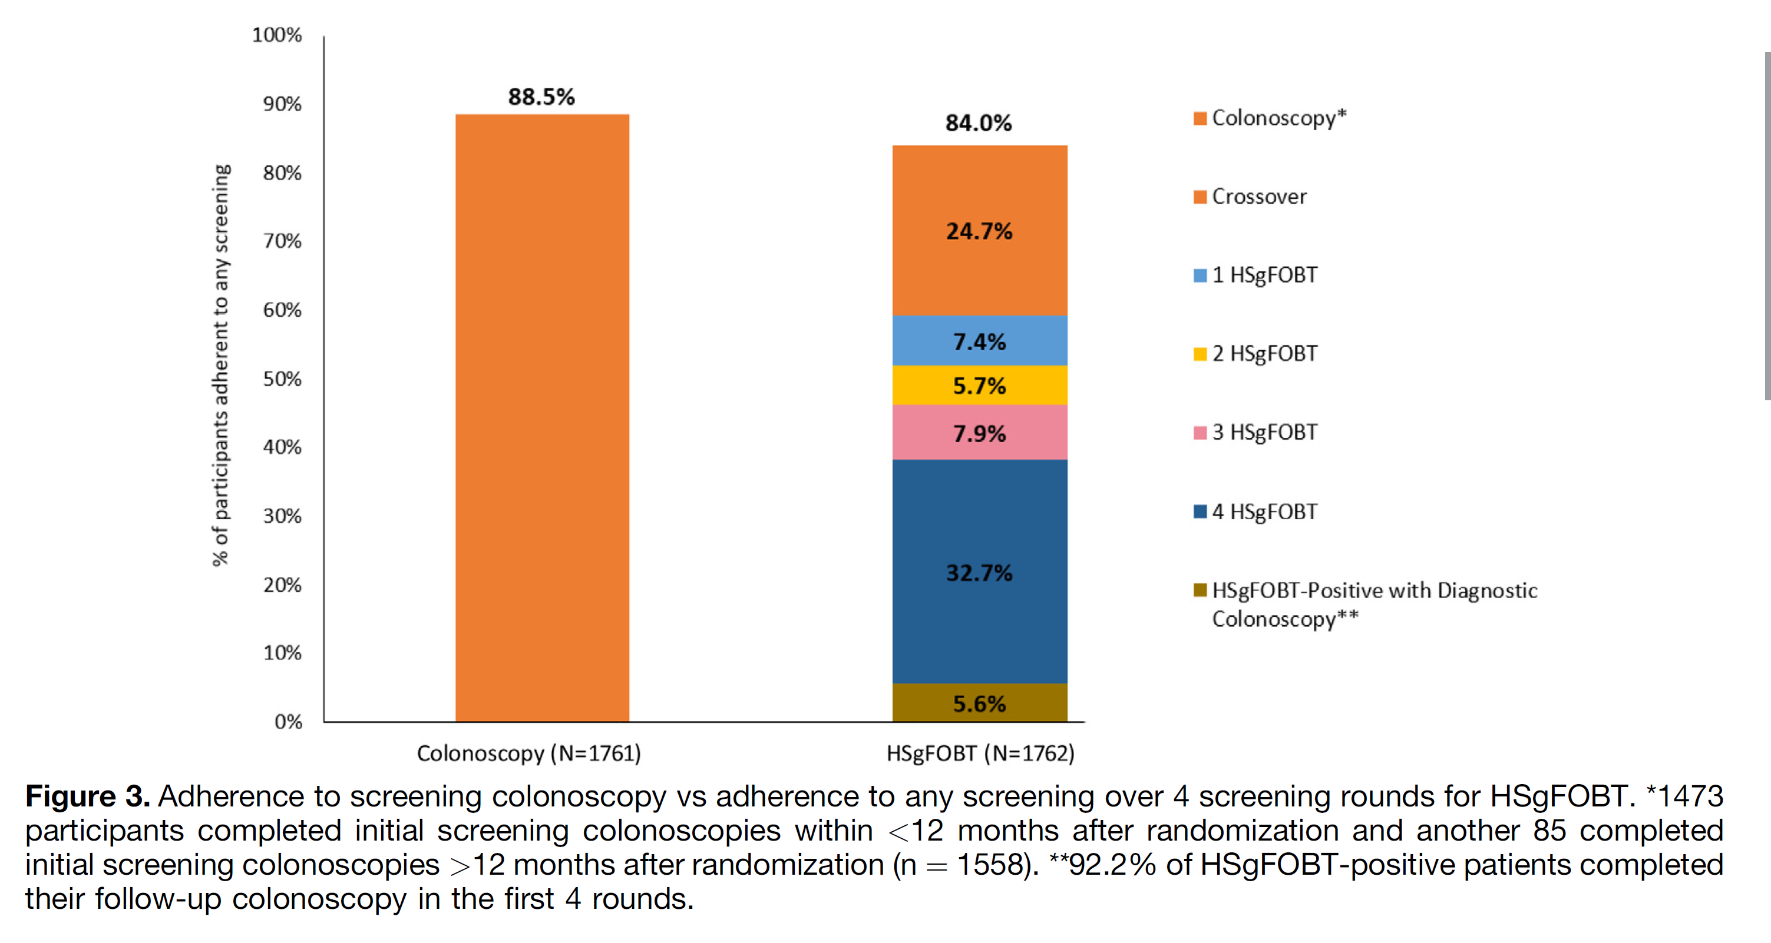

Slide 31
Advanced neoplasia or large serrated lesions were identified in 8.2% of participants who received initial colposcopy (per-protocol analysis).
Of the patients who completed the first round of HSqFOBT screening, 4.0% had a positive finding, and 91.4% of these participants followed up with colonoscopy.
Notes:
with tubulovillous or villous adenomas, high-grade dysplasia,
an adenoma $≥$1 cm in size, 3 or more tubular adenomas $≤$ 1 cm,
or CRC. Patients with nonadvanced adenomas were those with
only 1 or 2 tubular adenomas <1 cm. Serrated lesions were
classified as hyperplastic polyp (goblet cell or microvesicular
type), sessile serrated lesion (SSL), SSL with cytologic dysplasia,
and traditional serrated adenoma.36,37 We used the classification
from Rex et al36 and Gupta et al38 to designate serrated
lesions that were large (1 cm), multiple (3 or more), or
exhibiting dysplasia to permit a combined advanced neoplasia
category that combined adenoma and serrated lesions (ADNSERs)
and/or CRC as our main pathology outcome

Slide 32
#5 Improving CRC screening using a risk-adapted approach
A risk-adapted CRC screening approach is feasible and cost effective. This approach has comparable detection rates for advanced neoplasms and requires less colonoscopies to detect one advanced neoplasm. Future results will report CRC mortality.
Clinical Gastroenterology and Hepatology 2023;21:808–818

Slide 33
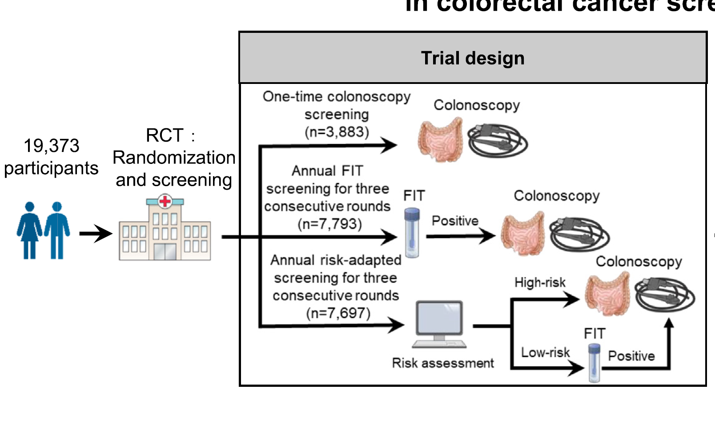
Main outcome: detection rate of advanced colorectal neoplasia (CRC and advanced precancerous lesions)
Notes:
We randomly allocated 19,373 participants into 1 of the 3 screening arms in a 1:2:2 ratio: (1)
one-time colonoscopy (n [ 3883); (2) annual fecal immunochemical test (FIT) (n [ 7793); (3)
annual risk-adapted screening (n[7697), in which, based on the risk-stratification score, high risk
participants were referred for colonoscopy and low-risk ones were referred for FIT.

Slide 34
For risk assessment, we used the modified Asia-Pacific Colorectal Screening (APCS) score, which comprises 5 CRC-related risk factors, including
age (0: 50–54 years; 1: 55–64 years; 2: 65–74 years),
sex (0: female; 1:male),
family history of CRC among first-degree relatives (0: absent; 1: present),
cigarette smoking (0: nonsmoker; 1: current or past smoker), and
body mass index (0: <23 kg/m2; 1: >23 kg/m2).
Participants with a score $≥$4 were defined as high risk (referred for colonoscopy) and those with a score <4 were defined as low risk (referred
for FIT).

Slide 36
#6 Low FODMAPS diet is better than an oral spasmolytic for irritable bowel syndrome
This pragmatic trial found a clinically meaningful benefit of a low FODMAPS diet, implemented using an app, compared with an active medication comparator. Given its safety and low cost, the authors argue that a low FODMAPS diet should be first-line therapy for our patients with IBS. The process includes elimination of FODMAPS from the diet and then reintroducing foods, one at a time, until the offending food or foods are identified. (LOE=1b-)
Gut 2022;71(11):2226-2232.
Notes:
EMPHASIZE THAT THIS WAS DONE IN PRIMARY CARE AND WITHOUT DIETITIANS
The process includes elimination of FODMAPS from the diet and then reintroducing foods, one at a time, until the offending food or foods are identified. The app used in this Belgian study was in French and Dutch, but there are many highly rated apps available. I found a free "Fast FODMAPS" app in the App store that included food lists, a food search, and other features. Caveat: These apps have not been evaluated in clinical trials. (LOE = 1b-)

Slide 37
Both low FODMAPS diets and otilonium bromide (OB) have been shown in randomized trials to have efficacy for the treatment of irritable bowel syndrome (IBS).
FODMAPS stands for fermentable oligosaccharides, disaccharides, monosaccharides, and polyols, which are short-chain carbohydrates that are poorly absorbed by some people.
This was a pragmatic trial, enrolling primary care patients given a diagnosis of IBS by their physician. Patients with psychiatric comorbidity, who had used a FODMAPS diet, or who had taken OB were excluded.

Slide 38
The dietary intervention consisted of an app that provided guidance for a low FODMAPS diet and provided more than 100 recipes; the 40 mg OB intervention was given 3 times daily.
Groups were similar at baseline, with a mean age of 41 years, and 76% were female.
Analysis was by intention to treat.
The primary outcome was a clinically significant improvement of 50 points on the 500-point IBS-Severity Symptom Scale.

Slide 39
At 8 weeks, a response was noted by more patients in the FODMAPS group than in the OB group at
4 weeks (62% vs 51%; P = .02; number needed to treat [NNT] = 9) and at
8 weeks (71% vs 61%; P = .03; NNT = 10).
The average decline in the score was also significantly higher in the FODMAPS group (-97 vs -77 points; P = .02).
There were no differences between groups in overall quality-of-life scales.

Slide 40
The authors also prespecified a subgroup analysis of the 309 patients (70%) who met the most recent Rome IV criteria for IBS.
The benefit was even greater in these patients in terms of the percentage of responders (77% vs 62%; P = .004; NNT = 7). Adherence was high and was actually better for the diet than for the medication (94% vs 73%).
Notes:
GET APP AND NICE GUIDELINE

Slide 41
#7 Efficacy of Helicobacter pylori eradication therapy for functional dyspepsia
Bottom line
HP eradication is an effective treatment for cure or improvement of symptoms of functional dyspepsia, especially if there is evidence of successful HP eradication. (LOE = 1a)
Ford AC, Tsipotis E, Yuan Y, Leontiadis GI, Moayyedi P. Efficacy of Helicobacter pylori eradication therapy for functional dyspepsia: updated systematic review and meta-analysis. Gut 2022;71:1967-1975.

Slide 42
This systematic review updated a 15-year-old Cochrane review with 10 new trials and 2896 patients, for a total of 29 trials and 6781 patients.
Only 6 studies were classified as having a low risk of bias, with the most common problems being unclear allocation concealment and unclear complete outcome reporting.
Based on 18 studies with 4564 patients, Helicobacter pylori (HP) eradication therapy decreased the likelihood of failure to cure functional dyspepsia (relative risk [RR] = 0.91; 95% CI 0.88 - 0.94; I2 = 7%; number needed to treat [NNT] = 14).
Notes:
The authors did the usual high-quality Cochrane systematic review to identify randomized trials with at least 3 months of follow-up, using a random effects meta-analysis.

Slide 43
However, there was some evidence for publication bias, suggesting that smaller negative trials were not published.
The benefit was consistent regardless of the comparator (placebo or antisecretory therapy) or study quality.
Based on 22 studies with 5193 patients, HP eradication therapy also decreased the likelihood of failure to improve symptoms without evidence of publication bias but moderate heterogeneity (RR 0.84; 0.78 - 0.91; I2 = 69%; NNT = 9).
Notes:
They did multiple subgroup analyses based on different comparators and study quality, etc. and the benefit was consistent.

Slide 44
In 16 studies reporting whether eradication was successful, patients with successful eradication were significantly less likely to fail to improve or to fail to be cured than those who received the comparator (RR 0.74; 0.64 - 0.85; I2 = 82%; NNT = 6).
However, there was significant heterogeneity, and funnel plot asymmetry suggests possible publication bias.

Slide 45
#8 British Society of Gastroenterology guidelines for the evaluation and management of dyspepsia
The guidance regarding imaging and the use of upper endoscopy is probably on the conservative side for US physicians. The authors acknowledge that approximately half of the recommendations are based on low- or very low–quality evidence. This POEM aligns with the Canadian Association of Gastroenterology's Choosing Wisely Canada recommendation: Avoid using an upper GI series to investigate dyspepsia. (LOE = 1a)
Black CJ, Paine PA, Agrawal A, et al. British Society of Gastroenterology guidelines on the management of functional dyspepsia. Gut 2022;71(9):1697–1723.

Slide 46
Based on a series of systematic reviews and network meta-analyses.
The authors recommend urgent evaluation of patients with upper gastrointestinal alarm symptoms,
such as anyone with dysphagia,
or persons 55 years or older with weight loss and either dyspepsia, upper abdominal pain, or reflux.
They also recommend urgent evaluation for patients 40 years or older who are either from a region where gastric cancer is common or who have a family history of gastroesophageal cancer.

Slide 47
Other alarm symptoms warranting a less urgent evaluation include hematemesis; and in persons 55 years or older, treatment-resistant dyspepsia, dyspepsia, or upper abdominal pain with elevated platelet count, low hemoglobin, nausea or vomiting, or nausea or vomiting with any weight loss, reflux, dyspepsia, or upper abdominal pain.
Patients without alarm symptoms who present with at least 2 months of epigastric burning or pain, early satiety, and/or postprandial fullness should be given a diagnosis of functional dyspepsia and be told that it is a disorder of gut-brain interaction.
Notes:
SEE IF THERE IS A FLOW DIAGRQM OR ALGORITHM IN PUBLICATION

Slide 48
As part of the initial evaluation, all patients 55 years or older should have a complete blood count with platelets, those with overlapping irritable bowel symptoms should have celiac serology, and those 60 or older with abdominal pain and weight loss should have an abdominal CT to evaluate for pancreatic cancer.
All patients with dyspepsia should be evaluated for the presence of helicobacter pylori (HP) using a stool or breath test, and if the results are abnormal the patient should be treated to eradicate HP

Slide 49
Confirmation of HP eradication is only recommended for patients at increased risk of gastric cancer, although it should also be considered in patients whose symptoms persist.
The guidelines recommend against the routine use of gastric emptying tests or 24-hour pH monitoring.
For patients who are HP negative, first-line therapy includes acid-suppressive therapy with a histamine antagonist or proton pump inhibitor and regular aerobic exercise; the guidelines do not recommend specific diets such as a FODMAPS diet.

Slide 50
Prokinetics may be an effective treatment, with the strongest evidence supporting tegaserod.
Second-line therapies include low-to-moderate dose tricyclic antidepressants (eg, amitriptyline 10 mg once daily, titrating to 30 mg to 50 mg).
The authors recommend against selective serotonin reuptake inhibitors, serotonin-norepinephrine reuptake inhibitors, and buspirone.
Finally, cognitive behavioral therapy, psychodynamic interpersonal psychotherapy, stress management, and hypnotherapy may be effective. Patients with refractory or persistent symptoms should be referred to a gastroenterologist.
Notes:
It is important to note that approximately half of the 35 recommendations in the guidelines are based on low- or very low–certainty evidence.

Slide 51
#9 No increased risk of esophageal cancer with nonerosive gastroesophageal reflux
Bottom line
We can reassure our patients (and ourselves) that nonerosive GERD does not increase the likelihood of esophageal cancer. Erosive GERD, however, is associated with a doubled — but still low — risk of developing cancer, with the likelihood increasing over time. (LOE = 1b)
BMJ 2023 Sep 13;382:e076017.

Slide 52
These Scandinavian researchers followed up on 486,556 adults who underwent endoscopy in Denmark, Finland, and Sweden.
These countries have national registries, which allows follow-up of patients over time; this one took place over a 32-year period ending in 2019.
Among the 285,811 patients with nonerosive gastroesophageal disease (GERD), 228 (0.08%) developed esophageal cancer during 2,081,051 person-years of follow-up (median follow-up 6.3 years, though some patients were followed for up to 31 years).

Slide 53
This rate is similar to the rate of developing esophageal cancer in the general population.
In contrast, 542 (0.27%) of patients with erosive GERD subsequently developed cancer.
These results may not apply to Eastern Asia, where the overall incidence of esophageal cancer is higher than in other countries.

Slide 54
#10 American College of Gastroenterology guideline for evaluating and managing patients with celiac disease
Bottom line
Although the American College of Gastroenterology recommends biopsies to diagnose celiac disease, it also states the combination of high titers of tissue transglutaminase and a positive endomysial antibody test are reliable alternatives. To achieve remission, a gluten-free diet (including gluten-free oats because of the prevalence of gluten contamination) remains the treatment of choice. (LOE = 5)
Am J Gastroenterol 2023;118(1):59-76.

Slide 55
The American College of Gastroenterology assembled a panel of content experts and methodology experts (no mention of participation by primary care clinicians, patients, or patient representatives) who identified 8 broad questions on evaluating and managing children and adults with celiac disease.
They then addressed these questions via systematic reviews.
The guideline has several useful tools, including a complex algorithm on the approach to a person with clinical suspicion of celiac disease.
Notes:
Although some of the recommendations are oriented toward gastroenterologists, the following are more relevant to primary care clinicians.

Slide 56
The panel strongly recommends that patients undergo esophagogastroduodenoscopy (EGD) with multiple biopsies.
The panel also states that, in children and in adults unwilling to undergo EGD, the combination of high titers of tissue transglutaminase and a positive endomysial antibody test result are reliable alternatives.
The panel recommends against mass screening in favor of case finding approaches to improve detection in the general population.
While a gluten-free diet is the therapy of choice, gluten contamination of grains is problematic.

Slide 57
The panel made a strong recommendation on using gluten-free oats to increase the likelihood of achieving clinical remission.
Although there was dissension, the panel made a conditional recommendation against using gluten-detection devices.
Finally, the panel found insufficient evidence to recommend for or against using probiotics.

Slide 58
One more time…..
#1 Re-consider screening interval after initial negative colonoscopy
#2 Subsequent colon cancer is rare in older patients with polyps
#3 Consider not screening average-risk adults aged 45-49 years for colorectal cancer; stick to usual means of screening
#4 Once-and-done screening colonoscopy has higher rates of adherence than yearly fecal-based blood testing
#5 Improving CRC screening using a risk-adapted approach

Slide 59
#6 Low FODMAPS diet is better than an oral spasmolytic for irritable bowel syndrome
#7 Efficacy of Helicobacter pylori eradication therapy for functional dyspepsia
#8 British Society of Gastroenterology guidelines for the evaluation and management of dyspepsia
#9 No increased risk of esophageal cancer with nonerosive gastroesophageal reflux
#10 American College of Gastroenterology guideline for evaluating and managing patients with celiac disease

