Slide 1
Polyposis Syndromes of the Colon
Aaron Sinclair, MD
University of Kansas School of Medicine – Wichita
Department of Family and Community Medicine
Associate Professor
Wesley Family Medicine Residency
Program Director
Notes:
familial adenomatous polyposis (FAP), hamartomatous polyposis syndromes, and other rare polyposis syndromes, such as hereditary-mixed polyposis syndrome (HMPS)
Show you how but maybe not why

Slide 2
Learning Objectives:
Differentiate the different Hamartomatous Polyposis Syndromes
Discuss the differences between Serrated Polyps and Hyperplastic polyps
Distinguish the malignant potential of serrated polyps
Identify when serrated polyps are considered serrated polyposis syndrome
Describe the relationship between hyperplastic polyps and serrated polyps

Slide 3
Hamartomatous Polyposis Syndromes
Phosphatase and Tensin Homolog (PTEN) Hamartoma Tumor Syndrome
Cowden Polyposis Syndrome
Peutz-Jehgers Polyposis Syndrome
Bannayan-Riley-Ruvalcaba syndrome
Proteus-like syndrome – really rare – not covered
Autism spectrum disorders and macrocephaly – not covered
Juvenile Polyposis Syndrome
Diagnosis of exclusion after the PTEN Syndrome has been ruled out

Slide 4
Phosphatase and Tensin homolog (PTEN) hamartoma tumor syndrome
Cowden Polyposis Syndrome
Peutz-Jehgers Polyposis Syndrome
Bannayan-Riley-Ruvalcaba syndrome
Proteus-like syndrome – really rare – not covered
Autism spectrum disorders and macrocephaly – not covered
Notes:
Germline pathogenic variants in the phosphatase and tensin homolog (PTEN) gene have been described in a variety of rare syndromes with different clinical presentations that are collectively known as PTEN hamartoma tumor syndromes (PHTS). The defining clinical feature of PHTS is the presence of hamartomatous tumors, which are disorganized growths of native cells in native tissues. PHTS is inherited in an autosomal dominant fashion.

Slide 5
Cowden Polyposis Syndrome
Estimated prevalence of Cowden syndrome is 1 in 200,000 to 250,000
PTEN genetic mutation is found in 20-34%
Most pathogenic variants are unique to a given family.
Range of clinical manifestations:
Hamartomatous tumors in multiple organ systems
Both mucocutaneous and extracutaneous
An increased risk for malignancy

Slide 6
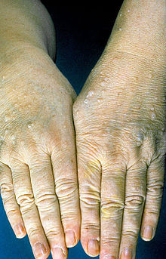
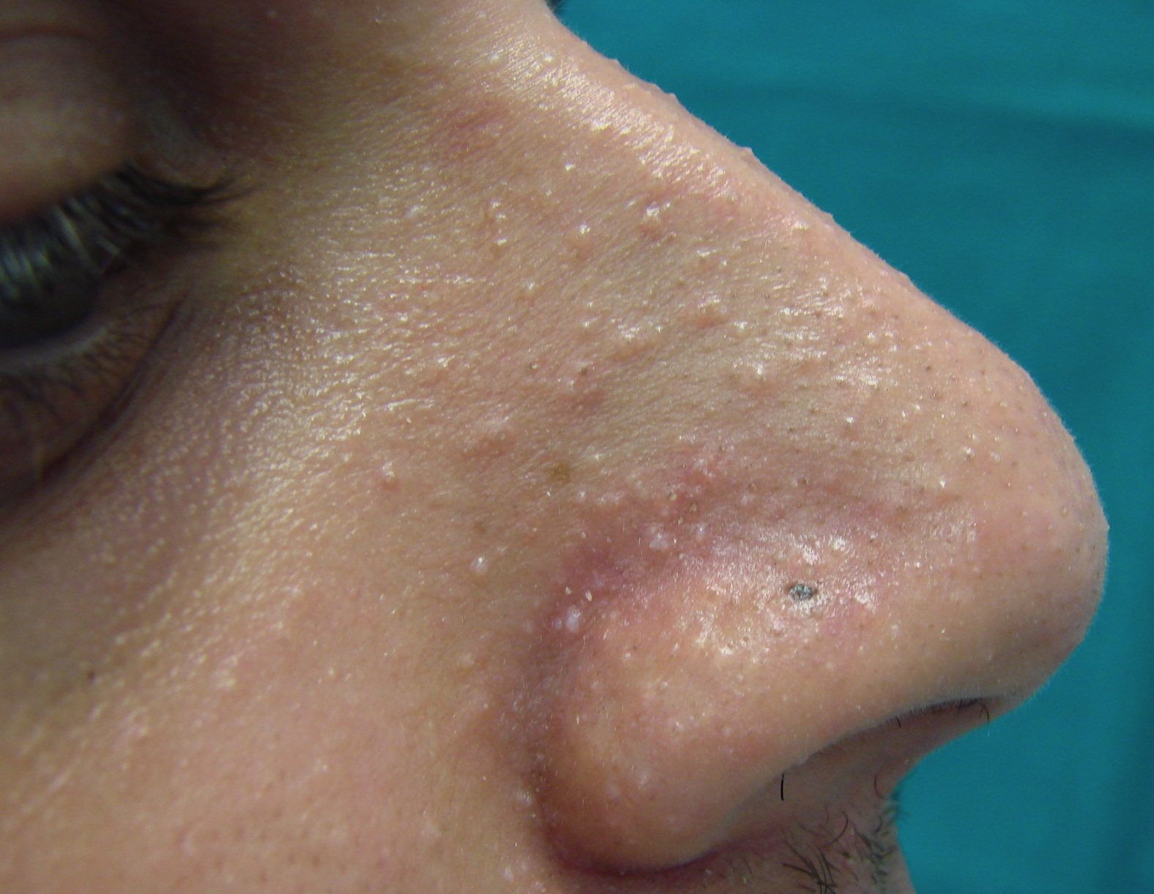
Cowden Polyposis Syndrome
Mucocutaneous findings typically the presenting symptom that leads to diagnosis
Typically noticed in the second decade of life, (variability = 4 to 75 years)
Trichilemmomas, Facial Papules, Acral Keratoses
Notes:
https://contourderm.com/tag/trichilemmomas/
https://en.wikipedia.org/wiki/Cowden_syndrome
https://escholarship.org/uc/item/916821pq
A trichilemmoma is rarely a sporadic feature. One study found a complete loss of PTEN expression by immunohistochemistry in five of six (83 percent) trichilemmomas from patients with Cowden syndrome compared with only 1 of 33 (3 percent) sporadic trichilemmomas [49]. (See "Cutaneous manifestations of internal malignancy", section on 'Heritable conditions associated with skin disorders and malignancy'.)
●Acral keratoses present as 1 to 4 mm keratotic verrucous papules that are located on the dorsal hands, wrists, or feet. Patients can also develop translucent punctate keratoses on the palms or soles [13,43,50].
●Facial papules are the most frequent lesions and are found in up to 86 percent of cases [51]. They have a predilection for periorificial regions, sometimes extending into the nostrils. Oral papules and papillomas (coalesced papules) on the lips, buccal mucous membranes or palate are pink or white smooth lesions of 1 to 4 mm in diameter. When they coalesce, they can form a distinctive cobblestone appearance (picture 3) [46,50].

Slide 7
Cowden Polyposis Syndrome
Breast Disease
The lifetime risk of breast cancer for affected female patients is frequently reported at between 25 and 50 percent.
Thyroid Disease
Benign thyroid abnormalities in up to 68 percent of patients
Non-medullary thyroid cancer relative to the general population approximately 70-fold increased incidence
Genitourinary Disease
Males - lipomatosis of the testes
Females
Benign – uterine fibroids - ? Increased incidence
Malignant – Endometrial Cancer with a reported cumulative lifetime risk of 13 to 30 percent and Renal Cell Cancer (in individuals with PTEN pathogenic variants) in 2 - 5 percent of all patients
Notes:
Benign thyroid abnormalities such as multinodular goiter, lymphocytic (Hashimoto) thyroiditis, and adenomas are very common and reported in up to 68 percent of patients [13,69-71]. (See "Diagnostic approach to and treatment of thyroid nodules", section on 'History and physical examination'.)
According to one estimate, individuals with Cowden syndrome have an approximately 70-fold increased incidence of non-medullary thyroid cancer relative to the general population
Benign uterine abnormalities such as uterine fibroids are common findings in female patients
RCC is also increased in individuals with PTEN pathogenic variants. In large case series of patients with PTEN mutations, RCC was reported in 2 to 5 percent

Slide 8
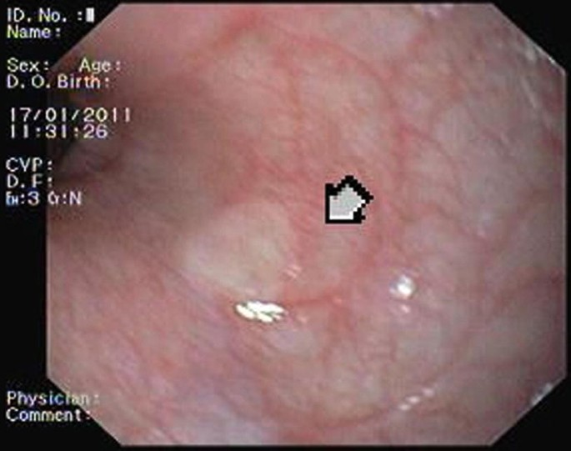
Cowden Polyposis Syndrome - Gastrointestinal Findings
Esophageal glycogen acanthosis — Glycogenic acanthosis of the esophagus
multiple, uniformly sized gray-white round elevations
usually in the midportion of the esophagus
Pathology of the Gastrointestinal Tract -
Glycogenic Acanthosis
Marques R et al. Online: 12 October 2018
Notes:
Esophageal glycogen acanthosis — Glycogenic acanthosis of the esophagus typically appears as multiple, uniformly sized gray-white round elevations in an otherwise normal-appearing mucosa, usually in the midportion of the esophagus (picture 4) [81]. The exact frequency of esophageal glycogen acanthosis is unclear, but in one report, diffuse dozens or scores of lesions were observed in 8 of 10 patients with Cowden syndrome who underwent evaluation [82]. Although usually clinically irrelevant, when present in conjunction with hamartomatous GI tract polyps, further work-up for Cowden syndrome should occur. (See "Benign lesions of the esophagus", section on 'Glycogen acanthosis'.)
Gastric and duodenal polyps — Polyps have been reported throughout the GI tract among PTEN pathogenic variant carriers, with 66 to 100 percent of affected individuals reported to have gastric or duodenal polyps [45,82,83]. Polyp histologies include hamartomas, hyperplastic polyps, ganglioneuromas, adenomas, and inflammatory polyps. Interestingly, there is a report of significant regression of gastric polyps in a Cowden syndrome patient after eradication of Helicobacter pylori [84]. There are rare case reports of gastric cancer [85,86] and duodenal carcinoma [87], but these have not been found to be common in larger case series.
Colon polyps — The prevalence of colon polyps among PTEN pathogenic variant carriers is as high as 95 percent of those undergoing colonoscopy [45,83,88,89]. The histologic spectrum is diverse. Hamartomatous and inflammatory polyps are the most prevalent, but ganglioneuromas, adenomas, leiomyomas, lipomas, and hyperplastic polyps can also be found. Many patients have multiple synchronous histologic types of polyps [45,88,90]. (See "Juvenile polyposis syndrome" and "Overview of colon polyps", section on 'Hamartomatous polyps' and "Overview of colon polyps", section on 'Inflammatory polyps'.)
Colorectal cancer — An increased risk of early onset colorectal cancer has been reported in patients with Cowden syndrome:
●A Japanese series found a 9 percent prevalence of colon cancer, a remarkable finding in view of the low rates of colorectal cancer in this population [83].
●In a series of PTEN pathogenic variant carriers, 13 percent of patients undergoing screening colonoscopy were found to have colorectal adenocarcinomas; all were under the age of 50 (average age 44.4, range 35 to 49) [45]. In a report from the same group of 368 PTEN pathogenic variant-positive patients, the risk of colorectal cancer was estimated at 10-fold higher than the general population, with an estimated lifetime risk of 9 percent [38].
●A multinational series of 156 patients with germline PTEN pathogenic variants found an 18 percent risk of colorectal cancer by the age of 60 [91].
It remains unclear whether colonic malignancy arises from adenomatous polyps or whether it can also arise from hamartomatous polyps. Because of these associations, guidelines suggest that PTEN pathogenic variant carriers undergo routine endoscopic surveillance.

Slide 9
Cowden Polyposis Syndrome - Gastrointestinal Findings
Gastric and Duodenal Polyps
66-100 % of affected individuals
Varying polyp histologies found including hamartomas, inflammatory, adenomas, etc.
Some benefit with possible regression of polyp numbers with H. Pylori treatment
No large association of stomach or duodenal cancer with PTEN patients
Notes:
Gastric and duodenal polyps — Polyps have been reported throughout the GI tract among PTEN pathogenic variant carriers, with 66 to 100 percent of affected individuals reported to have gastric or duodenal polyps [45,82,83]. Polyp histologies include hamartomas, hyperplastic polyps, ganglioneuromas, adenomas, and inflammatory polyps. Interestingly, there is a report of significant regression of gastric polyps in a Cowden syndrome patient after eradication of Helicobacter pylori [84]. There are rare case reports of gastric cancer [85,86] and duodenal carcinoma [87], but these have not been found to be common in larger case series.

Slide 10
Cowden Polyposis Syndrome - Gastrointestinal Findings
Colon Polyps
Upwards of 95% of affected individuals
Varying polyp histologies found including hamartomas, inflammatory, adenomas, etc.
Colorectal Cancer
9-13% of patients will have CRC
Average age 44 (35-49)
Risk of colorectal cancer was estimated at 10-fold higher than the general population, with an estimated lifetime risk of 9 percent
Unclear where the CRC is arising from which polyps
Therefore routine endoscopy recommended
Notes:
Colon polyps — The prevalence of colon polyps among PTEN pathogenic variant carriers is as high as 95 percent of those undergoing colonoscopy [45,83,88,89]. The histologic spectrum is diverse. Hamartomatous and inflammatory polyps are the most prevalent, but ganglioneuromas, adenomas, leiomyomas, lipomas, and hyperplastic polyps can also be found.
Colorectal cancer — An increased risk of early onset colorectal cancer has been reported in patients with Cowden syndrome:
●A Japanese series found a 9 percent prevalence of colon cancer, a remarkable finding in view of the low rates of colorectal cancer in this population [83].
●In a series of PTEN pathogenic variant carriers, 13 percent of patients undergoing screening colonoscopy were found to have colorectal adenocarcinomas; all were under the age of 50 (average age 44.4, range 35 to 49) [45]. In a report from the same group of 368 PTEN pathogenic variant-positive patients, the risk of colorectal cancer was estimated at 10-fold higher than the general population, with an estimated lifetime risk of 9 percent [38].
●A multinational series of 156 patients with germline PTEN pathogenic variants found an 18 percent risk of colorectal cancer by the age of 60 [91].
It remains unclear whether colonic malignancy arises from adenomatous polyps or whether it can also arise from hamartomatous polyps. Because of these associations, guidelines suggest that PTEN pathogenic variant carriers undergo routine endoscopic surveillance.

Slide 11
Cowden Polyposis Syndrome - Miscellaneous Findings
Autism
Dysplastic Gangliocytoma of the Cerebellum
Macrocephaly
Developmental Delays
Immune Dysregulation

Slide 12
Cowden Polyposis Syndrome
Annual comprehensive physical exam, starting at 18 years of age or five years before the youngest age of diagnosis of a component cancer in the family.
Colonoscopy at age 35 years unless symptomatic or if close relative with colon cancer before age 40; then start 5 to 10 years before the earliest known colorectal cancer in the family. Repeat every five years or more frequently if patient is symptomatic or polyps are noted.

Slide 13
Cowden Polyposis Syndrome
Annual thyroid ultrasound starting at age seven
Consider renal ultrasound at age 40 and repeat every one to two years.
Annual dermatologic exam is recommended.
Consider psychomotor assessment in children at diagnosis and brain MRI if there are symptoms.
Recommendations specifically for females include:
Breast awareness starting at age 18 years.
Clinical breast exam every 6 to 12 months starting at age 25 years or 10 years before the earliest known onset of breast cancer in family.
Annual mammography and breast MRI screening starting at age 35 years or 10 years before the earliest known breast cancer in the family.
Education regarding endometrial cancer
Consider random endometrial biopsies every one to two years.
Discuss options of risk-reducing mastectomy and hysterectomy (at completion of childbearing) and provide counseling regarding all aspects of these procedures.

Slide 14
Yehia et al. The Clinical Spectrum of PTEN Mutations
Annual Review of Medicine. Vol. 71:103-116 (Volume publication date January 2020)

Slide 15
Peutz-Jehgers Polyposis Syndrome
Hamartomatous polyp originating from the muscularis portion of the colon.
Commonly, associated with STK11 mutations
Polyps are usually benign, but may grow progressively and produce symptoms or undergo malignant transformation.
Patients with PJS are at increased risk of both gastrointestinal (gastric, small bowel, colon, pancreas) and nongastrointestinal cancers including breast cancer.
Epithelial misplacement → pathological misdiagnosis
Notes:
Epithelial misplacement involving all the layers of the bowel has been reported in approximately 10 percent of small intestinal polyps in PJS. Epithelial misplacement, possibly due to mechanical forces, may extend into the serosa and be misdiagnosed as a well-differentiated adenocarcinoma.

Slide 16
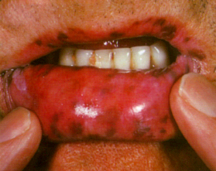
Peutz-Jehgers Polyposis Syndrome
Incidence of 1:8000 to 1:200,000 births
The two characteristic manifestations
Pigmented mucocutaneous macules
Multiple hamartomatous gastrointestinal polyps
Notes:
Reprinted with permission from Pounder RE, Allison MC, Dhillon AP. A Colour Atlas of the Digestive System, Wolfe, London 1989 p. 118.

Slide 17
Peutz-Jehgers Polyposis Syndrome
Polyp location:
Small bowel (60 to 90 percent) more specifically in the jejunum
Stomach (15 to 30 percent
Colon (50 to 64 percent)
Polyps develop in the first decade of life
Symptoms begin between the ages of 10 and 30
Notes:
Although 50 percent of patients are asymptomatic at the time of diagnosis, individuals with PJS can present with obstruction caused by intussusception or occlusion of the gastrointestinal lumen by the polyp, abdominal pain caused by infarction, anemia from acute or chronic bleeding, or extrusion of the polyp through the rectum. Up to 69 percent of patients experience an intussusception during their lifetime, most often in the small intestine

Slide 18
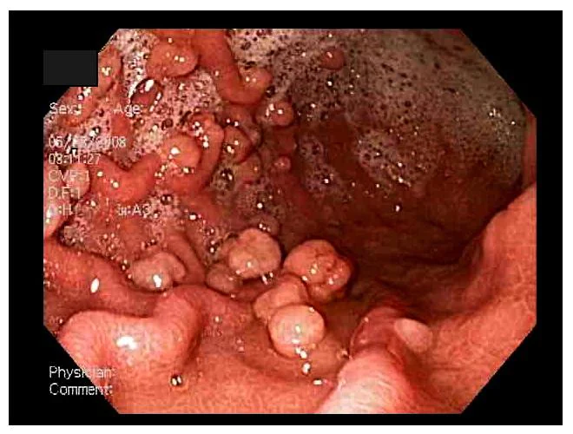
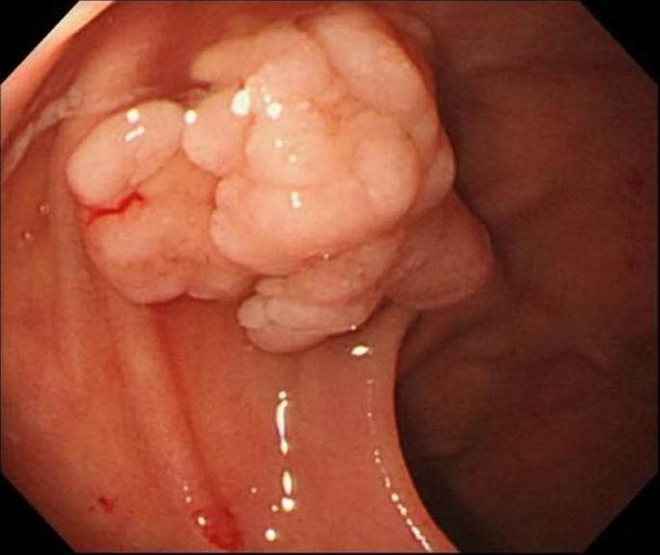
Peutz-Jehgers Polyposis Syndrome
Hamartomas are the most typical histopathological type of polyps found in about 2/3 of patients.
Polyp Morphology - have no major distinguishing features, and may be sessile, pedunculated, or lobulated.
Size 0.1 – 5 cm in diameter
Number 1-20 per bowel segment
Notes:
On gastrointestinal endoscopy, the Peutz-Jeghers (PJ) polyps have no major distinguishing features, and may be sessile, pedunculated, or lobulated. The number of polyps ranges from 1 to more than 20 per segment of bowel, although some patients have solitary lesions. The size of the polyps ranges from 0.1 to more than 5 cm in diameter
https://emedicine.medscape.com/article/182006-overview?form=fpf
Solitary Peutz-Jeghers type hamartomatous polyps in the duodenum are not always associated with a low risk of cancer: two case reports
Yusuke Sekino,
Masahiko Inamori,
Mitsuru Hirai,
Kaori Suzuki,
Kaoru Tsuzawa,
Keiko Akimoto,
Ayako Takahata,
Nobutaka Fujisawa,
Kumiko Saito,
Akisa Tsunemi,
Michio Tanaka,
Hiroshi Iida,
Yasunari Sakamoto,
Hirokazu Takahashi,
Tomoko Koide,
Chikako Tokoro,
Yasunobu Abe,
Atsushi Nakajima,
Shin Maeda &
Shigeru Koyama
Journal of Medical Case Reports volume 5, Article number: 240 (2011)

Slide 19
Peutz-Jehgers Polyposis Syndrome
Complications – frequent
Intussusception
Blockage
Iron deficiency anemia
Management
Frequent endoscopy - the interval of surveillance (1-3 years) should be adjusted according to the growth rate of polyps and symptoms
Wireless capsule enteroscopy (pill) or magnetic resonance enterography for detection
Device-assisted enteroscopy (double-balloon enteroscopy, spiral enteroscopy or single balloon enteroscopy) has become the gold standard for polyp reduction/removal

Slide 20
Bannayan-Riley-Ruvalcaba Syndrome
Rare, pediatric disorder
60% of patients with PTEN mutations
Diagnosis often made early in life as young as 5 years of age.
True frequency not fully understood
Sporadic cancers of the kidney, thyroid, and ovary but no overall increased internal malignancy.
Thus no consistent cancer surveillance recommendations.

Slide 21
Bannayan-Riley-Ruvalcaba Syndrome
Physical Manifestations
Macrocephaly (at least two standard deviations above the mean)
Penile lentigines (a very characteristic marker of the disease
GI tract hamartomatous polyps
Lipomas
Vascular anomalies including arteriovenous shunts and fistulae
Intramuscular lesions with a mixture of adipose tissue, fibrous tissue, and abnormal vessels (labeled a PTEN hamartoma of soft tissue)
Hashimoto thyroiditis and other thyroid disorders including thyroid cancer
Mild-to-severe developmental delay or intellectual disability
Proximal muscle myopathy
High palate
Joint hypermobility
Eye abnormalities such as downslanting palpebral fissures, strabismus, and amblyopia
Reproduced from: Hendriks YM, Verhallen JT, van der Smagt JJ, et al. Bannayan–Riley–Ruvalcaba syndrome: further delineation of the phenotype and management of PTEN mutation-positive cases. Familial Cancer 2003; 2:79, with kind permission from Springer Science + Business Media B.V. Copyright © 2003. UTDOL.com
Notes:
DOI:10.5223/pghn.2017.20.1.65
Corpus ID: 11355505
Bannayan-Riley-Ruvalcaba Syndrome in a Patient with a PTEN Mutation Identified by Chromosomal Microarray Analysis: A Case Report
Sun Hwa Lee, E. Ryoo, H. Tchah
Published in Pediatric Gastroenterology… 1 March 2017

Slide 22
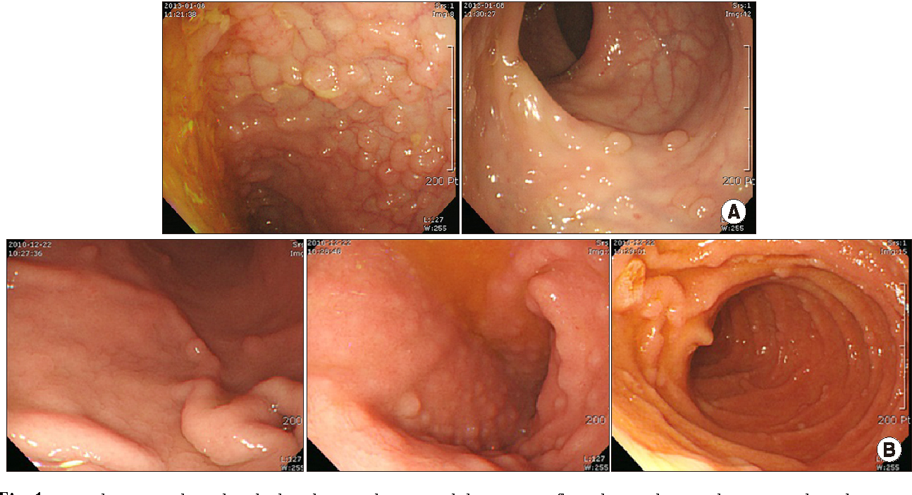
Bannayan-Riley-Ruvalcaba Syndrome
DOI:10.5223/pghn.2017.20.1.65 Bannayan-Riley-Ruvalcaba Syndrome in a Patient with a PTEN Mutation Identified by Chromosomal Microarray Analysis: A Case Report. Sun Hwa Lee, E. Ryoo, H. Tchah. Published in Pediatric Gastroenterology… 1 March 2017

Slide 23
Hamartomatous Polyposis Syndromes
Phosphatase and Tensin Homolog (PTEN) Hamartoma Tumor Syndrome
Cowden Polyposis Syndrome
Peutz-Jehgers Polyposis Syndrome
Bannayan-Riley-Ruvalcaba syndrome
Proteus-like syndrome – really rare – not covered
Autism spectrum disorders and macrocephaly – not covered
Juvenile Polyposis Syndrome
Diagnosis of exclusion after the PTEN Syndrome has been ruled out

Slide 24
Juvenile Polyposis Syndrome
Presence of numerous juvenile polyps in the colorectum or in other GI locations.
Syndromic features extra-intestinal manifestations
Cutaneous
Telangiectasia Pigmented nevi
Skeletal stigmata
Macrocephalus Hydrocephalus
Cleft palate Polydactyly
Hypertelorism
Pathogenic germline variants of either BMPR1A or SMAD4 cause the syndrome.
Notes:
Orbital hypertelorism – Wikipedia image

Slide 25
Juvenile Polyposis Syndrome
Occurrence 1 in 100.000 and 1.6 in 160.000 people.
JPS patients develop multiple juvenile polyps of the GI tract,
Colon/rectum (98%)
Stomach (14%)
Duodenum (7%)
Small bowel (7%)
Most of the colonic polyps, ≈70%, occur in the proximal colon.
The juvenile polyps may vary in size and aspect, from small, diminutive sessile to large pedunculated polyps (also ≥3 cm in diameter)
Polyps typically appear before age 20
Highly variable expression of the genotype with as few as 10 but as many as 200 polyps developed.
Typically start screening for CRC at age of 12-15 years of age to modify the cancer risk.

Slide 26
Juvenile Polyposis Syndrome
Consider based on the following clinical criteria:
At least five juvenile polyps in the colon/rectum
Juvenile polyps in other parts of the GI tract
Any number of juvenile polyps in an individual with a positive family history of JPS

Slide 27
Juvenile Polyposis Syndrome
JPS patients have a high risk of developing CRC, the estimated cumulative CRC risk ranges from 39% to 68%
They carry a cumulative risk as well of ≈21% for upper gastrointestinal cancers, including gastric, duodenal, and pancreatic cancer
Colonoscopy should be performed annually, starting from the age of 12 years
Depending on the polyp burden and size the colonoscopy can be anticipated or delayed to 2–3 years
Polypectomy is always recommended for polyps larger than 5 mm.
Regarding the preventive strategies for the stomach, the upper endoscopy is advised every 1–3 years, equally starting at the age of 12 years

Slide 28
GI tract | Cancer risk | Starting age | Recommended surveillance | Note
Colon-rectum | 39–68% | 12–15 years | Colonoscopy every 1-3 years, depending on polyps' burden | Colorectal polyps >10 mm should be removed
Stomach | 21% | 18 years for SMAD4; 25 years for BMPR1A | Esophago-gastro-duodenoscopy every 1–3 years | Multidisciplinary management advisable
Small bowel | Rare, undefined | Undefined | Recommended for symptomatic JPS patients | Capsule endoscopy, CT/MR entrography

Slide 29
Classification - Serrated Polyps World Health Organization (WHO)
Pathological distinctions first appeared in 2005.
2008 – first pathological diagnostic criteria and nomenclature introduced.
2010 – WHO adopted criteria
Hyperplastic Polyps (HP) (75%)
Sessile Serrated Lesions (SSA or SSP) (25%)
Traditional Serrated Adenomas (TSA)
2019 – WHO reclassified in paper published in 2020 – abandon the SSA – use SSL or SSP.

Slide 31
Notes:
The most substantial variation was the abandonment of the old II criterion (a least one serrated polyp proximal to the sigmoid in a first-degree relative of a patient with SPS). This change was based on the fact that these patients have a lower CRC risk than those with a polyposis phenotype

Slide 32
Serrated polyposis syndrome (SPS)
Presence of multiple and/or large serrated polyps in the colorectum and increased risk of colorectal cancer
SPS has emerged as the most common colorectal polyposis syndromes, affecting up to 1:238 to 1:127 average-risk individuals who undergo colonoscopy due to a positive fecal immunochemical test (FIT)

Slide 33
Serrated polyposis syndrome (SPS)
A Spanish study aimed at evaluating the usefulness of 1-year reassessment colonoscopy in a FIT-based screening cohort of individuals with proximal serrated lesions.
3444 screening colonoscopies – using high definition and chromoendoscopy
196 met entry criteria
11 patients met SPS criteria (0.32%)
71 patients had with one or more serrated lesions of ≥ 5 mm proximal to the sigmoid colon on baseline colonoscopy
Repeat colonoscopy at one year detected 20 additional patients with SPS, a tripling of the rate of SPS up to 0.90 %.
Overall take away point with a caveat – high definition and chromoendoscopy.
Notes:
Background and study aims Serrated polyposis syndrome (SPS) is a high risk condition for colorectal cancer (CRC). Surveillance strategies for patients with serrated lesions remain controversial. We aimed to evaluate a diagnostic strategy to detect SPS consistently during reassessment colonoscopy in patients with proximal serrated lesions. Methods This was a retrospective study of all individuals from a fecal immunochemical test (FIT)-based CRC screening program (2010 - 2013) with one or more serrated lesions of ≥ 5 mm proximal to the sigmoid colon on baseline colonoscopy. We analyzed all individuals empirically scheduled for a reassessment colonoscopy aimed at diagnosing SPS within 1 year. Reassessment colonoscopy was performed with standard white-light or chromoendoscopy ± high definition endoscopy depending on availability. SPS diagnosis was based on the cumulative number of polyps in both the baseline and reassessment colonoscopies. Factors associated with SPS diagnosis were analyzed. Results From 3444 screening colonoscopies, 196 patients met the study entry criteria, of whom 11 patients (0.32 %) met the criteria for SPS on baseline colonoscopy. Reassessment colonoscopies were performed in 71 patients at 11.9 ± 1.7 months and detected 20 additional patients with SPS, a tripling of the rate of SPS up to 0.90 %. Independent factors associated with SPS diagnosis were: having five or more proximal serrated lesions (odds ratio [OR] 4.01 [95 % confidence interval 1.20 - 13.45]; P = 0.02) or two or more sessile serrated polyps ≥ 10 mm (OR 6.35 [1.40 - 28.81]; P = 0.02) on baseline colonoscopy and the use of chromoendoscopy ± high definition endoscopy during reassessment colonoscopy (OR 4.99 [1.11 - 22.36]; P = 0.04). Conclusions A 1-year reassessment colonoscopy using chromoendoscopy and high definition endoscopes substantially improves SPS detection in individuals from a FIT-based screening program with proximal serrated lesions. Five or more proximal serrated lesions or two or more sessile serrated polyps ≥ 10 mm could be thresholds for requiring a reassessment colonoscopy. Prospective studies are required to validate these results and adjust surveillance recommendations in patients with serrated lesions.

Slide 34
Serrated polyposis syndrome (SPS)
Usually diagnosed in the fifth decade of life
No significant age differences between Western and Asian countries.
No gender predominance has been documented in western series
? Small asian male studies show a predominance
Most patients with SPS are diagnosed in the 50s, with no family history of polyposis, and strong association with environmental factors (i.e., smoking)
It has been suggested that, overall, SPS is not an inherited syndrome and rather behaves as a complex disorder where the interaction between some genetic susceptibility and environment exposures are behind its cause.

Slide 35
SPS and The Smoking Paradox
Cigarette-smoking history has been firmly related with greater risk of serrated polyps, mainly located at the left side colon.
Smoking history has been reported in up to 74% of individuals with SPS, suggesting a potential causative or predisposing role.
However, smokers with SPS have not been found to be at an increased risk of CRC than non-smoking SPS patients.

Slide 36
SPS and CRC Risk
Based on initial small retrospective series, SPS was considered a high-risk condition for CRC comparable to other high-risk hereditary syndromes as familial adenomatous polyposis or Lynch syndrome.
In a meta-analysis from 2021 the risk of CRC prior to diagnosis, at the time of diagnosis and during surveillance was evaluated. Thirty-six studies including 2788 patients with SPS were included.
The risk of CRC at diagnosis showed to be substantial (14.7%; 95% CI, 11.4%–18.8%), but lower than initially reported.
Once cleared of all relevant lesions, individual patient risk of CRC during surveillance is low (7 cases per 1000 person-years)
Muller C et al. Risk of Colorectal Cancer in Serrated Polyposis Syndrome: A Systematic Review and Meta-analysis. Clin Gastroenterol Hepatol. 2022;20(3):622. Epub 2021 Jun 2.

Slide 37
SPS and Extra-Intestinal Cancer Risk
In a retrospective study of 115 patients with SPS, 28% had a personal history of extra-colonic cancer, while 54% had a family history of extra-colonic cancer .
Prostate cancer, skin cancer, leukemia/lymphoma and breast cancer were most frequently reported among SPS patients.
A formal comparison of cancer prevalence with the general population was not performed.
In another retrospective study of 52 patients with SPS, 24% have had extra-colonic cancer.
Most frequently reported were skin cancer and breast cancer.
A formal comparison of cancer prevalence with the general population was also not performed in this study.
Notes:
Four studies evaluated the risk of cancer outside the colorectum in SPS patients.

Slide 38
SPS and Extra-Intestinal Cancer Risk
A gastroscopy, which was performed in 30 patients with SPS.
Demonstrated only 1 patient (3%) with gastroduodenal polyps.
In a third retrospective study the risk of extra-colonic cancer was evaluated among 105 SPS patients and 341 first-degree relatives. The relative risk of SPS patients (RR 0.69, 95% CI 0.36–1.33; p = 0.27) as well as first-degree relatives (RR 0.92, 95%CI 0.69–1.24; p = 0.60) was comparable to the general population.
A fourth retrospective study among 64 patients with SPS
Demonstrated a standardized incidence ratio of extra-colonic cancers of 31 (95% CI 15–57), as compared with the general population.
In total, three patients had breast cancer; two patients had prostate cancer, while one patient had either cervix, ovarian, ureter cancer of basal cell carcinoma.
Notes:
Four studies evaluated the risk of cancer outside the colorectum in SPS patients.

Slide 39
SPS and Extra-Intestinal Cancer Risk
In conclusion, the risk of extra-colonic cancer in SPS patients seems increased, as compared to the general population.
However, all studies are of older age and performed retrospective analyses.
Furthermore, results are somewhat conflicting.
Accordingly, screening and surveillance for other types of cancer (aside from CRC) does not seem useful for patients with SPS beyond current standard patient guidelines.
Notes:
Four studies evaluated the risk of cancer outside the colorectum in SPS patients.

Slide 40
American College of Gastroenterology guideline from 2015
Notes:
In the American College of Gastroenterology guideline from 2015 it was recommended that all polyps ≥5 mm in size should be removed, followed by colonoscopy surveillance with 1–3 years intervals [32]. No personalized advice was given on when to choose more or less strict surveillance. A shorter surveillance interval of either 1 or 2 years was recommended in a position paper of the British Society of Gastroenterology published in 2017 [33]. In the most recent guideline on endoscopic management of polyposis syndromes by the ESGE advises to remove all polyps ≥ 5 mm and all polyps of any size with optical suspicion of dysplasia (including adenomas, and SSL with dysplasia) [9]. Once cleared of all relevant lesions, surveillance advice is based on findings during the last colonoscopy. A surveillance interval of 1 year is advised after the resection of ≥1 advanced polyp or ≥5 non-advanced clinically relevant polyps. A surveillance advice of 2 years is advised in any other situation. (Fig. 3). A stopping rule for end of surveillance was not defined in the ESGE guideline. These recommendations were based on a recent prospective multicenter study which followed 271 SPS patients for a median of 3.6 years using the above-mentioned surveillance protocol. [34] Two-third of patients were appointed surveillance with a two-year interval after 3 consecutive surveillance colonoscopies. The cumulative incidence of CRC was low and comparable to that of a regular post-polypectomy population after resection of intermediate-risk adenomas. N

Slide 41
Hyperplastic Polyps
80 - 90% of all Serrated Polyps
Malignant potential - <1%
Size: < 5mm
Typical Location is Recto-Sigmoid
Increases in number up to 50 years of age then stable thereafter.

Slide 42
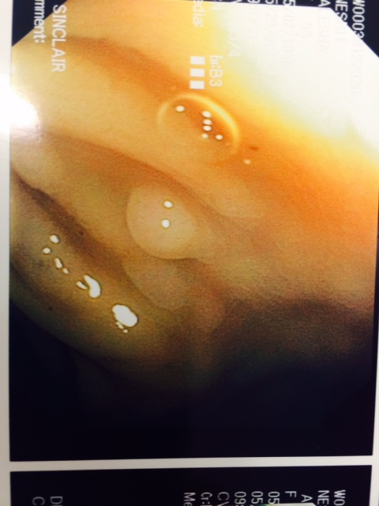
Hyperplastic Polyps
Mucosa is typically paler
Size <5 mm
Typically flatten with full insufflation

Slide 43
Sessile Serrated Lesion/Polyp
Malignant Potential – uncertain but higher than adenomatous polyps which is at least 25% over 10 years if larger than 2 cm.
Size is variable
More common in the proximal colon.
Increases in number throughout life.

Slide 44
Familial Risk CRC for SPS Relative
Two large retrospective studies demonstrated a 5-fold relative risk of CRC in first degree relatives of SPS patients.
In a prospective study 78 first degree relatives of 34 SPS patients underwent colonoscopy
8 individuals met the 2019 WHO criteria for SPS.
In one individual CRC was diagnosed
44% of patient had a first degree relative with CRC.
In another prospective study 77 first degree relatives of SPS patients underwent a colonoscopy
1 individual met the 2019 WHO criteria for SPS. CRC was not detected.
However, 43% of patient had at least one significant polyp (defined as adenomas, TSA, SSL, or proximal HP).

Slide 45
Familial Risk CRC for SPS Relative
Based on these 4 studies with overall increased cancer/problematic polyp findings the European Society of Gastrointestinal Endoscopy (ESGE) recommends that, for first degree relatives of individuals with serrated polyposis syndrome, CRC screening by colonoscopy should be offered:
Age 45 years
Interval of 5 years

Slide 46
Sessile Serrated Polyp
Typically covered with a “mucus cap”
Grow horizontally, flat, sessile
Size is variable
50% >5mm
12-20% > 10 mm
Red and Puckered appearance

Slide 47
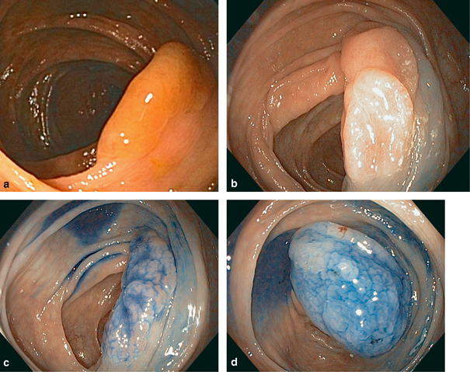
The Clinical Significance of Serrated Polyps - Christopher S Huang, Francis A Farraye, Shi Yang and Michael J O'Brien - American Journal of Gastroenterology
Notes:
Serrated polyps are often inconspicuous, flat-elevated lesions that are easily missed by endoscopists. As a result, standard use of (virtual) chromoendoscopy might help to detect serrated polyps in SPS patients. The use of narrow-band imaging was evaluated in two prospective randomized controlled trials with a cross-over back-to-back design [36, 37]. In an unicenter study within an expert academic center the polyp miss rate showed to be significantly lower using narrow-band imaging as compared to white light endoscopy (OR 0.21; 95% CI 0.09–0.45) [36]. In a follow up multicenter study from the same research group a statistical difference was not found, although a clear trend was seen favoring narrow band imaging (polyp miss rate 20 vs 29%; P = 0.065). [37] However, this difference in miss rate was fully explained by a difference in the detection of hyperplastic polyps. Based on these studies the standard use of Narrow Band Imaging does not seem to be of clear added value. Usefulness of conventional chromoendoscopy with indigo carmine was evaluated in a more recent multicenter randomized controlled trial [38]. Patients were assigned randomly to either receive two tandem white-light endoscopy examinations or a white-light endoscopy examination followed by chromoendoscopy. A significantly higher additional polyp detection rate (P < 0.001) was found in the chromoendoscopy group (0.39; 95% CI 0.35–0.44), as compared to the white-light endoscopy group (0.22; 95% CI 0.18–0.27). Furthermore, more serrated polyps, serrated polyps proximal to the sigmoid colon and serrated polyps > 5 mm proximal to the sigmoid colon were found with chromoendoscopy. In conclusion, the standard use of chromo-endoscopy seems promising to detect more clinically relevant lesions within patients with SPS.
Endoscopic appearance of a large sessile serrated adenoma and the use of chromoendoscopy to facilitate polyp delineation and resection. (a) This lesion, which demonstrates the characteristic mucus covering and smooth surface, was initially biopsied but not resected by the referring gastroenterologist, and the adjacent mucosa was tattooed. (b) Follow-up examination revealed this to be a large lesion with a redundant, fold-like morphology and poorly defined margins.
(c) Chromoendoscopy using topical application of 0.2% indigo carmine clearly delineated the margins of the polyp. (d) Submucosal injection of 0.2% indigo carmine further highlighted the extent of the polyp and simultaneously provided a cushion for endoscopic mucosal resection.

Slide 48
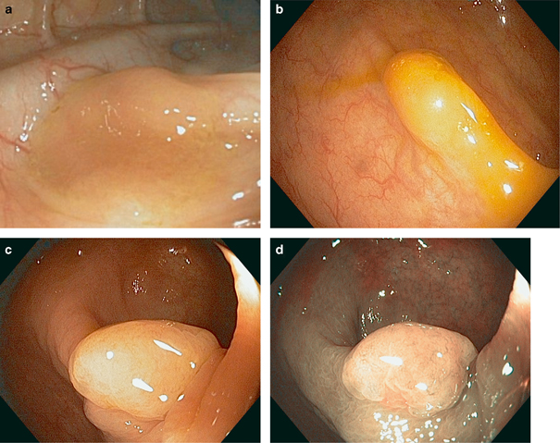
The Clinical Significance of Serrated Polyps - Christopher S Huang, Francis A Farraye, Shi Yang and Michael J O'Brien. American Journal of Gastroenterology
Notes:
Endoscopic features of sessile serrated adenomas. These lesions are frequently subtle and flat, and may resemble a redundant mucosal fold (a) with an adherent layer of mucus on the surface (b). They typically have a smooth surface seen on white light endoscopy (c) and a weak/normal vascular pattern intensity seen using narrow-band imaging (d).

Slide 49
Traditional Serrated Adenomas
2-5% of all Serrated Polyps
Malignant Potential – 3 fold increased risk compared to Adenomatous Polyps
Predominately Left Sided
Increases in number throughout life

Slide 50
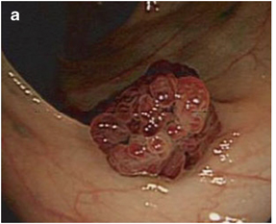
Traditional Serrated Adenoma
Variable size up to 5 cm
Often adenomatous appearing
Red appearance
http://www.nature.com/ctg/journal/v3/n1/images/ctg20115f2.jpg

Slide 51
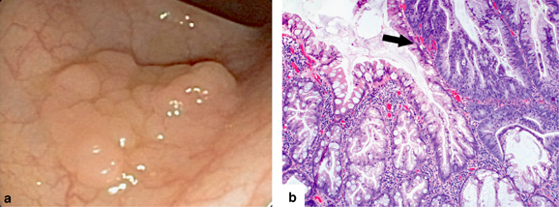
How accurate are pathologist in depicting a Serrated Polyp from a Hyperplastic Polyp? Are they basing it on where I took the polyp off at?
The Clinical Significance of Serrated Polyps - Christopher S Huang, Francis A Farraye, Shi Yang and Michael J O'Brien American Journal of Gastroenterology
Notes:
Endoscopic appearance and histology of a sessile serrated adenoma with dysplasia. Endoscopically (a), the polyp has a sessile, lobulated appearance. Histology (b) demonstrates a protruding nodule of adenomatous low- and high-grade dysplasia (black arrow) arising within a non-dysplastic sessile serrated adenoma (SSA) on the left of the image, identified by serration and marked irregularity of the crypt architecture.

Slide 52
How Reliable is the Diagnosis - Pathological distinctions first appeared in 2005.
Virchows Archives, 2012
70 cases using World Health Organization Pathological Diagnostic Criteria/Worksheets
16 European Pathologists
28 Hyperplastic Polyps
25 Sessile Serrated Adenomas/Polyps
11 Traditional Serrated Adenomas
15 Mixed HP with SSP features
How do you think the 16 pathologists did?

Slide 53
How Reliable is the Diagnosis
Virchows Archives, 2012
16 European Pathologists
28 Hyperplastic Polyps – 44% got all 28
25 Sessile Serrated Adenomas/Polyps – 40% got all 20
11 Traditional Serrated Adenomas – 10% got all 11
15 Mixed HP with SSP features – 6% got all 15
How do you think the 16 pathologists do?
After 2 rounds and a conference reviewing the WHO diagnostic criteria, they were able to come to near perfect alignment on diagnosis.
The authors of this study stated that at best reproducibility of the histopathological diagnosis on a Serrated Polyp remains imperfect.

Slide 54
Importance of Serrated Polyps
15-30% of all cancers are secondary to serrated polyps
The progression of dysplasia to cancer for Sessile Serrated Adenomas and Polyps is 10-15 years. A period 2-3 years longer than conventional adenomas.
Additionally, studies have demonstrated higher rates of interval CRC arising from the serrated pathway.
These findings highlight the importance of distinguishing SSL from HP, as accurate diagnosis ensures that patients can be appropriately screened per the 2020 US Multi-Society Task Force on Colorectal Cancer recommendations.
Implications: Call the pathologist if it doesn’t make sense and look diligently on the scope
Notes:
With considerable advances in subsequent decades, a broad array of preneoplastic polyps has been recognized. This includes SSLs (Figure 2, B), which were undoubtedly misinterpreted as HPs by pathologists for decades. Similarly, sessile lesions were often missed by endoscopists because of their subtle, flat gross appearance or not biopsied because endoscopic features can overlap with those of benign HPs.¹² As published literature grew, so did detection by endoscopists and diagnosis by pathologists.^{12–16}
Although TAs can progress to colorectal carcinoma (CRC) via the chromosomal instability pathway, SSLs serve as precursor lesions for most of the approximately 30% of CRC that arises through the serrated neoplasia pathway.^{17,18} That pathway is thought to begin with activating mutations in BRAF present in almost all SSLs or KRAS in the majority of traditional serrated adenomas (TSAs), a distinct serrated polyp with some morphologic overlap with SSL (Figure 2, C). BRAF mutations are followed by hypermethylation of CpG islands (so-called CpG island methylator phenotype [CIMP]), resulting in silencing of tumor suppressor expression (eg, MLH1) and ultimately giving rise to CRC.¹⁷ A minority of SSLs proceed through the WNT activation pathway with TP53 mutations, leading to microsatellite-stable CRC.^{19–21}
It has been shown that patients with an SSL are at an equivalent or greater risk for CRC development as those with a conventional adenoma.²² Additionally, studies have demonstrated higher rates of interval CRC arising from the serrated pathway.^{23–25} These findings highlight the importance of distinguishing SSL from HP, as accurate diagnosis ensures that patients can be appropriately screened per the 2020 US Multi-Society Task Force on Colorectal Cancer recommendations.²⁶ Unfortunately, this distinction is not always straightforward, nor is the complex history regarding nomenclature and diagnostic criteria for SSL.

Slide 55
SPS Mutations
While some patients with SPS carry a mutation in rare polyposis-associated genes including SMAD4, BMPR1A, PTEN, GREM1, RNF43, and MUTYH, these genes are not altered in the majority of individuals
RNF43 where mutated has been most closely related to SPS, but is still very uncommon.
With this inconsistency of mutations with SPS, genetic testing is NOT routinely recommended.

Slide 56
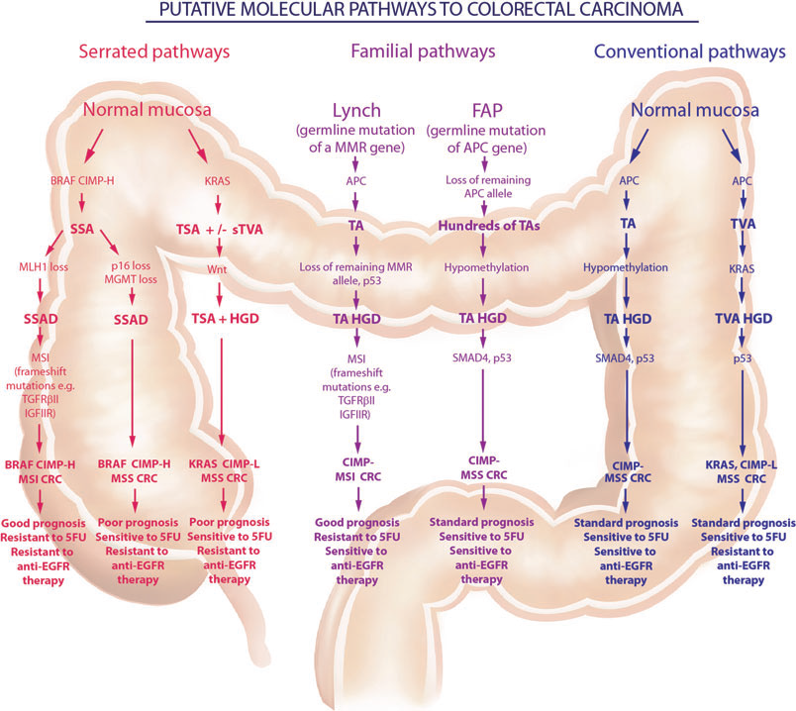
30% of CRC
80%
Notes:
80% have the BRAF Mutation

Slide 57
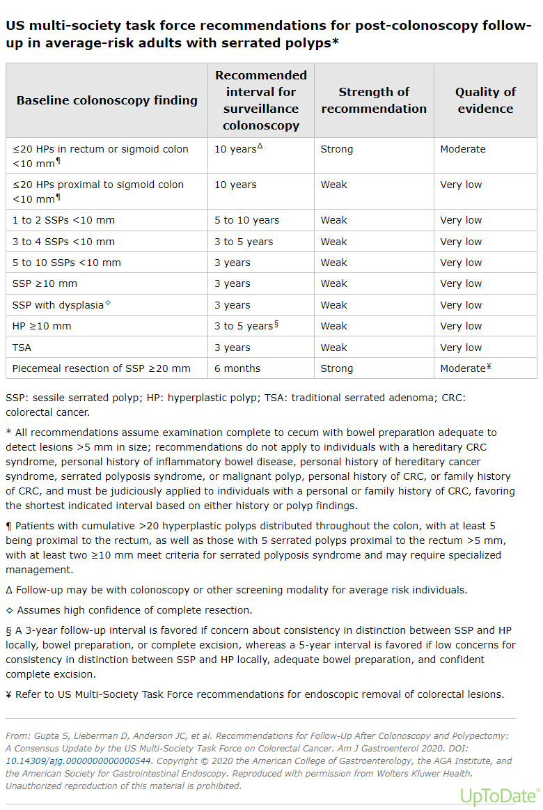

Slide 58
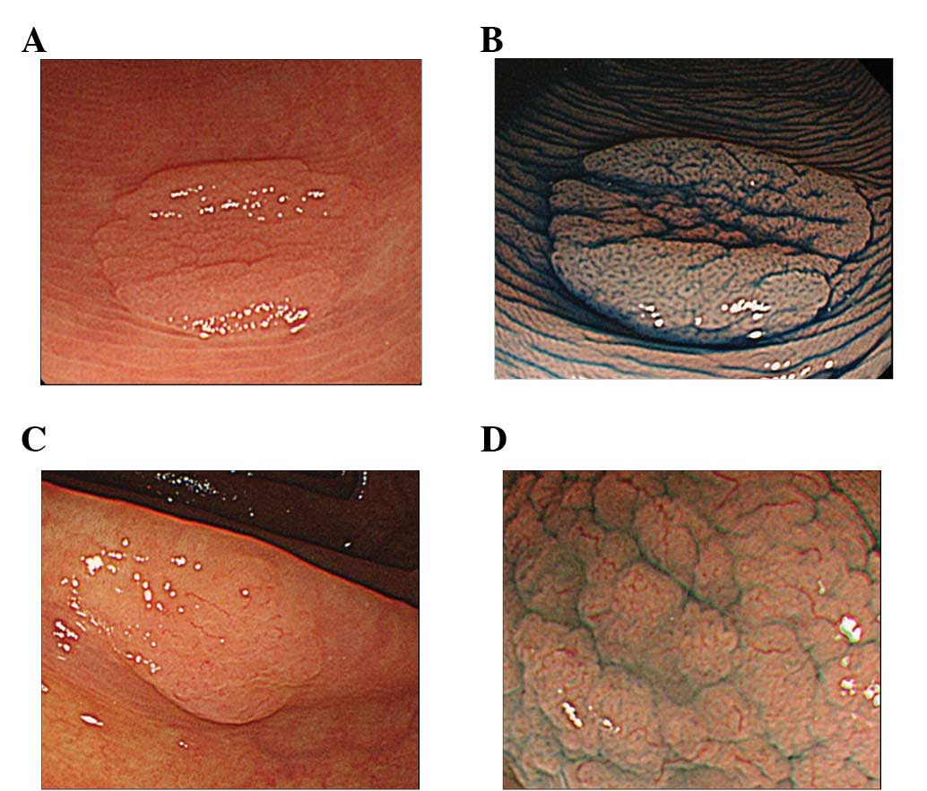
Notes:
Figure 4 - Endoscopy and magnified endoscopy images of non-SSA/P and SSA/P is shown. (A) and (B) are non-SSA/P, while (C) and (D) are SSA/P. Upper-side images are conventional endoscopic, while lower-side images are magnifying endoscopic images with indigo carmine solution. (A) Small flat elevated lesion located in the sigmoid colon. (B) Magnified view of the star-like pit pattern. (C) Small flat elevated lesion located in the ascending colon. (D) Magnified view of the expanded/fernlike pit pattern is shown (IIIH by T. Fujii, type 2: brown sicker vessels by Y. Sano). SSA/P, sessile serrated adenoma/polyp; non-SSA/P, sessile serrated adenoma/polyp.
Differentiation between sessile serrated adenoma/polyp and non-sessile serrated adenoma/polyp in large hyper plastic polyp: A Japanese collaborative study
Authors: Yosuke Shida, Kazuhito Ichikawa, Takahiro Fujimori, Yukari Fujimori, Shigeki Tomita, Takahiro Fujii, Yasushi Sano, Yasushi Oda, Hideyo Goto, Akihiko Ohta, Shinji Tanaka, Tamotsu Sugai, Takashi Yao, Yasuo Ohkura, Johji Imura, Hiroyuki Kato
View Affiliations
Department of Surgery 1, Dokkyo Medical University School of Medicine, Mibu, Japan, Department of Surgical and Molecular Pathology, Dokkyo Medical University School of Medicine, Mibu, Japan, Takahiro Fujii Clinic, Tokyo, Japan, Endoscopy Division, Gastrointestinal Center, Sano Hospital, Kobe, Japan, Oda GI Clinic, Kumamoto, Japan, Hattori GI Endoscopy and Oncology Clinic, Kumamoto, Japan, Ohta Clinic, Tokyo, Japan, Department of Endoscopy, Hiroshima University Hospital, Hiroshima, Japan, Division of Molecular Diagnostic Pathology, Department of Pathology, School of Medicine, Iwate Medical University, Morioka, Japan, Department of Human Pathology, Juntendo University School of Medicine, Tokyo, Japan, Department of Pathology, Kyorin University School of Medicine, Tokyo, Japan, Department of Diagnostic Pathology, Graduate School of Medicine and Pharmaceutical Science, University of Toyama, Toyama, Japan
Published online on: Friday, September 7, 2012 Journal of Molecular and Clinical Oncology.

Slide 59
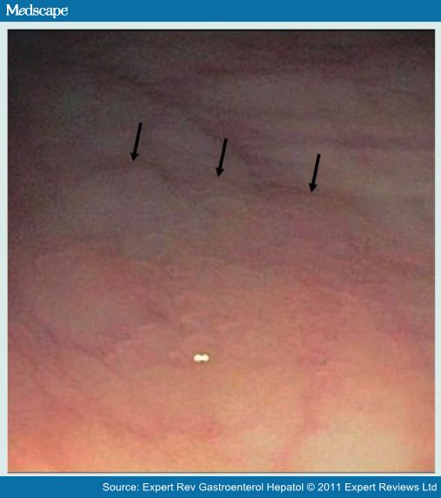

Slide 61
Current Recommendation for Hyperplastic Polyps
Remove all polyps when technically possible except for the small (<5mm) distal HP – appearing polyps
Consider removing a few as a sample to confirm they are true HP’s

Slide 62
Serrated Polyposis Syndrome
A clinical diagnosis of SPS requires the presence of one of the following World Health Organization criteria:
>20 serrated lesions/polyps of any size, distributed throughout the colon with ≥5 being proximal to the rectum.
At least five serrated lesions/polyps proximal to the rectum, all being ≥5 mm, with at least two ≥10 mm in size.

Slide 63
Serrated Polyposis Syndrome
Treatment is Colonoscopy every 1-3 years with complete removal of ALL polyps. Can be modified based on specific polyp findings.
Potential indications for colectomy include:
Documented or suspected CRC.
Severe symptoms related to colonic neoplasia (eg, severe gastrointestinal bleeding).
Polyps with high-grade dysplasia or multiple adenomas larger than 6 mm.
Marked increases in polyp number on consecutive examinations.
Inability to adequately survey the colon because of multiple diminutive polyps.
Patient preference to avoid colonoscopic surveillance. The decision to undergo colectomy in such cases requires an informed discussion of the relative risks versus benefits

Slide 64
Serrated Polyposis Syndrome
Patient with Family History of SPS – Not great evidence
Begin screening first-degree relatives of individuals with SPS around age 40 (or 10 years earlier than the earliest age at presentation of the SPS in the family)
Continue surveillance every five years if no polyps are detected.

Slide 65
References:
Bueno, A et al. Juvenile polyposis syndrome: An overview. Best Practice & Research Clinical Gastroenterology. Volumes 58–59, June–August 2022, 101799
Nagtegaal et al. The 2019 WHO classification of tumours of the digestive system. Histopathology. Volume76, Issue2. January 2020. Pages 182-188
Liseth Rivero-Sanchez et al. Reassessment colonoscopy to diagnose serrated polyposis syndrome in a colorectal cancer screening population. Endoscopy 2017 Jan;49(1):44-53. doi: 10.1055/s-0042-115640.
Utsunomiya J et al. Peutz-Jeghers syndrome: its natural course and management. Johns Hopkins Med J. 1975;136(2):71.
Peutz-Jeghers syndrome. Tacheci, Ilja et al. Current Opinion in Gastroenterology. Issue: Volume 37(3), May 2021, p 245-254

Slide 66
References:
Pilarski R et al. Predicting PTEN mutations: an evaluation of Cowden syndrome and Bannayan-Riley-Ruvalcaba syndrome clinical features. J Med Genet. 2011 Aug;48(8):505-12. Epub 2011 Jun 9
Chung D et al. Peutz-Jeghers syndrome: Clinical manifestations, diagnosis, and management. UpToDate 1/3/23
Yehia et al. The Clinical Spectrum of PTEN Mutations. Annual Review of Medicine. Vol. 71:103-116 (Volume publication date January 2020)
Muller C et al. Risk of Colorectal Cancer in Serrated Polyposis Syndrome: A Systematic Review and Meta-analysis. Clin Gastroenterol Hepatol. 2022;20(3):622. Epub 2021 Jun 2.
Hwa Lee S et al. Bannayan-Riley-Ruvalcaba Syndrome in a Patient with a PTEN Mutation Identified by Chromosomal Microarray Analysis: A Case Report. Published in Pediatric Gastroenterology… 1 March 2017
Booth A et al. From Mixed Hyperplastic/Adenomatous Polyp to Sessile Serrated Lesion: A Long and Winding Road for Long and Winding Crypts. Arch Pathol Lab Med 2021 Oct 1;145(10):1289-1296. doi: 10.5858/arpa.2020-0591-RA.

